Slide 1
Your First Neural Network
Lesson 3.1 | Stage 3: Neural Networks
AI Basic Training
From sklearn to Keras - Deep Learning Begins

Slide 2
What We'll Cover
Neural network architecture - layers, neurons, weights
The three steps: define, compile, train
Loss functions, optimisers, and epochs
Reading loss curves - good training vs overfitting
sklearn vs Keras - when to use which

Slide 3
01
Network
Architecture

Slide 4
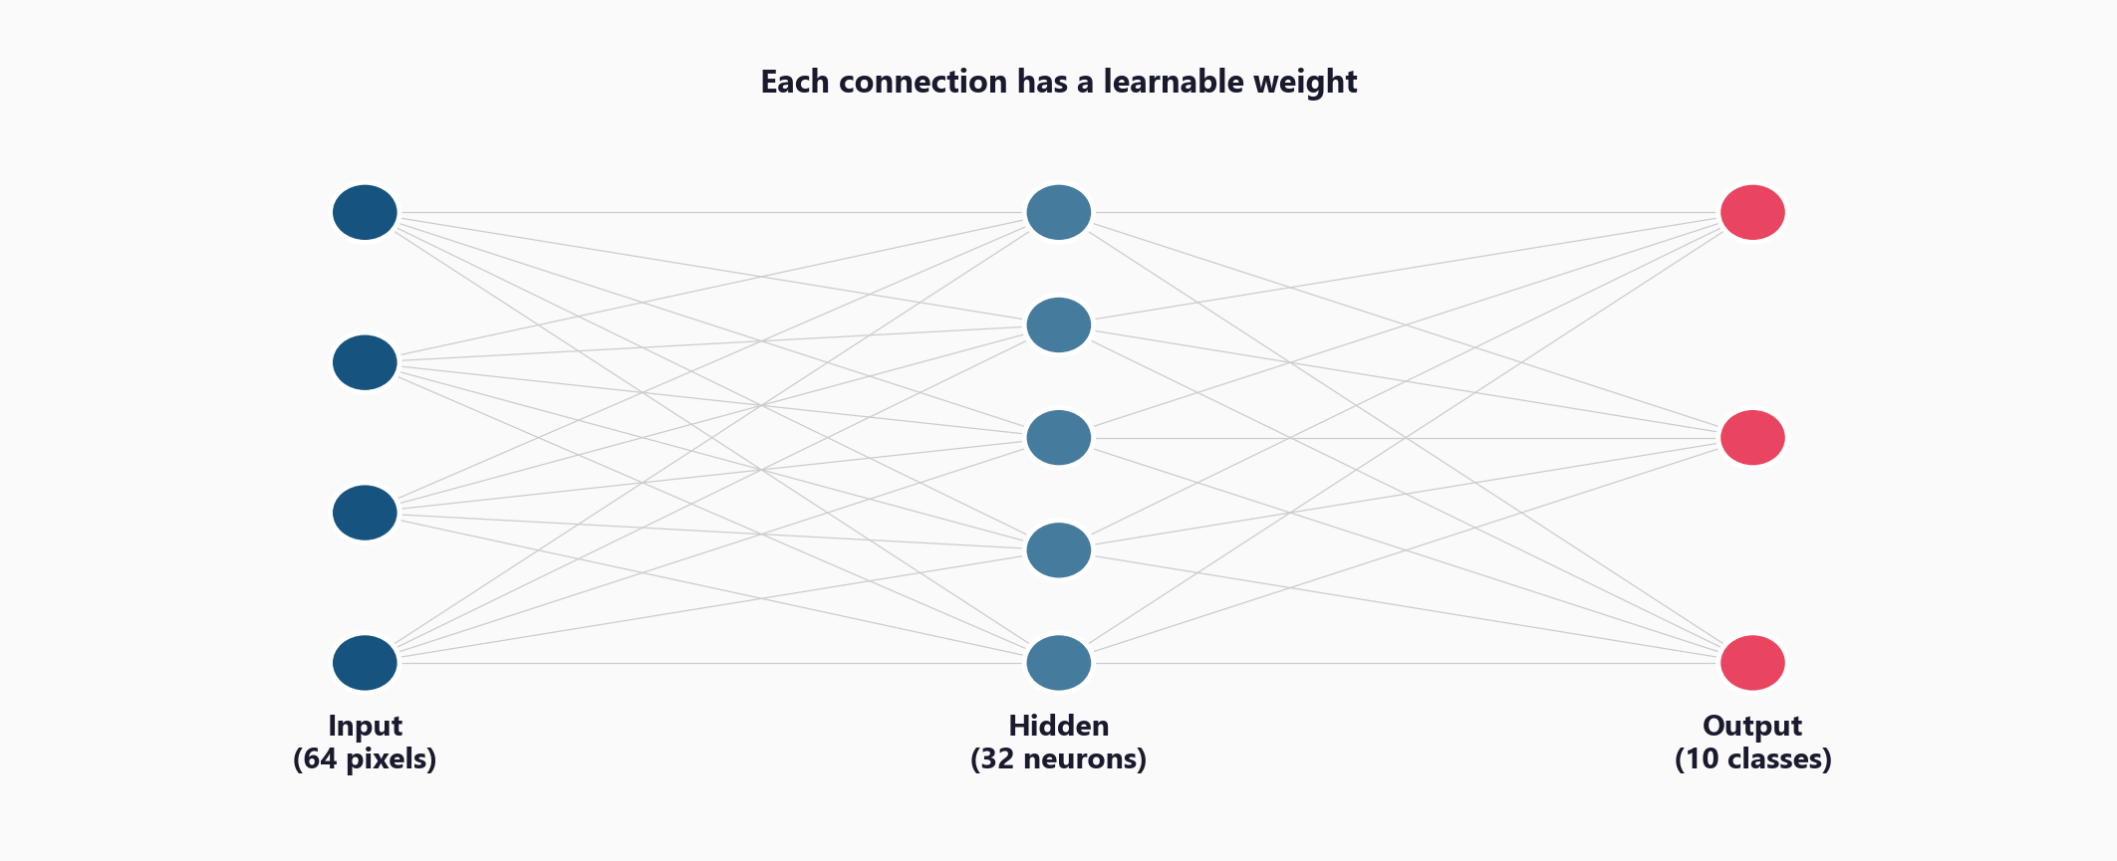
Layers, Neurons, and Connections

Slide 5
From NumPy to Keras - Same Concept, Less Code
What you built by hand in foundations:
weights = np.random.randn(n_inputs, n_neurons)
output = np.dot(inputs, weights) + biases
Keras equivalent:
keras.layers.Dense(32, activation='relu')
Keras handles initialisation, forward pass,
AND the backward pass (backpropagation) automatically

Slide 6
02
Define, Compile,
Train

Slide 7
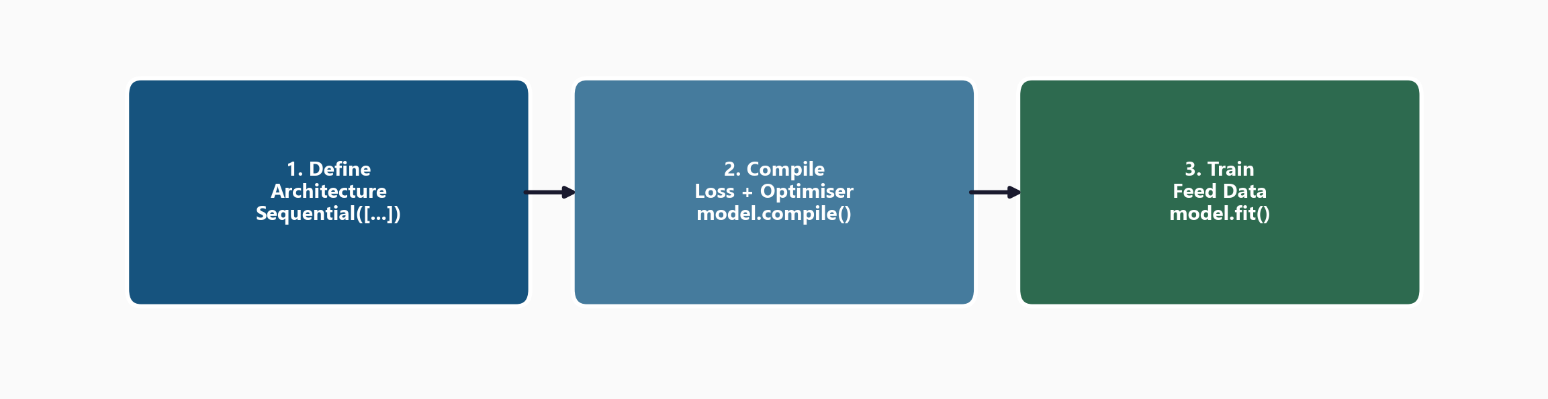
Three Steps to Train Any Keras Model

Slide 8
Key Training Concepts
Epochs
One full pass through all data
Need many passes to converge
Batch size
Process 32 samples at a time
Update weights after each batch
Common: 32, 64, 128
Optimiser: Adam
Adaptive learning rate
Default choice for most tasks
Loss functions:
binary_crossentropy (binary)
categorical_crossentropy (multi)
mse (regression)

Slide 9
03
Reading
Loss Curves

Slide 10
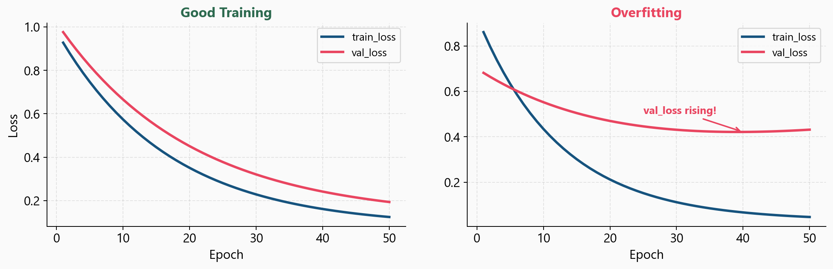
Good Training vs Overfitting - Read the Curves

Slide 11
What to Watch For
Both curves falling together = good
Model is learning, not memorising
val_loss rising while train_loss falls
= OVERFITTING - stop training
Neither curve falling = underfitting
Need more capacity or better data
The loss curves are your
most important diagnostic
tool in deep learning.
Always plot them.

Slide 12
04
sklearn vs Keras

Slide 13
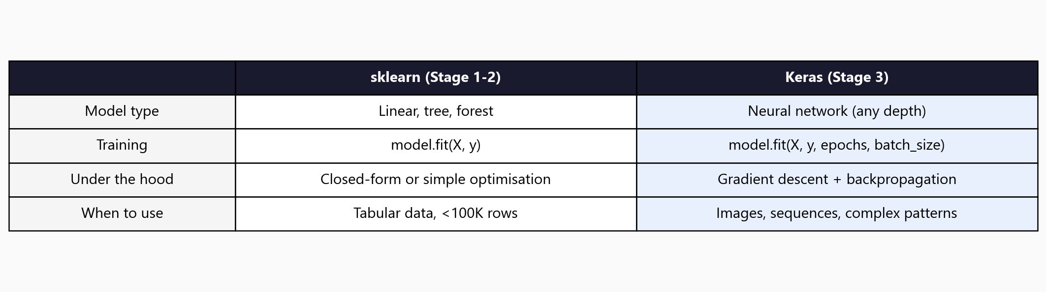
When to Use sklearn vs Keras

Slide 14
05
Workshop
and Next Steps

Slide 15
Workshop: 4 Hands-On Exercises
Exercise 1: Dense layer = matrix multiply + bias + activation
Exercise 2: Build the network - choose layers, activations, output shape
Exercise 3: Compile and train - model.fit(), history object, training curves
Exercise 4: Evaluate and improve - classification report, compare to LR baseline
Each exercise: lecture.md + handson.md + solution file

Slide 16
Key
Takeaways
A neural network is layers of neurons with learnable weights
Keras: define architecture, compile (loss+optimiser), train (fit)
Adam optimiser + binary_crossentropy is the standard starting point
Loss curves are your most important diagnostic - always plot them
val_loss rising = overfitting, both curves high = underfitting
Next: Dropout and regularisation - controlling overfitting in deep networks

Slide 17
Your First Neural Network
Next: Lesson 3.2 - Dropout and Regularisation

