Slide 1
Dropout & Regularisation
Lesson 3.2 | Stage 3: Neural Networks
AI Basic Training
Deeper Networks, Controlled Overfitting

Slide 2
What We'll Cover
Going deeper - why more layers help (and hurt)
Dropout - randomly disabling neurons during training
Batch Normalisation - stabilising deep networks
Early Stopping - automatic overfitting prevention
Class weights for imbalanced security data

Slide 3
01
Going Deeper

Slide 4
Why Depth Matters
Layer 1: low-level features
(e.g. high packet rate)
Layer 2: combinations
(high rate + specific port = scan)
Layer 3: context
(that combo + long duration = APT)
But deeper = more parameters
= more risk of overfitting
Deeper networks learn
hierarchical patterns.
But they need regularisation
to prevent memorisation.

Slide 5
02
Dropout

Slide 6
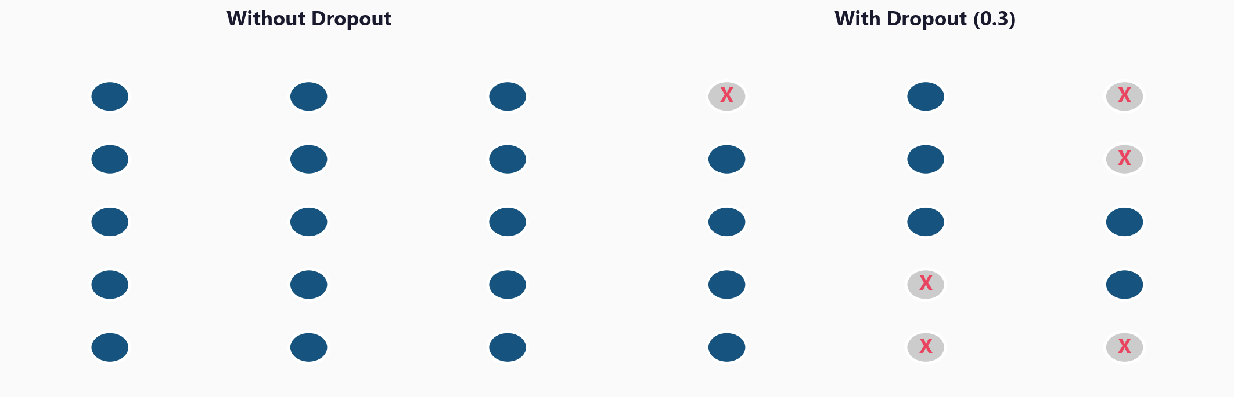
Dropout: Randomly Disable Neurons During Training

Slide 7
How Dropout Works
keras.layers.Dropout(0.3) # zero 30% of neurons each step
Applied only during training - not during inference
Typical values: 0.2 - 0.5
Analogy: like training a sports team where random
players sit out each practice - everyone learns every position
Effect: forces the network to build redundant representations
No single neuron can become a bottleneck

Slide 8
03
All Four
Techniques

Slide 9
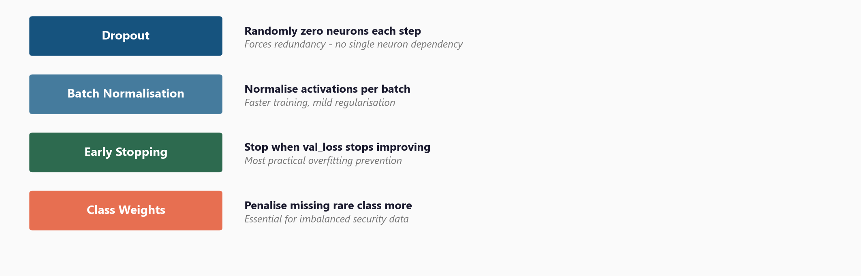
The Regularisation Toolkit for Neural Networks

Slide 10
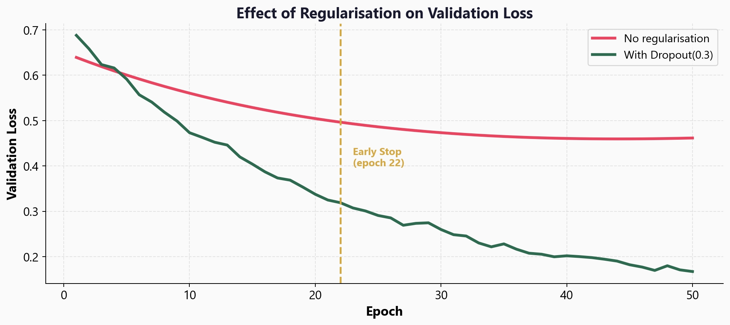
Effect on Validation Loss

Slide 11
04
Workshop
and Next Steps

Slide 12
Workshop: 4 Hands-On Exercises
Exercise 1: Deliberately overfit a large network - see the problem
Exercise 2: Add Dropout(0.3) - compare val_loss to exercise 1
Exercise 3: BatchNormalisation - smoother curves, combine with Dropout
Exercise 4: EarlyStopping - patience, restore_best_weights
Each exercise isolates one technique to measure its effect

Slide 13
Key
Takeaways
Deeper networks learn hierarchical patterns but overfit more easily
Dropout randomly disables neurons - forces redundancy (0.2-0.5)
BatchNorm stabilises training and acts as mild regularisation
EarlyStopping is the most practical tool - stop when val_loss plateaus
Class weights fix imbalanced security data (class_weight='balanced')
Next: CNNs - networks that understand spatial structure (images, signals)

Slide 14
Dropout & Regularisation
Next: Lesson 3.3 - Convolutional Networks

