Slide 1
Convolutional Networks
Lesson 3.3 | Stage 3: Neural Networks
AI Basic Training
Networks That See - Spatial Pattern Recognition

Slide 2
What We'll Cover
Why Dense layers fail on images
How convolution works - filters and feature maps
CNN architecture - Conv2D, MaxPooling, Flatten
Security applications of CNNs
Building and training a CNN on MNIST

Slide 3
01
Why Dense
Layers Fail

Slide 4
The Problem with Dense Layers on Images
Dense layers treat all inputs equally
Pixel (0,0) and pixel (7,7) are the same
No concept of 'next to' or 'nearby'
Dense flattens the image:
8x8 image = 64 independent numbers
Spatial relationships are destroyed
CNNs preserve spatial structure
A CNN knows that pixel (10,10)
is adjacent to pixel (10,11).
A Dense layer does not.

Slide 5
02
How Convolution
Works

Slide 6
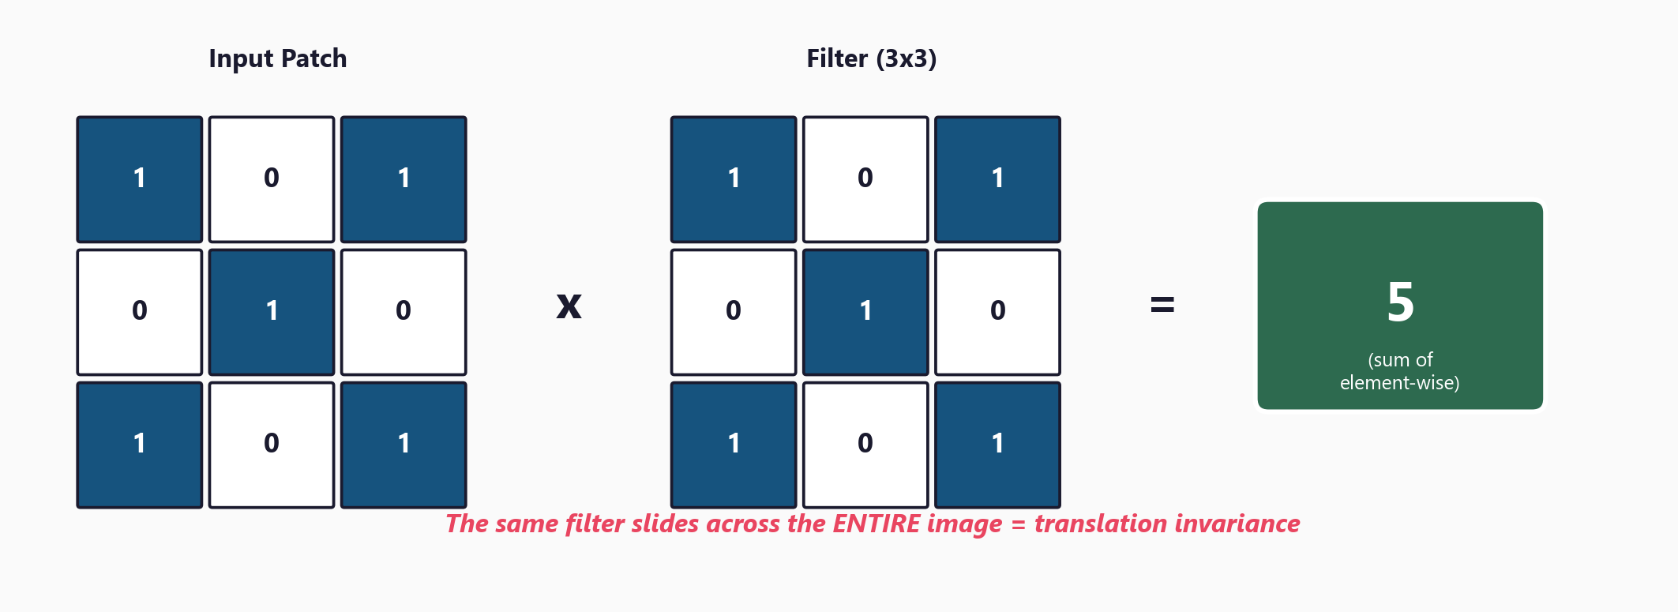
A Small Filter Slides Across the Entire Image

Slide 7
03
CNN
Architecture

Slide 8
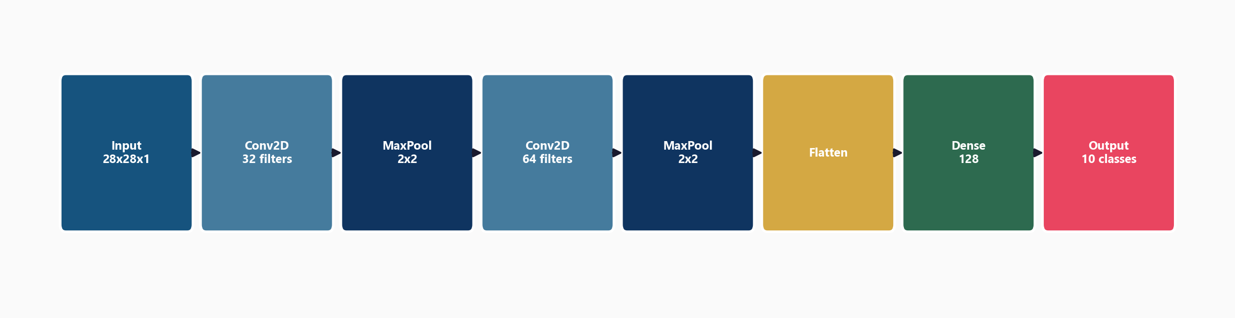
The Full CNN Pipeline

Slide 9
Key Components
Conv2D(32, (3,3))
32 filters, each 3x3
Detects local patterns
Output: feature maps
MaxPooling2D((2,2))
Keeps strongest activation
Reduces spatial dimensions
Makes features position-tolerant
Flatten()
Converts 2D maps to 1D vector
Bridge to Dense layers
Dense(128, activation='relu')
Combines spatial features
Dense(10, activation='softmax')
Class probabilities (sum=1)

Slide 10
04
Security
Applications

Slide 11
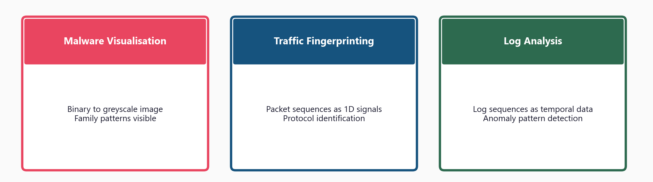
CNNs in Cybersecurity

Slide 12
05
Workshop
and Next Steps

Slide 13
Workshop: 4 Hands-On Exercises
Exercise 1: Why Dense fails on images - flatten destroys spatial info
Exercise 2: Conv2D and MaxPooling - filter sliding, shape arithmetic
Exercise 3: Build and train a CNN on MNIST - compare to Dense baseline
Exercise 4: Malware visualisation - binary to image, CNN relevance
MNIST downloads automatically (~11MB), CNN trains in 1-3 minutes

Slide 14
Key
Takeaways
Dense layers ignore spatial relationships - CNNs preserve them
Convolution: small filter slides across image detecting local patterns
Translation invariance: same pattern detected anywhere in the image
Architecture: Conv2D -> MaxPool -> Conv2D -> MaxPool -> Flatten -> Dense
Security use cases: malware images, traffic fingerprinting, log patterns
Next: Hyperparameter Tuning - systematically optimise your network

Slide 15
Convolutional Networks
Next: Lesson 3.4 - Hyperparameter Tuning

