Slide 1
Hyperparameter Tuning
Lesson 3.4 | Stage 3: Neural Networks
AI Basic Training
The Knobs You Turn - Systematic Optimisation

Slide 2
What We'll Cover
Parameters vs hyperparameters - what the model learns vs what you set
The five key hyperparameters
Learning rate sensitivity - the most impactful setting
Search strategies: manual, grid, random
Practical tuning workflow

Slide 3
01
Parameters vs
Hyperparameters

Slide 4
What the Model Learns vs What You Choose
Parameters (learned)
Weights and biases
Adjusted during training
via backpropagation
You never set these
The model finds them
Hyperparameters (you set)
Learning rate, batch size
Number of layers/neurons
Dropout rate, epochs
You choose before training
Getting them right: 75% -> 95%

Slide 5
02
The Five Key
Hyperparameters

Slide 6
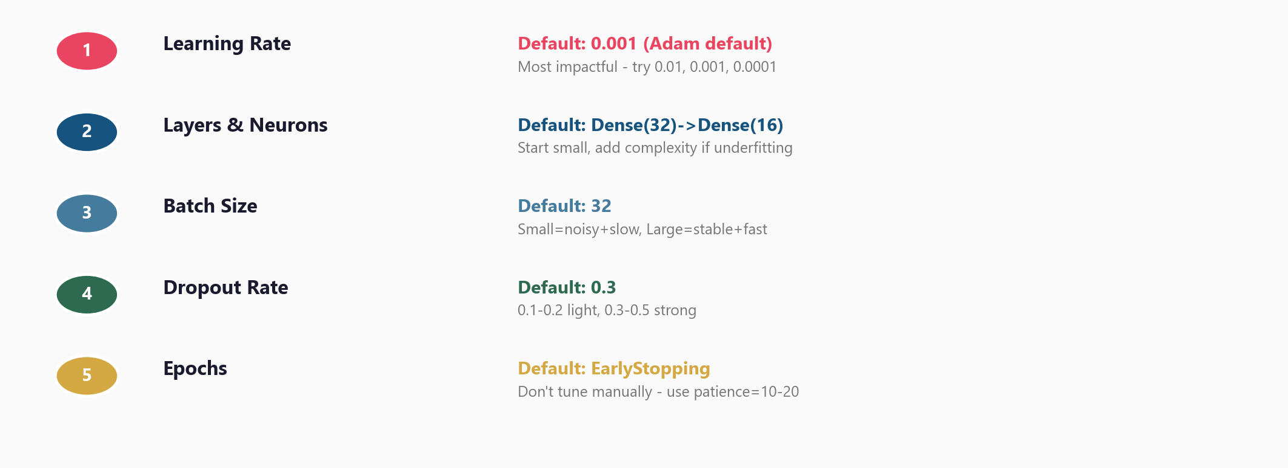
Ranked by Impact on Model Performance

Slide 7
03
Learning Rate
Sensitivity

Slide 8
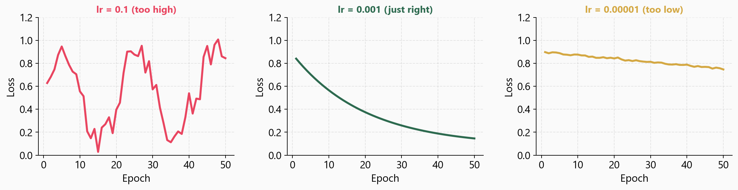
Too High, Just Right, Too Low

Slide 9
Finding the Right Learning Rate
Start with Adam default: 0.001
Try three values: 0.01, 0.001, 0.0001
Plot loss curves for each
Signs of trouble:
Oscillating loss = lr too high
Barely moving loss = lr too low
Smooth descent = just right
Learning rate is the single
most impactful hyperparameter.
Always tune it first.

Slide 10
04
Search
Strategies

Slide 11
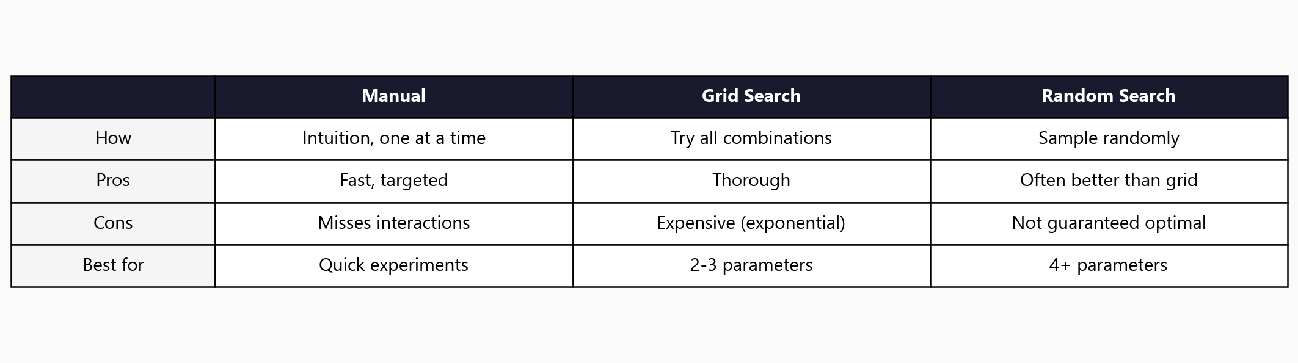
Three Approaches to Hyperparameter Search

Slide 12
05
Workshop
and Next Steps

Slide 13
Workshop: 4 Hands-On Exercises
Exercise 1: Parameters vs hyperparameters - inspect weights before/after
Exercise 2: Learning rate sensitivity - compare 0.001 vs 0.01 vs 0.1
Exercise 3: Batch size effects - 32 vs 256 vs 1024
Exercise 4: Architecture search - grid over units x layers, store results
Exercise 4 trains up to 9 models - may take 2-5 minutes total

Slide 14
Key
Takeaways
Parameters are learned; hyperparameters are set by you before training
Learning rate is the most impactful - always tune it first (0.01/0.001/0.0001)
Start simple (small network) and add complexity only if underfitting
Use EarlyStopping instead of manually choosing epochs
Random search often beats grid search for 4+ hyperparameters
Next: Stage 4 - Generative AI (LLMs, APIs, and RAG)

Slide 15
Hyperparameter Tuning
Next: Stage 4 - Generative AI

