Slide 1
How LLMs Work
Lesson 4.1 | Stage 4: Generative AI
AI Basic Training
Tokens, Embeddings, and Next-Token Prediction

Slide 2
What We'll Cover
The core idea: next-token prediction
Tokens - how text becomes model input
Embeddings - meaning as vectors
Attention - which tokens matter to which
Classic ML vs LLMs - the paradigm shift

Slide 3
01
Next-Token
Prediction

Slide 4
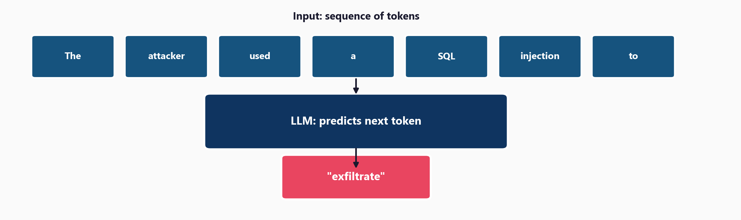
An LLM Is a Next-Token Predictor

Slide 5
Everything Emerges from This
The model predicts one token at a time
Then feeds its output back as input
And repeats
Reasoning, coding, summarisation -
all emerge from next-token prediction
trained on trillions of tokens
That's all it's doing.
Everything impressive about
ChatGPT and Claude comes
from predicting the
next token.

Slide 6
02
Tokens and
Embeddings

Slide 7
Tokens: How Text Becomes Model Input
Roughly 1 token = 1 word:
"the" = 1 token
"attack" = 1 token
Subwords for rare terms:
"injection" = "inject" + "ion"
"CVE-2024-1234" = 5 tokens
Why tokens matter:
API pricing is per-token
Context windows measured in tokens
(Claude: 200,000 tokens)
Long documents need chunking

Slide 8
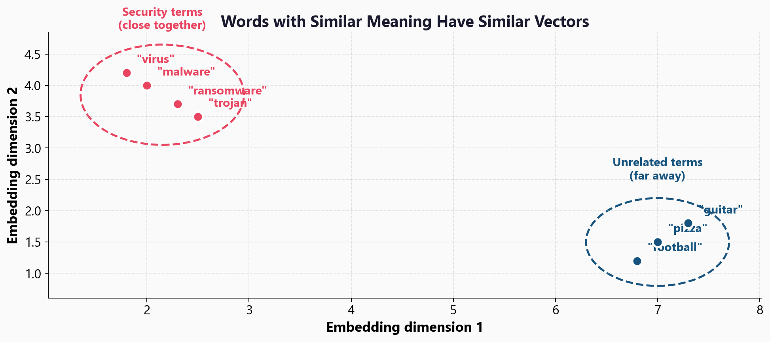
Embeddings: Meaning as Vectors

Slide 9
03
The Attention
Mechanism

Slide 10
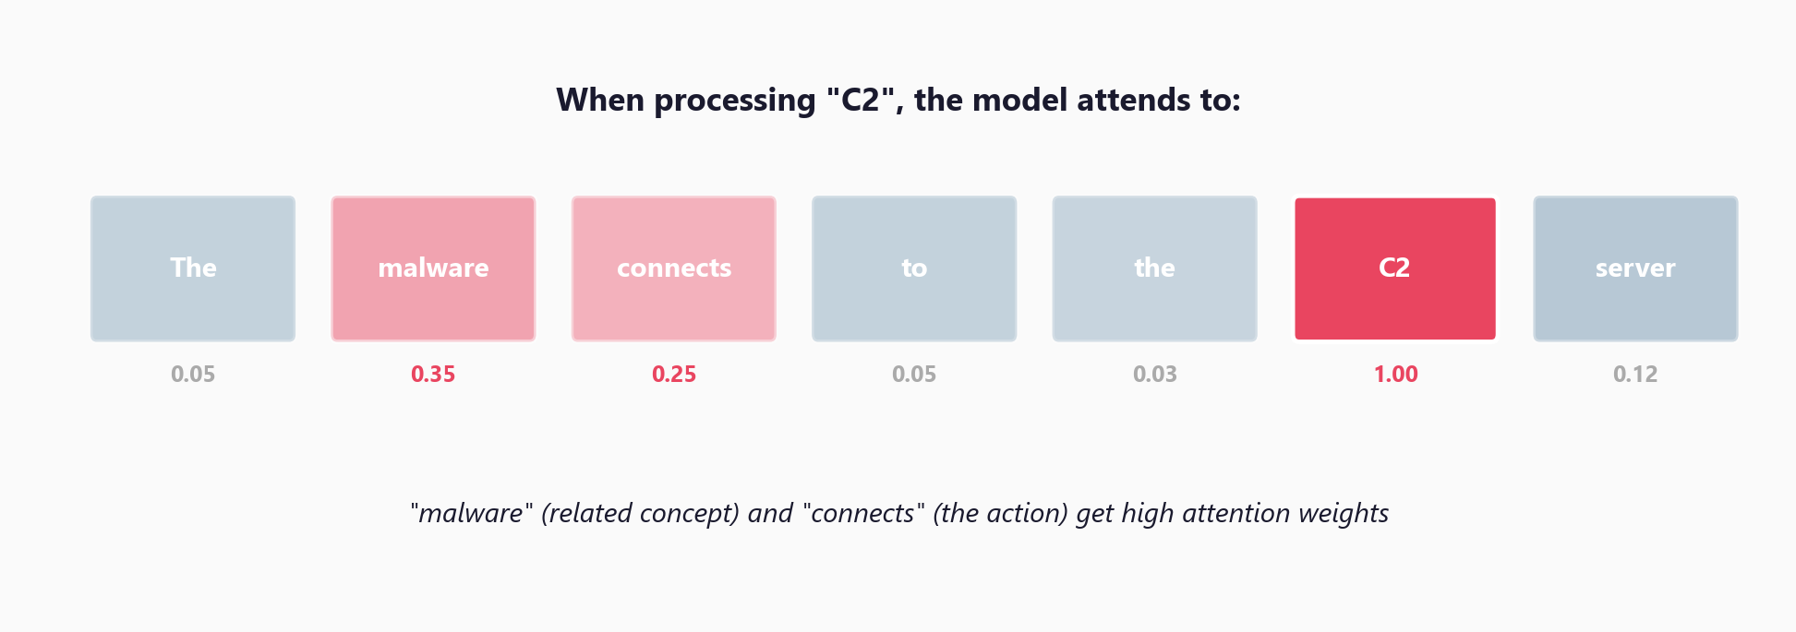
Attention: Which Tokens Matter to Which?

Slide 11
04
Classic ML
vs LLMs

Slide 12
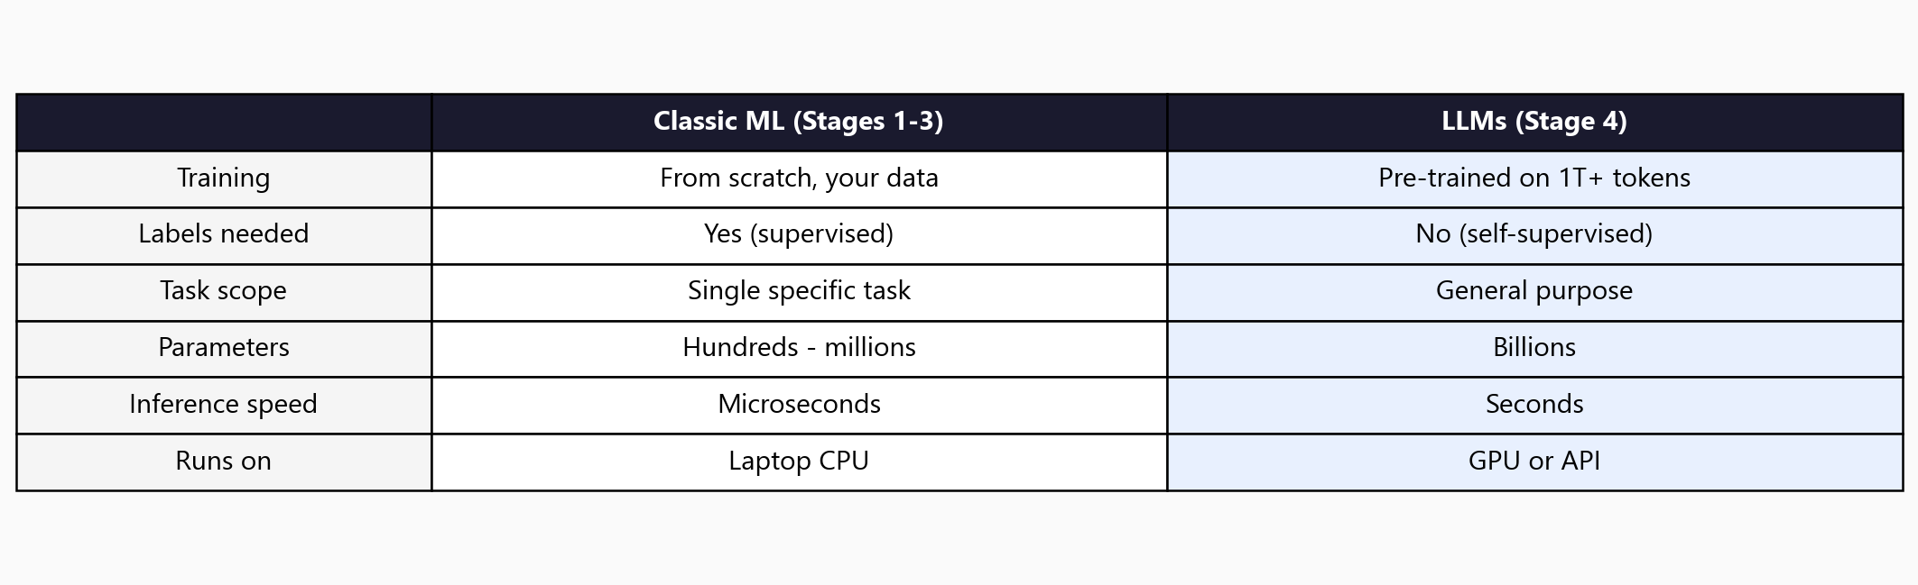
The Paradigm Shift

Slide 13
05
Workshop
and Next Steps

Slide 14
Workshop: 3 Hands-On Exercises
Exercise 1: Tokenisation - text to tokens to IDs, vocabulary, OOV
Exercise 2: Embeddings - tokens to vectors, cosine similarity, semantic distance
Exercise 3: Attention - weight matrices, which words attend to which
No GPU or API key required - all exercises run on NumPy alone
The goal is intuition, not production code

Slide 15
Key
Takeaways
LLMs predict the next token - everything else emerges from this
Tokens are roughly words; rare terms get split into subwords
Embeddings map tokens to vectors - similar meaning = similar vectors
Attention lets the model focus on relevant tokens across the input
LLMs are pre-trained on trillions of tokens - you use them, not train them
Next: HuggingFace - use pre-trained models with zero training

Slide 16
How LLMs Work
Next: Lesson 4.2 - HuggingFace Pre-trained Models

