Slide 1
RAG
Lesson 4.4 | Stage 4: Generative AI
AI Basic Training
Retrieval-Augmented Generation - Ground Answers in Your Documents

Slide 2
What We'll Cover
The problem RAG solves - knowledge cutoff and hallucination
The three stages: index, query, generate
Chunking, embedding, and retrieval
Grounding: 'based on the context only'
Building a security analyst RAG assistant

Slide 3
01
The Problem
RAG Solves

Slide 4
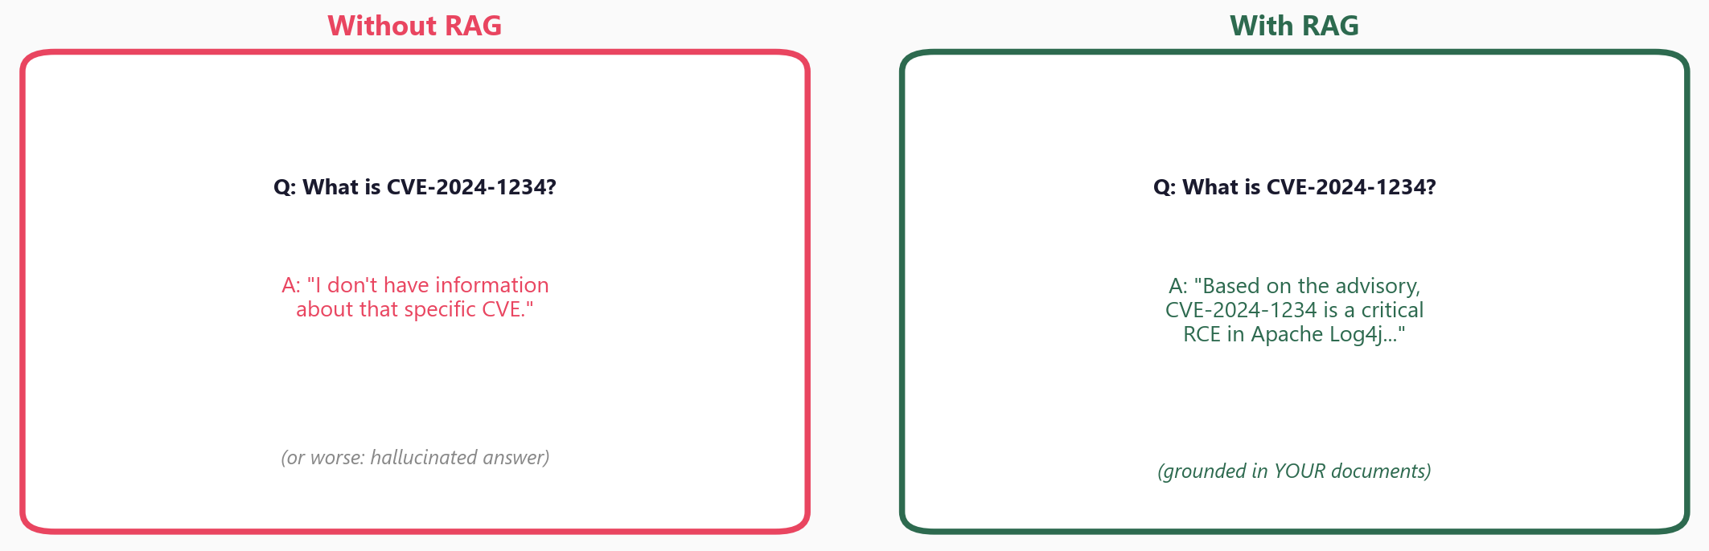
Without RAG vs With RAG

Slide 5
Two Limitations of LLMs
Knowledge cutoff
The model doesn't know about
CVEs published after training
Your internal runbooks,
policies, and past incidents
are unknown to it
Hallucination
Without source documents,
the model may fabricate
plausible-sounding answers
RAG grounds answers in
YOUR documents - verifiable
and attributable

Slide 6
02
The RAG
Pipeline

Slide 7
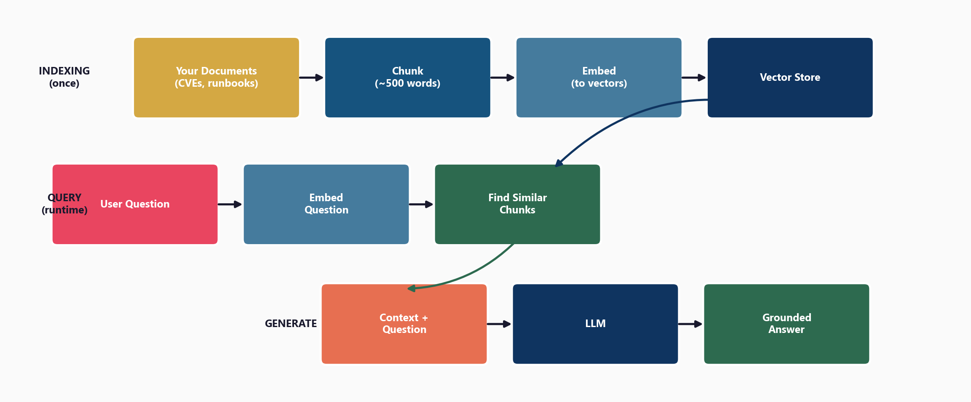
Three Stages: Index, Query, Generate

Slide 8
03
The Components

Slide 9
Chunking and Embedding
Chunking: split documents into ~500-word pieces
Overlap prevents boundary cuts
Embedding: convert each chunk to a vector
model = SentenceTransformer('all-MiniLM-L6-v2')
embeddings = model.encode(chunks)
Similar topics = similar vectors
This is what makes retrieval possible

Slide 10
Retrieval and Generation
Retrieval: encode query, find closest chunks
q_vec = model.encode([question])
similarities = cosine_similarity(q_vec, embeddings)
top_chunks = get_top_k(similarities, k=3)
Generation: inject chunks into prompt
'Based on the following context ONLY,
answer the question. If not in context, say so.'
The 'ONLY' instruction prevents hallucination

Slide 11
04
Why Grounding
Matters

Slide 12
'Based on the Context Only'
Without this instruction:
Model blends pre-training + documents
Can't verify where answer came from
With grounding instruction:
Attributable answers (cite the source)
Accurate recall of your policies
Reduced hallucination
Model says 'not in context' when unsure
In security, every answer
must be verifiable.
Grounding ensures you know
exactly where the
information came from.

Slide 13
05
Workshop
and Next Steps

Slide 14
Workshop: 3 Hands-On Exercises
Exercise 1: Chunking strategies - fixed-size, overlap, by sentence
Exercise 2: Retrieval - encode chunks, retrieve top-k by cosine similarity
Exercise 3: Full RAG pipeline - retrieve + augment prompt + generate
Exercises 1-2 require no API key (local models only)
Exercise 3 requires one API key for the generation step

Slide 15
Key
Takeaways
RAG solves two LLM limitations: knowledge cutoff and hallucination
Three stages: index (chunk+embed), query (retrieve), generate (LLM+context)
Chunking splits documents; embedding converts chunks to searchable vectors
Retrieval finds the most relevant chunks via cosine similarity
'Based on context only' grounds answers and prevents hallucination
Congratulations - you have completed all 4 stages of AI Basic Training!

Slide 16
RAG
AI Basic Training - Complete!

