Slide 1











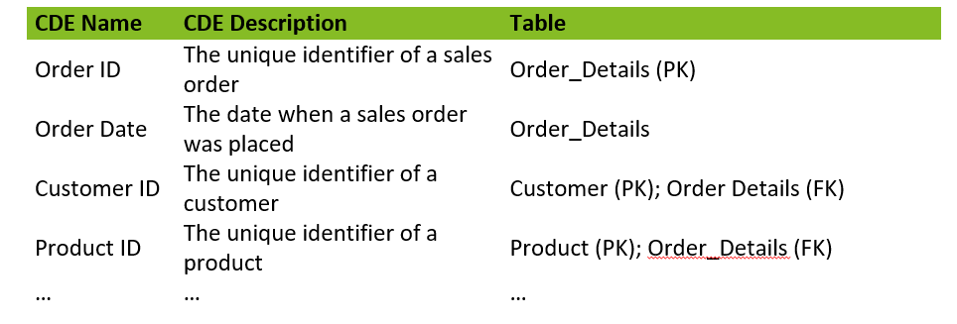
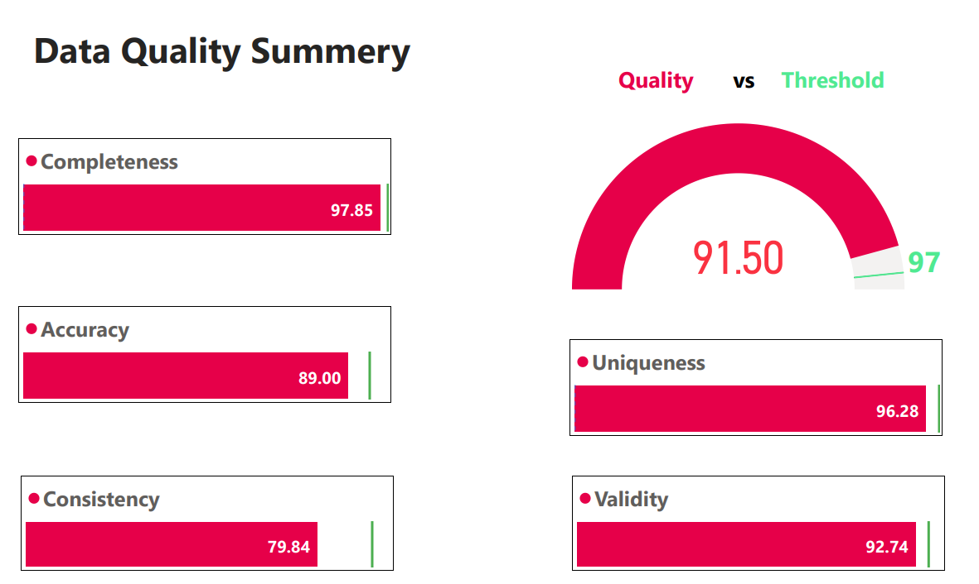

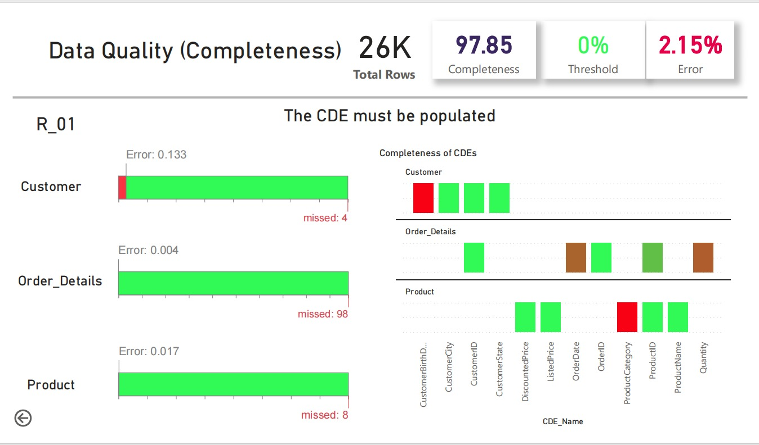
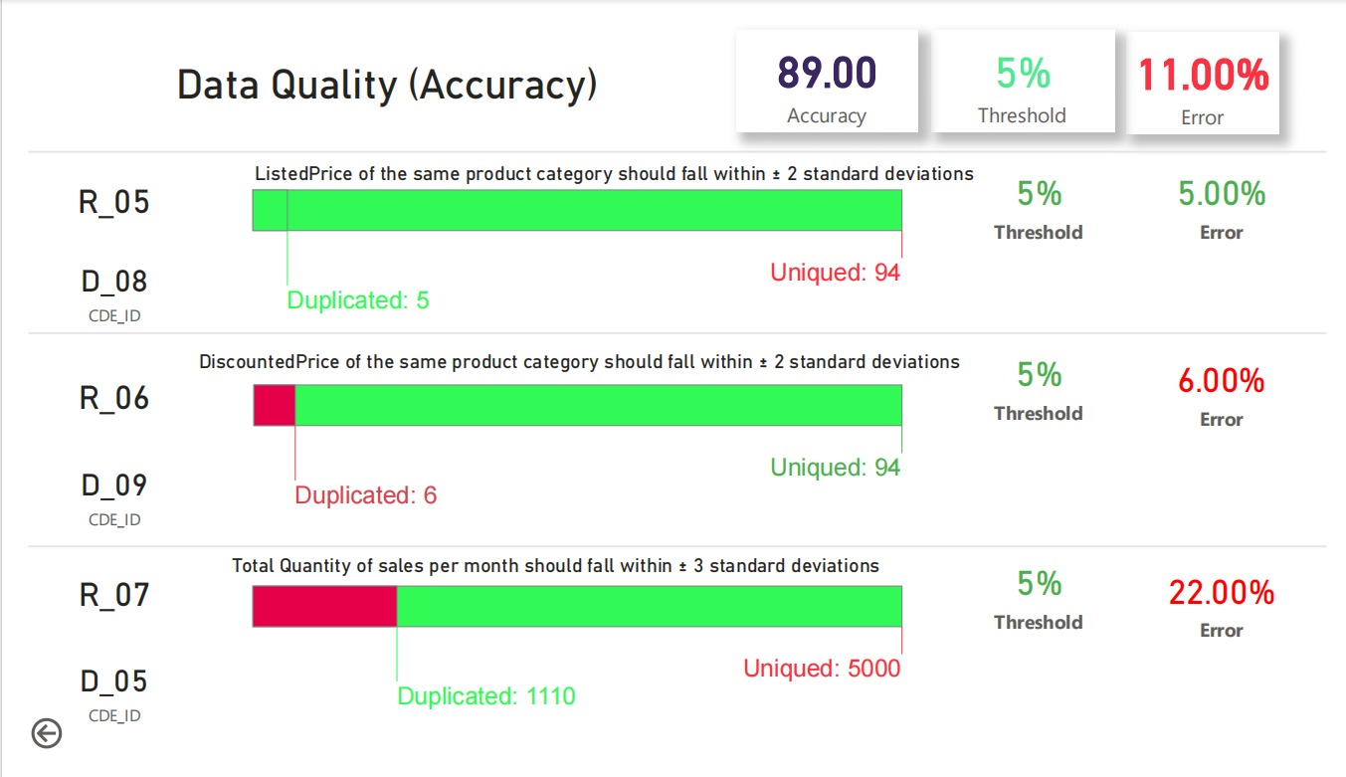



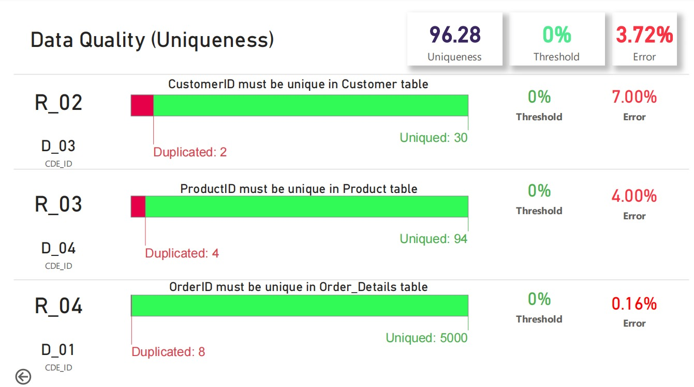
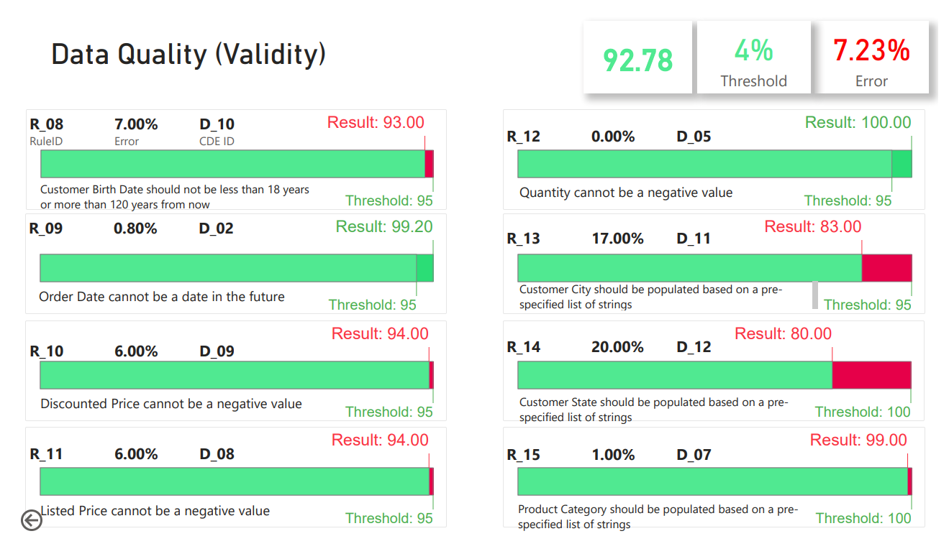

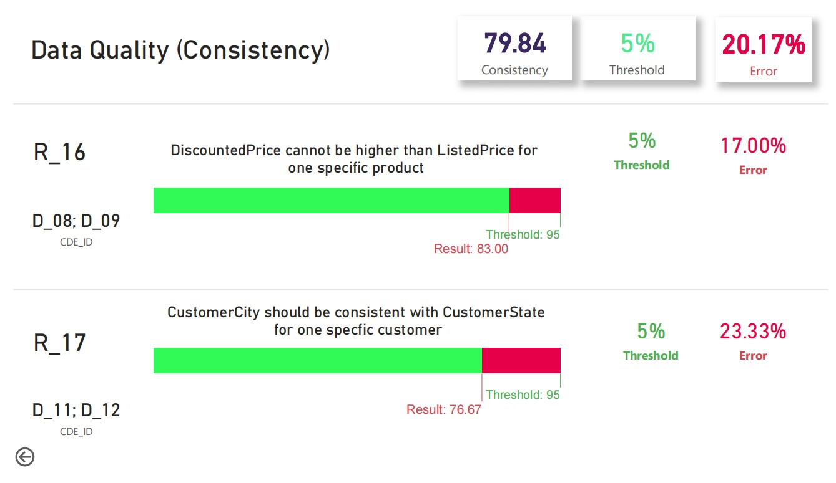





Data Quality Assessment (DQA) for improving IPEA's Growth Strategy
Task
To build a Data Quality dashboard, where data attributes must be assessed along 6 dimensions. CDE’s are defined to form rules, of which the status is shown in the DQ Dashboard.
Dimensions of Data Quality
Approach
Completeness, Accuracy, Uniqueness, Consistency, Validity
1-Defining Data Governance
2-Identifying Critical Data Elements
3-Designing Data Quality Rules
4-Setting thresholds
5-Implementing DQ
6-Monitoring
CDE & Rules
- Critical data elements consist of e.g., Customer ID, customer state.
- These CDE’s are linked to Rules as e.g., if the Order ID is unique, if Customers are unique in the data table (but not in the order table).
Final result
Completeness
Accuracy
≠
Uniqueness
Validity
=
≠
=
consistency
Team: Eissa Al-shari Ali Ameen Motea Al-omari Saddam Obaid
Supervisors:
Nick Bennink
Majda Kasmi
October 2023
Tools and software

