Slide 1




Enabling Self-management Of Component Based Distributed Applications
Ahmad Al-Shishtawy¹, Joel Höglund², Konstantin Popov², Nikos Parlavantzas³, Vladimir Vlassov¹, and Per Brand²
Royal Institute of Technology (KTH), Stockholm, Sweden
Swedish Institute of Computer Science (SICS), Stockholm, Sweden
Institut National de Recherche en Informatique et en Automatique (INRIA), Grenoble, France
CoreGRID Symposium 2008
Las Palmas de Gran Canaria, Canary Island, Spain
August 25-26, 2008

Slide 2
Outline
Introduction
The Management Framework
Implementation and Evaluation
Conclusions
Future Work
Notes:
Our management framework

Slide 3
Introduction
Dynamic distributed environments
  heterogeneous, volatile, failure prone
Increased software complexity
Management by humans is complicated and time-consuming
Autonomic management is needed in order to improve management efficiency
  reduce cost of administration
  speed up its execution
Notes:
Give some background information:
this work has been done within the Gird4All EU-project and in part funded by the CoreGRID project. Grid4All project focuses on dynamic Grids and introduces the vision f the Democratic Grid bult of resources donated by ordinary IT-unexperienced users. This calls for agressive support for slef-management at different levels. In this research we focus on enablisg self-management of component-based systems, services and applications deployed on structured overlay networks fomed of Grid nodes.

Slide 4
The Management Framework
DCMS: Distributed Component Management System
Framework (model, APIs) for developing self-managing component-based applications
    self-configuration
    self-healing
    self-optimization
    self-protection

Slide 5
The Management Framework (DCMS)
Separates functional and management parts of a distributed application
Provides
  Deployment
  Communication
  Distributed management
  Network-transparent programming model
Distributed management
  Management components
  Event based communication
  Sensing / actuation
Extends Fractal with
  the component group abstraction
  one-to-any & one-to-all bindings

Slide 6
Application Architecture
actuation
Mgr1
publish/
subscribe
Aggr1
W1
sensors
W2
W3
A
B
B1
B2
Notes:
DISTRIBUTED
We found it useful to subdivide
Implementation that provides robustness of self management hrough mobility and replication
App architecture
Management part (self-* code)
Management part is a network of Management Elements (MEs)
MEs are of three types:
watchers: monitor status of individual elements or groups
aggregators: subscribe to multiple watchers
managers: subscribe to watchers/aggregators and modify architecture

Slide 7
Management Part (Self-* Code)
Management part is a network of distributed Management Elements (MEs)
MEs are of three types:
  watchers: monitor status of individual elements or groups
  aggregators: subscribe to multiple watchers to aggregate information at a higher level
  managers: uses higher level information to manage the application
Notes:
Manipulate architecture of the managed application: configuration (bindings, placement, deploy/undeply), life-cycle and behaviour (mode, function, stopping / starting) – all actuations that Fractal allows to include in the component control interfaces.

Slide 8
Self-* Code (cont’d)
MEs subscribe to and receive events from sensors and other MEs.
Sensors provide information about status of individual components
  application- specific or DCMS-provided (e.g., failure sensors)
  generate events fed to watchers
Manipulate the architecture using management actuation API (Deploy, Bind, Reconfigure, ... )

Slide 9
Management Elements
Management Element
Application-
specific
Events OUT
Generic
proxy
Events IN
Actuation
Configure
Notes:
Funtionality of the Generic proxy
Sensord are similar

Slide 10
Implementation
Builds on structured overlay networking
All entities (e.g. components, bindings, groups) are uniquely identified, can be named
  (network) location transparency
  Overlay IDs to implement DCMS IDs
Uses the Set of Network References data structure for
  storing information about architecture elements
  implementing bindings and groups
  sensing of individual elements or groups
Notes:
Picture
DCMS runtime
A set of distributed containers connected through the Niche/DKS structured P2P overlay network
We are using an implementation of fractal component container calld JADE
Two container configurations: JadeBoot and JadeNode
JadeBoot
bootstraps the system
hosts “centralised” VO services (e.g., VOMS)

Slide 11
Applications and DCMS runtime architecture
Component Container
component-
based
self-*
applications
Functional Code
Non-Functional Code
component
#0
management component #0
component
#1
DCMS API services and run-time system
DCMS
platform
DCMS
entity #1
DCMS
entity #0
Overlay Services
Resource Fabric
Overlay Id#0
Resource#0

Slide 12
YASS: Yet-Another Storage Service
Proof-of-concept, self-managing storage service built on DCMS
Targets dynamic environments (resources join, leave, fail at any time)
Maintains file replication factor upon resource churn
Scales resource usage to match load
Notes:
We focus on managment not the application function it self

Slide 13
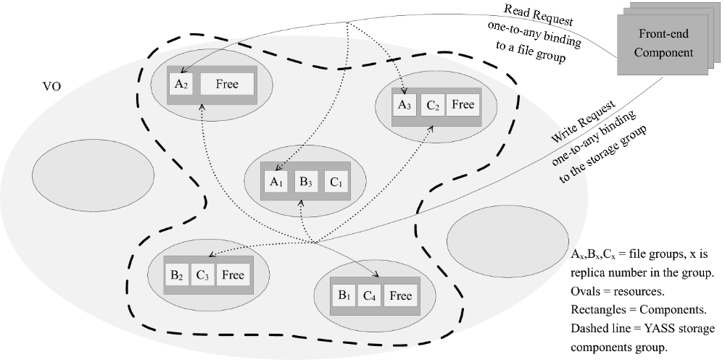
YASS Functional Part

Slide 14
YASS Self-management
3 control loops
Self-healing
  If resource leaves/fails, restore file replica
Self-configuration
  If total amount of available resources drops, add new resources
Self-optimisation
  If utilisation is high, add new resource
  If it is low, remove least loaded storage

Slide 15
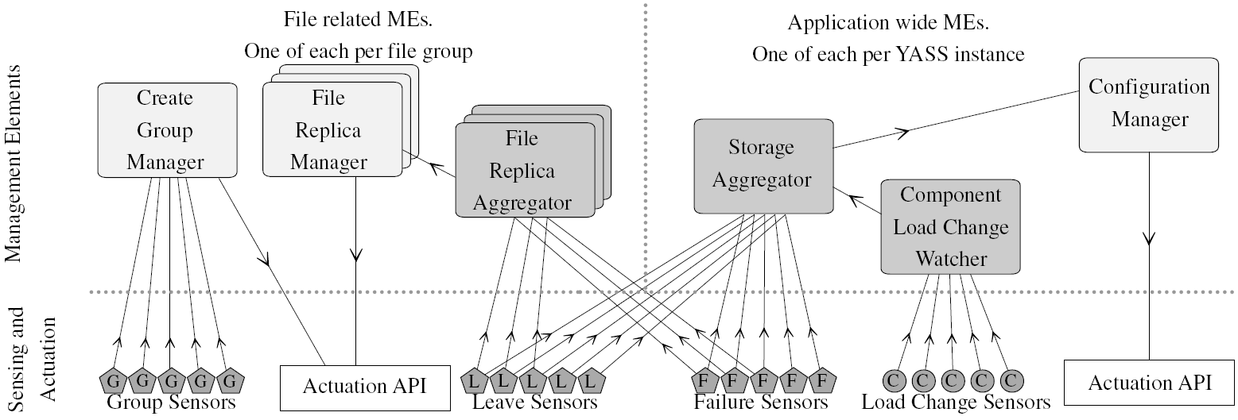
YASS Management Part

Slide 16
Example of Self-Management Code
public void eventHandler(Event e) {
StorageAvailabilityChangeEvent event = (StorageAvailabilityChangeEvent)e;
if (event.getTotalCapacity() < capacityLowThreshold) {
// find, allocate & add to group
ResourceId newResource =
myManagementInterface.getResource(preferenceHolder);
if (newResource != null) {
System.out.println("Found a new resource");
newResource = myManagementInterface.allocate(newResource);
ComponentId cid = myManagementInterface.deploy(newResource, depParams);
componentGroup.add(cid);
} else {
System.out.println("Cannot currently find a new resource");
}
}
}

Slide 17
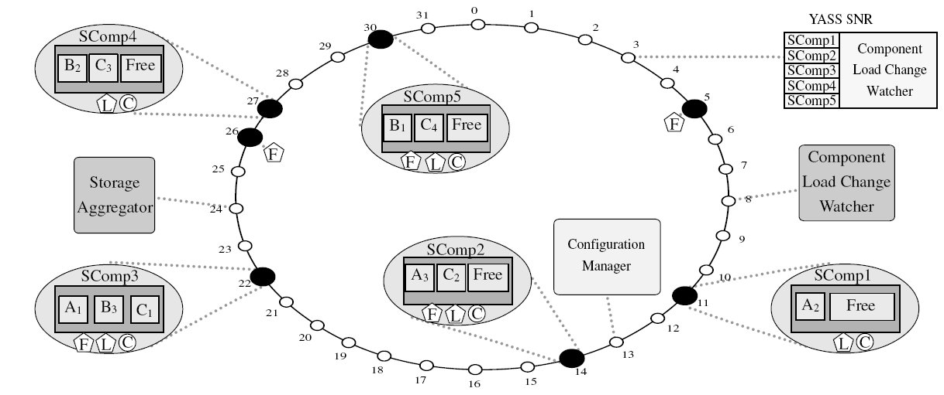
Example of YASS deployment

Slide 18
Conclusions
Provide model for distributed component based applications with self-* behavior
  Separates functional & management parts
  Structures self-management code
  Provides abstractions for developing self-*
Implementation leverages self-* properties of underlying structured overlay
Proof of concept prototype
Notes:
Possible question: Ellaborate: ”Implementation leverages self-* properties of underlying structured overlay” – see slide 10

Slide 19
Future Work
Evaluation on PlanetLab
Robustness of self-* through replication of MEs
Complex self-* behaviors
Language support for programming management logic
Extend ADL for management part
Notes:
Ask Nikos for language support ADL
For any case: Add slides with all other pictures and code fragments from the paper after Future Work

Slide 20
Thank You
Questions?

