Slide 1
An Intrusion Detection Architecture for Computational Grids
  Prof. Dr. Mohammed F. Tolba
  Dr. Ismail A. Taha
  Ahmad M. Al Shishtawy

Slide 2
Table Of Contents
Introduction
Grid Security and the Need for IDS
Proposed Architecture.
Conclusion.

Slide 3
Globus Toolkit
To build Computational Grids and its applications.
Bag of services approach.
  Security
  Resource Management
  Information Services
  Data Management
Research Projects in our Faculty

Slide 4
Table Of Contents
Introduction
Grid Security and the Need for IDS
Proposed Architecture.
Conclusion.

Slide 5


Overview of Security in Globus Toolkit
SSL
SSH
Local Name
Local Name
Kerberos
Global Name
Local Name
Plain Text
TLS
Local Name
Local Name

Slide 6
Intrusion Detection System
Second line of defense
Normal differ from malicious use.
Anomaly vs. Misuse detection.
Main components:
  Data Gathering Module.
  Analyzing and Detection Module

Slide 7
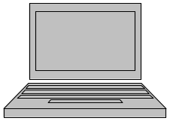
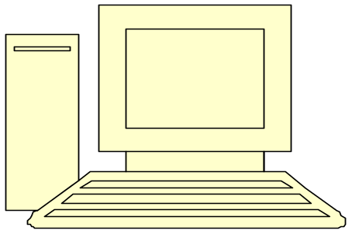
Centralized Intrusion Detection
LAN
Data gathering module
Analyzing and Detection module

Slide 8
Distributed Intrusion Detection
LAN
LAN
LAN
LAN
Data gathering module
Analyzing and Detection module

Slide 9
Table Of Contents
Introduction
Grid Security and the need for IDS
Proposed Architecture.
Conclusion

Slide 10
Requirements
Scalable.
Heterogeneity.
Minimal overhead.
Interoperability.
Integrity and confidentially.
Trust relationships.
Avoid bottleneck and single point of failure.

Slide 11

Grid Information Services (MDS-2)
discovery (GRIP or other)
Aggregate Directory
D
D
lookup (GRIP)
registration (GRRP)
P
P
P
P
standard Information Provider services

Slide 12
Grid Information Services (MDS-2)
Information Providers
Aggregate Directory
The GRid Information Protocol (GRIP)
The GRid Registration Protocol (GRRP)
Security (GSI)

Slide 13
Proposed Grid Intrusion Detection Architecture (GIDA)
Aggr. Dir.
IDS
IDS
Aggr. Dir.
Notes:
Information Providers
Aggregate Directory

Slide 14
Data Gathering Module
User Interface
Local IDS
A
DGM
A
A

Slide 15
Case I (Local)
Local IDS
IDS
IDS
Local IDS
Local IDS
Notes:
Information Providers
Aggregate Directory

Slide 16
Case II (Global)
IDS
IDS
Notes:
Information Providers
Aggregate Directory

Slide 17
Proposed Grid Intrusion Detection Architecture (GIDA)
IDS
IDS

Slide 18
Table Of Contents
Introduction
Grid Security and the Need for IDS
Proposed Architecture.
Conclusion.

Slide 19
Conclusions
Intrusion detection is missing in current grid security systems.
Intrusion detection is very important as a second line of defense.
Current intrusion detection does not satisfy the needs of The Grid.

Slide 20

The End
Thank you for careful listening ☺

