Slide 1

A SECURE GRID ENABLED SIGNATURE VERIFICATION SYSTEM
Mohammad F. Tolba
Mohammad S. Abdel-Wahab
Ismail A. Taha
Ahmad M. Al-Shishtawy
Scientific Computing Department
Faculty of Computer and Information Sciences
Ain Shams University
Cairo, Egypt

Slide 2
Agenda
Introduction.
Possible Scenarios.
The Grid Approach.
Implementation and Results.
Conclusions & Future Work.

Slide 3
The Signature Verification Problem
Signatures databases.
Signature verification algorithms.
Suspected signature.
User's QoS.

Slide 4
Agenda
Introduction.
Possible Scenarios.
The Grid Approach.
Implementation and Results.
Conclusions & Future Work.

Slide 5
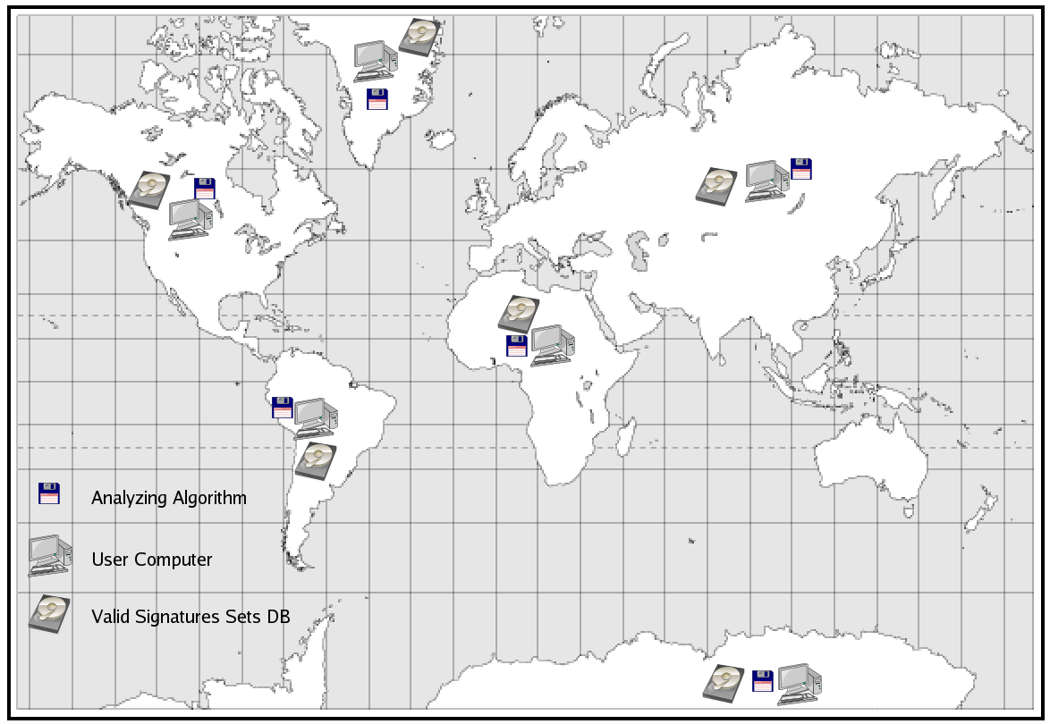
The Old Scenario

Slide 6
The Old Scenario (Requirements)
DBMS + DB with all signatures sets.
All algorithms needed by the user(s).
Dedicated computer with sufficient power.
Administration, maintenance, and upgrades.

Slide 7
The Old Scenario (Problems)
Large DB size.
High maintenance cost.
Update with new alg. & signatures.
Security:
DB integrity (not compromised).
Verify source of alg. & DB (correctness).
Risky to give all DB to the users.

Slide 8
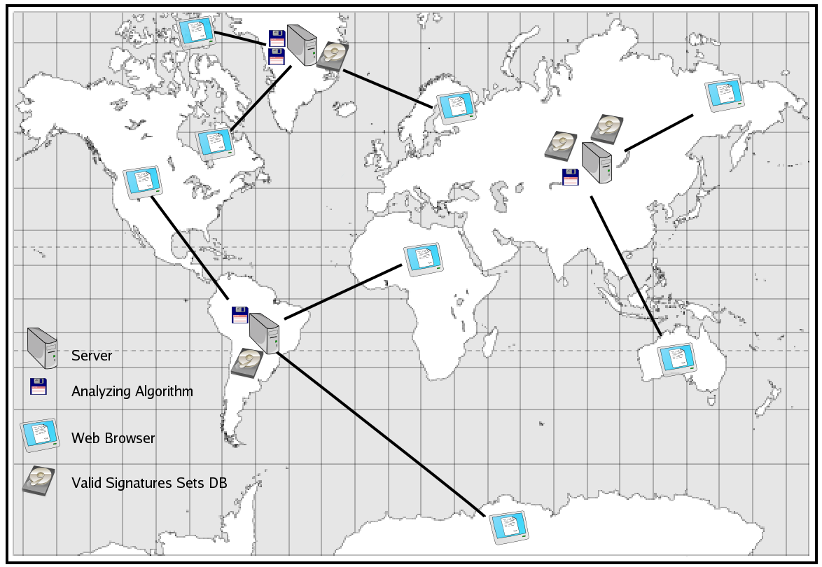
The Modern Scenario

Slide 9
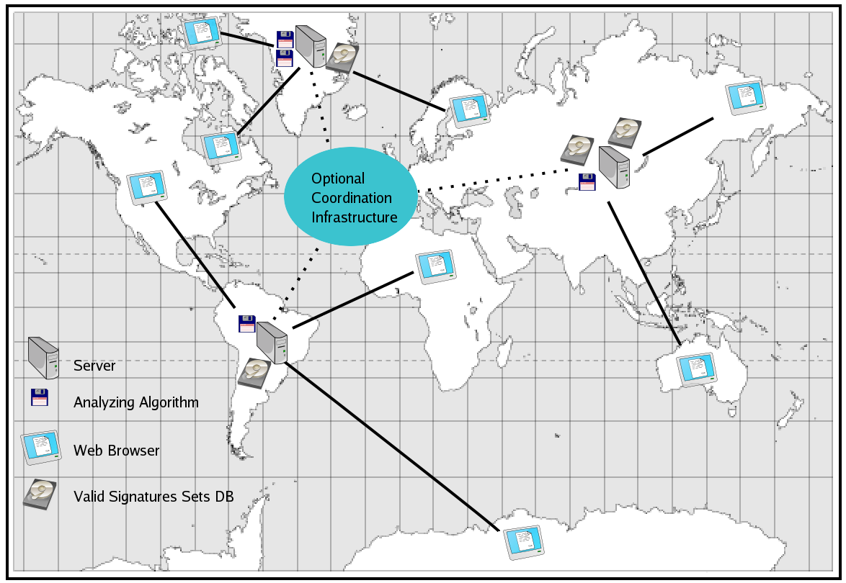
The Modern Scenario

Slide 10
The Modern Scenario (Requirements)
User:
Credentials (Password, Private Key, ...).
Web browser.
Server:
Suitable processing power.
Signature verification algorithms.
Signatures database.

Slide 11
The Modern Scenario (Problems)
Mirrors have same problems as old scenario.
Implement a complex and secure infrastructure specifically for this problem.
Define standards for inter-operation.

Slide 12
Agenda
Introduction.
Possible Scenarios.
The Grid Approach.
Implementation and Results.
Conclusions & Future Work.

Slide 13
Basic Grid Services
Resource
Management
Information
Services
Data
Management
Security

Slide 14
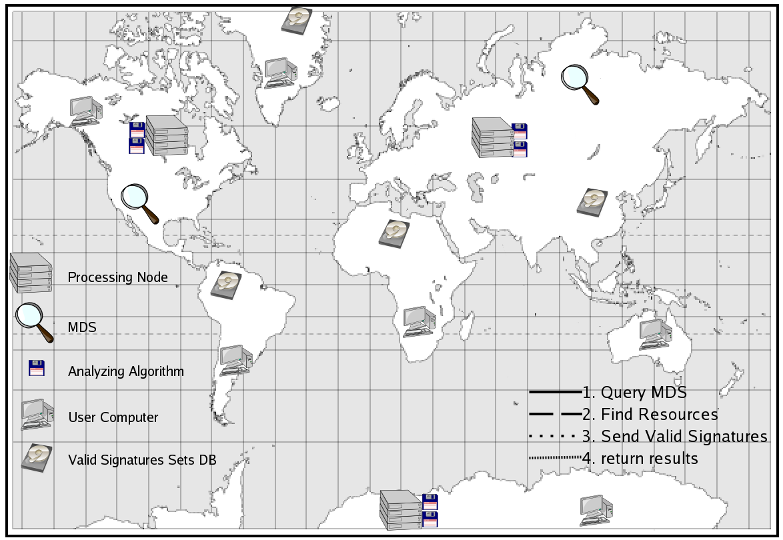
The Grid Scenario

Slide 15
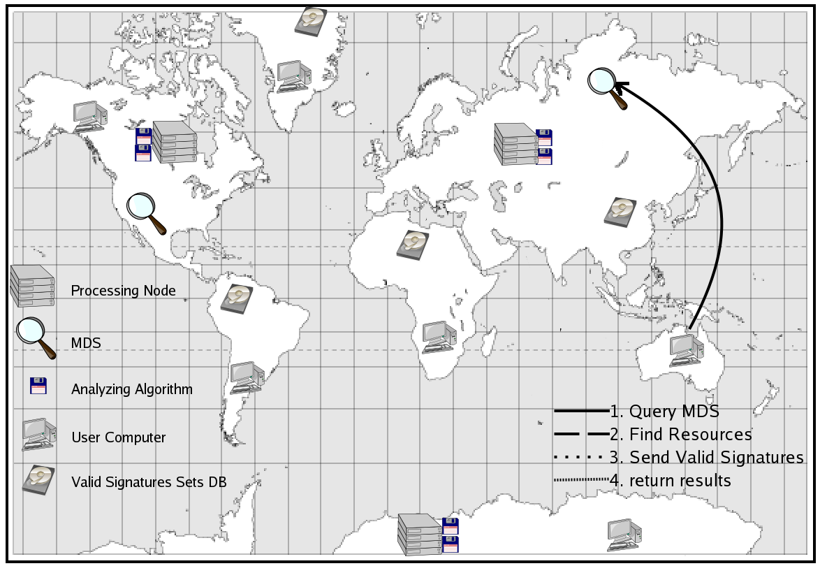
The Grid Scenario

Slide 16
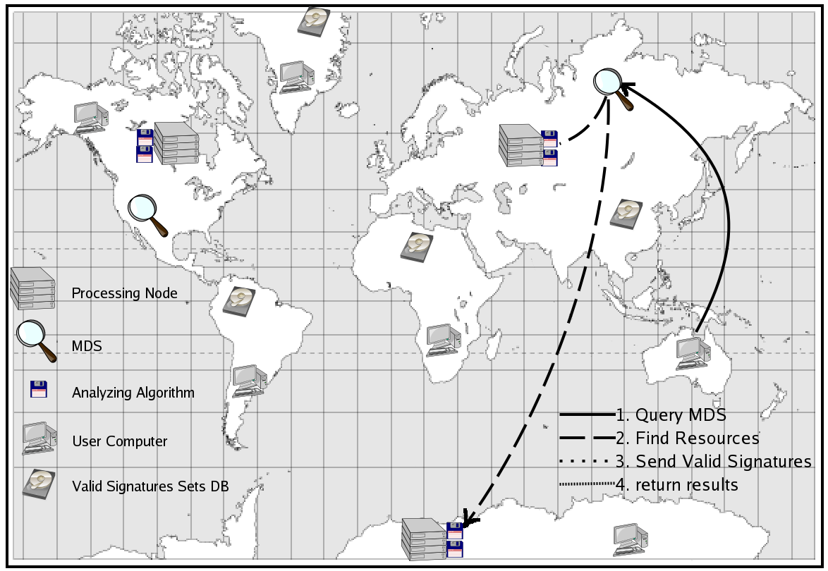
The Grid Scenario

Slide 17
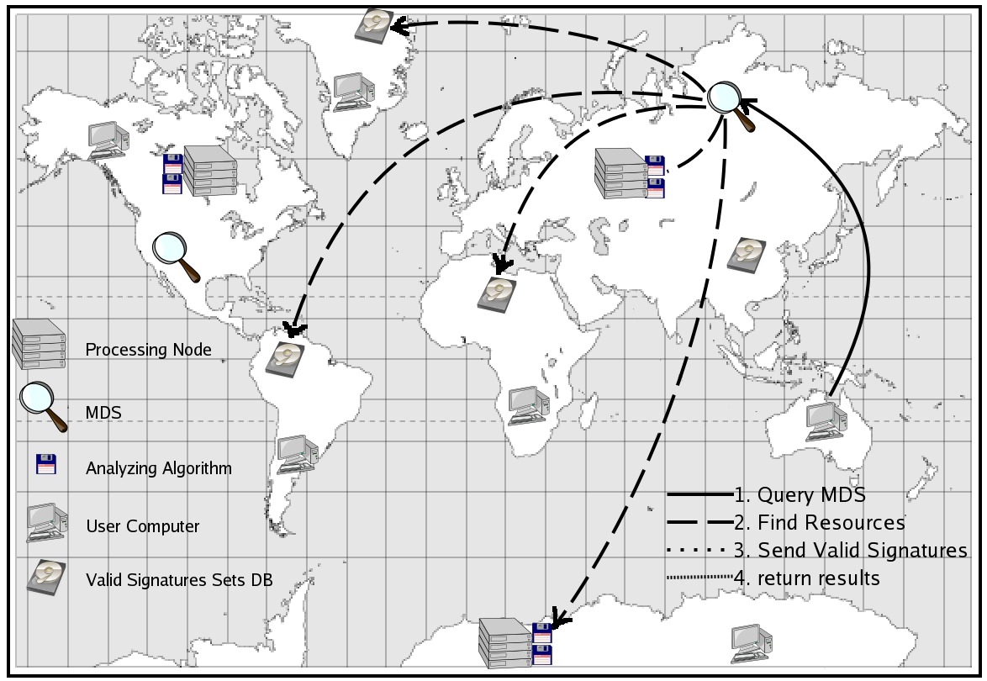
The Grid Scenario

Slide 18
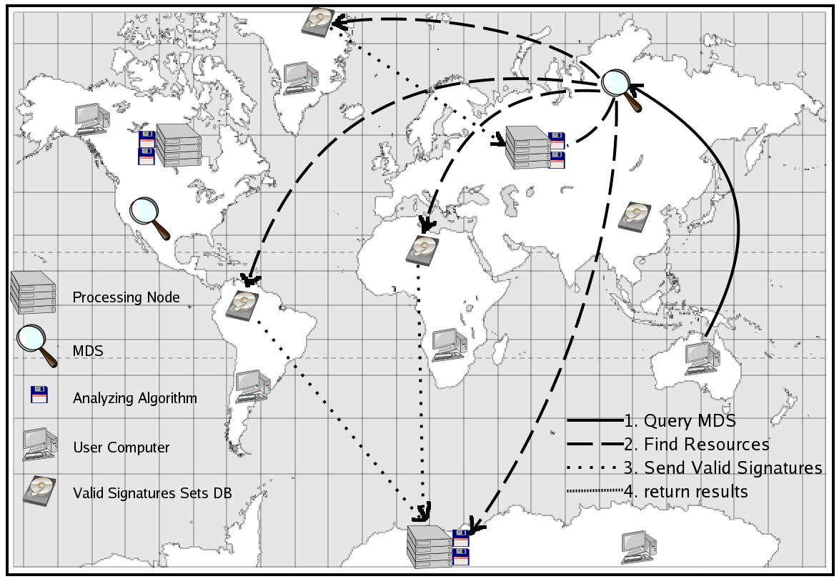
The Grid Scenario

Slide 19
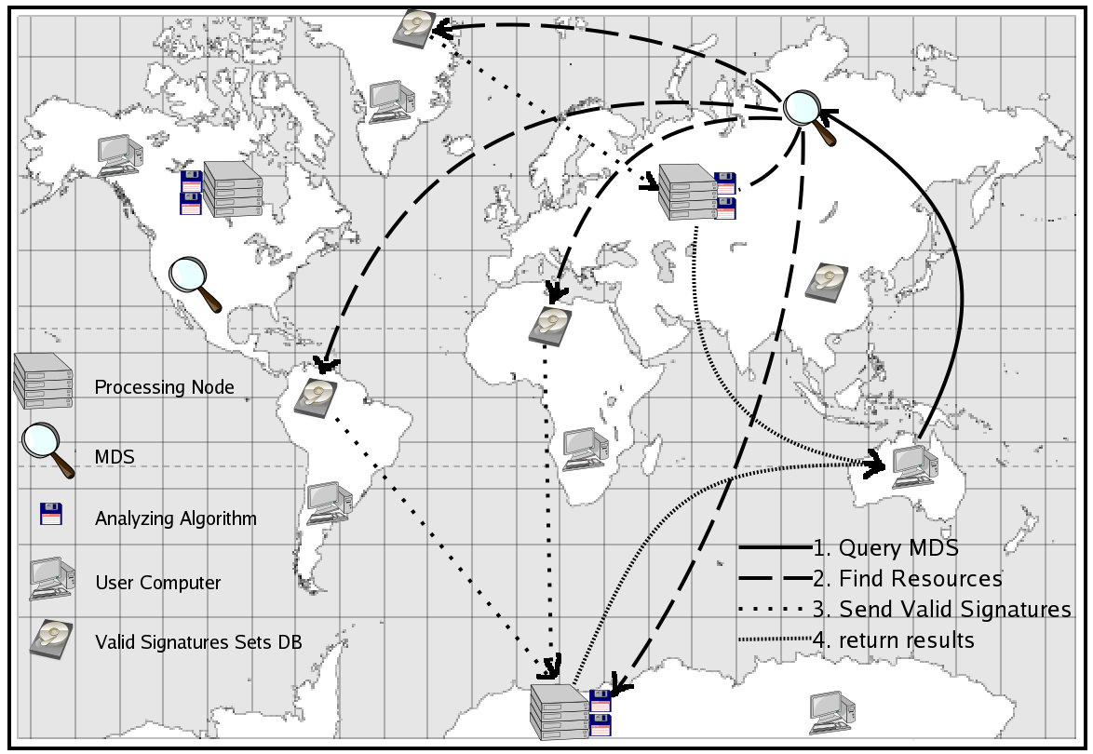
The Grid Scenario

Slide 20
The Grid Scenario (Requirements)
User:
  Globus ToolKit installed.
  Appropriate certificates.
  Grid enabled application.
Server:
  Globus ToolKit installed.
  Appropriate certificates.
  Signature verification algorithms.
  and/or signatures database.
  Information service.

Slide 21
The Grid Scenario (Security)
GIS provides authentication & login.
GASS & GridFTP for secure transfer of signatures sets.
Different trust relationships through Certificate Authorities.
Database kept at secure locations.
Trusted source for algorithm and processing.

Slide 22
The Grid Scenario (Advantages)
Dynamic environment.
Reduced cost.
Secure.
Complex issues hidden by Grid services
Different user QoS.
Reliable & Fault Tolerant.

Slide 23
Agenda
Introduction.
Possible Scenarios.
The Grid Approach.
Implementation and Results.
Conclusions & Future Work.

Slide 24
Implementation
Joint project between:
  Ain Shams University in Egypt
  George Washington University in USA
Three Grid Nodes:
  GWU Node: Processing Cluster + Database
  ASU1 Node: Processing Cluster
  ASU2 Node: Database

Slide 25
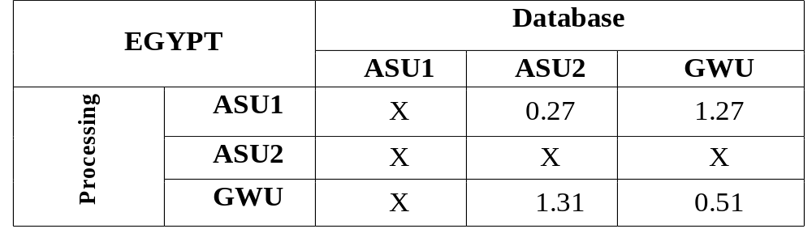
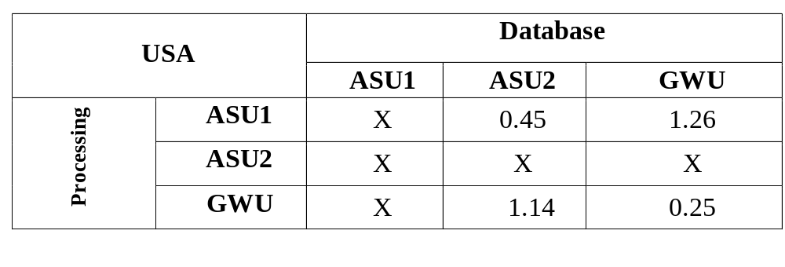
Results

Slide 26
Results
Sequential Single Machine:
  Average of 34 Seconds
The Grid Enabled System:
  Average of 49 Seconds

Slide 27
Agenda
Introduction.
Possible Scenarios.
The Grid Approach.
Implementation and Results.
Conclusions & Future Work.

Slide 28
Conclusions
Grid enables new applications.
Grid infrastructure hide complexities (seamless access to resources).
Increased Security (GSI).
Acceptable performance.
Other similar applications can use Grid Technologies.

Slide 29
Future Work
Add More Signature Verification Algorithms.
Improve Algorithms for locating and choosing best algorithms.
Address the financial issues.

Slide 30

The End
Thank you for careful listening ☺

