Slide 1
Robust Fault-Tolerant Majority-Based Key-Value Store Supporting Multiple Consistency Levels
Ahmad Al-Shishtawy^{1,2},Tareq Jamal Khan¹, and Vladimir Vlassov¹
1 - KTH Royal Institute of Technology, Stockholm, Sweden
{ahmadas, tareqjk, vladv}@kth.se
2 - Swedish Institute of Computer Science, Stockholm, Sweden
ahmad@sics.se
ICPADS 2011 Dec 7-9, Tainan, Taiwan

Slide 2
Contents
Introduction
Majority-Based Key-Value Store
Evaluation
Conclusions

Slide 3





Motivation
Web 2.0 applications
WiKis, social networks, media sharing
Rapidly growing number of users
User generated data
New challenges for storage infrastructure
Scalable storage system (growing number of users)
Lower response time (uneven load, user geographically scattered)
Highly available (partial failure, large number of concurrent requests)
Some guarantee of data consistency
Privacy of user generated data

Slide 4

CAP Theorem
Consistency
Availability
Partition-tolerance

Slide 5

For large scale geographically distributed systems
Network partition is unavoidable

Slide 6
Trade-off?
Availability & Performance
Data Consistency

Slide 7
Relaxed Consistency
Web 2.0 applications can tolerate relaxed consistency
Instead focuse on higher availability and lower response time

Slide 8
Consistency Models
Distributed data stores
Help developers to predict the results of read/write operations
Some consistency models:
Sequential consistency: all reads and writes appear as if executed sequentially
Eventual consistency: writes can be seen in different order for different readers.
Timeline consistency: writes are ordered but reads might return stale value
NoSQL Data Stores:
Amazon’s Dynamo
Yahoo!’s PNUTS

Slide 9
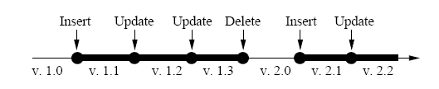
Yahoo!’s PNUTS
Master based approach (all updates are sent to master replica)
Mastership assigned on per record basis
Asynchronous propagation of updates using pub-sub system Yahoo! Message Broker (YMB)
Per-record timeline consistency
V. 2.1 indicates Generation = 2, Version =1

Slide 10
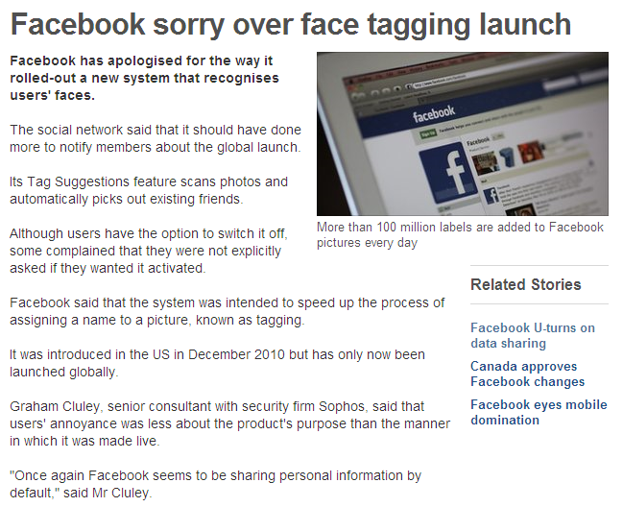

Facebook’s privacy issue

Slide 11
Peer-to-Peer Networks
Distributed network formed between nodes on the edge of the internet
Scalable and robust
Structured P2P
Structure of Overlay links
Efficient lookup service
Symmetric Replication Scheme
Used to calculate the IDs of replicas
Routing layer vs. Data layer

Slide 12
Our Goal
Key-Value Object Store
Based on P2P network
Owned and controlled by the users
Large-scale
Fault-tolerant
Read/Write operations
Various consistency guaranties
API similar to Yahoo! PNUTS
Decentralized implementation
Based on majority voting
Better consistency guaranties than classical DHTs
Not as expensive as Paxos based replication

Slide 13
Contents
Introduction
Majority-Based Key-Value Store
Evaluation
Conclusions

Slide 14
Storage API
We provide API similar to Yahoo!’s PNUTS
Read Any (key)
Read Critical (key, version)
Read Latest (key)
Write (key, data)
Test and Set Write (key, data, version)
We provide decentralized implementation
Tolerate high level of churn
Applications can choose operations according to their performance, availability and consistency requirements.

Slide 15
Data Consistency
Avoids master-based approach adopted in PNUTS
Majority-based quorum technique to ensure data consistency
W
R
Write to a majority of nodes will always overlap with a read from a majority

Slide 16
Majority-Based Data Consistency
Stronger consistency than what DHTs offer
But weaker than PAXOS based systems
Guarantees data consistency with a probability of more than 99%
Suitable for Web 2.0 apps
Classical
DHT
Majority-
Based
PAXOS
…
+
P2P = works more than 99%
This is because lookup inconsistencies
W
R

Slide 17
Comparison
PNUTS
Master-based
Targets a more stable & controlled environment comprising of handful data centers
If an entire region goes down, availability suffers due to master based approach
User data prone to company manipulation and privacy violation
Majority-Based K-V Store
Majority-based
Works in highly dynamic environment.
Benefits from scalability, fault-tolerance and self-management properties inherent in P2P systems
Completely distributed, doesn’t depend on master availability
Relieves a company from hosting and managing data

Slide 18
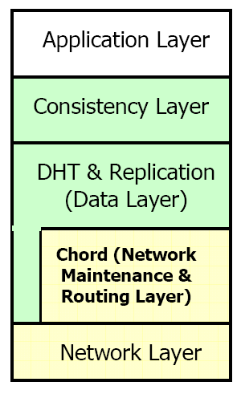
Peer Architecture
Consistency Layer
Implements the five read/write operations
DHT Layer
Get data/version
Put data/lock/unlock
Data relocation/recovery during node join, leave, failure
Chord Layer
Lookup key
Enables nodes to join, leave
Periodic stabilization

Slide 19
Example
x₂
ReadLatest(x)
Call returns
largest version
after receiving
from a majority
x = x₆
Symmetric Replication
& Lookup to find
Responsible nodes
x₆
Receive
Responses
Send Read
Requests
x₅
x₆
x₆

Slide 20
Contents
Introduction
Majority-Based Key-Value Store
Evaluation
Conclusions

Slide 21
Experimental Setup
Initially 100 nodes join the system
Default replication degree 5
Experiment run for 24 simulation hours (not including node joining time during warm up)
Request originating node and requested data identifiers are drawn from uniform distribution.

Slide 22
Evaluation Plan
5 experiements
Experiment | Property to Test
Varying Churn | Dynamism
Varying Request Rate | Scalability/Availability
Varying Network Size | Scalability
Varying Replication degree | Fault Tolerance/Availability
Varying Read-Write Ratio | Request Inter-dependency

Slide 23
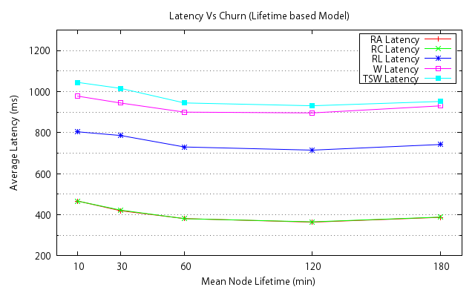
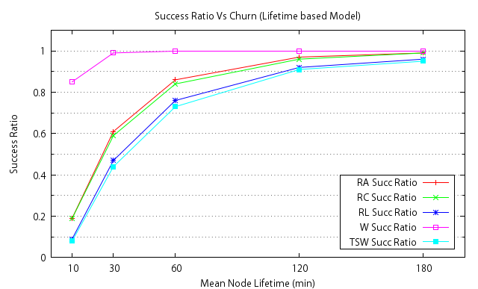
Varying Churn Rate

Slide 24
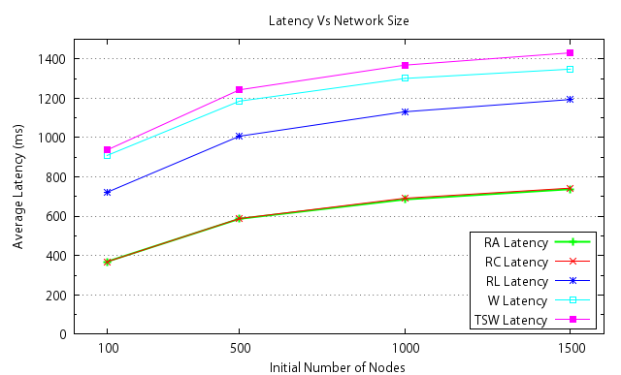
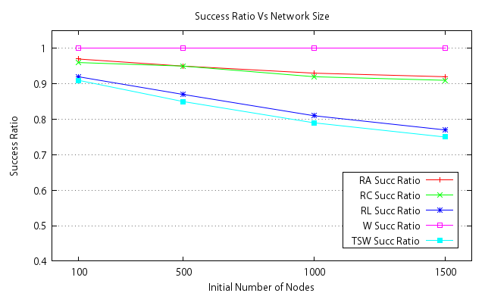
Varying Network Size

Slide 25
Contents
Introduction
Majority-Based Key-Value Store
Evaluation
Conclusions

Slide 26
Conclusions
presented a majority-based key-value store
architecture, algorithms, and evaluation
P2P to reduce costs and improve data privacy
provides a number of read/write operations with multiple consistency levels
achieve robustness and withstand churn in a dynamic environment
Evaluation by simulation has shown that the system performs rather well in terms of latency and operation success ratio in the presence of churn

