Slide 1

Scientific Computing Department
Faculty of Computer and Information Sciences
Ain Shams University
Security of Grid Computing Environments
  Supervised By:
  Mohammad F. Tolba
  Mohammad S. Abdel-Wahab
  Ismail A. Taha
  Presented By:
  Ahmad M. Al Shishtawy

Slide 2
Agenda
Introduction.
The Proposed Grid Intrusion Detection Architecture (GIDA).
GIDA Implementation.
Testing and Results.
Conclusions and Future Work.
Published Work.

Slide 3
Historical Background
Metacomputing.
Grid computing coined in the late 1990s.
Analogy to the electrical power grid.
Ultimate goal:
  Make access to computational power as easy as access to electrical power
Still under research and development.

Slide 4
The Evolution of the Grid
The Internet (Sharing of Information):
PC
LAN
WAN
The Internet
The Grid (Sharing of Computational Power):
Distributed
Computing
PC
Cluster
The Grid

Slide 5
Characteristics
Heterogeneity.
Scalability.
Dynamicity or adaptability.
Multiple administrative domains and autonomy.

Slide 6
Requirements
A Grid system should:
Coordinate resources that are not subject to centralized control.
Use standard, open, general-purpose protocols and interfaces.
Deliver nontrivial Qualities of Service.

Slide 7
Grid Computing – Current Efforts (Sample)
Globus: www.globus.org
GridBus: www.gridbus.org
Legion: legion.virginia.edu
UNICORE: www.unicore.org

Slide 8
The Grid Project Description
Joint project between:
  Ain Shams University in Egypt
  George Washington University in USA
Test Project (Signature Verification).
Goals:
  Understand Grid environments.
  Hands on practice.
  Master security related issues.

Slide 9
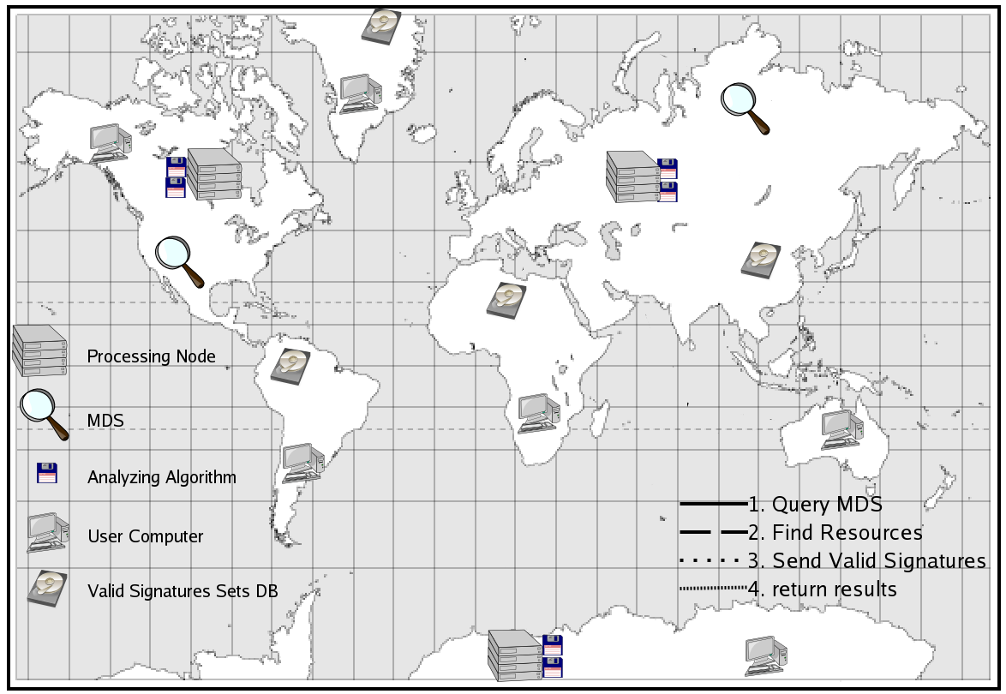
The Grid Scenario

Slide 10
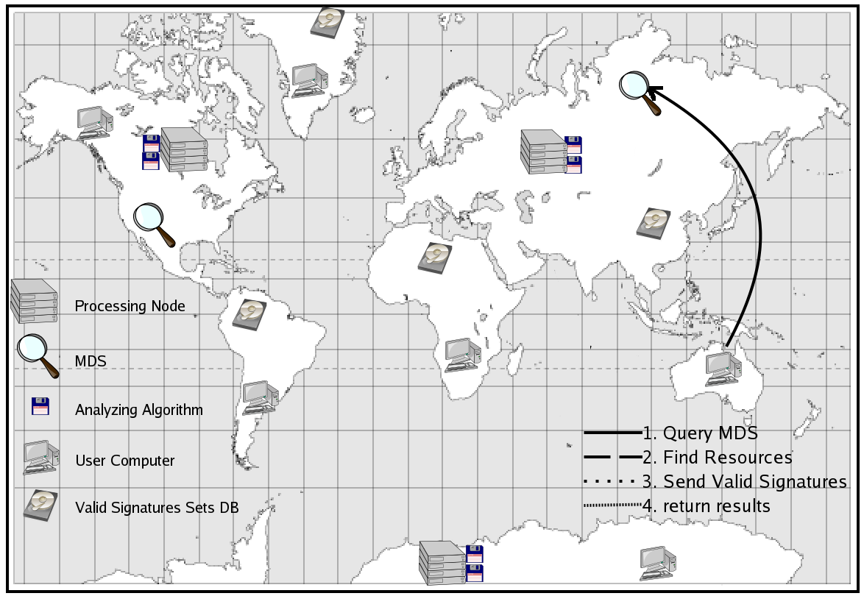
The Grid Scenario

Slide 11
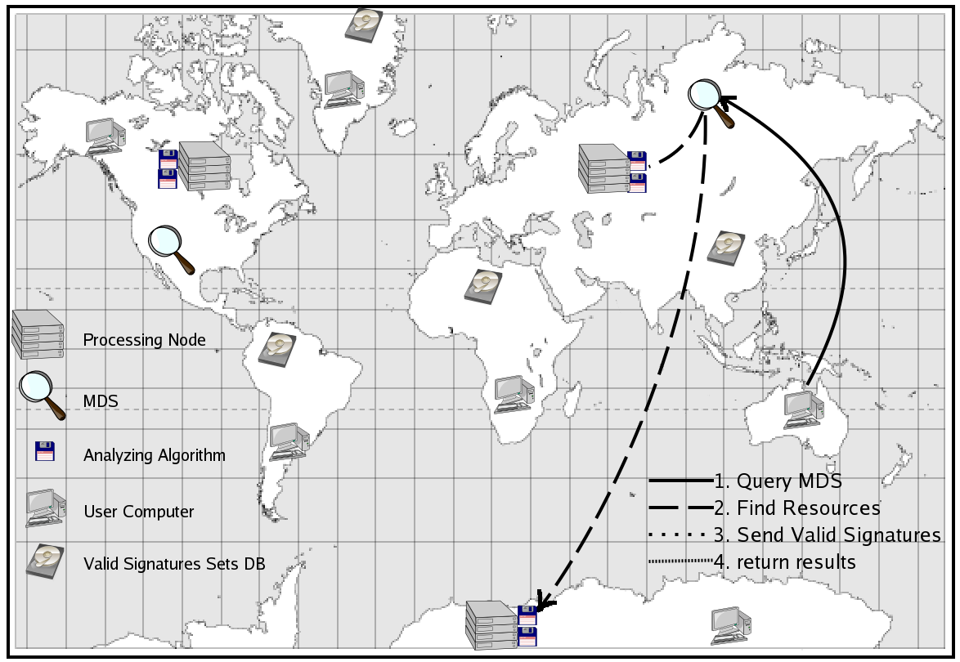
The Grid Scenario

Slide 12
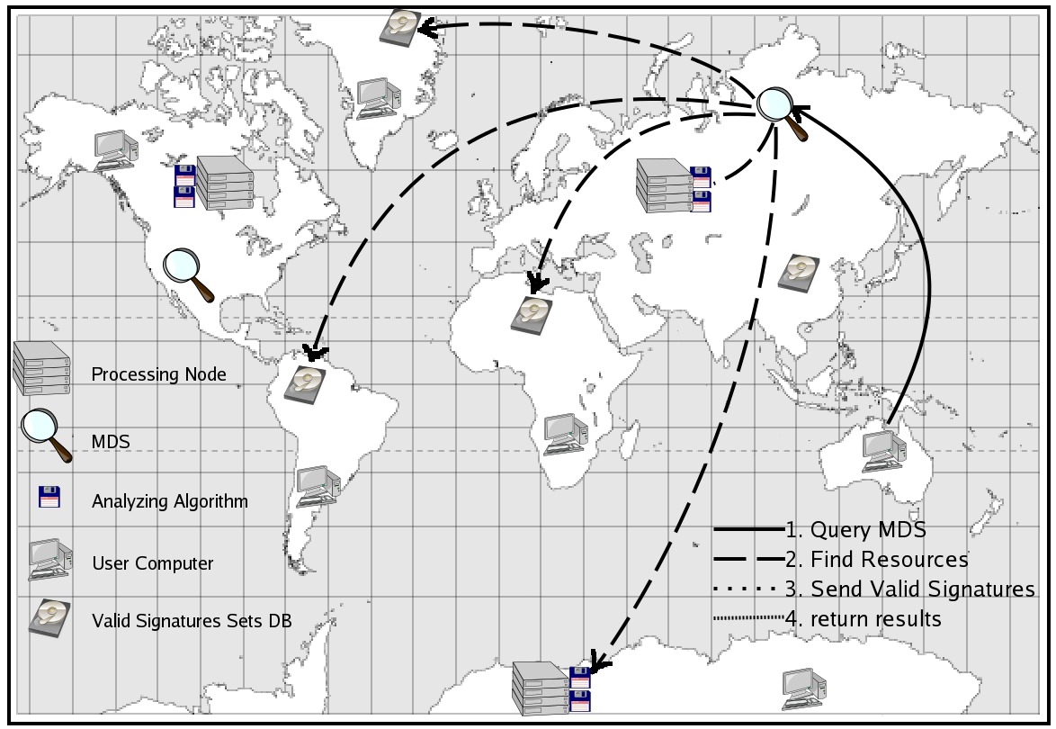
The Grid Scenario

Slide 13
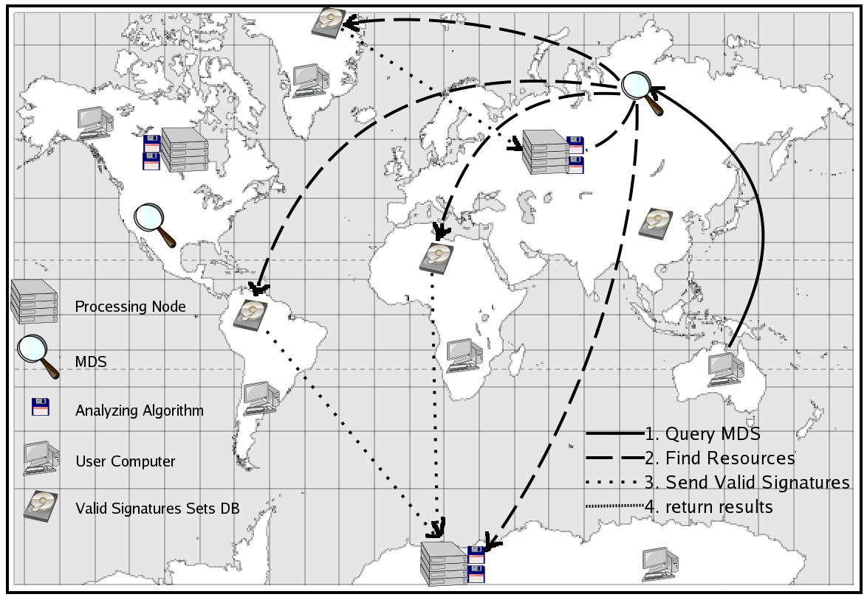
The Grid Scenario

Slide 14
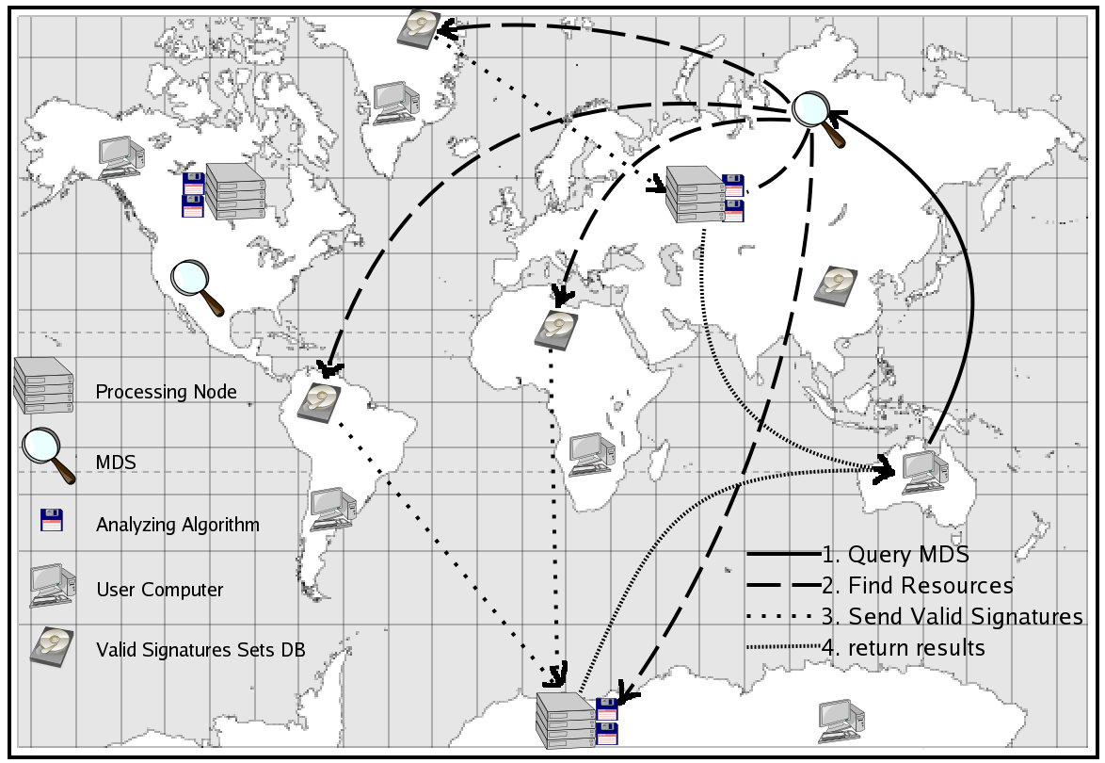
The Grid Scenario

Slide 15
Basic Grid Services
Resource
Management
Information
Services
Data
Management
Security

Slide 16
Security Problems
The need to establish security relationship among hundreds of processes .(not simple client/server).
The dynamic nature of the grid.
Interdomain security solutions must interoperate with the diverse intradomain access control technologies

Slide 17
Security Problems
Based on Public Key Infrastructure
Private Keys can be stolen.
Temporary Credentials poorly protected
No protection from insiders.
Software Bugs and Security Holes

Slide 18

Different Security Levels
First Level
Second Level
Attacks
Firewall
Password
Authentication
Authorization
...
...
Intrusion
Detection
Protected
Computer
System

Slide 19
Intrusion Detection System
Second line of defense
Normal differ from malicious use.
Data Gathering:
  Host-based.
  Network-based.
Analysis and Detection:
  Anomaly detection.
  Misuse detection.
Centralized vs. Distributed detection.

Slide 20
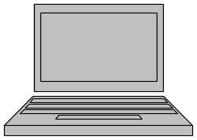
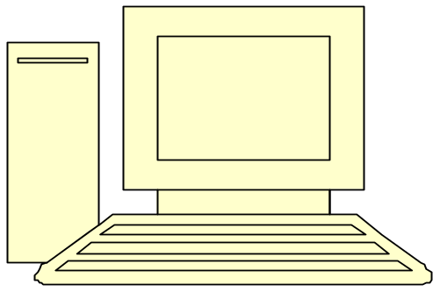
Centralized Intrusion Detection
LAN
Data gathering module
Analysis and Detection module

Slide 21
Distributed Intrusion Detection
LAN
LAN
LAN
LAN
Data gathering module
Analysis and Detection module

Slide 22
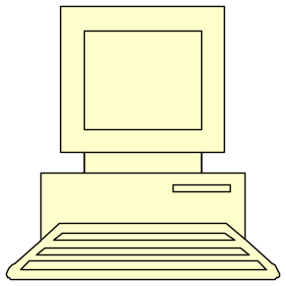
Hierarchical Distributed Intrusion Detection
LAN
Data Gathering Module
LAN
...
...
...
...
...
Intrusion Detection Servers
Data Analysis Module
LAN
LAN

Slide 23
Agenda
Introduction.
The Proposed Grid Intrusion Detection Architecture (GIDA).
GIDA Implementation.
Testing and Results.
Conclusions and Future Work.
Published Work.

Slide 24
Goal
Protect Grid resources from attacks that results from installing and using the Grid Infrastructure.
Normal Internet attacks (that are not related to the Grid) are the responsibility of the local intrusion detection system at each domain.

Slide 25
Grid Intrusion Detection Architecture
Intrusion Detection Agent (IDA)
  Data Gathering Module
Intrusion Detection Server (IDS)
  Analysis and Detection Module
  Cooperation Module

Slide 26
Proposed Grid Intrusion Detection Architecture (GIDA)

Slide 27
Data Gathering Module
User Interface
Local IDS
A
IDA
A
A

Slide 28
Proposed Grid Intrusion Detection Architecture (GIDA)
GIS
or DB
IDS
IDS
GIS
or DB

Slide 29
Proposed Grid Intrusion Detection Architecture (GIDA)
GIS
or DB
IDS
Dynamicity or adaptability
Heterogeneity
Scalability
No centralized control
Standard protocols
Nontrivial QoS
Autonomy
IDS
GIS
or DB

Slide 30
Agenda
Introduction.
The Proposed Grid Intrusion Detection Architecture (GIDA).
GIDA Implementation.
Testing and Results.
Conclusions and Future Work.
Published Work.

Slide 31
GIDA Implementation
Simulated Grid environment.
Simulated IDA.
Host-based anomaly detection technique.
Homogeneous IDSs with LVQ Neural Network.
Simple cooperation with sharing results.

Slide 32
Why Simulation?
No real Grid for testing (Expensive).
Best for testing and evaluation new architectures.
Control experiments in dynamic environment.

Slide 33
Grid Simulators
Many Grid simulation tools (GridSim, SimGrid, MicroGrid, …).
Unfortunately they concentrate on resource management problems.
Develop our own simulator for security and intrusion detection based on GridSim.

Slide 34
The Simulated Grid
Generated Log Files
Log
. . .
Log
Intrusion Detection Servers
IDS
. . .
IDS
Resources
. . .
Requests
. . .
. . .
Users
Intruders

Slide 35
GIDA Implementation
IDS
Log
Log
Log
Peer-to-peer Network or GIS
IDS
IDS

Slide 36
Why LVQ?
Similar to SOM and used for classification.
Does not require anomalous records in training data.
Classes and their labels (User Name) are known.

Slide 37
IDS Analyzing Module
Analyzing and detection module
Log
Preprocessing
Trained LVQ
Decision Module
Response
Cooperation Module

Slide 38
Agenda
Introduction.
The Proposed Grid Intrusion Detection Architecture (GIDA).
GIDA Implementation.
Testing and Results.
Conclusions and Future Work.
Published Work.

Slide 39
Measured Parameters
False Positive Percentage.
False Negative Percentage.
Recognition Rate.
Training Time.
Detection Duration

Slide 40
Tested Issues
Controllable (Internal)
  Data Preprocessing
  Number of IDSs
Uncontrollable (External)
  Number of Users
  Number of Resources
  Number of Intruders

Slide 41
Different Types of Windows
(Preprocessing)
Type 1: Fixed number of events.
Type 2: Fixed time period window.
Type 3: Fixed number of events with time limit.
Type 4: Fixed events with time limit ignoring incomplete.
Type 5: Fixed events with time limit fixing incomplete.

Slide 42
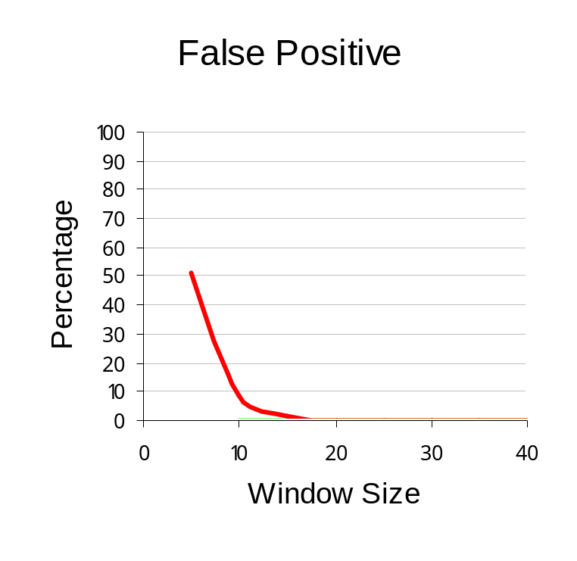
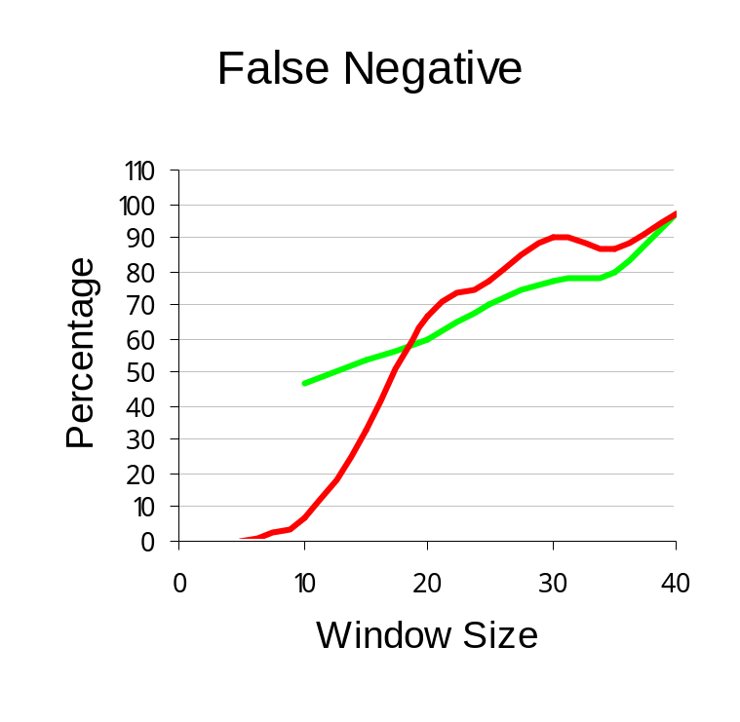
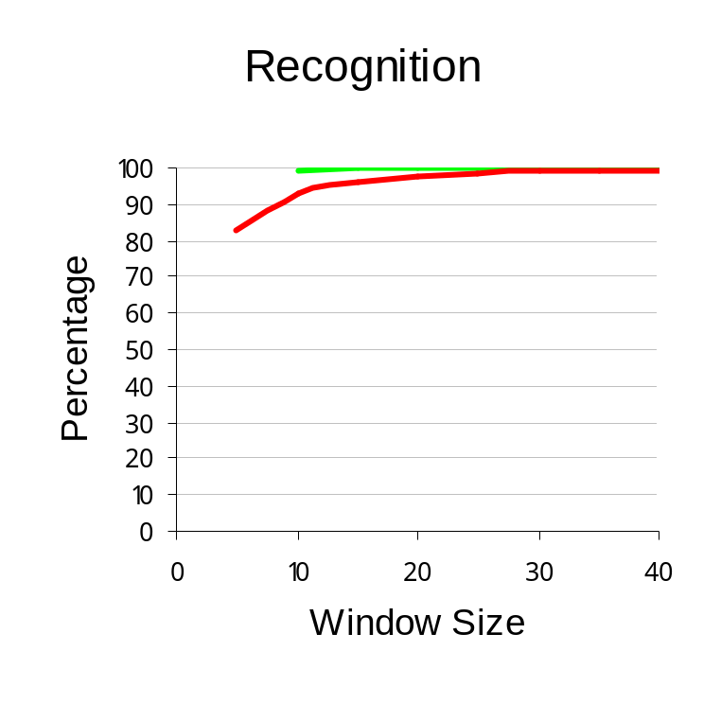
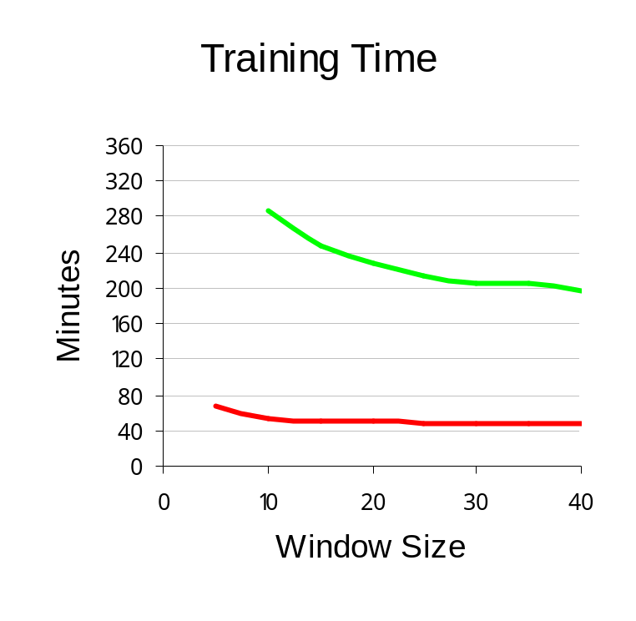
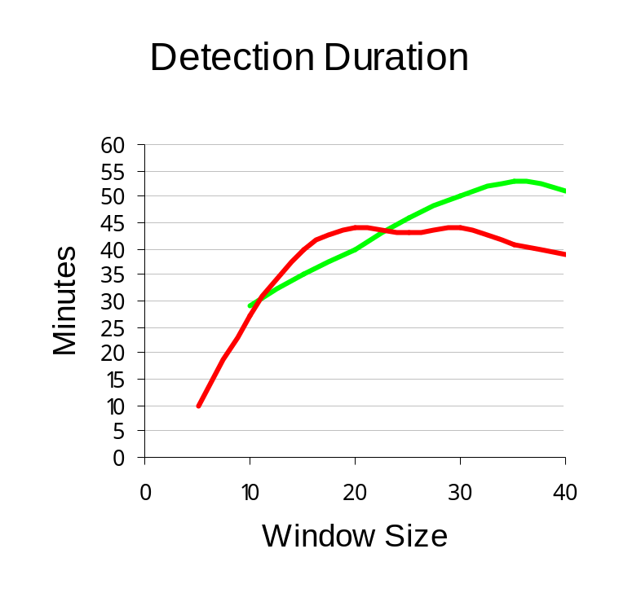
Fixed Window Size
Legend
1 IDS
4 IDSs

Slide 43
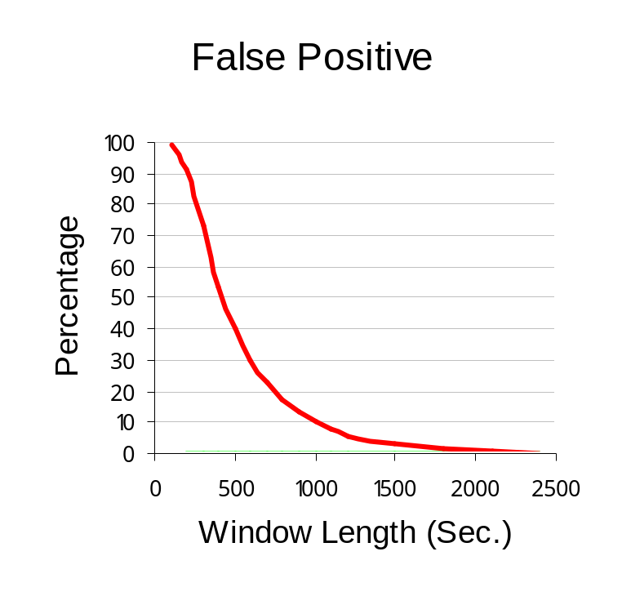
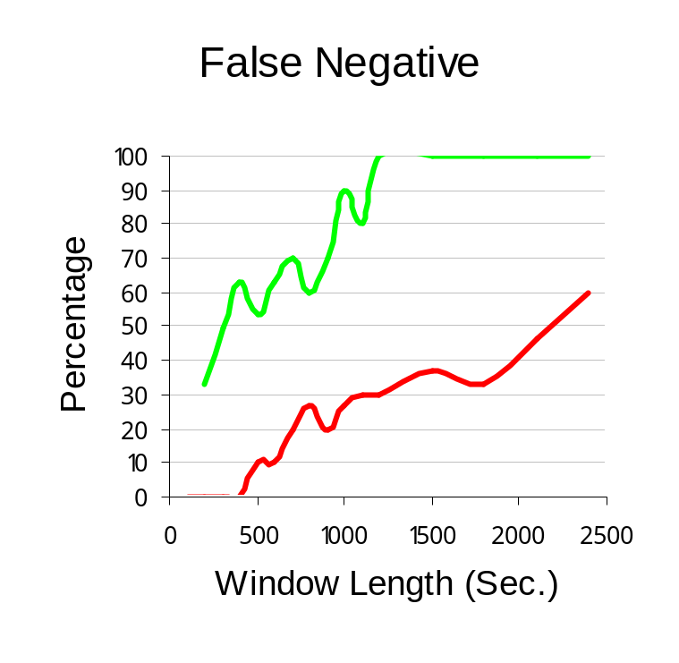
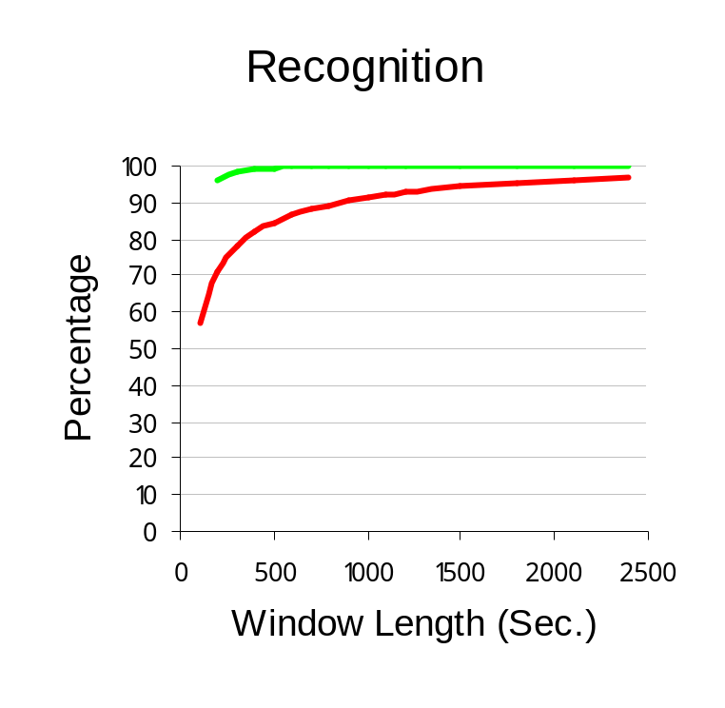
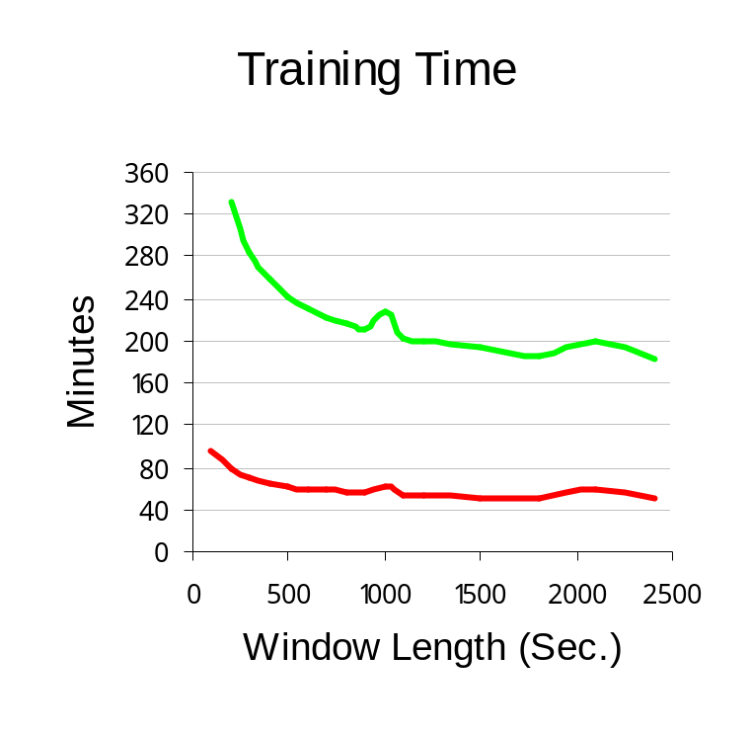
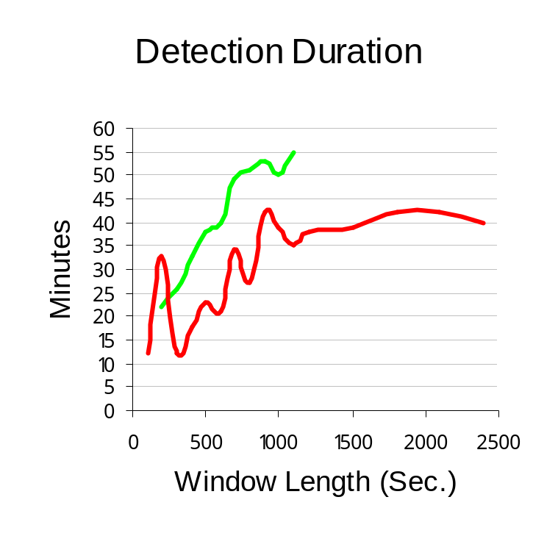
Time Period Window
Legend
1 IDS
4 IDSs

Slide 44
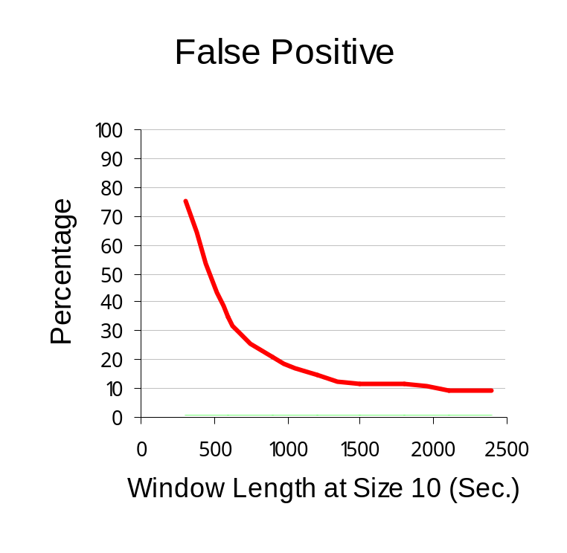
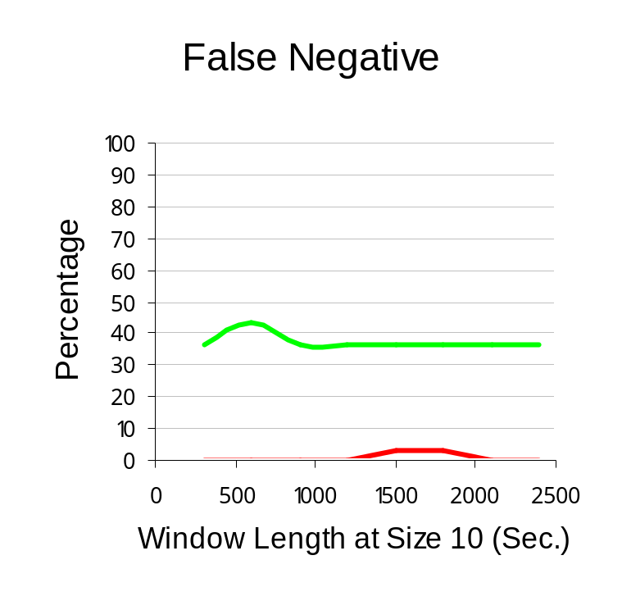
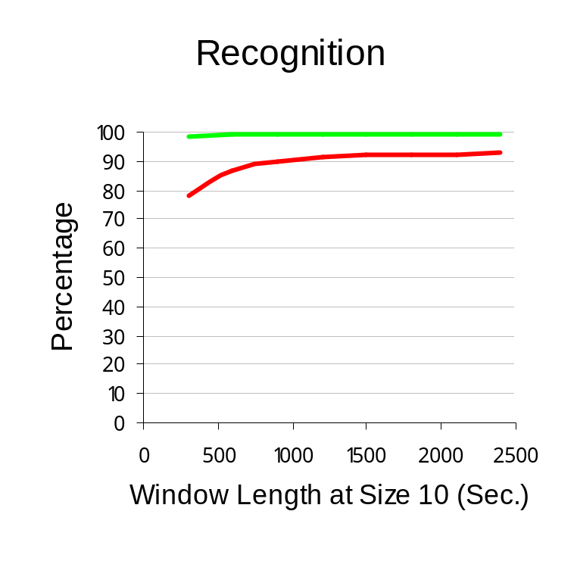
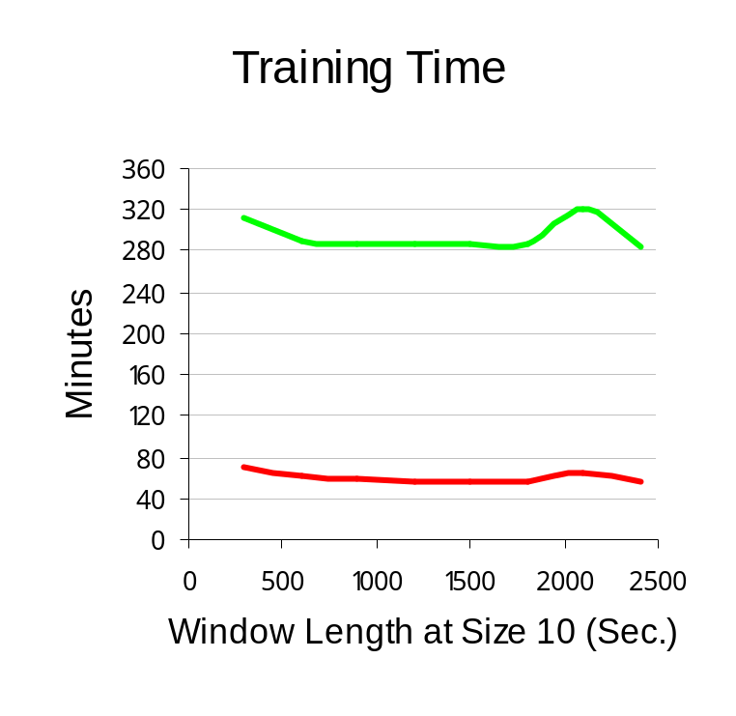
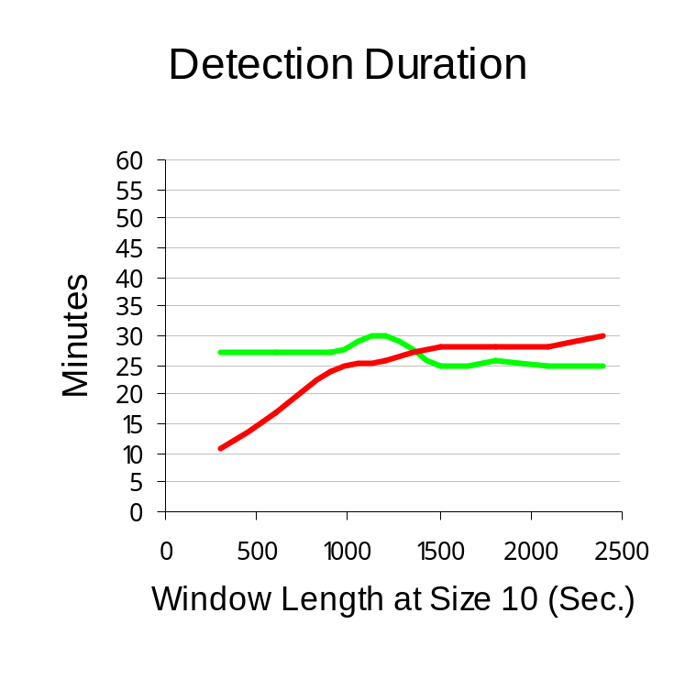
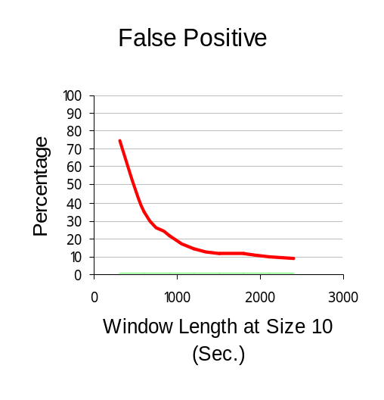
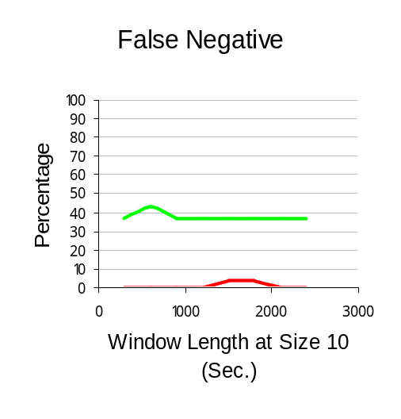
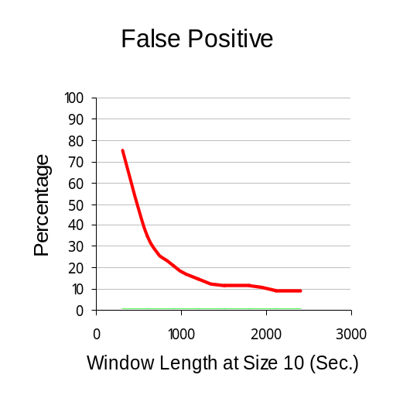
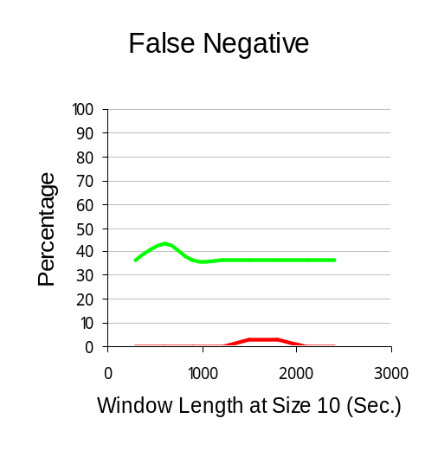
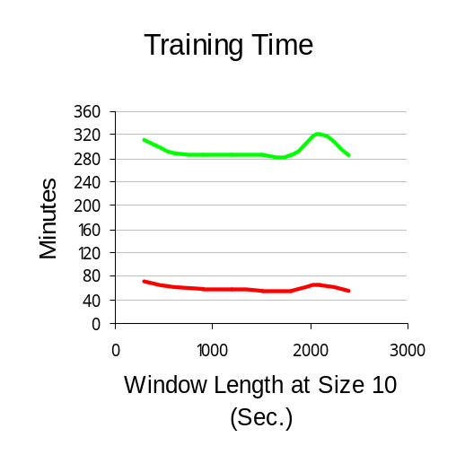
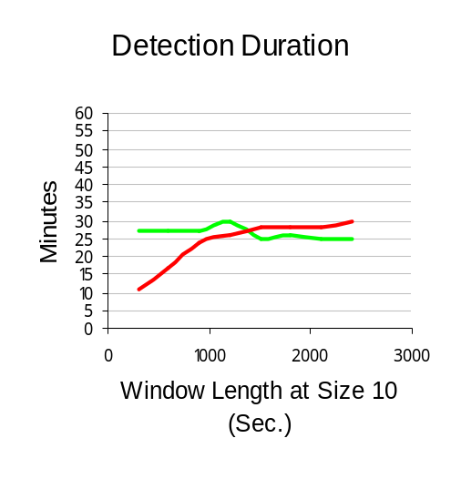
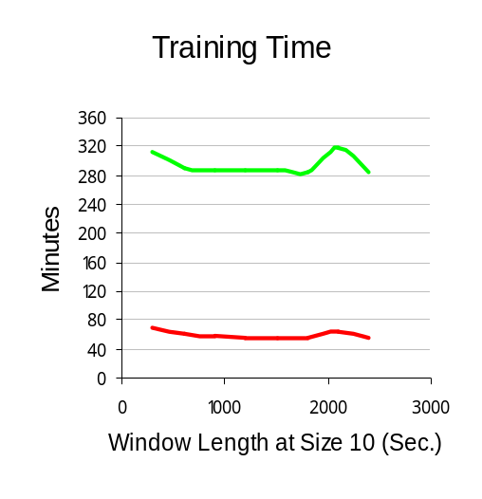
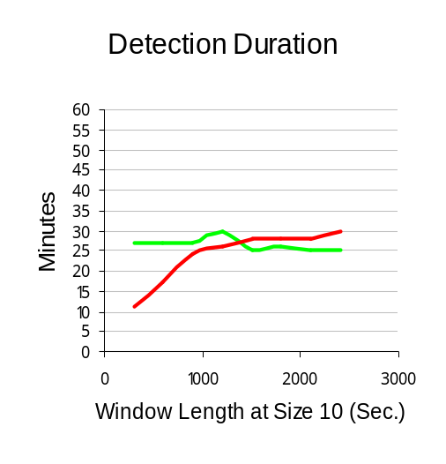
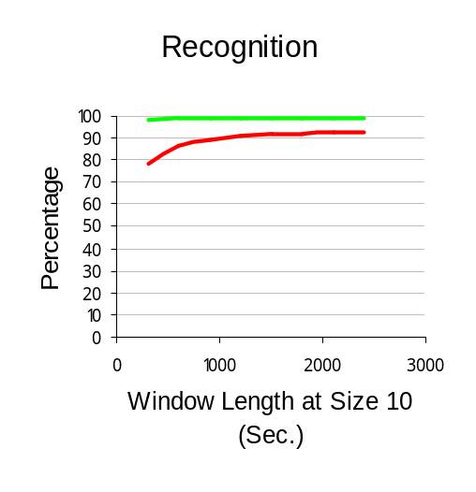
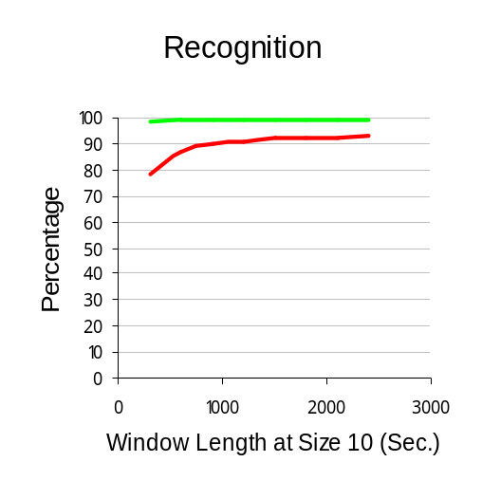
Hybrid Window at size 10
Legend
1 IDS
4 IDSs

Slide 45
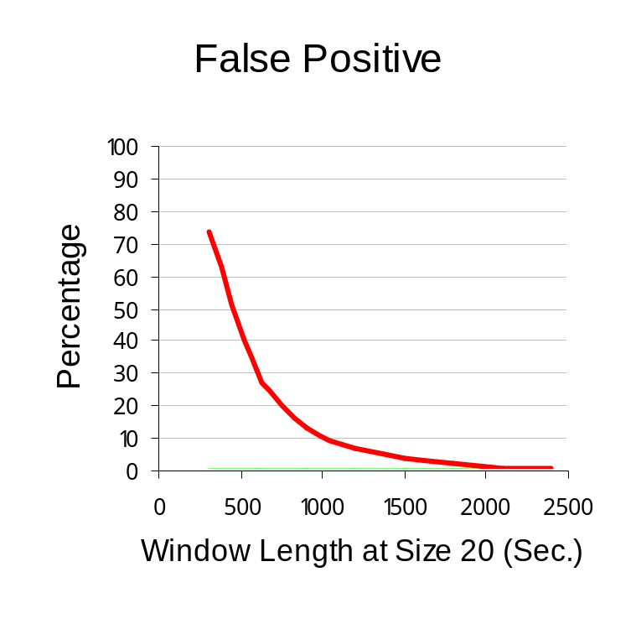
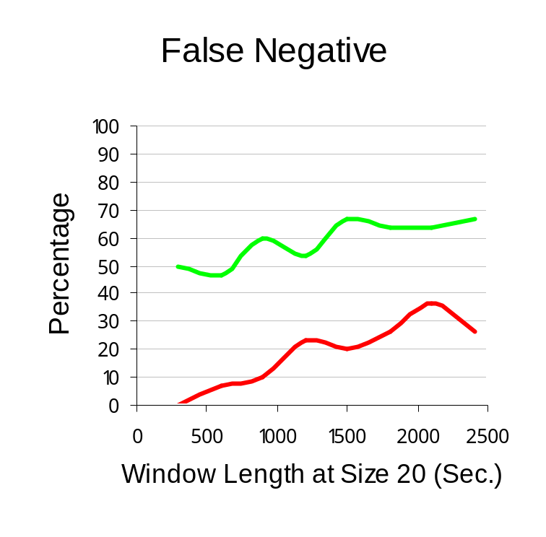
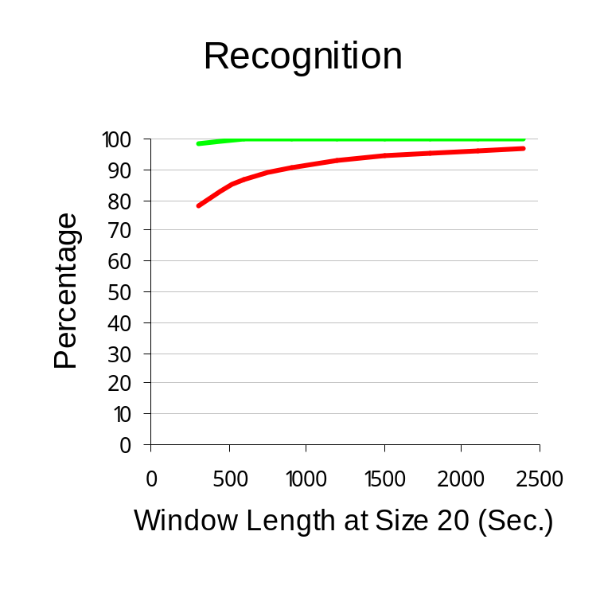
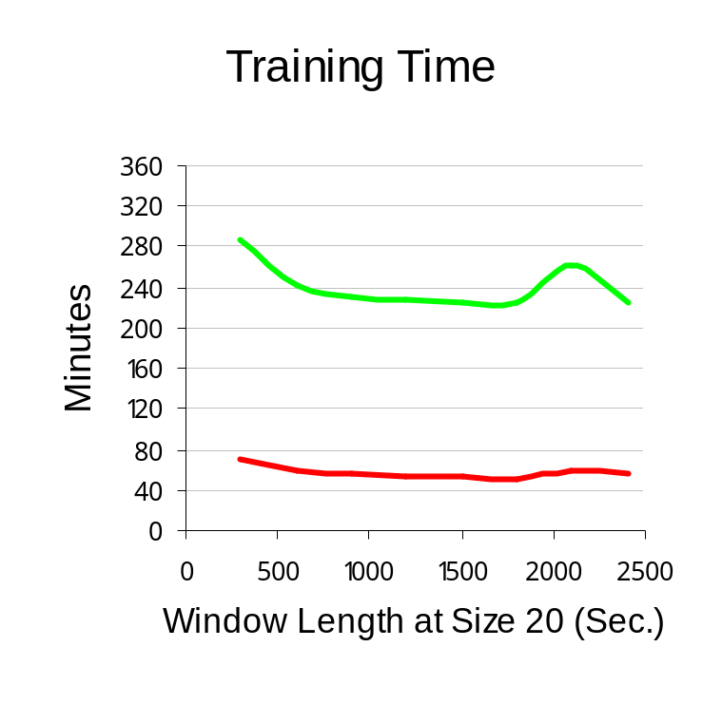
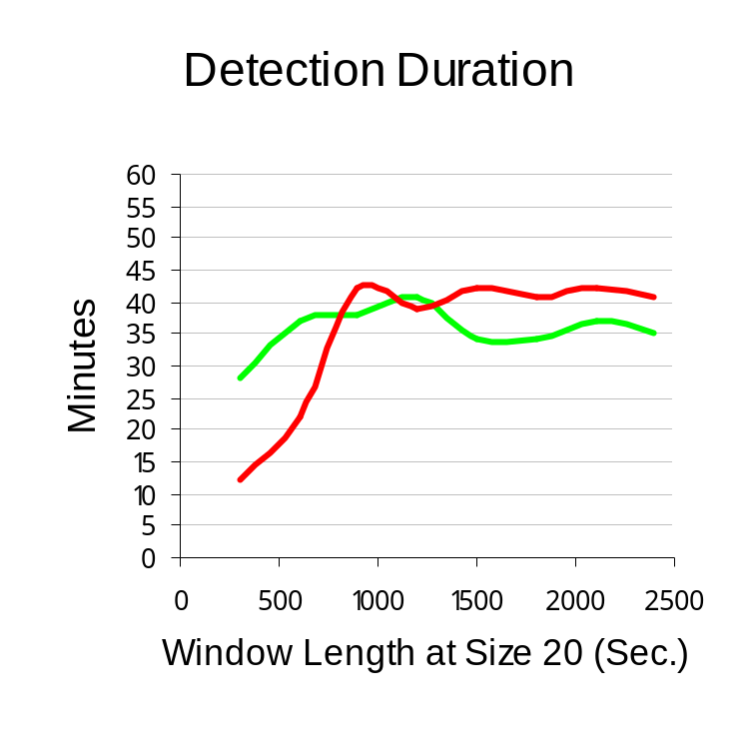
Hybrid Window at size 20
Legend
1 IDS
4 IDSs

Slide 46

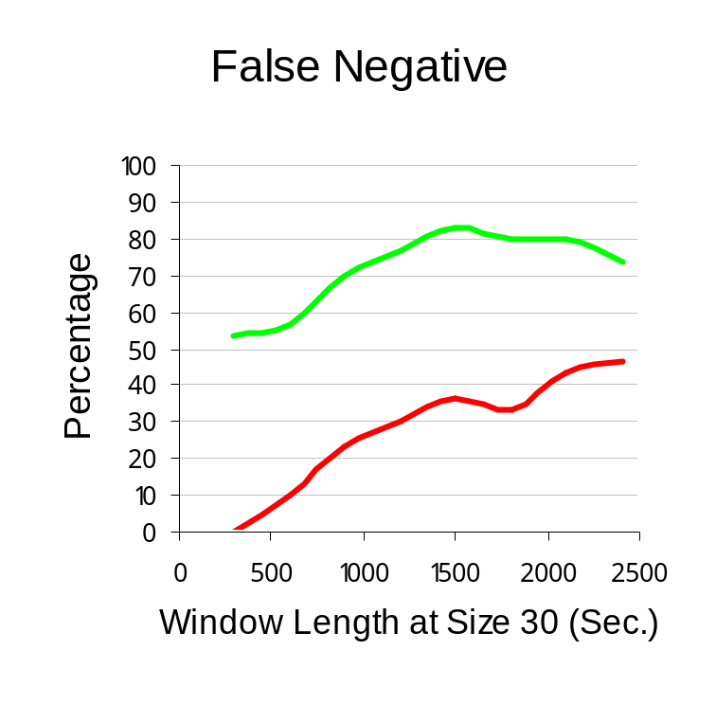

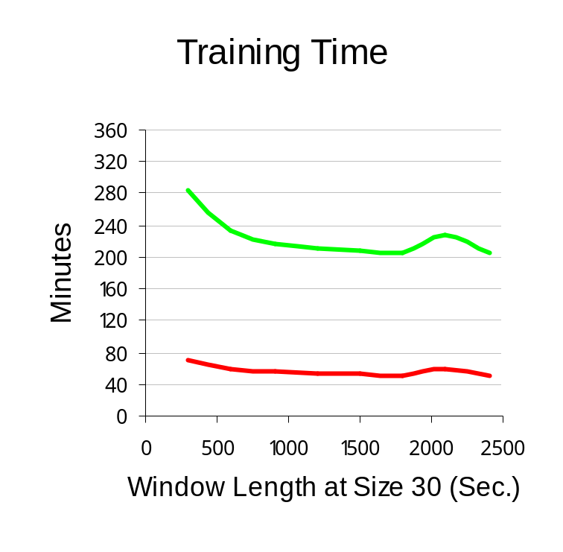
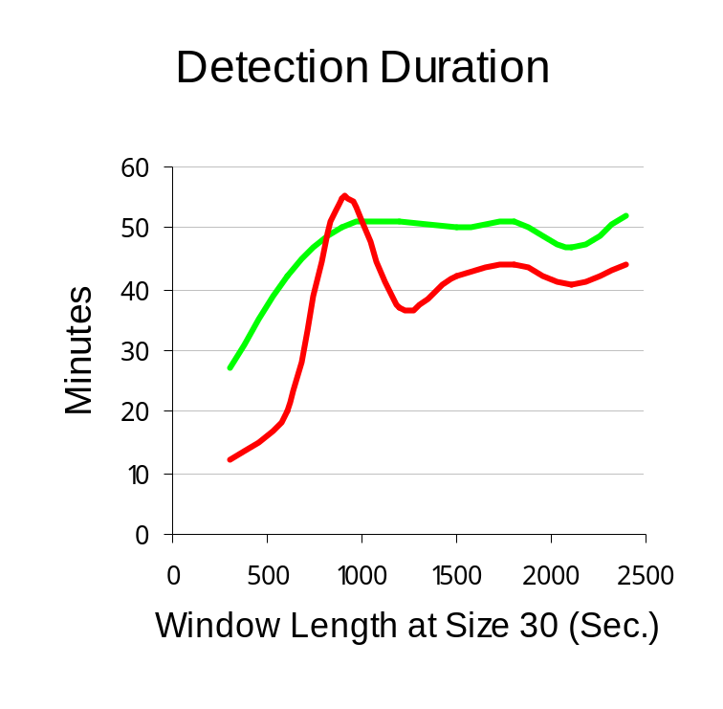
Hybrid Window at size 30
Legend
1 IDS
4 IDSs

Slide 47
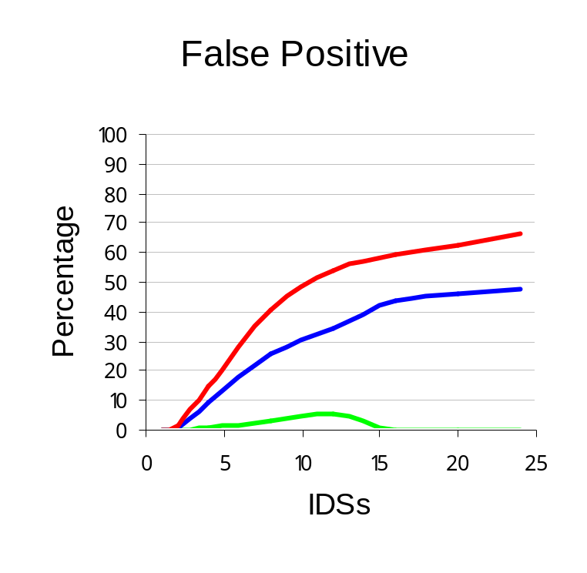
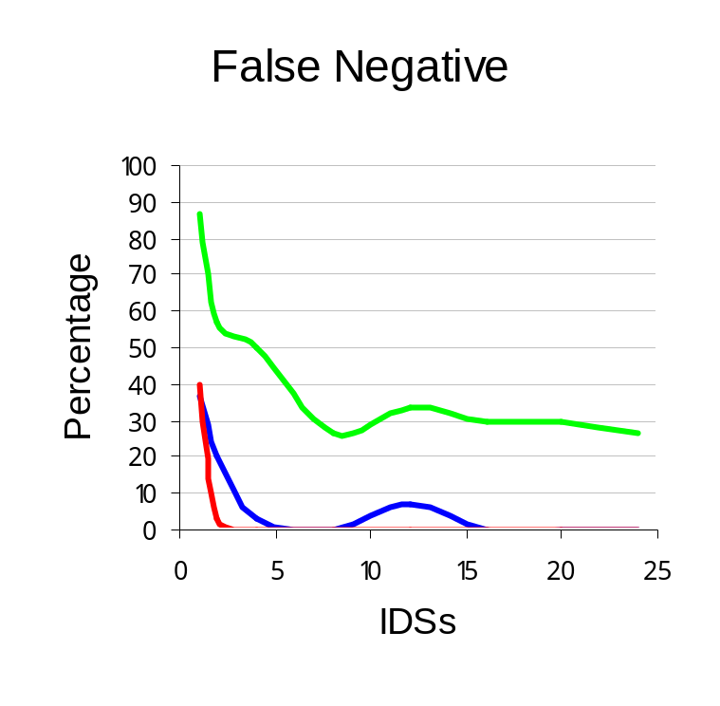
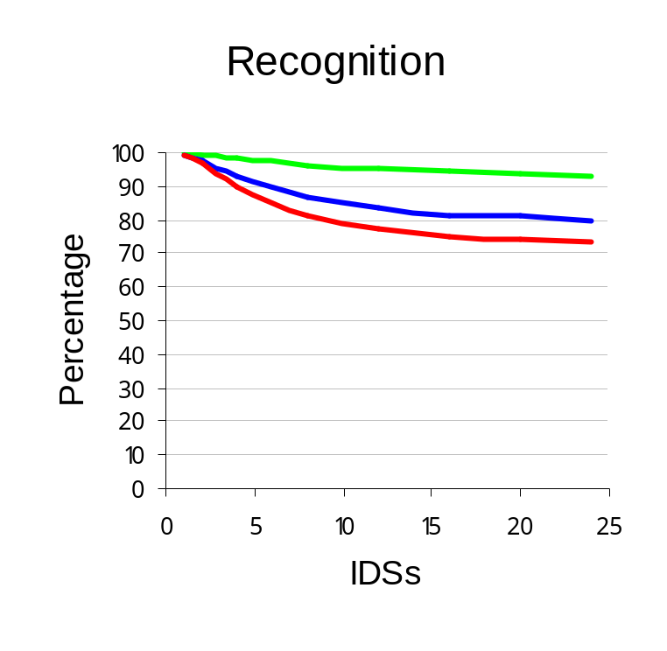
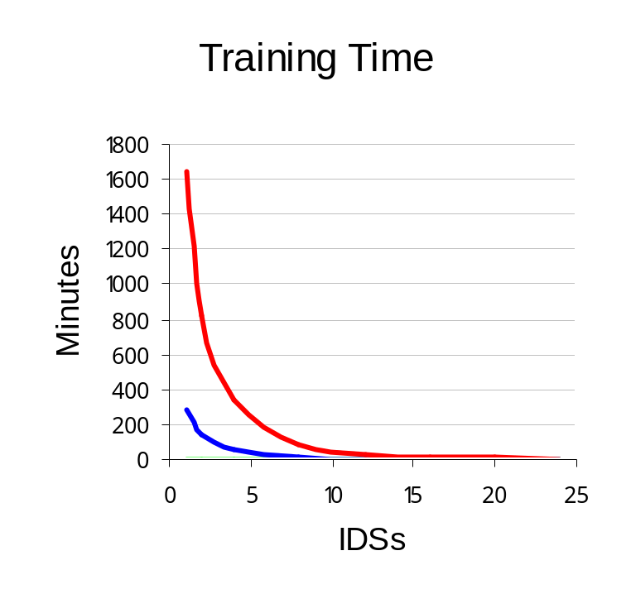
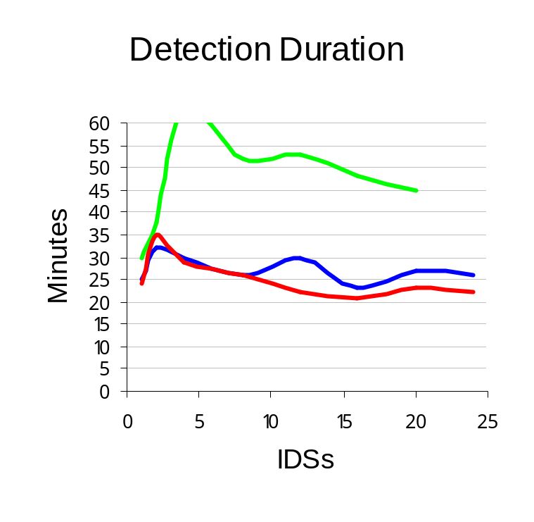
Number of IDSs
Legend
50 Users
200 Users
350 Users

Slide 48
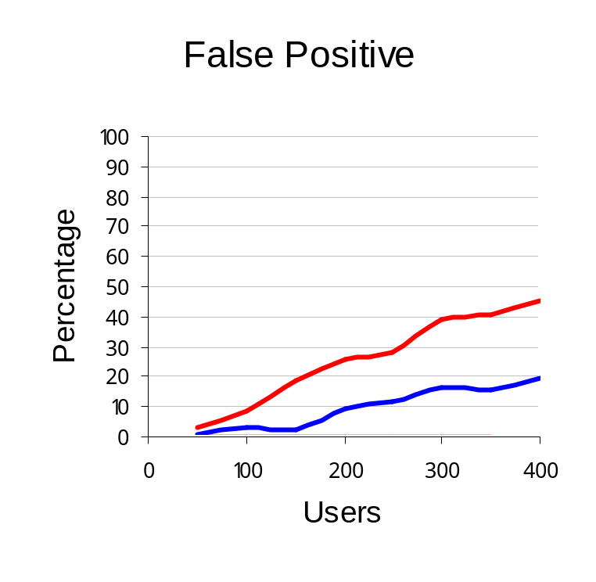
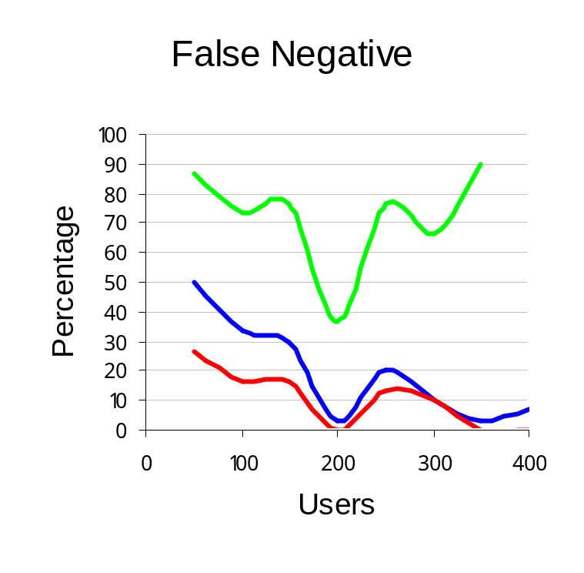
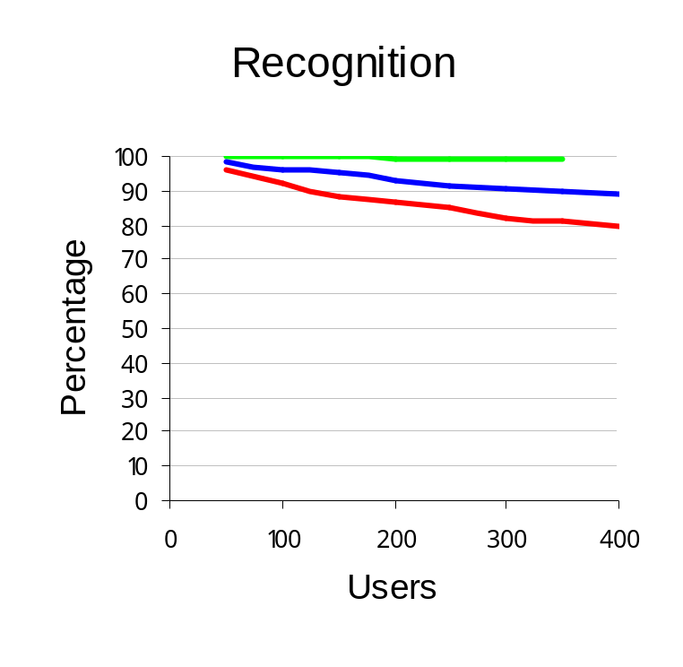


Number of Users
Legend
1 IDS
4 IDSs
8 IDSs

Slide 49





Number of Resources
Legend
1 IDS
4 IDSs
8 IDSs

Slide 50





Number of Intruders
Legend
1 IDS
4 IDSs
8 IDSs

Slide 51
Agenda
Introduction.
The Proposed Grid Intrusion Detection Architecture (GIDA).
GIDA Implementation.
Testing and Results.
Conclusions and Future Work.
Published Work.

Slide 52
Conclusions
GIDA designed compatible with the grid and proved by experiments. (IDA, IDS)
The hybrid window gave the best results by managing the number of events efficiently. (Detection Duration, False Negative)
Distributed systems is better that Centralized systems. (False Negative, Training Time)

Slide 53
Conclusions
GIDA is scalable. (IDSs, Users)
Natural increase in number of resources improved the results. (False Positive)
Better understanding of the problem of intrusion detection in Grid environments.

Slide 54
Future Work
Trust Relationships in Grid environment.
Heterogeneous IDSs.
More complicated algorithms for cooperation.
Misuse detection.
Testing on real Grid testbeds.

Slide 55
Agenda
Introduction.
The Proposed Grid Intrusion Detection Architecture (GIDA).
GIDA Implementation.
Testing and Results.
Conclusions and Future Work.
Published Work.

Slide 56
Published Work
M. Tolba, I. Taha, and A. Al-Shishtawy, "An Intrusion Detection Architecture for Computational Grids". First International Conference on Intelligent Computing and Information Systems, June 2002.
M. Tolba, M. Abdel-Wahab, I. Taha, and A. Al-Shishtawy, “A Secure Grid Enabled Signature Verification System”. Second International Conference on Intelligent Computing and Information Systems, Cairo, Egypt, March 2005.
M. Tolba, M. Abdel-Wahab, I. Taha, and A. Al-Shishtawy, "Distributed Intrusion Detection System for Computational Grids". Second International Conference on Intelligent Computing and Information Systems, Cairo, Egypt, March 2005.

Slide 57
Published Work
M. Tolba, M. Abdel-Wahab, I. Taha, and A. Al-Shishtawy, "GIDA: Toward Enabling Grid Intrusion Detection Systems". Cluster Computing and Grid 2005, Cardiff, UK, 9 - 12 May 2005.
http://dsg.port.ac.uk/events/conferences/ccgrid05/wip/schedule/Paper20.pdf
M. Tolba, M. Abdel-Wahab, I. Taha, and A. Al-Shishtawy, "Intrusion Detection System for the Grid". The 2005 International Conference on Grid Computing and Applications (GCA'05). Las Vegas, Nevada, USA, 20 - 23 June 2005.

Slide 58

The End
Thank you for careful listening ☺

