Slide 1
700 Tons of Code Later
When Your IDE Will Not Cut It You Need a Spoon
Alexander Shopov @TEQnation 2019

Slide 2
700

Slide 3
Tons of Code Later
700
When Your IDE Will Not Cut It You Need a Spoon

Slide 4
[ashopov@ashmac ~]$ whoami
By day: Software Engineer at Uber
By night: OSS contributor
Overall: father of 2, husband of 1
Coordinator of Bulgarian GNOME TP
Git, bash, Sentry, Jenkins speak Bulgarian
South Slavic language in Cyrillic

Slide 5
[ashopov@ashmac ~]$ whoami
Contacts:
E-mail: ash@kambanaria.org
LinkedIn: https://www.linkedin.com/in/alshopov
SlideShare: https://www.slideshare.net/al_shopov
GitHub: https://github.com/alshopov
Web: Just search “al_shopov”

Slide 6

Please Learn and Share
License: Creative Commons
Attribution 4.0 International
(CC-BY v4.0)

Slide 7
When We All Know How To Do Stuff
Files
  small or few - text editor
  big or many - sed, awk, perl
Data
  small, single table - spreadsheet
  many, interrelated, large tables - database
Explore the data
  quick check - ad hoc interactive session
  large, long, transform and change - SQL/ETL/script job

Slide 8
When We Only We Think We Do
1 module - use editor/IDE
10 modules - use editor/IDE
100 modules - use editor/IDE

Slide 9
When We Only We Think We Do
1 module - use editor/IDE
10 modules - use editor/IDE
100 modules - use editor/IDE
Really?
700 modules - use what?

Slide 10
So What Can We Do?
Don’t work on 700 modules
Curse at ℙ{IDE, CPU, memory} when trying to open 700 modules
Work, work, work
  Work in sequence - need time
  Work in parallel - need people
  Work in in sequence/parallel - need time, people and management

Slide 11
Is It Realistic?
Microservices
Growth
Monorepos

Slide 12
Lather, Rinse, Repeat
Files - put a single FS
Data - put in a single DB
Source - put in a single SCCS
Eggs - put in a single basket

Slide 13
IDEs Work Great Until They Don't
Text tools – inadequate
Lexer, parser – hard
Use good and tested solution

Slide 14

Spoon

Slide 15
Spoon At a Glance
Site: http://spoon.gforge.inria.fr
Development: https://github.com/INRIA/spoon
License: MIT/CeCILL-C
Distributed via maven, thin/fat (library/utility) versions
Started in 2005, currently at v7.4, going to v7.5
Developed at INRIA (Lille), part of OW2, used in academia and industry

Slide 16
Two Sides of The Polyhedron
Code analysis
  Static checks
  Get metrics
  Architecture
Code generation
  Annotation processing
  Instrumentation
  Reflection substitute

Slide 17
When You Do That:
Code Transformation

Slide 18
AKA Most of Programming
Refactor
Upgrade dependencies
Replace dependencies
Bug fixing
Maintenance
Most mundane things

Slide 19
Spoon’s Metamodel — Java AST
Based on the Java LANGUAGE
Java ≠ Java bytecode ≠ JVM
Programmers ≠ compilers, reflection
  nested classes — synthetic members
  covariant return, type erasure — bridge methods

Slide 20
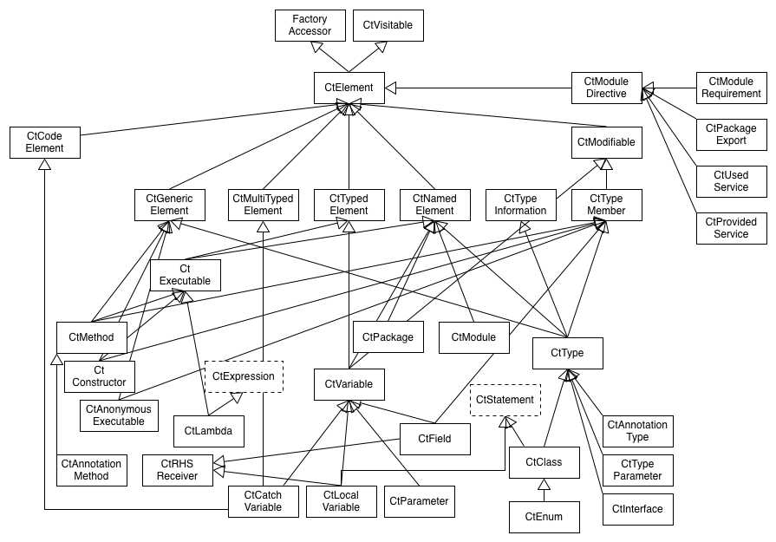
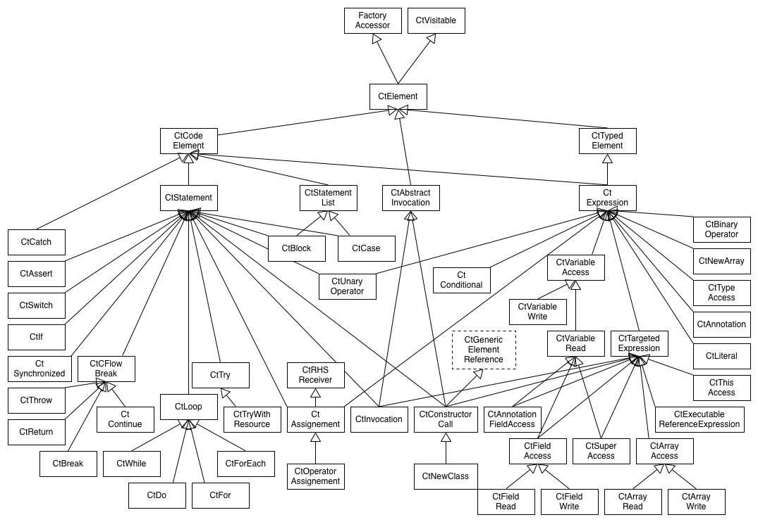
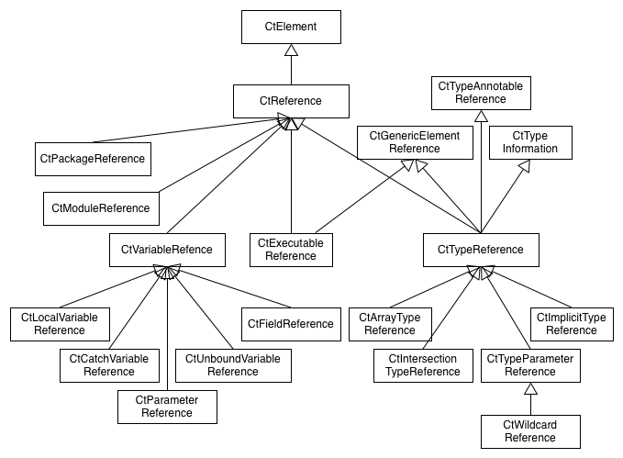
Legion
Structure (declarations, roughly what can be outside methods)
Code (executable statements and expressions, roughly inside methods)
References (names, roughly cross-references, may shortcut/terminate)

Slide 21
Everything is CtElement
Ct = Compile Time
Presents tree model on top of source (DOM for Java)
  children, parents, siblings
  queries
  paths
Instances are CtVisitable-able - accept(CtVisitor) that can visitCtSomeThing (CtSomeThing<?> thing)

Slide 22
The Fab Four
Elements are created via Factory-s
Elements are searched via Query-es
Analyses are done via Processor-s
Transformations are done via Template-s

Slide 23
Let’s Do a Realistic Example
Many modules that have lots of unit tests (hooray!) (jUnit 4.x)
For every one of the modules - introduce a common base class for unit tests
Inconsistent naming – there are TestFooBar, FooBarTest, even Bug123BeGone – whatever people liked
Some of the above names represent utility classes
Some of the test classes already extend others
There are inner classes as well

Slide 24
new
Spoonerism()
.readClasses()
.display()
.enumerateTestingClasses()
.determineBaseTestingClassPackage()
.createBaseTestingClass()
.extendTestingClasses()
.writeTransformedClasses();

Slide 25
new
Spoonerism()
.readClasses()
.display()
.enumerateTestingClasses()
.determineBaseTestingClassPackage()
.createBaseTestingClass()
.extendTestingClasses()
.writeTransformedClasses();

Slide 26
Spoonerism readClasses() {
// Command line launcher,
// others for maven,…
spoonUniverse = new Launcher();
// call it many times if needed
spoonUniverse.addInputResource(IN_DIR);
// build and wait
spoonUniverse.buildModel();
return this;
}

Slide 27
new
Spoonerism()
.readClasses()
.display()
.enumerateTestingClasses()
.determineBaseTestingClassPackage()
.createBaseTestingClass()
.extendTestingClasses()
.writeTransformedClasses();

Slide 28
Spoonerism display() {
// ↓ bad
// System.out.println(spoonUniverse);
// ↓ moderately good
SpoonModelTree tree = new SpoonModelTree(
spoonUniverse.getFactory());
/* Get the same via command line:
java -jar spoon-core-…—with-dependencies.jar -g -i DIR
*/
return this;
}

Slide 29
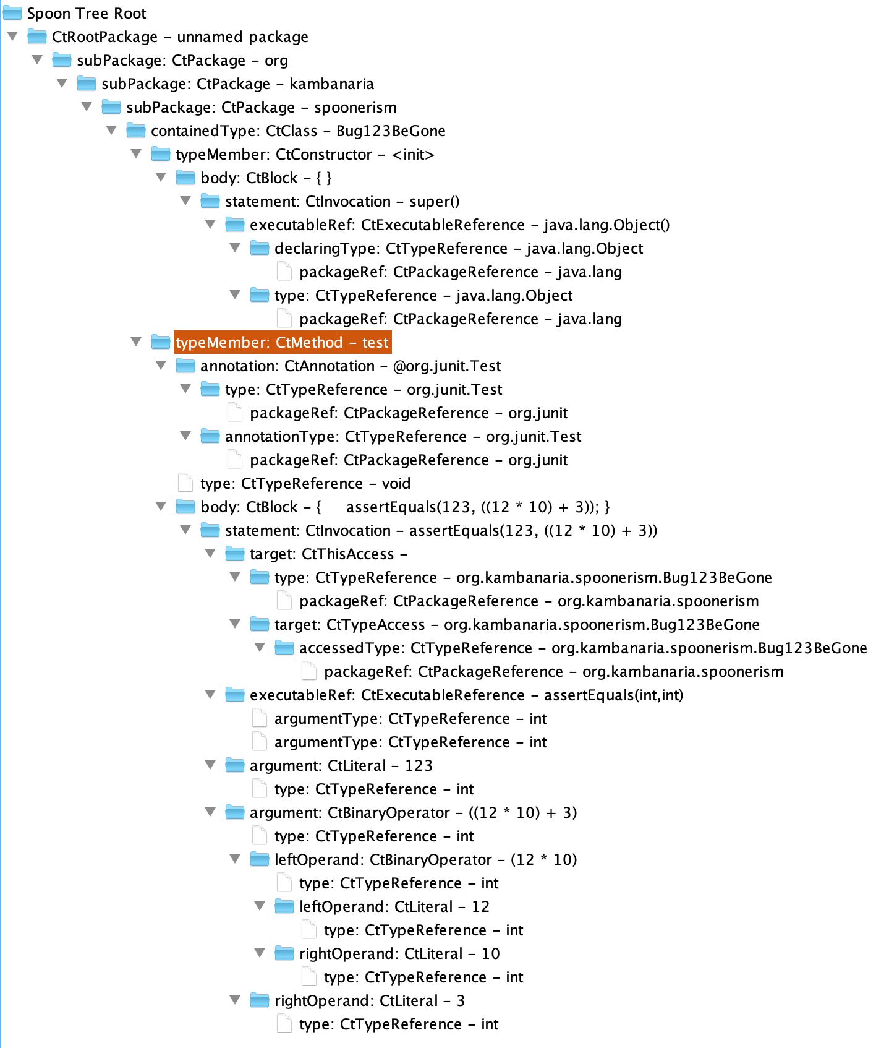
package org.kambanaria.spoonerism;
import org.junit.Test;
import static org.junit.Assert.assertEquals;
public class Bug123BeGone {
@Test
public void test() {
assertEquals(123, 12 * 10 + 3);
}
}

Slide 30
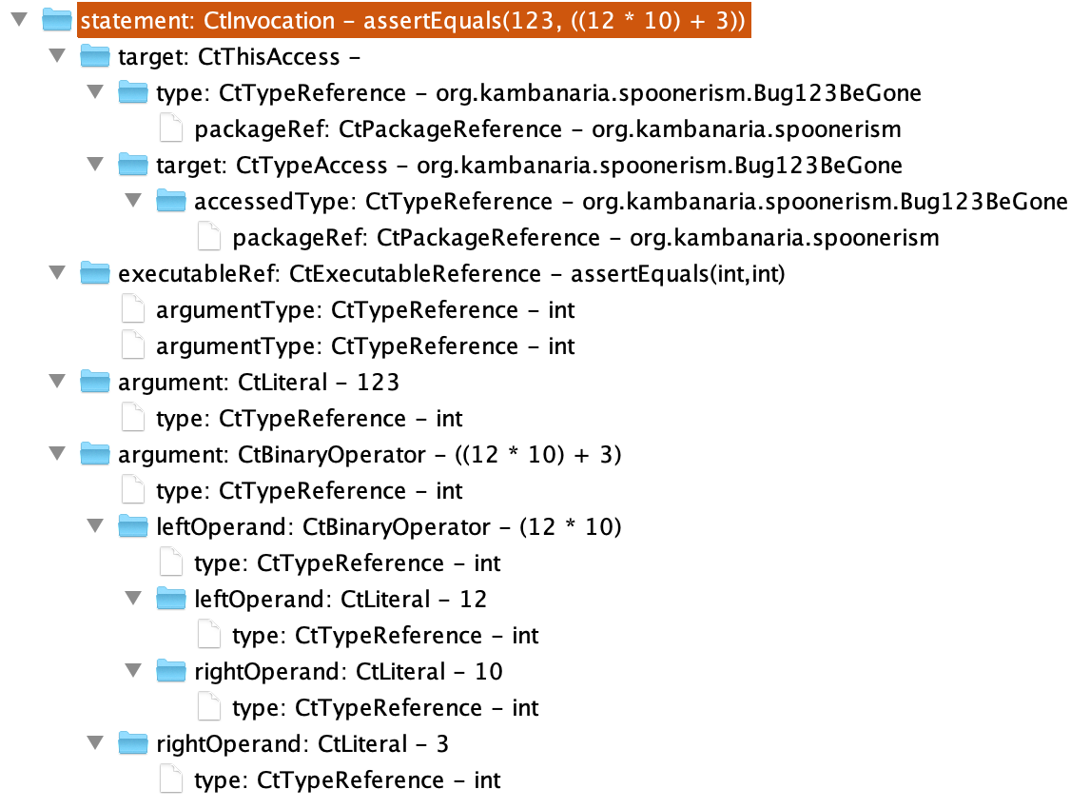
assertEquals(123, 12 * 10 + 3);

Slide 31
new
Spoonerism()
.readClasses()
.display()
.enumerateTestingClasses()
.determineBaseTestingClassPackage()
.createBaseTestingClass()
.extendTestingClasses()
.writeTransformedClasses();

Slide 32
TypeFilter<CtClass> isClass =
new TypeFilter<CtClass>(CtClass.class);

Slide 33
Factory factory = spoonUniverse.getFactory();
CtTypeReference<?> juTestRef =
factory.Type().createReference("org.junit.Test");
// can also use class literal
// factory.Type().createReference(org.junit.Test.class);
TypeFilter<CtClass> isWithTestAnnotatedMethods =
new TypeFilter<CtClass>(CtClass.class) {
@Override
public boolean matches(CtClass ctClass) {
return super.matches(ctClass) &&
!ctClass
.getMethodsAnnotatedWith(juTestRef)
.isEmpty();
}
};

Slide 34
TypeFilter<CtClass> isRealTestingClass = new TypeFilter<CtClass>(CtClass.class) {
@Override
public boolean matches(CtClass ctClass) {
if (!super.matches(ctClass)) {
return false;
}
CtTypeReference<?> current = ctClass.getReference();
do {
if (!current.getTypeDeclaration()
.getMethodsAnnotatedWith(juTestRef).isEmpty()) {
return true;
}
} while ((current = current.getSuperclass()) != null);
return false;
}
};
testingClasses = new HashSet<>(spoonUniverse.getModel().getRootPackage()
.getElements(isRealTestingClass));

Slide 35
if (!super.matches(ctClass)) {
return false;
}
CtTypeReference<?> current = ctClass.getReference();
do {
if (!current.getTypeDeclaration()
.getMethodsAnnotatedWith(juTestRef).isEmpty()) {
return true;
}
} while ((current = current.getSuperclass()) !=null);
return false;

Slide 36
new
Spoonerism()
.readClasses()
.display()
.enumerateTestingClasses()
.determineBaseTestingClassPackage()
.createBaseTestingClass()
.extendTestingClasses()
.writeTransformedClasses();

Slide 37
Spoonerism determineBaseTestingClassPackage(){
// What is the name of the new superclass? BaseTest
// What is the package of the new superclass?
CtClass firstClass = testingClasses.iterator().next();
String qualifiedName = firstClass.getPackage().getQualifiedName();
List<String> commonComponents = Arrays.asList(
qualifiedName.split("[.]"));
for (CtClass ctClass:testingClasses) {
List<String> currentComponents = Arrays.asList(
ctClass.getPackage().getQualifiedName().split("[.]"));
int max = Math.min(currentComponents.size(), commonComponents.size());
for (int i = 0; i < max; i++ ) {
if (!currentComponents.get(i).equals(commonComponents.get(i))) {
commonComponents = commonComponents.subList(0, i);
break;
}
}
}
baseTestingClassPackage = String.join(".", commonComponents);
return this;
}

Slide 38
A.B.C.D.E
A.B.F.G
A.B.H
A.B.I.J.K
A.B.L
A.B.M.N
—————————
A.B

Slide 39
new
Spoonerism()
.readClasses()
.display()
.enumerateTestingClasses()
.determineBaseTestingClassPackage()
.createBaseTestingClass()
.extendTestingClasses()
.writeTransformedClasses();

Slide 40
Spoonerism createBaseTestingClass() {
String baseClassFqn =
baseTestingClassPackage + ".BaseTest";
BaseTestingClass =
spoonUniverse.getFactory().createClass(baseClassFqn);
return this;
}

Slide 41
new
Spoonerism()
.readClasses()
.display()
.enumerateTestingClasses()
.determineBaseTestingClassPackage()
.createBaseTestingClass()
.extendTestingClasses()
.writeTransformedClasses();

Slide 42
Spoonerism extendTestingClasses() {
CtTypeReference<?> baseTestingClassRef =
baseTestingClass.getReference();
for (CtClass ctClass: testingClasses) {
CtTypeReference<?> superClass =
ctClass.getSuperclass();
if (ctClass.getSuperclass() == null) {
ctClass.setSuperclass(baseTestingClassRef);
}
}
return this;
}

Slide 43
new
Spoonerism()
.readClasses()
.display()
.enumerateTestingClasses()
.determineBaseTestingClassPackage()
.createBaseTestingClass()
.extendTestingClasses()
.writeTransformedClasses();

Slide 44
Spoonerism writeTransformedClasses () {
Environment env = spoonUniverse.getEnvironment();
env.setAutoImports(true);
env.setCommentEnabled(true);
spoonUniverse.setSourceOutputDirectory(OUT_DIR);
spoonUniverse.prettyprint();
return this;
}

Slide 45
Spoon Me Further
2016, Gérard Paligot, slides
2017, Benjamin Danglot, YouTube, slides
2018, Simon Urli, YouTube, slides

Slide 46
Fork Off
Eclipse JDT (Java Development Tools)
IntelliJ PSI (Program Structure Interface)
Try with Spoon first:
  It is for Java, based on Java and in Java
  Roots in academy, targeting industry and practitioners

Slide 47
Why Such Title And Names
Peter J. Landin —
The Next 700 Programming Languages
Bessey, et.al —
A few billion lines of code later: using
static analysis to find bugs in the real world
Spoonerism — changing sounds between words,
“Is it kisstomary to cuss the bride?”

Slide 48
Remember Two Things
Java source code transformation is reasonably easy with the Spoon library
If you have any questions, I would love to hear them. THANK YOU.

