Slide 1
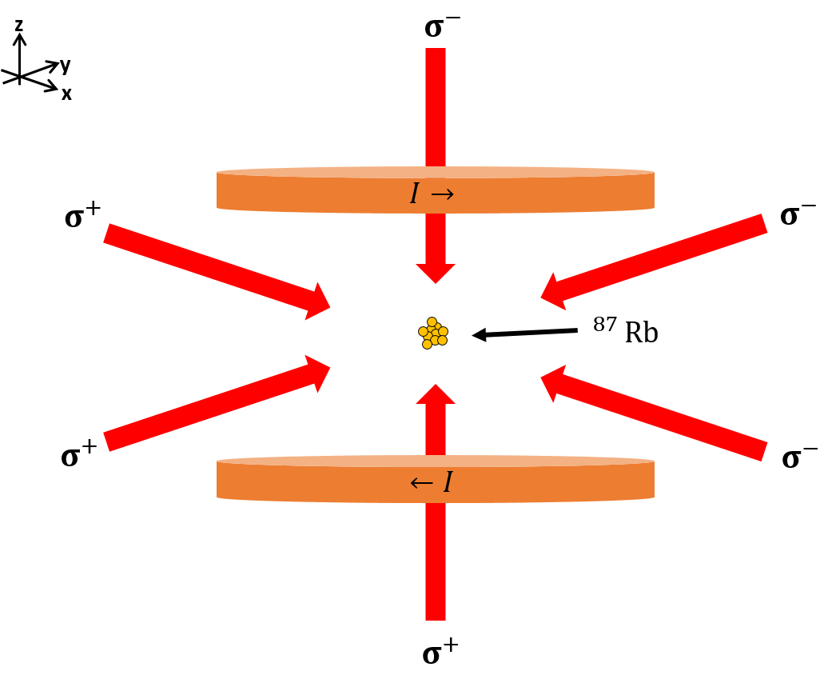
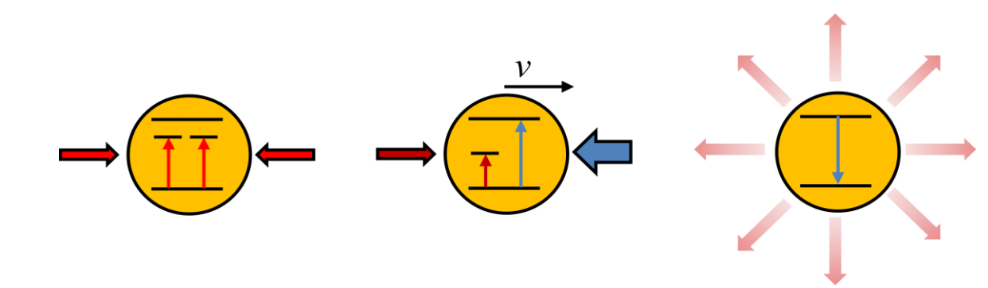
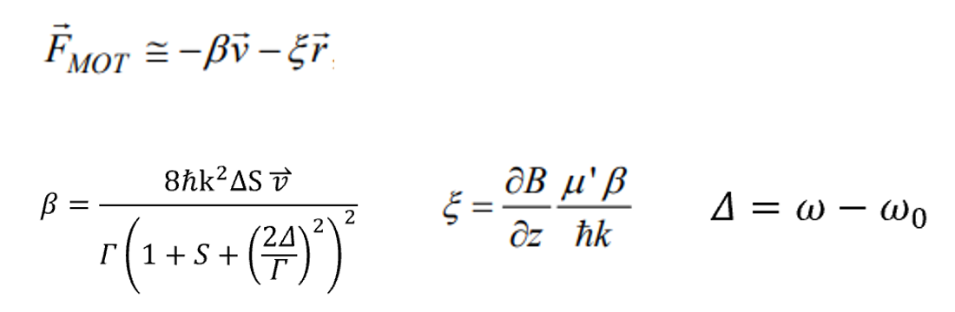
Magneto Optical Trap

Slide 2
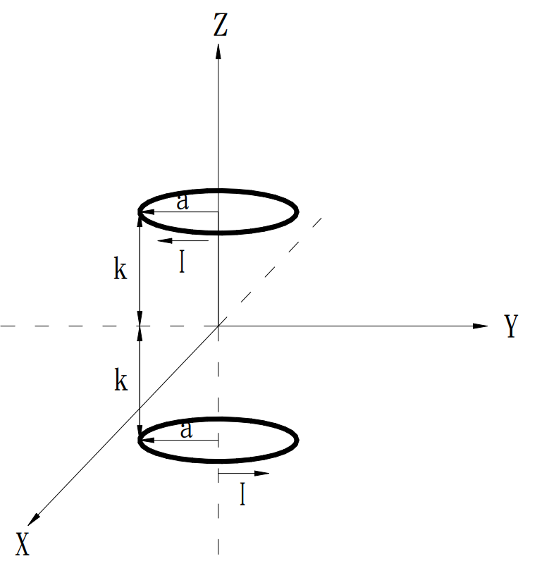
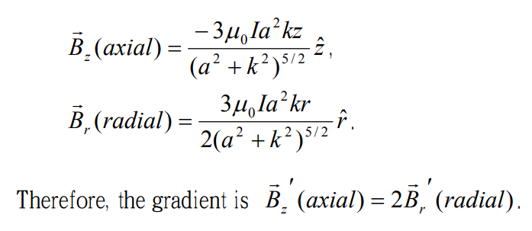



$$M_{j}$$
Energy
$$M_{j}$$
1
1
J = 1
|e\
0
0
-1
-1
$$σ^{+}$$
$$σ^{−}$$
|g\
Z
Anti-Helmholtz coils

Slide 3

Constant Table
Atom mass (${Rb}^{87}$): 1.44x${10}^{−25}$ Kg
Most probable velocity in chamber(T = 300 K): 300 m/s
Resonance wavelength: 780 nm
Decay rate(Lifetime): 6 MHz (27ns)
The gradient of magnetic field: 2.5 G/cm
Cooling ($β⁢)$ & Trapping ($⁢ζ$) coefficient:$1.36{\text{x}10}^{−21} Ns/m \& 1.244{\text{x}10}^{−18} \text{N}\text{/}\text{m}$
Doppler coolong limit : 140 $μ$K(for ${Rb}^{87}$)

