Slide 1
TwHappy
Happiness Check of your
Twitter users
2nd Aug 2018 – Alison Kline

Slide 2
Content
TwHappy the business
The APIs behind TwHappy
The Minimum Viable Product (MVP)
Technical Challenges

Slide 3
Business Opportunity & Market
Each Company has multiple products and brands they need to track!
Tracking social media is critical to the modern business and yet is hard to do efficiently
In US (2012)
16,055 large businesses
(>500 workers)
141,358 med businesses
(100-499 workers)
6.79 million small businesses
(<100 workers)

Slide 4
Key features
Introducing a ‘free text’ targeted solution:
Don’t miss out due to a forgotten hashtag!
TwHappy analyzes tweets
Free text search terms provided by you
Reports sentiment
Real time and historic dashboard
Notifies you immediately
On sentiment increase
On sentiment decrease

Slide 5
Competition & Go to Market
Pricing
1 search term/1000 tweets a month free
5 search terms/5000 tweets a month $8.95
Unlimited/10000 tweets a month $19.95
Launch
Beta customers, iterate quickly
Website and Targeted online marketing initially
Social Alert –
Hashtag based (Twitter/Instagram/Facebook)
Free trial $9.95/m – $29.95/m - $49.95/m
Sprout Social –
Manage, engage and report social media campaigns and chatbots,
$99/user/m - $149/user/m - $249/user/m
Talkwalker –
187 languages, image and text, 2 years history base, AI driven sentiment and relevance.
$8,400/yr - $18,000/yr, custom

Slide 6
TwHappy APIs
The secret sauce

Slide 7

Twitter
Search API
Provide ‘free text’ search term
Returns structured data:
Tweepy open-source helper library
‘Tweet Object’ including:
Text,
Create datetime,
User screen_name,
quote_count
reply_count
favorite_count
retweet_count

Slide 8

Google Cloud, Natural Language API Sentiment Analysis
Powerful Machine Learning model to extract information from natural language
Input: ‘text string/paragraph/doc’
Output:
Sentiment score -1:1 (neg : pos)
Magnitude score 0:1 (neutral : emotional)

Slide 9
The MVP Prototype
Functional Code

Slide 10
Twitter - Auth
def get_twitter_api_obj(keys=None):
"""Creating Tweepy API object using provided keys."""
if not keys:
keys = pd.read_csv('res/Access_Data_NO_GIT.csv')
# Creating the authentication object
auth = tweepy.OAuthHandler(keys.consumer_key[0], keys.consumer_secret[0])
# Setting your access token and secret
auth.set_access_token(keys.access_token[0], keys.access_token_secret[0])
# Creating the API object while passing in auth information (notifications gives wait in secs)
api = tweepy.API(auth, wait_on_rate_limit=True, wait_on_rate_limit_notify=True)
return api

Slide 11
Twitter – Search API
def get_tweets_from_search(api, query, language="en"):
"""Searching for tweets with provided query and with optional language selection."""
# get ~200 tweets from 2 pages as we get max 100 tweets per page
# Configure number of Tweets to fetch and fetching them.
(pages, count) = (1, 20) if DEBUG else (2, 100)
max_pages = pages
cursor = tweepy.Cursor(api.search, q=query, lang=language, count=count).pages(max_pages)
# Processing response
tweets = []
for i, page in enumerate(cursor):
now = datetime.now().strftime('%H:%M:%S')
print('At {}: Obtained {} tweet pages for {!r}.'.format(now, str(i + 1), query))
for tweet in page:
tweets.append(tweet)
return tweets

Slide 12
Natural Language API Sentiment Analysis - Auth
from google.cloud import language
from google.cloud.language import enums
from google.cloud.language import types
PATH = '/Users/alisonkline/Code/'
GOOGLE_KEY_FILE_NAME = 'TwHappy/res/tw-happy-d9fca2d70f33_NO_GIT.json'
# setting up authentication of the Google Cloud API
os.environ['GOOGLE_APPLICATION_CREDENTIALS'] = PATH + GOOGLE_KEY_FILE_NAME

Slide 13
Natural Language API Sentiment Analysis- Auth
def analyze(tw_texts):
"""Run a sentiment analysis request on a set of tweets."""
client = language.LanguageServiceClient()
sentiment = namedtuple("sentiment", ['score', 'magnitude'])
sentiments = []
print('Analysing sentiment for {} tweets...'.format(len(tw_texts)))
for text in tw_texts:
document = types.Document(content=text,type=enums.Document.Type.PLAIN_TEXT)
annotations = client.analyze_sentiment(document=document)
sentiments.append(sentiment(annotations.document_sentiment.score,
annotations.document_sentiment.magnitude))
return sentiments

Slide 14
Putting it together 1
def get_data(search_term):
"""Uses Twitter APIs to get tweets for provided search term.
Uses Google Sentiment API to analyse Tweet sentiment."""
# authenticating a tweepy api object
current_api = get_twitter_api_obj()
# searching for tweets of interest
tweets = get_tweets_from_search(current_api, search_term)
#running Google sentiment analysis on found tweets
tw_texts = [t.text if hasattr(t, 'text') else t.full_text for t in tweets]
sentiments = analyze(tw_texts)
return tweets, sentiments

Slide 15
Putting it together 2
def present(tweets, sentiments):
"""Summarizes key aspects of the data and presents it."""
dfp = pd.DataFrame(sentiments)
print('The {} most positive tweets have a sentiment score of {:.2f}'.format(
len(dfp.loc[dfp.score == dfp.max()['score']]), dfp.max()['score']))
print('The {} most negative tweets have sentiment score of {:.2f}'.format(
len(dfp.loc[dfp.score == dfp.min()['score']]), dfp.min()['score']))
dfg = pd.DataFrame(sentiments)
dfg['created_at'] = pd.DataFrame([t.created_at for t in tweets])
dfg.set_index('created_at', inplace=True)
plot_sent_vs_time(dfg)
swarm_and_hist(dfg)
summarise_extreme_tweets(tweets, sentiments)

Slide 16
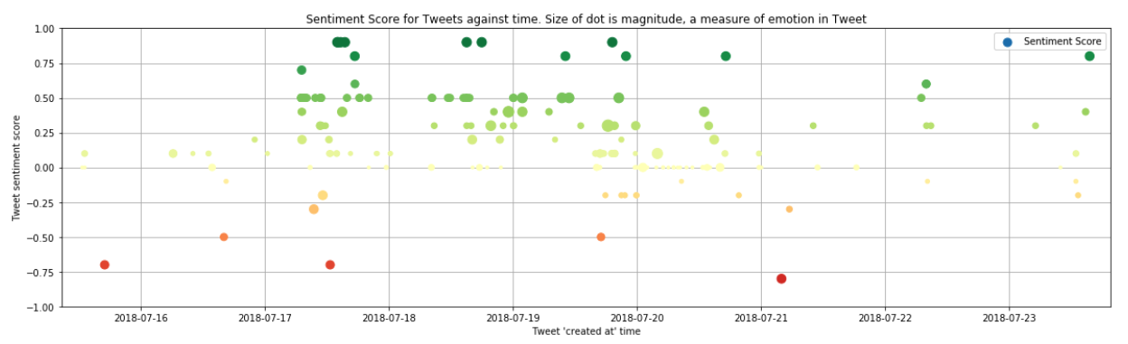
Results Dashboard 1

Slide 17
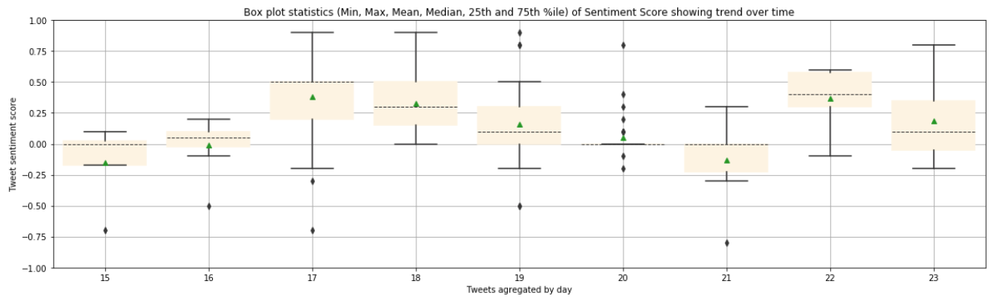
Results Dashboard 2

Slide 18
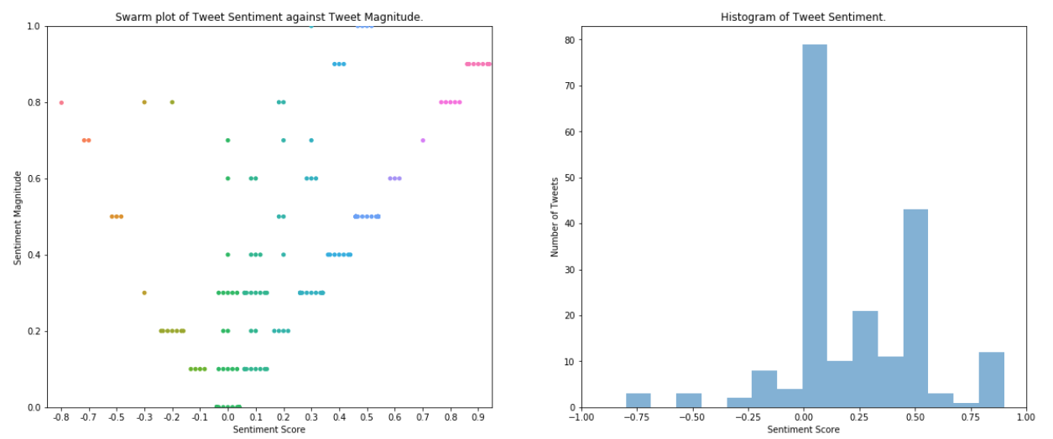
Results Dashboard 3

Slide 19
Summary of Extreme Tweets
Positive:
At 2018-07-19 19:15:13, Sonobi, (@sonobi) tweeted:
RT @MarTechSeries: @LiveRamp and @sonobi Collaboration Gives Marketers Unique Direct Access to Add..
Sentiment score: 0.9, Magnitude: 0.9
At 2018-07-18 17:58:35, Gillian Ca milleri, (@GMilleri) tweeted in reply to LiveRamp:
@LiveRamp Excellent stuff
Sentiment score: 0.9, Magnitude: 0.9
At 2018-07-17 14:10:05, Sonobi, (@sonobi) tweeted:
LiveRamp and Sonobi Collaboration Gives Marketers Unique Direct Access to Addressable Consumers @s..
Sentiment score: 0.9, Magnitude: 0.9
At 2018-07-17 14:01:27, Crwe World, (@CrweWorld) tweeted:
LiveRamp and Sonobi Collaboration Gives Marketers Unique Direct Access to Addressable Consumers ht..
Sentiment score: 0.9, Magnitude: 0.9
Negative:
At 2018-07-21 04:00:14, Serkan YUMUSAK, (@serkanyumusak) tweeted:
LiveRamp brings its search targeting to Bing Ads https://t.co/qZAZy9ZZcR #EmailMarketing #ALTERIDE..
Sentiment score: -0.8, Magnitude: 0.8

Slide 20
Technical Challenges
Next steps and road map

Slide 21
Technical Challenges
😊
Volume of API calls
Size and structure of servers
User authentication & acct mgmt
Security & charging
Latency and response times
API limits
Twitter $$ of relationship
Google API $$ of relationship
Storage and retrieval of longer durations of data
SMTP server for sending trend change notifications

Slide 22
Product Roadmap
Phase 1
Phase 2
Phase 3
Notifications
email triggers
txt triggers
Longer Time Frame
enhanced dashboard
Improve quality of sentiment interpretation
Augment Google API
Better insight by combining data
Better presentation to deliver value customer needs
Better search/smart filter results
Incorporate re-tweets/quote-tweets
Advanced custom triggers and notifs
Additional support
Facebook, Instagram, Friendster
Wechat, RenRen

Slide 23
Thank you
2nd Aug 2018 – Alison Kline

