Slide 1
PHARMACY STORE MANAGEMENT SYSTEM
By: Team “Ctrl C - Ctrl V”
MEMBERS
4MT22CS008 AFHAAM
4MT22CS017 ALSON MATHIAS
4MT22CS025 ANUSH SHETTY
4MT22CS047 DHEERAJ D N
4MT22CS054 GLEN FONCECA

Slide 2
contents
01
LANDING PAGE
02
LOGIN PAGE
03
CREATE BILL
04
ADD NEW STOCK
05
MODIFY & CHECK STOCK

Slide 3
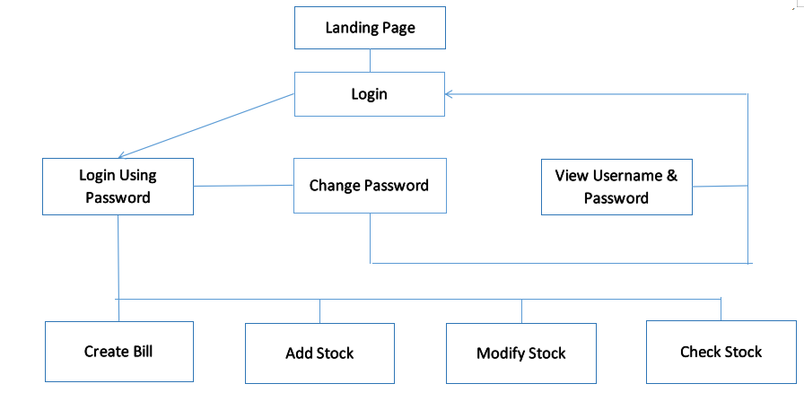
FLOW CHART

Slide 4
01
LANDING PAGE

Slide 5
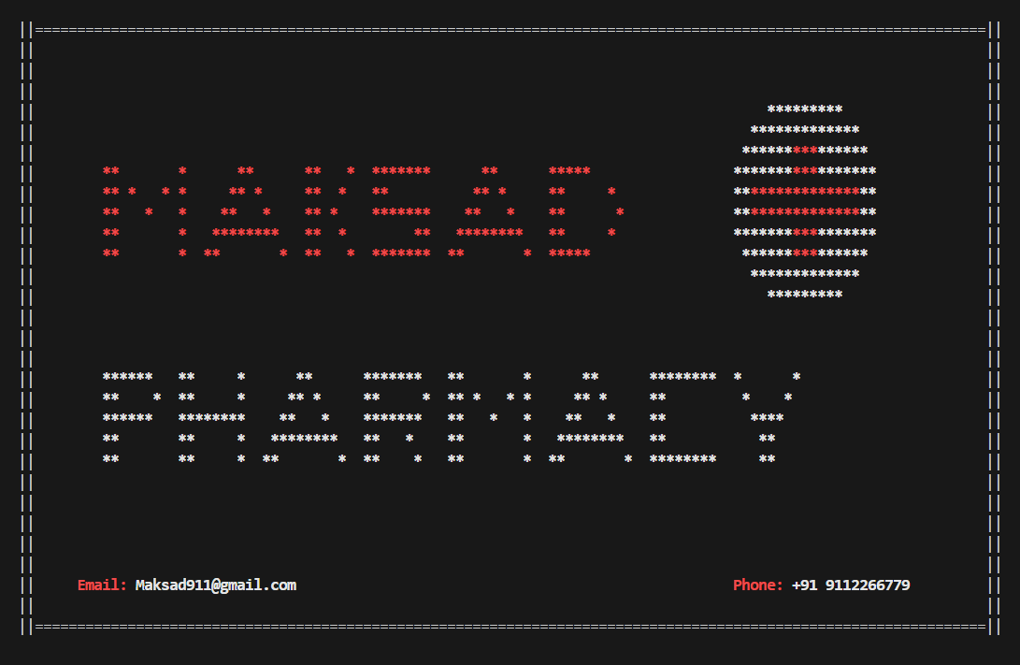
01
LANDING PAGE
Landing Page
Landing Page is the Page that prints the Pharmacy Name (MAK-SAD Pharmacy).
The Printing of Name is done using the printf() in C language.gotoxy() function helps to align text on the Terminal, and color.c file ha s different color functions which color the text printed on the Terminal.

Slide 6
02
LOGIN PAGE

Slide 7
02
LOGIN PAGE
Login Page
Test Case
Login Page is the Menu Page that displays options like Login, Change Password, and View Username & Password.
Login is to be done using the Username “Pharmacy” and Password “Password”.
Change Password can be done using the Username, and a New Password can be created.
Viewing Username and Password can be done using the 6-digit License Number.
Login: If Login is Successful, goes to the Options Menu
Change Password: Change Password using username.
View Username & Password: Using License Number, Access is either granted or denied.

Slide 8
03
CREATE BILL

Slide 9
03
CREATE BILL
Create Bill
Test Case
Create Bill is an option that can be used to choose the item to be purchased, and generate a bill for the same.
First, the we needs to enter their Patient ID or create a new ID, then select the catagory from which the purchase is to be made. After selecting the Catagory, Required Item is selected by entering its ID and specifying the quantity needed.
Create an New User, and then Generate a Bill.
For an Existing User, Generate a Bill

Slide 10
04
ADD NEW STOCK

Slide 11
04
ADD STOCK
Add Stock
Test Case
Add a new Item to the Stock, if Present print error, else read the other details and add it to the stock.
The Add Stock option is used to Add a New Item into the Pharmacy Stock.
To add a New Item into the Stock, we need to Input ID, Item Name, Dosage (or Weight), Quantity, Unit Price & Catagory.

Slide 12
05
MODIFY & CHECK STOCK

Slide 13
05
MODIFY & CHECK STOCK
Modify & Check Stock
Test Case
Modify Stock is the option that helps us to Increase the Quantity of Existing Stock. We need to enter ItemID, and the modified quantity.
Check Stock is the option that helps us to check the available Stock. We need to enter the Catagory and the Stock of that catagory is displayed on the Screen.
Modify Stock: Modify Stock for an Existing Item in Stock.
Check Stock: Check Stock Available based on the Catagory.

Slide 14
THANK YOU!

