Slide 1

Predicting Customer Buying Behaviour

Slide 2
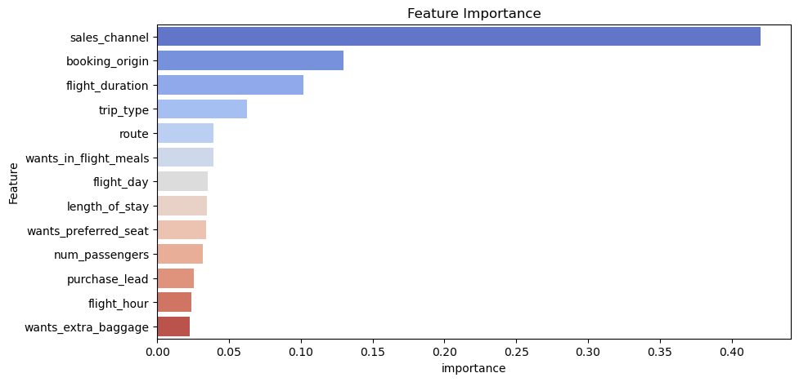
Predictive Model To Understand Factors That Influence Buying Behavior
The model utilized XGBoost (XGB). To address the class imbalance, weighting, hyperparameter tuning, and cross-validation were applied.
Test Accuracy: 80%
Most Important Features:
Sales Channel
Booking Origin
Flight Duration
Trip Type
Route

