Slide 1
Health service & monitoring
Mini project
Presented by
Aniket Sulke
Rushabh Bokade
Gaurav Mahto
& Guide by
Rajeshwari Goudar

Slide 2

Content
Introduction
DSGT concepts
Algorithm
Outcome
Conclusion
References

Slide 3

Introduction
Objectives-
Predict the disease
Identification of Medicines & its quantity
Directly access your hospital webpage
Finding hospital nearest to your destination hospital
Determining common symptoms of diseases

Slide 4
Advantages-
Better access to healthcare
Improved quality of care
Low cost
Visual tools help to prescribe disease easily
Useful to find the nearest hospital and its website automatically
Disadvantages-
Accuracy is minimum in certain cases
Internet connections required to redirect to the webpage

Slide 5
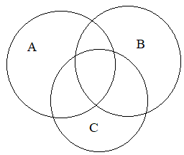
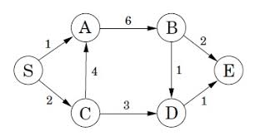
DSGT concepts
Principle of Inclusion & Exclusion
Dijkstra's Algorithm

Slide 6
Outcomes
Patient will be able to
Find out his/her disease.
Counter that disease before having appointment with doctor.
Find out nearer hospital than his destination hospital.
Access website of that hospital easily.

Slide 7
Algorithm
Step 1: Enter the required details
Step 2: convert string input into list
Step 3: Compare each symptom in the list and increase the count at each match and store each count in list.
Step 4 : Store maximum count in a variable
MaxSymtomsCount = max(countArr)
Step 5: Plot the graph between count and disease and predict the disease
Step 6: def patient() :
Use rule of inclusion and exclusion
Step 7 : def anasthesia() :
Calulate the anasthesia drugs using details
Step 8 : def dijekstra’s() :
Path shortest hospital using dijekstra’s algorithm

Slide 8
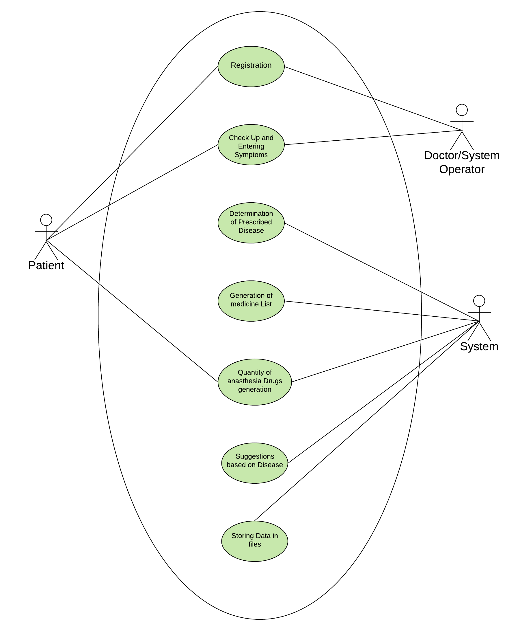
Use Case

Slide 9
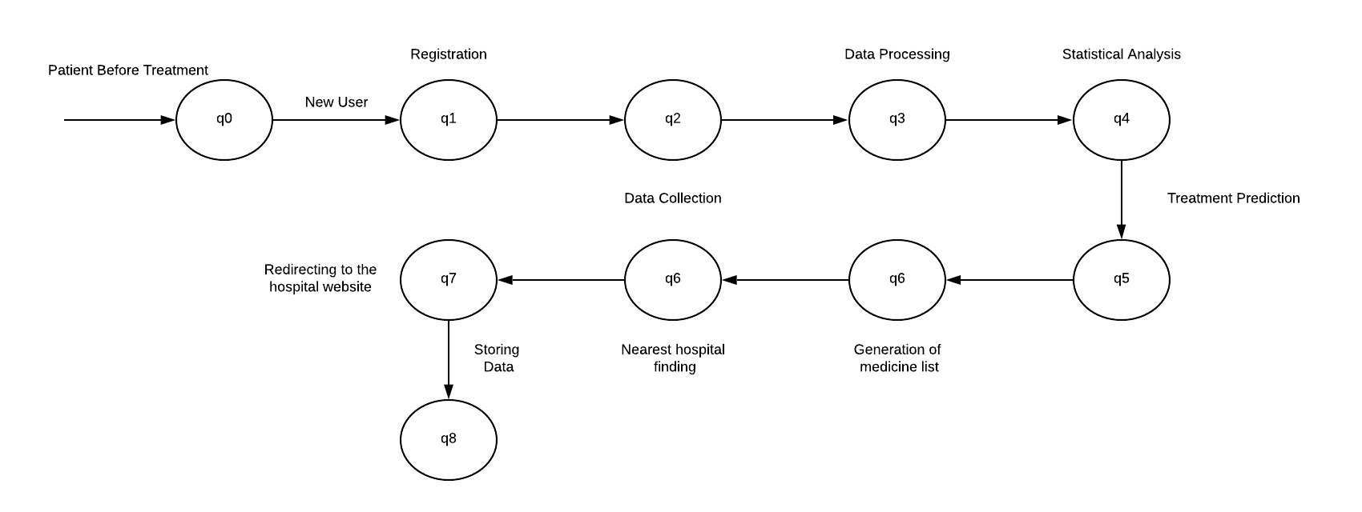
Sequence State Diagram

Slide 10
Conclusion
Able to predict his diseases & what cure should be taken by him.
Able to try cure & using medicines advice by application with quantity we will free from side-effect of that medicine or drugs.
Find hospital nearer to his destination hospital & it again show that hospital website home page.

Slide 11
References
[01] Chung Laung Liu, “Elements of Discrete Mathematics”, 4th edition. Practice-Hall, 1977. (ISBN-9781259006395)
[02] https://brilliant.org/wiki/dijkstras-short-path-finder/
[03] https://www.webharvy.com/articles/what-is-web-scraping.html

Slide 12


