Slide 1
SPECIAL TOPICS IN INFORMATION SECURITY
Integrated Two-Device
Incident Response Lab
10
Cybersecurity skills integrated into one reproducible IR workflow
2
A safe, evidence-driven investigation across Ubuntu and Windows
Authorized endpoints: Ubuntu analyst/server + Windows 11 endpoint
PASS
AYHAM AL-SWAITI
Final evidence validation and submission package
Student ID 12116003 · August 2026
Notes:
This project is an incident response lab on two authorized devices. Ubuntu is the management and analysis platform, and Windows is the monitored endpoint. The goal is not to demonstrate an attack. The goal is to build a safe, documented response cycle that connects ten practical skills in one reproducible case.
[Sources]
- Local project evidence and finalization output (2026-08-08).
[/Sources]

Slide 2
INTEGRATED INCIDENT RESPONSE
02
Objective, boundaries, and success criteria
AUTHORIZED & SAFE
THE QUESTION
Two personally controlled devices on one local network
RFC 5737 documentation addresses only: 198.51.100.77 and 203.0.113.50
Benign process, file, login, and loopback events—no exploit or malware
Can a small home lab perform a professional, end-to-end incident response workflow without unsafe attack activity?
SUCCESS GATES
10/10 selected skills verified from the pinned repository commit
Remote endpoint evidence collected and correlated
Containment is narrow, reversible, and validated
SHA-256 integrity and final evidence archive both pass
Answer: yes—when collection, analysis, containment, recovery, and evidence integrity are designed as one controlled process.
Ayham Al-Swaiti · 12116003
Notes:
The scope is defined before the tools. All activity was performed on two personally controlled devices. The external addresses are RFC 5737 documentation ranges, not real targets. The scenario created harmless evidence such as failed logins and a test-file change. Success required ten verified skills, matching SHA-256 hashes, reversible containment, and a final PASS result.
[Sources]
- RFC 5737: https://www.rfc-editor.org/rfc/rfc5737
- Local safe-simulation scripts and final validation output.
[/Sources]

Slide 3
INTEGRATED INCIDENT RESPONSE
03
Two-device architecture and trust boundaries
ANALYST / SERVER
MONITORED ENDPOINT
Ubuntu 26.04 LTS
TLS CLIENT CHANNEL · TCP 8000
Windows 11 Pro 25H2
192.168.1.31
192.168.1.128
Velociraptor server + local GUI
Splunk and Timesketch containers
Volatility 3 analysis
Dedicated NTFS evidence partition
Velociraptor 0.77.1 client
Safe simulation + volatile collection
WinPmem memory acquisition
PowerShell response automation
COLLECTION TASKS + RESULTS
GUI 127.0.0.1:8889
Evidence at rest: /mnt/ir-evidence/incident-response-project
Ayham Al-Swaiti · 12116003
Notes:
Windows connects to the Velociraptor service on Ubuntu through TCP 8000. Ubuntu sends collection tasks and receives the results. The management interface on port 8889 is restricted to loopback. Splunk, Timesketch, and Volatility run on Ubuntu, while evidence is stored on a separate partition. This separates the endpoint from the analyst workstation and creates a clearer evidence path.
[Sources]
- Local network baseline screenshot.
- Velociraptor deployment documentation: https://docs.velociraptor.app/docs/deployment/
[/Sources]

Slide 4
INTEGRATED INCIDENT RESPONSE
04
Ten skills selected from the pinned catalog
01
implementing-velociraptor-for-ir-collection
06
conducting-memory-forensics-with-volatility
02
analyzing-security-logs-with-splunk
07
performing-disk-forensics-investigation
03
analyzing-linux-audit-logs-for-intrusion
08
collecting-indicators-of-compromise
04
collecting-volatile-evidence-from-compromised-host
09
building-incident-timeline-with-timesketch
05
containing-active-breach
10
validating-backup-integrity-for-recovery
10 / 10 VERIFIED ON UBUNTU
Repository commit 2fb6a9faff42977f9e64b1f0dcb97bb2a1e67267
Notes:
These are the exact skill names found in the pinned repository commit. They were arranged as one lifecycle: collection and logs, containment, memory and disk analysis, IOC handling, timeline reconstruction, and recovery. The value is the integration between the skills, not ten isolated demonstrations.
[Sources]
- Anthropic-Cybersecurity-Skills commit: https://github.com/mukul975/Anthropic-Cybersecurity-Skills/commit/2fb6a9faff42977f9e64b1f0dcb97bb2a1e67267
- Local selected-skills verification output.
[/Sources]

Slide 5
INTEGRATED INCIDENT RESPONSE
05
One workflow, not ten disconnected demonstrations
1
PREPARE
2
COLLECT
3
CORRELATE
Baseline, time sync, evidence storage
Velociraptor, auditd, volatile data
Splunk queries and IOC register
4
CONTAIN
5
ANALYZE
6
RECOVER
Narrow RFC 5737 rules + rollback
Timeline, memory, disk forensics
Backup validation + final archive
Every phase writes evidence, timestamps, and SHA-256 records for the next phase.
Ayham Al-Swaiti · 12116003
Notes:
The sequence matters. A baseline is collected before analysis. Volatile evidence is preserved before containment. Recovery is accepted only after backup validation. Every phase produces evidence, timestamps, or hashes that support the next phase. This is what makes the work an integrated incident response workflow.
[Sources]
- NIST SP 800-61 Rev. 3: https://csrc.nist.gov/pubs/sp/800/61/r3/final
- Local RUN_ME_FIRST.sh workflow and evidence structure.
[/Sources]

Slide 6
INTEGRATED INCIDENT RESPONSE
06
Manual first, AI second: the required presentation logic
1 · MANUAL INVESTIGATION
2 · AI-ASSISTED WORK
Show the evidence before the automation
Use the agent after evidence exists
VERIFY
Run or open the real collection step
Explain the input, output, and why the tool was chosen
Preserve raw output, timestamps, and SHA-256
State what the evidence proves—and what it does not prove
• Organize the case and draft reproducible commands
• Summarize findings as suggestions, not unquestioned facts
• Require human approval for containment and recovery
• Validate every claim against raw evidence and PASS checks
NO AUTOMATION WITHOUT EXPLANATION OR VERIFICATION
OBSERVED FACTS → ANALYST INTERPRETATION → AI-ASSISTED SUMMARY
Notes:
The investigation was completed manually first: observe the evidence, explain the purpose of each tool, record the input and output, and verify limitations. AI assistance was used only to organize documentation and improve repeatable commands. The analyst verified every claim against screenshots, command results, hashes, and tool output. AI was not treated as a source of truth.
[Sources]
- Local project workflow, screenshots, and validation records.
- NIST SP 800-86: https://csrc.nist.gov/pubs/sp/800/86/final
[/Sources]

Slide 7
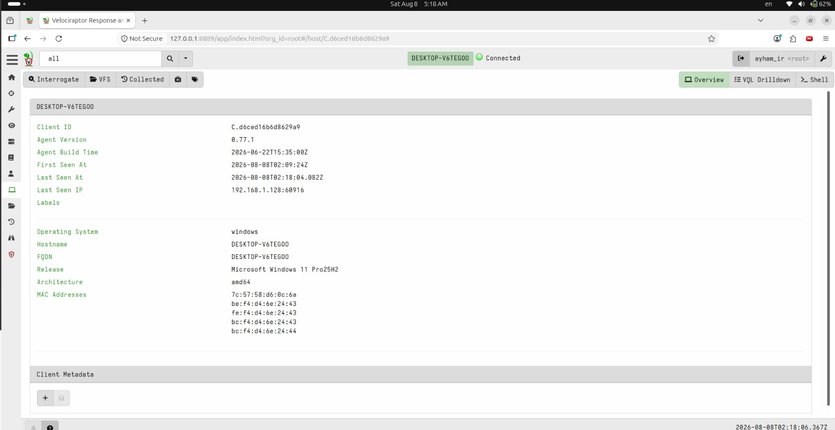
INTEGRATED INCIDENT RESPONSE
07
Velociraptor: the Windows endpoint is live and trusted
GREEN
Client state: connected
0.77.1
Agent version on both server and endpoint
25H2
Windows 11 Pro release identified remotely
DESKTOP-V6TEGOO
Ayham Al-Swaiti · 12116003
Notes:
This screen proves that the Windows endpoint is actually connected. The green status, hostname, operating system, agent version, and last IP are visible. Ubuntu can now send centralized collection jobs to the endpoint instead of relying on a copied installation file.
[Sources]
- Local Velociraptor endpoint screenshot.
- Velociraptor client documentation: https://docs.velociraptor.app/docs/gui/clients/
[/Sources]

Slide 8
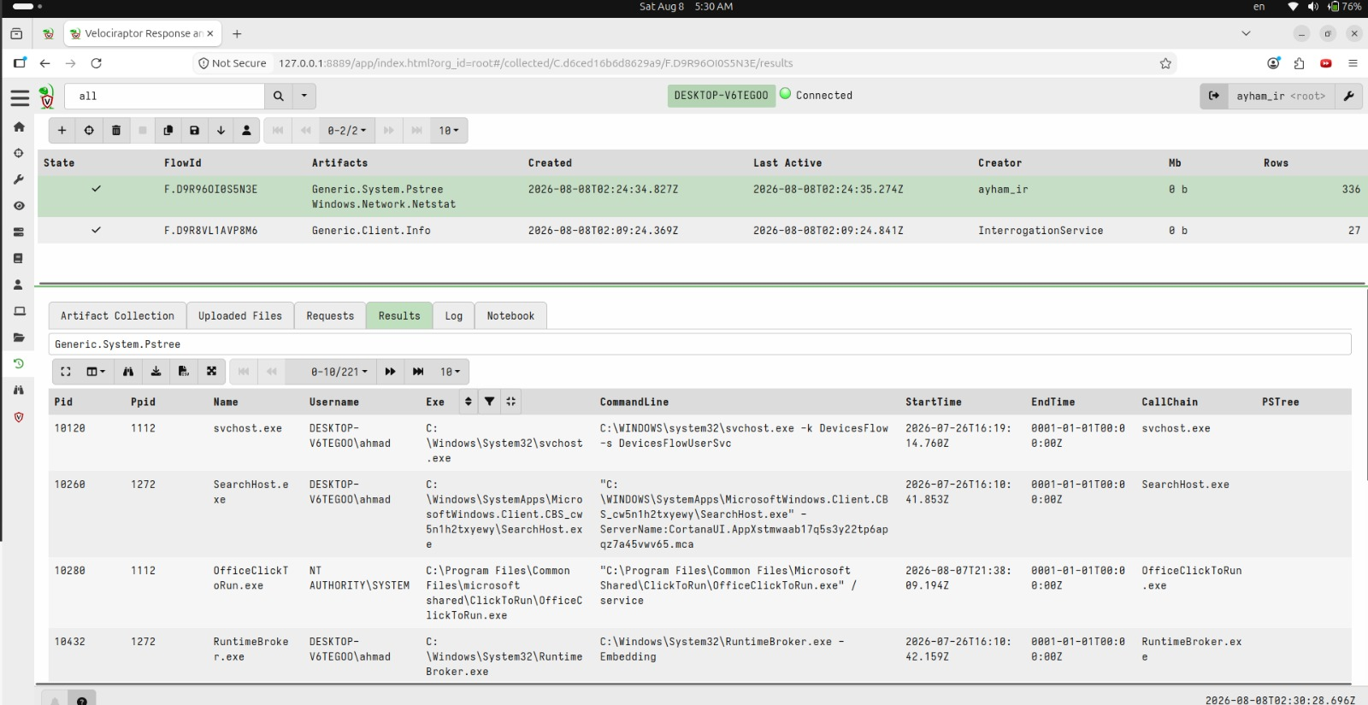
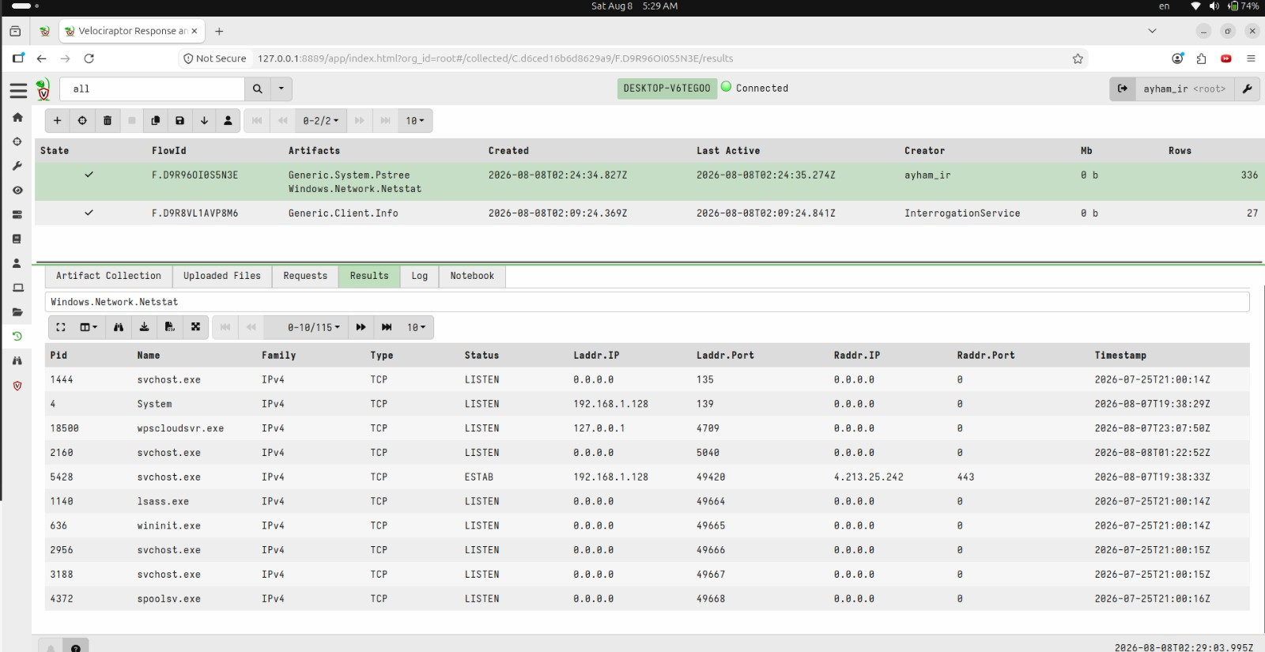
INTEGRATED INCIDENT RESPONSE
08
Remote collection: processes and network state
336
Total remote rows returned in the completed collection
Generic.System.Pstree · 221 rows
Windows.Network.Netstat · 115 rows
Ayham Al-Swaiti · 12116003
Notes:
Two remote evidence sources were collected: the process tree and the network socket table. The process collection returned 221 rows and Netstat returned 115 rows, for a total of 336 rows. These results are a point-in-time snapshot, so a connection is not automatically suspicious. It must be correlated with the timeline and other evidence.
[Sources]
- Local Velociraptor process and network collection screenshots.
- Velociraptor artifacts documentation: https://docs.velociraptor.app/docs/artifacts/
[/Sources]

Slide 9
INTEGRATED INCIDENT RESPONSE
09
Safe incident simulation and reversible containment
01
GENERATE
Failed-login, file, process, and IOC markers
NARROW CONTAINMENT
02
PRESERVE
198.51.100.77
203.0.113.50
Pre-containment volatile evidence + hashes
03
CONTAIN
Block only the two simulated RFC 5737 IOCs
Documentation-only addresses
Network contact = false
04
VALIDATE
Normal LAN, DNS, gateway, and IR links remain
05
ROLL BACK
Remove only project firewall rules
CONTAINMENT PASS
ROLLBACK PASS
Ayham Al-Swaiti · 12116003
Notes:
The scenario generated harmless evidence only. Volatile evidence was preserved before containment. The nftables rules blocked only two RFC 5737 simulation addresses while keeping loopback, LAN, DNS, Velociraptor, and normal Internet access available. The project rules were then removed and the rollback check passed. Professional containment should be narrow and reversible.
[Sources]
- RFC 5737: https://www.rfc-editor.org/rfc/rfc5737
- Local safe incident, containment, and rollback output.
[/Sources]

Slide 10
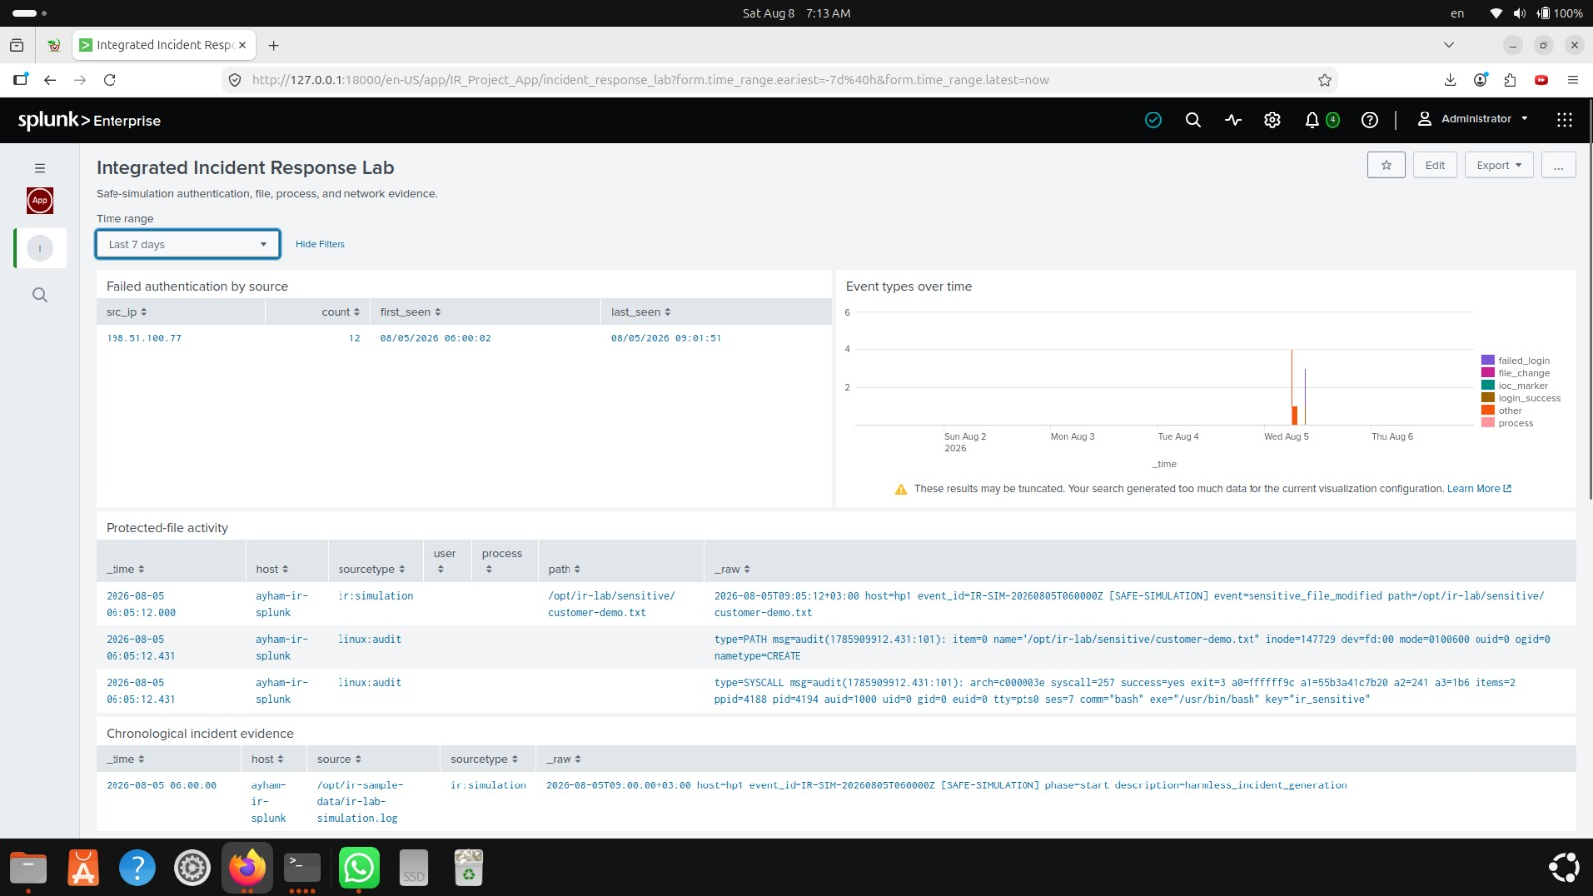
INTEGRATED INCIDENT RESPONSE
10
Splunk correlation: repeated authentication failures
12
Failed authentication events correlated
1
Source IOC: 198.51.100.77
>= 5
Detection threshold in the SPL query
Correlation combines simulated events with Linux audit evidence—without claiming a real compromise.
Ayham Al-Swaiti · 12116003
Notes:
Splunk correlated the simulation log with Linux audit evidence. The SPL query extracted the source IP, counted events, recorded the first and last occurrence, and applied a threshold of five attempts. It identified 12 failed login events from 198.51.100.77. Because this is a safe simulation, the result is a validated detection, not a claim of a real attacker.
[Sources]
- Local Splunk dashboard and search screenshot.
- Splunk Search Manual: https://help.splunk.com/en/splunk-enterprise/search/search-manual/10.0/search-overview/about-the-search-language
[/Sources]

Slide 11
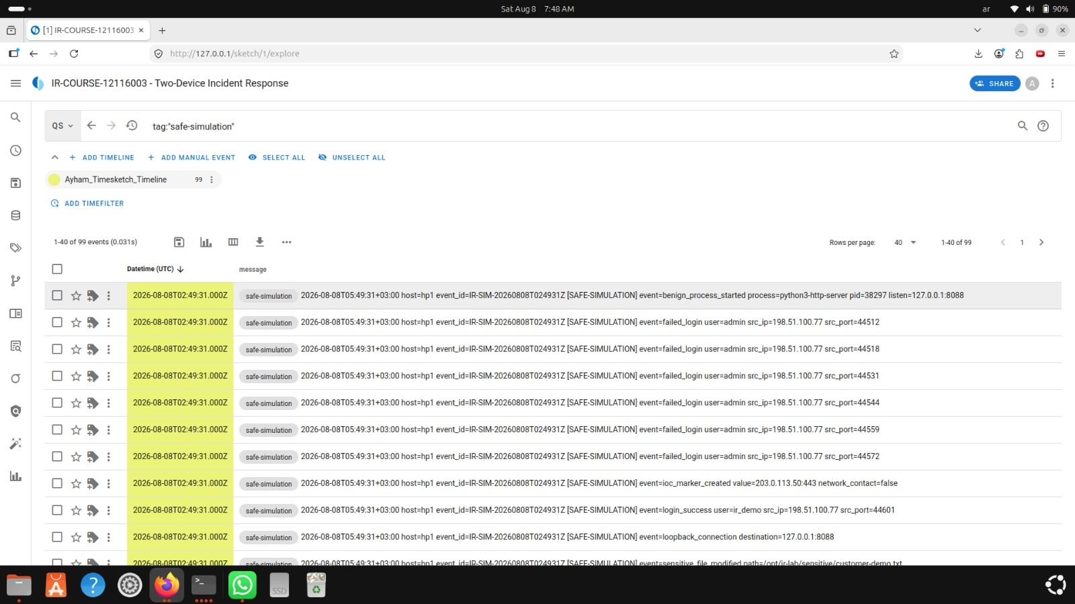
INTEGRATED INCIDENT RESPONSE
11
Timesketch: reconstructing the incident chronology
4,210
Total events imported into the timeline
99
Events matching tag:safe-simulation
Example sequence
phase-start marker
failed_login burst
file modification
benign process start
IOC marker + phase-end
Ayham Al-Swaiti · 12116003
Notes:
Timesketch combined evidence from different sources into one chronology. The imported timeline contained 4,210 events. Filtering on tag:safe-simulation isolated 99 scenario events. The sequence shows the start marker, failed logins, a file modification, a benign process, an IOC marker, and the end marker.
[Sources]
- Local Timesketch timeline screenshot.
- Timesketch CSV import guide: https://timesketch.org/guides/user/import-from-json-csv/
[/Sources]

Slide 12
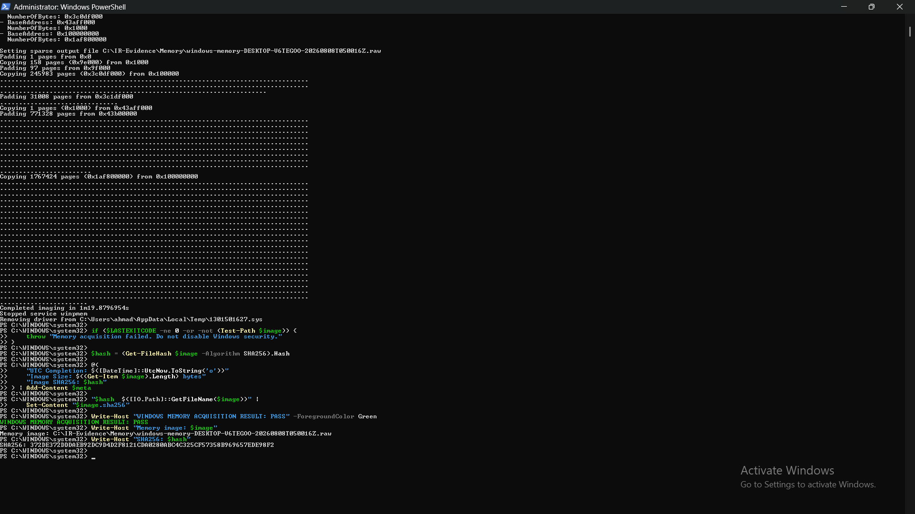
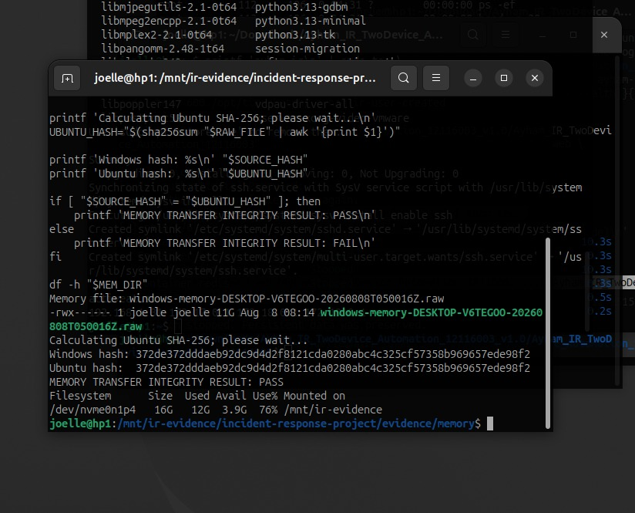
INTEGRATED INCIDENT RESPONSE
12
Windows memory acquisition with end-to-end integrity
≈ 11 GiB
1m 19s
MATCH
SCP
Sparse RAW image produced by WinPmem
Acquisition duration on the endpoint
Windows and Ubuntu SHA-256 values
Temporary SSH transfer, then service disabled
Ayham Al-Swaiti · 12116003
Notes:
A signed WinPmem build created a sparse RAW memory image of about 11 GiB. The acquisition took about one minute and nineteen seconds. SHA-256 was calculated on Windows, the image was transferred by SCP, and the hash was calculated again on Ubuntu. The hashes matched. SSH was disabled after the temporary transfer was complete.
[Sources]
- Local acquisition and transfer-integrity screenshots.
- WinPmem project: https://github.com/Velocidex/WinPmem
[/Sources]

Slide 13
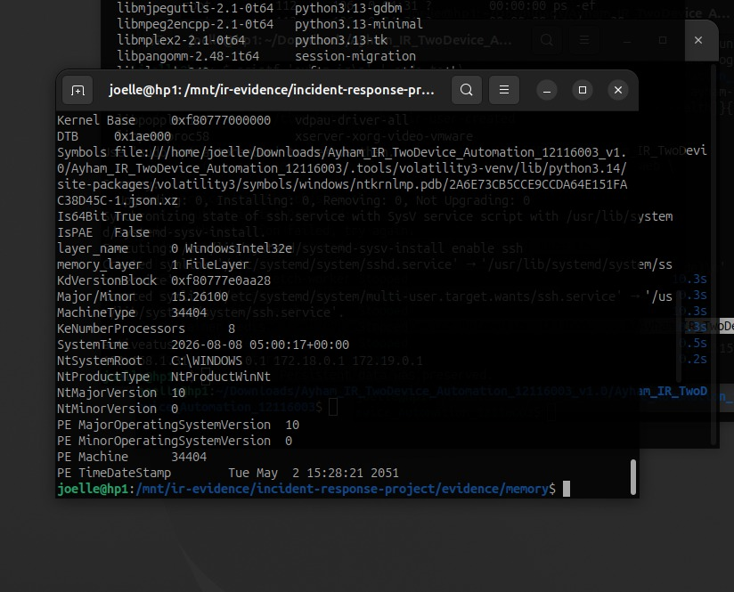
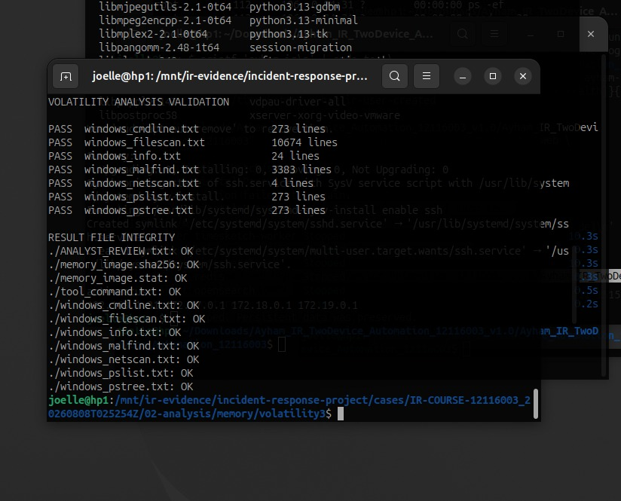
INTEGRATED INCIDENT RESPONSE
13
Volatility 3: structured memory triage
windows.info
windows.pslist
windows.pstree
windows.cmdline
windows.netscan
windows.filescan
windows.malfind
malfind output = candidate regions for review; it is not proof of malware.
Ayham Al-Swaiti · 12116003
Notes:
The verified memory image was analyzed with Volatility 3. The workflow ran windows.info, pslist, pstree, cmdline, netscan, filescan, and malfind. Every expected output passed the manifest check. A malfind result is only a candidate memory region for analyst review; it is not proof of malware by itself.
[Sources]
- Local Volatility profile and validation screenshots.
- Volatility 3 documentation: https://volatility3.readthedocs.io/en/latest/
[/Sources]

Slide 14
INTEGRATED INCIDENT RESPONSE
14
Disk, IOC, STIX, and recovery validation
DISK FORENSICS
IOC REGISTER
BACKUP RECOVERY
Forensic image created and verified
1,716 reviewed candidates
Clean and corrupted copies hashed
Deleted file: RECOVERED_AND_CONTENT_VALIDATED
1,716 STIX 2.1 indicators generated
Tamper detected; isolated restore validated
SAFE CASE RESULT: PASS
Recovery was accepted only after integrity, content, and token checks succeeded.
Ayham Al-Swaiti · 12116003
Notes:
Disk forensics produced and verified an image, then recovered a deleted test file and validated its content. The IOC register was exported as CSV and STIX 2.1. Recovery testing compared clean and modified copies, detected tampering, and validated an isolated restore. The final PASS result therefore depends on evidence checks, not assumptions.
[Sources]
- Local disk, IOC, STIX, and recovery outputs.
- OASIS STIX 2.1: https://docs.oasis-open.org/cti/stix/v2.1/os/stix-v2.1-os.html
[/Sources]

Slide 15
INTEGRATED INCIDENT RESPONSE
15
Troubleshooting: failure, correction, and verification
01
Root storage pressure
02
CSV field-size limit
Moved large evidence to the dedicated partition; removed only disposable container layers.
Raised the Python parser limit before building STIX and Timesketch inputs.
03
Splunk health checks
04
Timesketch 502
Distinguished process health from the expected HTTP 303 redirect.
Confirmed Gunicorn was live, then restarted nginx and created the user.
05
USB / NTFS dirty flag
06
WinPmem CLI mismatch
Ran CHKDSK, used safe removal, then verified source and destination hashes.
Updated automation to use signed Go WinPmem with the acquire subcommand.
Troubleshooting became part of the evidence: each correction was followed by a measurable PASS condition.
Ayham Al-Swaiti · 12116003
Notes:
The project also documents real engineering corrections. Storage pressure was reduced by moving evidence to a dedicated partition. The Python CSV field limit was increased. Splunk health was distinguished from its expected HTTP redirect. Timesketch was recovered by checking Gunicorn and restarting nginx. NTFS was repaired with CHKDSK and safe removal. WinPmem automation was updated to use the correct acquire command. Every correction ended with a measurable check.
[Sources]
- Local troubleshooting screenshots, terminal output, and project log.
[/Sources]

Slide 16
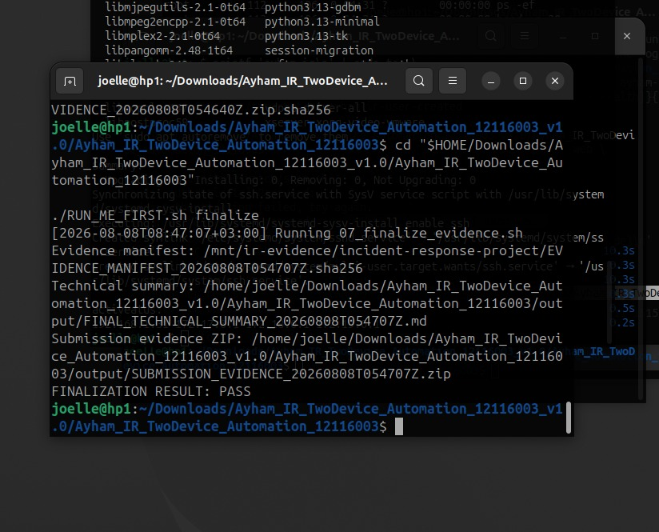
INTEGRATED INCIDENT RESPONSE
16
Final evidence package and discussion conclusion
QUALITY GATES
10 / 10
skills verified
2
authorized devices integrated
SHA-256
manifests for transferred evidence
PASS
safe case, rollback, recovery, memory, and finalization
ZERO
unauthorized targets or destructive payloads
EVIDENCE_MANIFEST_*.sha256
FINAL_TECHNICAL_SUMMARY_*.md
SUBMISSION_EVIDENCE_*.zip
The project demonstrates a defensible, ethical, and reproducible incident response lifecycle.
FINALIZATION RESULT: PASS · 2026-08-08
Notes:
Finalization created an evidence hash manifest, a technical summary, and a submission archive. The final check passed. The project demonstrates preparation, collection, containment, analysis, correlation, and recovery across two authorized devices without unsafe attack activity. The strongest results are evidence integrity, cross-tool correlation, and reproducibility.
For a live demonstration, show the Windows client in Velociraptor, the process and network collection, the Splunk dashboard, the Timesketch timeline, the matching memory hashes, one Volatility result, and the final PASS output.
[Sources]
- Local finalization output.
- NIST SP 800-61 Rev. 3: https://csrc.nist.gov/pubs/sp/800/61/r3/final
[/Sources]

