Slide 1

温绍锦(温高铁)
http://weibo.com/wengaotie

Slide 2
Druid数据库连接池的特点
稳定
高效率
可扩展
可监控
可动态配置
防SQL注入

Slide 3
稳定
阿里巴巴大规模部署
应用超过500个
部署实例超过3000
最大集群超过60台
我们大规模使用中，开源连接池只有两个是稳定的：
Druid DataSource
Jboss DataSource （历史原因还在使用）

Slide 4
稳定的特性-ExceptionSorter
当连接产生不可恢复的异常时，需要及时从连接池中清除，否则会产生大量错误。这个功能也称为ExceptionSorter，只有JBossDataSource和DruidDataSource实现了这个功能。

Slide 5
Oracle Fatal Excetion
Error Code
28 | Session has been killed
600 | Internal oracle error
1012 | Not logged on
1014 | Oracle shutdown in progress
1033 | Oracle initialization or shutdown in progress
1034 | Oracle not available
1035 | ORACLE only available to users with RESTRICTED SESSION privilege
1089 | Immediate shutdown in progres – no operations are permitted
1090 | Shutdown in progress – no operations are permitted
1092 | ORACLE instance terminated. Disconnection forced
1094 | ALTER DATABASE CLOSE in progress. Connections not permitted
…

Slide 6
MySql Fatal Exception
Error Code
1040 | ER_CON_COUNT_EEROR
1042 | ER_BAD_HOST_ERRROR
1043 | ER_HANDSHAKE_ERROR
1047 | ER_UNKOWN_COM_ERROR
1081 | ER_IPSOCK_ERROR
1029 | ER_HOST_IS_BLOCKED
1030 | ER_HOST_NOT_PRIVILEGED
1045 | ER_ACCESS_DENIED_ERROR
1004 | ER_CANT_CREATE_FILE
1005 | ER_CANT_CREAT_TABLE
1015 | ER_CANT_LOCK
1021 | ER_DISK_FULL
…

Slide 7
高性能
 | 1 线程 | 2 线程 | 5 线程 | 10 线程 | 20线程 | 50线程
Druid | 1,102 | 1,509 | 1,889 | 1,904 | 2,007 | 1,977
Tomcat-jdbc | 1,399 | 1,378 | 2,257 | 2,289 | 2,305 | 2,503
DBCP | 3,144 | 3,834 | 6,276 | 6,408 | 6,563 | 6,783
BoneCP | 4,327 | 3,598 | 3,800 | 5,242 | 9,402 | 19,066
Jboss-Datasource | 4,912 | 3,049 | 6,868 | 6,512 | 40,146 | 43,748
C3P0 | 18,570 | 19,467 | 15,270 | 19,294 | 28,195 | 66,677
Proxool | 16,221 | 14,455 | 24,688 | 38,905 | 48,087 (Error) | 58,238 (Error)
详细测试信息：
https://github.com/alibaba/druid/wiki/%E5%90%84%E7%A7%8D%E8%BF%9E%E6%8E%A5%E6%B1%A0%E6%80%A7%E8%83%BD%E5%AF%B9%E6%AF%94%E6%B5%8B%E8%AF%95
Druid是目前性能最好的数据库连接池

Slide 9
SQL Parser
Parser基本概念
词法分析
Token
语法分析
抽象语法树
表达式
语句

Slide 10
手写Parser的性能
Cobar的SQL Parser，从Antlr生成的parser修改为Druid Parser之后，大约提升6倍的性能。
Druid Parser最近再次大幅度提升性能(50%)
SQL Parser的关键在于词法
词法分析要支持预测

Slide 11
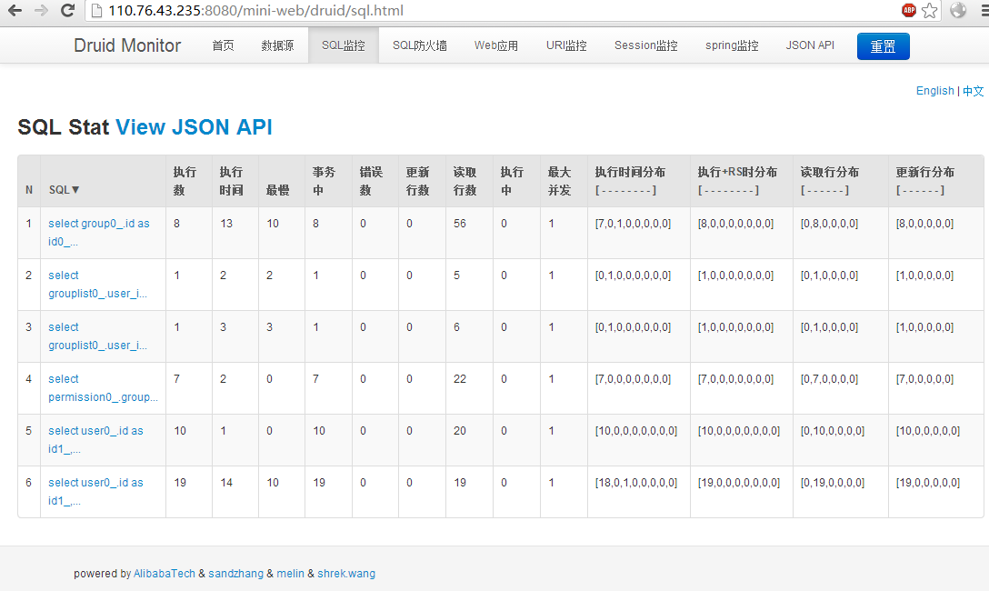
监控

Slide 12
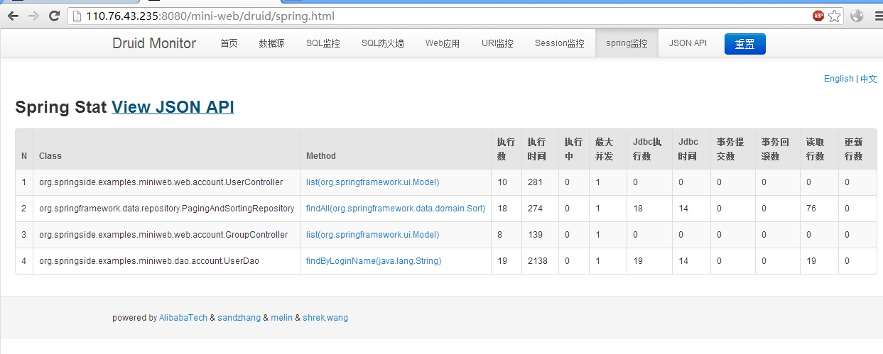
Spring关联监控

Slide 13
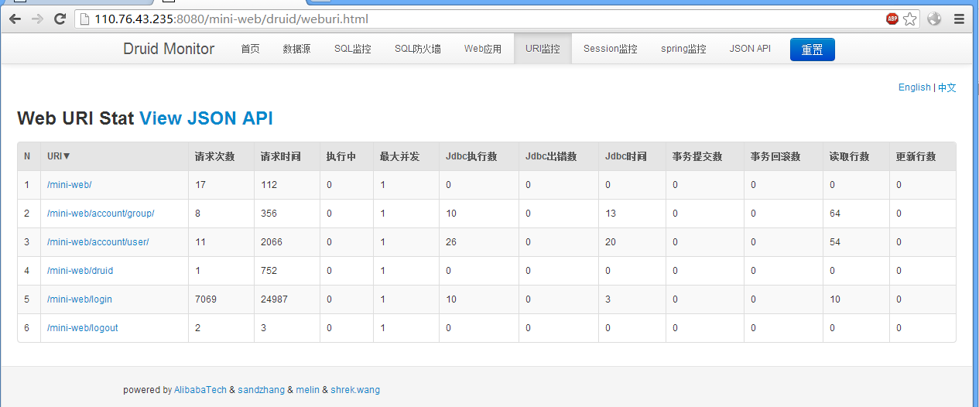
Web关联监控

Slide 14
查看SQL执行明细
配置filters=log4j
2013-07-12 16:10:17,966 [DEBUG] Connection:132 - {conn-10001} connected
2013-07-12 16:10:17,970 [DEBUG] Connection:132 - {conn-10001} commited
2013-07-12 16:10:17,970 [DEBUG] Connection:132 - {conn 10001} rollback
2013-07-12 16:10:17,983 [DEBUG] Statement:137 - {conn-10001, stmt-20000} created
2013-07-12 16:10:17,986 [DEBUG] Statement:137 - {conn-10001, stmt-20000} executed. 0.052501 millis. SELECT 1
2013-07-12 16:10:17,986 [DEBUG] Statement:137 - {conn-10001, stmt-20000} batch executed. 0.041842 millis. SELECT 1
2013-07-12 16:10:18,205 [DEBUG] Statement:137 - {conn-10001, stmt-20000, rs-50000} query executed. 219.082247 millis. SELECT 1
2013-07-12 16:10:18,205 [DEBUG] ResultSet:142 - {conn-10001, stmt-20000, rs-50000} open
2013-07-12 16:10:18,206 [DEBUG] ResultSet:142 - {conn-10001, stmt-20000, rs-50000} Header: [null]
2013-07-12 16:10:18,206 [DEBUG] Statement:137 - {conn-10001, stmt-20000} update executed. effort 0. 0.019343 millis. SELECT 1
2013-07-12 16:10:18,223 [DEBUG] Statement:137 - {conn-10001, pstmt-20001} created. SELECT 1
2013-07-12 16:10:18,260 [DEBUG] Statement:137 - {conn-10001, pstmt-20001} Parameters : [null, null, null, null, com.alibaba.druid.mock.MockBlob@34aee875, 1, [B@471f7458, null, com.alibaba.druid.mock.MockClob@620f61e2, null, 1.0, 1, 1, null, com.alibaba.druid.mock.MockNClob@5fe36eb9, null, null, null, com.alibaba.druid.mock.MockRef@4c7a64dd, com.alibaba.druid.mock.MockRowId@77741064, 1, com.alibaba.druid.mock.MockSQLXML@64e05280, , null, null, null, null]
2013-07-12 16:10:18,260 [DEBUG] Statement:137 - {conn-10001, pstmt-20001} Types : [ARRAY, OTHER, DECIMAL, OTHER, BLOB, TINYINT, OTHER, OTHER, CLOB, DATE, FLOAT, INTEGER, BIGINT, OTHER, NCLOB, NVARCHAR, VARCHAR, OTHER, REF, ROWID, SMALLINT, SQLXML, VARCHAR, TIME, TIMESTAMP, OTHER, OTHER]
2013-07-12 16:10:18,260 [DEBUG] Statement:137 - {conn-10001, pstmt-20001} executed. 0.564872 millis. SELECT 1
2013-07-12 16:10:18,260 [DEBUG] Statement:137 - {conn-10001, pstmt-20001} batch executed. 0.0075 millis. SELECT 1
2013-07-12 16:10:18,260 [DEBUG] Statement:137 - {conn-10001, pstmt-20001} Parameters : [null, null, null, null, com.alibaba.druid.mock.MockBlob@34aee875, 1, [B@471f7458, null, com.alibaba.druid.mock.MockClob@620f61e2, null, 1.0, 1, 1, null, com.alibaba.druid.mock.MockNClob@5fe36eb9, null, null, null, com.alibaba.druid.mock.MockRef@4c7a64dd, com.alibaba.druid.mock.MockRowId@77741064, 1, com.alibaba.druid.mock.MockSQLXML@64e05280, , null, null, null, null]
2013-07-12 16:10:18,262 [DEBUG] Statement:137 - {conn-10001, pstmt-20001} Types : [ARRAY, OTHER, DECIMAL, OTHER, BLOB, TINYINT, OTHER, OTHER, CLOB, DATE, FLOAT, INTEGER, BIGINT, OTHER, NCLOB, NVARCHAR, VARCHAR, OTHER, REF, ROWID, SMALLINT, SQLXML, VARCHAR, TIME, TIMESTAMP, OTHER, OTHER]
2013-07-12 16:10:18,262 [DEBUG] Statement:137 - {conn-10001, pstmt-20001, rs-50001} query executed. 1.805932 millis. SELECT 1
2013-07-12 16:10:18,262 [DEBUG] ResultSet:142 - {conn-10001, pstmt-20001, rs-50001} open
2013-07-12 16:10:18,263 [DEBUG] ResultSet:142 - {conn-10001, pstmt-20001, rs-50001} Header: [null]
2013-07-12 16:10:18,263 [DEBUG] Statement:137 - {conn-10001, pstmt-20001} Parameters : [null, null, null, null, com.alibaba.druid.mock.MockBlob@34aee875, 1, [B@471f7458, null, com.alibaba.druid.mock.MockClob@620f61e2, null, 1.0, 1, 1, null, com.alibaba.druid.mock.MockNClob@5fe36eb9, null, null, null, com.alibaba.druid.mock.MockRef@4c7a64dd, com.alibaba.druid.mock.MockRowId@77741064, 1, com.alibaba.druid.mock.MockSQLXML@64e05280, , null, null, null, null]
2013-07-12 16:10:18,263 [DEBUG] Statement:137 - {conn-10001, pstmt-20001} Types : [ARRAY, OTHER, DECIMAL, OTHER, BLOB, TINYINT, OTHER, OTHER, CLOB, DATE, FLOAT, INTEGER, BIGINT, OTHER, NCLOB, NVARCHAR, VARCHAR, OTHER, REF, ROWID, SMALLINT, SQLXML, VARCHAR, TIME, TIMESTAMP, OTHER, OTHER]
2013-07-12 16:10:18,263 [DEBUG] Statement:137 - {conn-10001, pstmt-20001} update executed. effort 0. 0.287765 millis. SELECT 1
2013-07-12 16:10:18,274 [DEBUG] Statement:137 - {conn-10001, cstmt-20002} created. SELECT 1
2013-07-12 16:10:18,274 [DEBUG] Statement:137 - {conn-10001, stmt-20000, rs-50002} query executed. 0.081711 millis. SELECT 1
2013-07-12 16:10:18,274 [DEBUG] ResultSet:142 - {conn-10001, stmt-20000, rs-50002} open
2013-07-12 16:10:18,274 [DEBUG] ResultSet:142 - {conn-10001, stmt-20000, rs-50002} Header: [null]
2013-07-12 16:10:18,275 [DEBUG] ResultSet:142 - {conn-10001, stmt-20000, rs-50002} Result: [1]

Slide 15
防御SQL注入
配置filters=“wall”
智能拦截永真条件
智能拦截系统函数调用
智能拦截系统表访问

Slide 16
集中配置、动态配置
filters=“config”
支持数据库密码加密
支持从本地或者http远程读取配置文件

