Slide 1
Stock Market Prediction
By:
Neil Deshpande (33121)
Sudeep Mangalvedhekar (33147)
Pranav Bhagwat (33161)
Vishwajit Shelke (33172)

Slide 2
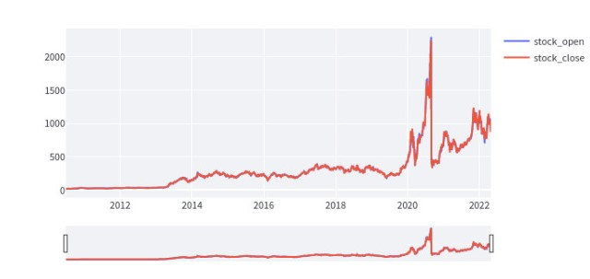
Stock Market Prediction
Predicting future stock prices using historical data.
Involves Time Series data.
Time Series Data

Slide 3
Literature Review
Studying finance related concepts:
Stock: Consists of all the shares into which ownership of the company is divided.
OHLC: Open High Low Close.
Volume: Total trading activity.
Studying models useful in predicting time series data
Regression Models.
Deep Learning Models.

Slide 4
Alpha Vantage API
Alpha Vantage provides enterprise-grade financial market data through a set of powerful and developer-friendly APIs.
The data returned by the API is from the NASDAQ index.
We have used their Core Time Series Stock Data APIs to fetch stock price data of a few companies.
API key required to fetch data.

Slide 5
Model for Prediction
For predicting stock market prices, we are using:
Long Short Term Memory Neural Network
It has reasonable accuracy, and does not overfit

Slide 6

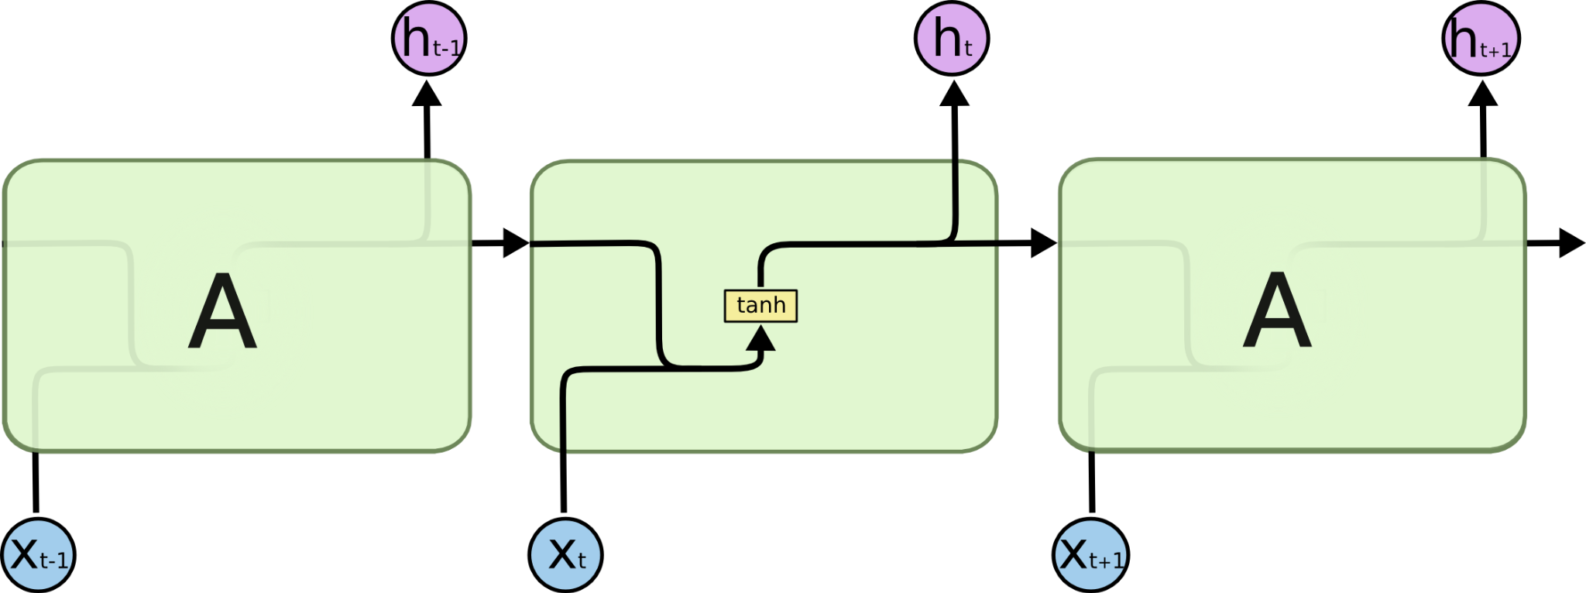
Long Short Term Memory (LSTM) Neural Network
LSTM is a special kind of Recurrent Neural Network that solves the Long-Term Dependency Problem.
Long Short Term Memory Neural Network
Recurrent Neural Network

Slide 7
Long Short Term Memory (LSTM) Neural Network contd.
Unlike RNNS, the repeating layer consists of more than a single neural network with a special structure.
This helps the LSTM network to access data that the network has not encountered in the recent past.

Slide 8
Technologies and Libraries used
Tensorflow and Keras
For creating, training and performing predictions.
Used Keras’ Sequential API for developing a LSTM Network.
Used Keras’ API for training and testing the LSTM network.

Slide 9
StreamLit
StreamLit is a software to create web applications for machine learning and data science projects.
It is an all python framework.
Compatible with major data science libraries in python (numpy, panda, matplotlib etc)
Easy to use, useful for quick prototyping.

Slide 10
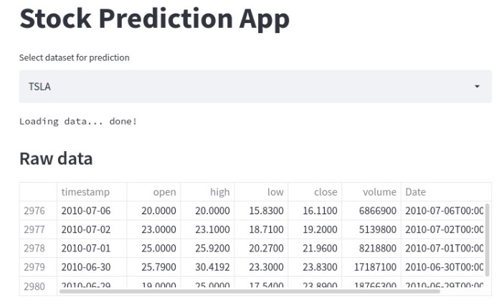
End Product
Selecting Stock to predict:

Slide 11
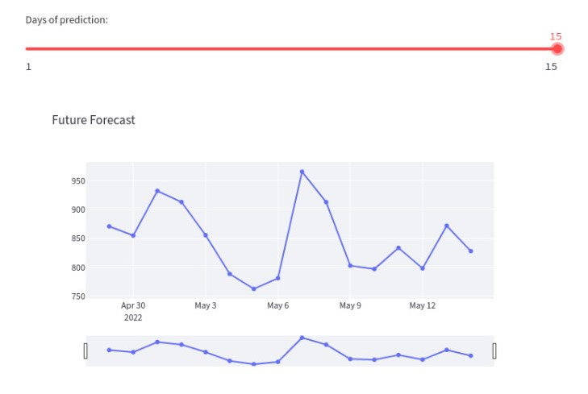
End Product contd.
2. Selecting Number of days for which stock price is to be predicted.

Slide 12
Conclusion
Through this Mini Project, we have created a web application for predicting stock prices.
Performed data collection using the Alpha Vantage API.
Used a Long Short Term Memory Neural Network to predict the stock prices based on historical data.
Displayed the results using StreamLit.

