Slide 2
One To Many Relationship

Slide 3
One-to-Many Relationship
Each table has a primary key that uniquely defines each row within the table.
The easiest way to configure a one-to-many relationship is by convention.
EF Core will create a relationship if an entity contains a navigation property.

Slide 4
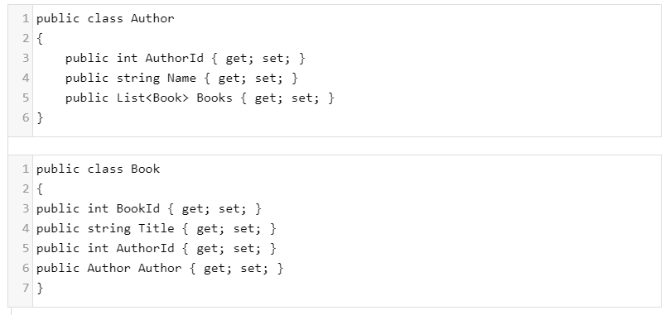
One-to-Many Relationship

Slide 5
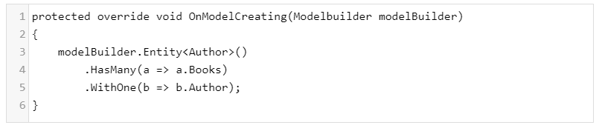
One-to-Many Relationship
Now if your model does not follow the default conventions, the Fluent API can be used to configure the correct relationship between entities.

Slide 6
Configuring Relationships with the Fluent API
When configuring relationships with the Fluent API, you will use the Has/With pattern.
The "Has" side of the pattern is represented by the HasOne and HasMany methods.
The "With" side of the relationship is represented by the WithOne and WithMany methods.

Slide 7
One To One Relationship

Slide 8
One To One Relationship
Each row of data in one table is linked to zero or one row in the second table.

Slide 9
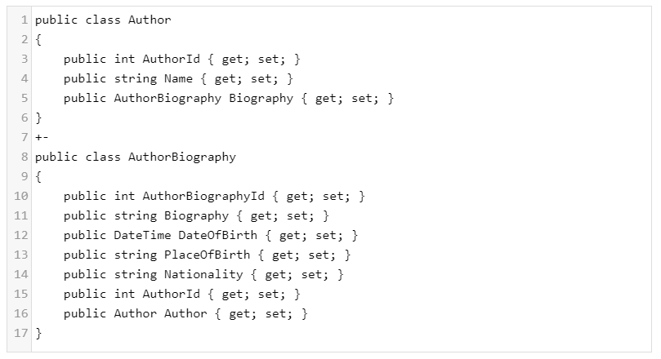
One To One Relationship

Slide 10
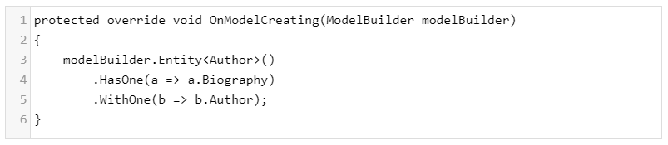
One To One Relationship
Now if your model does not follow the default conventions, the Fluent API can be used to configure the correct relationship between entities.

Slide 11
Many To Many Relationship

Slide 12
Many To Many Relationship
Each row of data in one table is linked to many rows in the second and vice versa.
Example:
a book can appear in multiple categories and a category can contain many books.
In EF Core, many-to-many relationships are not yet supported without an entity class to represent the join table.

Slide 13
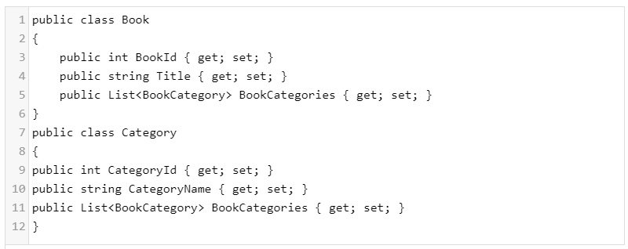
Many To Many Relationship
You can represent a many-to-many relationship by including another entity class for the join table and mapping two separate one-to-many relationships.

Slide 14
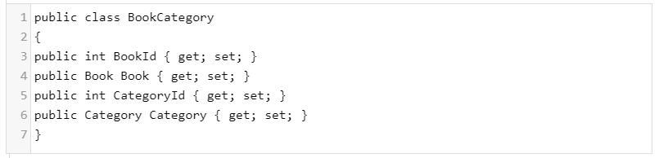
Many To Many Relationship
The Book and BookCategory have one-to-many relationship.
The Category and BookCategory have also one-to-many relationship.

Slide 15
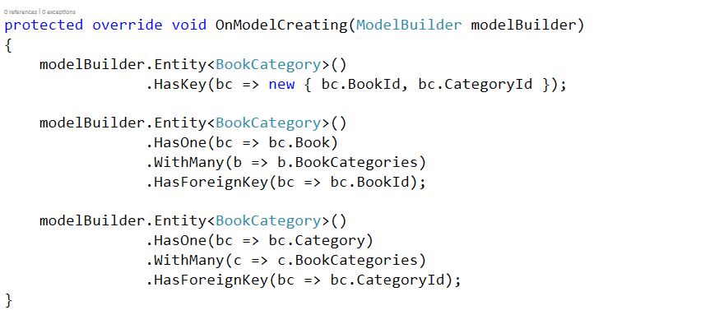
Many To Many Relationship
Now we need to configure the relationship using Fluent API.

