Slide 1

Teaching computer science principles as an ap course Preparing for the AP CSP exam
Perla Weaver
Associate Professor, Computer Science
Johnson County Community College
CSP APSI consultant, CSP AP Reader/Leader

Slide 2
Understanding AP Computer Science Principles
The course framework
Computational Thinking Practices
Big Ideas ​
End-of-course AP exam
​Create Performance Task​

Slide 3

Computational Thinking Practices
Six Computational Thinking Practices – what students should be able to do, they frame the course skills
P1: Computational Solution Design
P2: Algorithms and Program Development
P3: Abstraction in Program Development
P4: Code Analysis
P5: Computing Innovations
P6: Responsible Computing

Slide 4
Big Ideas
Five overarching concept or themes, these topics define the concepts addressed in the course
Idea 1: Creative Development (CRD)
Idea 2: Data (DAT)
Idea 3: Algorithms and Programming (AAP)
Idea 4: Computing Systems and Networks (CSN)
Idea 5: Impact of Computing

Slide 5
The CSP framework
CTPs and Big Ideas provide a framework to develop curriculum
Units, order, pacing, etc. is built around and to fulfill the framework requirements
Curriculum providers develop and provide syllabi, units, lesson plans, materials, PD, etc.

Slide 6


The exam
End-of-course and Create Performance Task

Slide 7

End-of-course exam
Multiple choice questions
57 single select multiple-choice
5 single-select with passage about a computing innovation
8 multiple-select multiple-choice
70% of the course weight
120 minutes
Questions
Multiple choice
Pseudocode – Exam reference sheet for “code like” questions
Flowcharts

Slide 8
End-of-course exam
Preparing
AP Classroom practice questions
Questions can be searched by CTP skills, Big Idea Topics, Enduring Understandings (EU), Learning Objectives (LO), Essential Knowledge (EK)
Questions must be matched to the specific curriculum sequence
AP Classroom practice exams
Prep books and provider sample questions

Slide 9

Create performance task
30% of the course weight
Scored by a “reader” at the annual AP Reading in June
Students develop a program or application using any programming language
12 hours (720 minutes) of in class time required
Students submit
A video demonstrating the functionality of their program/application
A pdf of the source code
Responses to a set of prompts that ask student to analyze their work

Slide 10
Preparing - resources
Student handout
Description of requirements and guidelines for completing the task
Sample student responses
New set every year
Scoring guidelines applied at the reading
Scoring commentary
Score distributions
Chief Reader Report

Slide 11
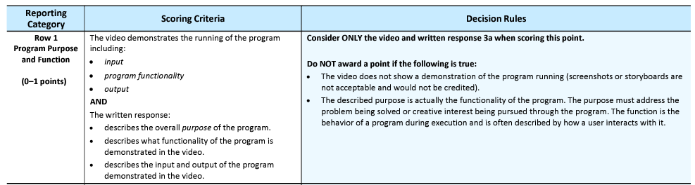
The program – Row 1
Students often describe functionality instead of purpose
Function is what the program does.
Purpose is the reason, the why the program exists
3a. Provide a written response that does all three of the following
i. Describes the overall purpose of the program
ii. Describes what functionality of the program is demonstrated in the video
iii. Describes the input and output of the program demonstrated in the video

Slide 12
Tips for row 1 – Practice purpose
Use the terms “purpose” and “function” often and in many settings
“Getting to know” activities, for example:
Favorite apps, what does the app do? (function) vs what do we use it for? (purpose)
Example: timer app
What does it do? → counts seconds, minutes, measures time → function
What do we use it for? → check when to turn off the oven, track my swim lap times → purpose
When talking about innovations
Every programming activity
Targeted practices: answer the prompts

Slide 13
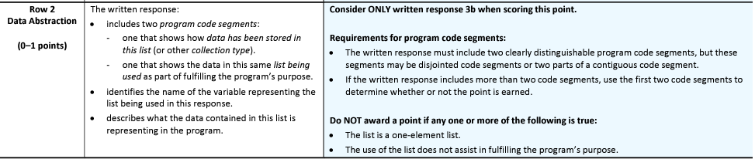
Using a list – Row 2
Students show single line or block, mention multiple lists
Capture and paste two program code segments you developed during the administration of this task that contain a list (or other collection type) being used to manage complexity in your program.
i. The first program code segment must show how data have been stored in the list.
ii. The second program code segment must show the data in the same list being used, such as creating new data from the existing data or accessing multiple elements in the list, as part of fulfilling the program’s purpose.
iii. Identifies the name of the list being used in this response
iv. Describes what the data contained in the list represent in your program
Select code that shows enough context of list use Focus on one list

Slide 14
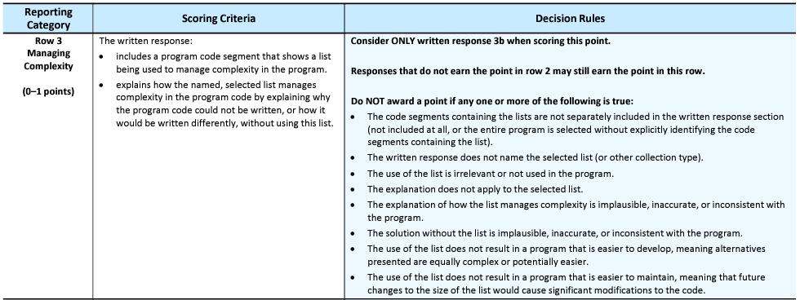
Lists reduce complexity – Row 3
3 b. v. Explains how the selected list manages complexity in your program code by explaining why your program code could not be written, or how it would be written differently, if you did not use the list

Slide 15
Tips for row 3 – complexity from the beginning
Be explicit about the benefit of every programming abstraction
Demonstrate benefits “organically”
For example, can we write a program that adds two numbers?
What happens if we want to change the values?
How does our abstraction change if we introduce variables?
What do we gain?
Another example, can we draw a square?
How about 3 squares, 10? → introduce loops
How about n squares, of different sizes? → introduce a function with parameters
Don’t just talk about lists reducing complexity, all abstractions reduce complexity
Let students work out a problem or two without a function, or a list, or a loop – then introduce the new abstraction, have students describe the benefits, how complexity was reduced, how the implementation without it was more cumbersome, or even not possible

Slide 16
Function with parameters – Row 4
3 c. Capture and paste two program code segments you developed during the administration of this task that contain a student-developed procedure that implements an algorithm used in your program and a call to that procedure.
i. The first program code segment must be a student-developed procedure that:
□ Defines the procedure’s name and return type (if necessary)
□ Contains and uses one or more parameters that have an effect on the functionality of the procedure
□ Implements an algorithm that includes sequencing, selection, and iteration
ii. The second program code segment must show where your student-developed procedure is being called in your program.
Then, provide a written response that does both of the following:
iii. Describes in general what the identified procedure does and how it contributes to the overall functionality of the program

Slide 17
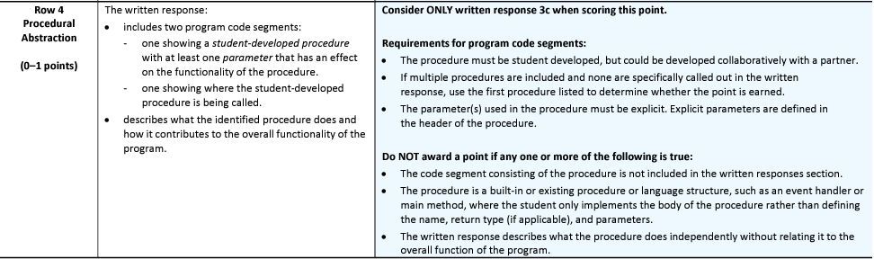

Row 4
Describing contribution is difficult with small programs
Arguments are often unused, overridden
Practice breaking down functionality, identifying the part of the algorithm delegated to the function, and using parameters.
Tips: be aware of the language, in many environments, variables are global or values are
entered in a GUI. Parameter concepts must be solid, or students may not recognize “errors”.

Slide 18
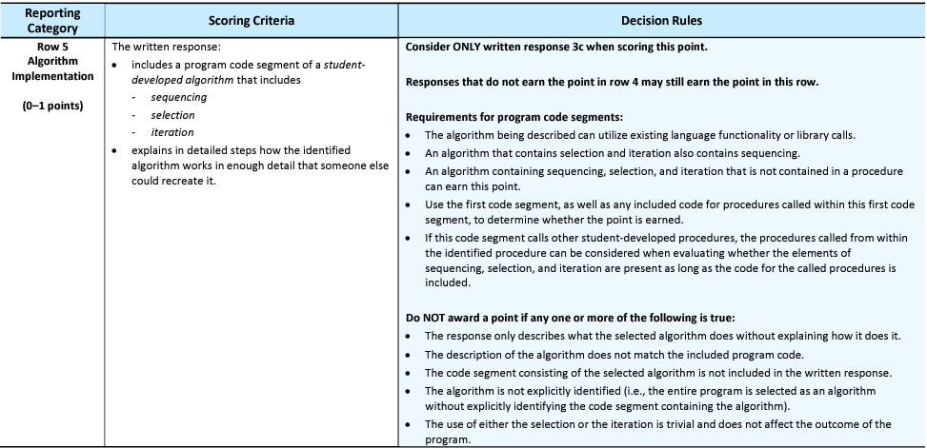
Algorithm analysis – Row 5
3 c. iv. Explains in detailed steps how the algorithm implemented in the identified procedure works. Your explanation must be detailed enough for someone else to recreate it.
Focus on describing the selected function, avoid describing the “calling algorithm”.
Selection and iteration should be functional.
Code trace!

Slide 19
Inputs decide outputs – Row 6
Provide a written response that does all three of the following:
i. Describes two calls to the procedure identified in written response 3c. Each call must pass a different argument(s) that causes a different segment of code in the algorithm to execute.
First call: Second call:
ii. Describes what condition(s) is being tested by each call to the procedure Condition(s) tested by the first call: Condition(s) tested by the second call:
iii. Identifies the result of each call Result of the first call: Result of the second call:

Slide 20
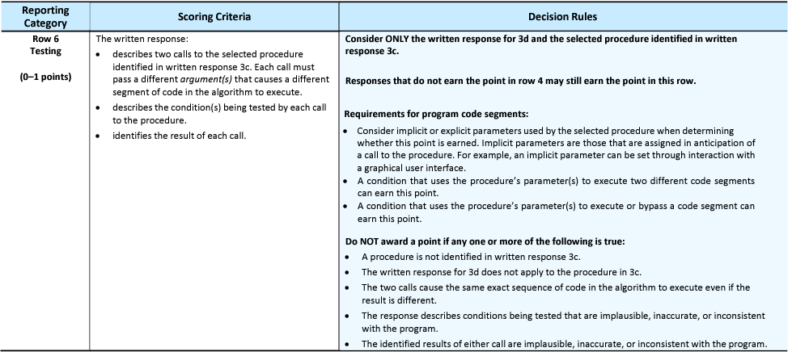
Inputs decide outputs – Row 6
Students describe two inputs that produce different outcomes but not different code paths.
Paths do not depend on the argument values

Slide 21
Tips for row 6
Trace code identify all input variables, conditions and output variables
Use colors for each path
Use a flow chart to describe multiple paths in an algorithm
Differentiate patterns for functions
Parameters that affect calculations, different inputs → different outputs, but always execute the same code
function calculateAreaOfTriangle(base, height)
area = (base * height) / 2
Parameters that affect decisions, different inputs → different outputs and different code segments
function calculateDiscount(sales)
if (sales < 10)
discount = 0.05
else
discount = 0.1
Identify call arguments Sales | Condition tested Sales <10 | Identify result Discount
7 | 7 < 10 → T | 0.05
25 | 25 < 10 → F | 0.1

Slide 22
The most important tip
Scaffold, scaffold, scaffold!!
Practice concepts often and varied.
Modify, generalize, expand → remember the zone of proximal development!
If we only teach what is needed for a good score in the exam and the PT, then we are teaching to the test.
Often, this doesn’t work. We see it in the scores!
If we teach our students to think computationally, then they will do great in the exam and the PT.

Slide 23
Links
AP CSP Course and Exam Description
AP Central

Slide 24
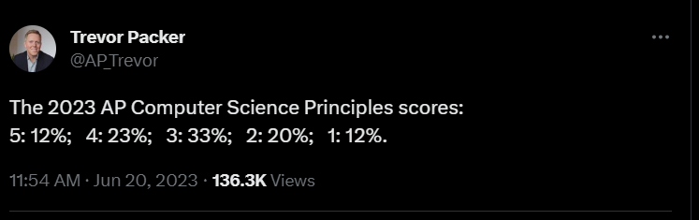
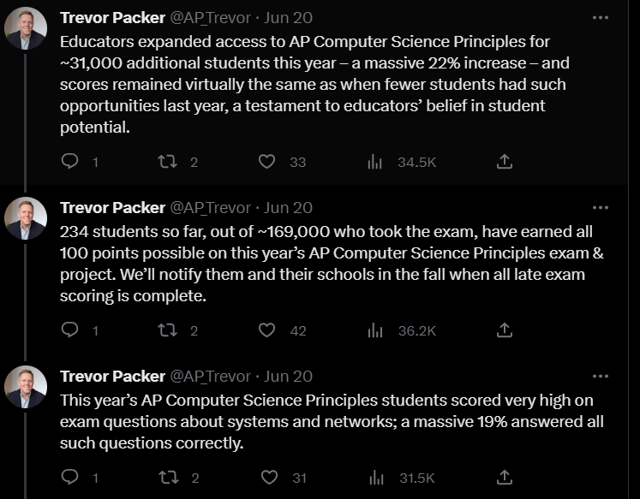
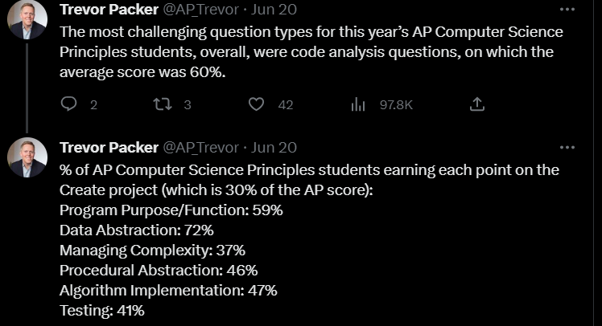
Stats

