Slide 1

Psychology for Student Learning & Motivation
Michelle Friend, PhD
University of Nebraska Omaha
mfriend@pobox.com

Slide 2
Look at this list of values
athletic ability
being good at art
creativity
independence
living in the moment
music
membership in a social group (such as your community, racial group, or school club)
politics
relationships with friends or family
religious values
sense of humor
Choose the most important to you
Notes:
First we’ll start with a short activity, which I won’t explain but we’ll come back to

Slide 3
athletic ability
being good at art
being smart or getting good grades
creativity
independence
living in the moment
membership in a social group (such as your community, racial group, or school club)
music
politics
relationships with friends or family
religious values
sense of humor
Look at the value you chose, and think about times when that value was important to you. In a few sentences, write why that value is important to you. Focus on your thoughts and feelings, and don’t worry about spelling, grammar, or how well written it is.
Notes:
Take about 10 minutes

Slide 4

A short biography
Programming in Elementary School
Chemistry credential
IT at Indiana University
Computer Science Teacher at The Girls Middle School
Computer Science Teachers Association
PhD focused on Computer Science Education
Notes:
Goal of this slide: establish empathy with audience AND establish credentials
Focus on interest, casual misogyny, imposter syndrome, the development of curricula
I study computer science education, particularly interest and identity. I identify as a learning scientist – someone who studies learning – but primarily from a psychology point of view

Slide 5
Belonging –
the feeling of being accepted and approved by a group or by society as a whole

Slide 6
Values Affirmation: What is it?
Value menu: present a list of personal values
Writing task: write a brief essay about their most important value
Value domain: value should not be related to school, but should be personal / relevant to social groups
Cohen, Geoffrey L., Julio Garcia, Nancy Apfel, and Allison Master, ‘Reducing the Racial Achievement Gap : A Social-Psychological Intervention’, Science, 313.5791 (2006), 1307–10
Notes:
Going back

Slide 7
Values Affirmation: What does it do?
Overcomes “social identity threat” (does nothing for unthreatened students)
Sets up a “virtuous cycle” of improved performance
Outcomes: GPA & other achievement
Wu, Zezhen, Thees F. Spreckelsen, and Geoffrey L. Cohen, ‘A Meta-Analysis of the Effect of Values Affirmation on Academic Achievement’, Journal of Social Issues, 77.3 (2021), 702–50 <https://doi.org/10.1111/josi.12415>
Notes:
Works against social identity threat – stereotype threat is one – psychological adaptation based on awareness and apprehension about possibility of being judged negatively in light of their social group or identity. Chronic, effects accumulate over time leading to downward spiral in performance,.

Slide 8
What does your classroom communicate?
Cheryan, S., Plaut, V. C., Davies, P. G., & Steele, C. M. (2009). Ambient belonging: How stereotypical cues impact gender participation in computer science. Journal of Personality and Social Psychology, 97(6), 1045–1060. https://doi.org/10.1037/a0016239
Cheryan, S., Meltzoff, A. N., & Kim, S. (2011). Classrooms matter: The design of virtual classrooms influences gender disparities in computer science classes. Computers & Education, 57(2), 1825–1835. https://doi.org/10.1016/j.compedu.2011.02.004
Notes:
Think about walking into these two rooms. On the left we have a bust of Spock, a Star Trek poster, pieces of electronics, science fiction. On the right we have nature posters and general art, a plant, general magazines. Which one would you rather be in?
Each contained 12 students’ desks and chairs, one professor’s desk and chair, a bulletin board, a shelf and a whiteboard labeled with “Welcome to Introduction to Computer Science.” The classrooms differed only in their objects. One classroom contained objects stereotypically associated with computer science and the other did not. The stereotypical objects were generated by undergraduates who were surveyed about what objects they expected to find in stereotypical computer science environments (Cheryan et al., 2009). Specifically, the objects stereotypically associated with computer science were: science fiction books, computer parts, electronics, software, technology magazines, video games, computer books and Star Wars and Star Trek items. The objects not stereotypically associated with computer science were: water bottles, a coffee maker, art pictures, nature pictures, lamps, pens, general magazines

Slide 9
Ambient belonging –
the feeling of fitting in to an environment

Slide 10
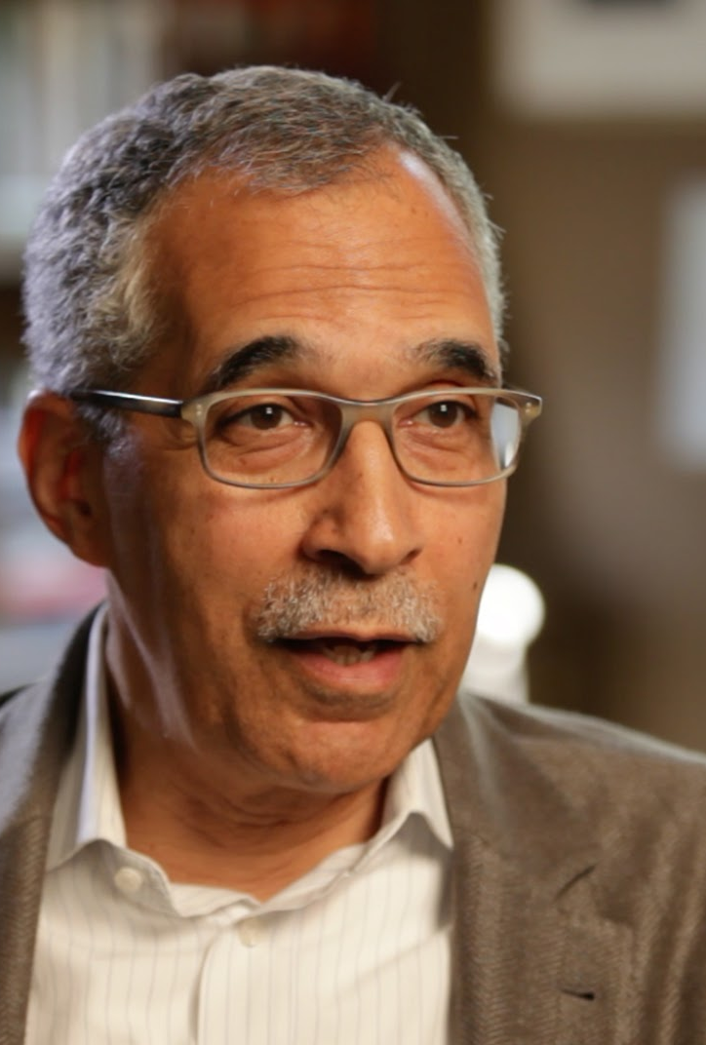
Stereotype threat
The social-psychological threat that arises when one is in a situation or doing something for which a negative stereotype about one's group applies. A concern that one’s actions can be seen through the lens of a negative stereotype.
Claude Steele, identifier of stereotype threat
Image by TeachAIDS from Stanford, California, USA - Claude Steele - TeachAIDS Interview, CC BY-SA 2.0, https://commons.wikimedia.org/w/index.php?curid=48861312
Steele, Claude M., ‘A Threat In The Air’, American Psychologist, 52.6 (1997), 613–29

Slide 11
What are some stereotypes?

Slide 12
Stereotype threat examples
White men can’t jump
Women aren’t good at math
Asians are good at math (stereotype lift)

Slide 13

Multi-Threat Framework Jenessa Shapiro (Shapiro & Neuberg, 2007)
 |  | Target of the threat
 |  | Self | Group
Source of the threat | Self | Self Concept Threat | Group Concept Threat
 | Other - outgroup member | Own Reputation Threat (outgroup) | Group Reputation Threat (outgroup)
 | Other - ingroup member | Own Reputation Threat (ingroup) | Group Reputation Threat (ingroup)
Notes:
Self Concept Threat - fear that my behavior will confirm, in my own mind, that the negative stereotypes of my group are true of me
Group Concept Threat - fear that my behavior will confirm, in my own mind, that the negative stereotypes of my group are true of my group
Own Reputation Threat (outgroup) - fear that my behavior will confirm, in the minds of outgroup members, that the negative stereotypes held of my group are true of me and I will therefore be judged or treated badly by outgroup members
Group Reputation Threat (outgroup) - fear that my behavior will confirm, in the minds of outgroup members, that the negative stereotypes held of my group are true of my group and my group will therefore be judged or treated badly by outgroup members
Own Reputation Threat (ingroup) - fear that my behavior will confirm, in the minds of ingroup members, that the negative stereotypes held of my group are true of me and I will therefore be judged or treated badly by ingroup members
Group Reputation Threat (ingroup) - fear that my behavior will confirm, in the minds of ingroup members, that the negative stereotypes held of my group are true of my group and my group will therefore be judged or treated badly by ingroup members

Slide 14
Interventions for Stereotype Threat
Tell your students about stereotype threat
Tell them that their feelings of anxiety are not representative of their ability
Values affirmation
Role models – useful for group-as-target stereotype threat
Self affirmation – useful for self-as-target stereotype threat

Slide 15
The Mentor’s Dilemma
Wise strategies for assisting students – “assure students that they will not be judged stereotypically – that their abilities and `belonging’ are assumed rather than doubted” AND do not lower standards
Wise feedback - should invoke high standards and belief that students can meet them: “I have high standards, but I wouldn’t go to the trouble of giving you this feedback if I didn’t think you could meet them”
Cohen, Geoffrey L., Claude M. Steele, and Lee D. Ross, ‘The Mentor’s Dilemma: Providing Critical Feedback Across the Racial Divide’, Personality and Social Psychology Bulletin, 25.10 (1999), 1302–18 <https://doi.org/10.1177/0146167299258011>

Slide 16

Mindset
What do you know about mindset?
Carol Dweck. Picture courtesy of Stanford University

Slide 17
Mindset
Growth Mindset | Fixed Mindset
“Incremental Theory of Intelligence” | “Entity Theory of Intelligence”
Mastery goals | Performance goals
Persist in the face of failure | Give up in the face of failure
Learning more important than doing well | Looking good more important than understanding
Dweck (2006)
Notes:
Fixed: Means having to prove yourself over and over – any failure means you’ve reached the limit of your ability
It’s only relevant in the face of failure
CS & programming are inherently growth mindset activities
What students SAY they believe and how they ACT are often not the same. As educators, we have to create environments where failure really IS okay.

Slide 18
Mindset
Many people SAY growth things but act in a fixed way
To promote a growth mindset:
Failure must ACTUALLY be okay
Mastery-based grading
Opportunities for showing growth
I can’t YET

Slide 19
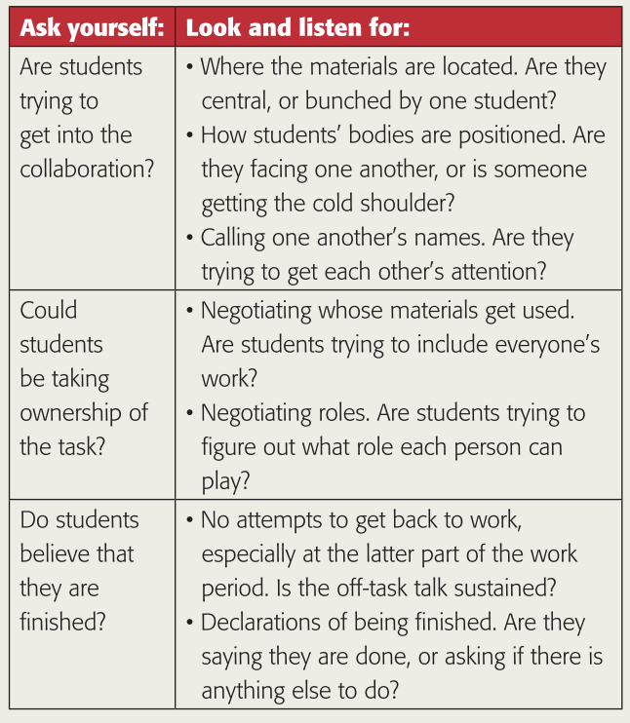
Off Task Behavior
Gargroetzi, E. C., Chavez, R. D., Munson, J., Langer-Osuna, J. M., & Lange, K. E. (2019). Can off-task be on-track?
Phi Delta Kappan, 100(8), 62–66. https://doi.org/10.1177/0031721719846892
Notes:
Off-task behavior serves to include people who are outsiders – either bid for inclusion by the excluded or the group, resist domination, bid for attention
﻿Because the professional literature emphasizes the importance of time on task (Milner et al., 2018), teachers assume that off-task talk is wasting time and detracting from learning. But is that always true? What are students doing when they appear off task? As it turns out, some research suggests that off-task talk can support collaboration by alleviating boredom (Baker et al., 2010), supporting emotional regulation (Sabourin et al., 2011), negotiating status within the group (Sullivan & Wilson, 2015), or extending work in new directions

Slide 20
Attributions
Inferred causes of events or behaviors
Especially negative or surprising events
Reattribution
Consider alternate causes

Slide 21
General Attributional Model
Antecedent Conditions
Environmental Factors
Perceived Causes
Attributions
Causal Dimensions
Stability
Personal Factors
Locus
Control
Psychological Consequences
Behavioral Consequences
Expectancy for success
Self-efficacy
Affect
Choice
Persistence
Level of effort
Achievement
Before
Outcome
After Outcome:
Attribution & Consequences
What happens-> Why you think it happened -> Interpretation -> Feelings -> Behavior
Notes:
Antecedent conditions - Actor vs. observer – each will have different specific information.
Causal schemas are cognitive shortcuts or principles individuals use to determine causality. For example causes must precede effects – Sam didn’t fail a test due to the fight he had with his girlfriend after the test was over. Another example – spatial and temporal contiguity are considered, so a fight right before the test might be considered a reason while a fight two months ago probably wouldn’t. A band playing right outside the window would be a distraction but one playing far away wouldn’t. Also size – a big test failed might be attributed to a big cause, like a divorce not to small causes like failing to do any homework
Prior knowledge – scripts are situations with high consensus about normal behavior, like what to do in a restaurant. People look for attributions when things don’t go according to script, like if the teacher starts yelling
Individual differences – people have different attributions to the same outcome, such as one person who is thrilled with an 84% and another who thinks it’s terrible, or two people who fail a test but one thinks it’s because the material is difficult and she didn’t study enough, while another thinks its because he’s stupid

Slide 22
Why did that happen?
Antecedent Conditions
Environmental Factors
Perceived Causes
Attributions
Causal Dimensions
Stability
Personal Factors
Locus
Control
Psychological Consequences
Behavioral Consequences
Expectancy for success
Self-efficacy
Affect
Choice
Persistence
Level of effort
Achievement
What do you think caused the outcome?
Traditional four causes:
Ability
Effort
Task Difficulty
Luck
Notes:
This is the heart of attribution theory – these are the attributions. What do I think caused the outcome?
Traditional four causes: : ability, effort, task difficulty, luck
Recent research has discovered more than the traditional four which were the subject of early research, but they still show up too
People do make spontaneous attributions – when events are unexpected, such as doing differently on a test than expected (better OR worse), when events are negative, like failing a test or losing a game, when events are important to the individual – more likely to attribute failure on a final exam than a little weekly vocab quiz.
Conditions that foster attributional search:
To understand the causes of outcomes of events
When events are unexpected
When events are negative
When events are important to the individual

Slide 23
What does it mean?
Antecedent Conditions
Environmental Factors
Perceived Causes
Attributions
Causal Dimensions
Stability
Personal Factors
Locus
Control
Psychological Consequences
Behavioral Consequences
Expectancy for success
Self-efficacy
Affect
Choice
Persistence
Level of effort
Achievement
Locus – whether a cause is internal or external to you
Internal vs. External
Stability – if cause is fixed or variable across situations & time
Stable vs. Unstable
Controllability – how much control you have
Controllable vs. Uncontrollable
Notes:
This is the heart of attribution theory – these are the attributions. What do I think caused the outcome?
Traditional four causes: : ability, effort, task difficulty, luck
Recent research has discovered more than the traditional four which were the subject of early research, but they still show up too
People do make spontaneous attributions – when events are unexpected, such as doing differently on a test than expected (better OR worse), when events are negative, like failing a test or losing a game, when events are important to the individual – more likely to attribute failure on a final exam than a little weekly vocab quiz.
Conditions that foster attributional search:
To understand the causes of outcomes of events
When events are unexpected
When events are negative
When events are important to the individual

Slide 24
What does it mean?
Antecedent Conditions
Environmental Factors
Perceived Causes
Attributions
Causal Dimensions
Stability
Personal Factors
Locus
Control
Psychological Consequences
Behavioral Consequences
Expectancy for success
Self-efficacy
Affect
Choice
Persistence
Level of effort
Achievement
 | Internal |  | External
 | Controllable | Uncontrollable | Controllable | Uncontrollable
Stable | Long-term effort | Aptitude | Instructor bias/favoritism | Ease/difficulty of school/course
Unstable | Skills Short-term effort | Health on exam day Mood | Help from friends/teacher | Chance

Slide 25
Attributional Biases
Fundamental Attribution Error Attribute other’s behavior to disposition
Actor-Observer Bias Actors attribute own behavior to situation; observers see actor not situation & attribute to disposition
Hedonic (Self-serving) Bias Taking responsibility for success but not failure
Self-centered Bias Taking more responsibility for outcome than is due
False Consensus Thinking you’re typical
Notes:
These are antecedent conditions for attribution theory – biases that affect the attributions we make for why things happen

Slide 26
Thank you!
Michelle Friend
mfriend@pobox.com
mefriend@unomaha.edu

