Slide 1
Reading Time Go over paper and review Discussion starts at 1:15
https://teach2impact.com/2020/07/19/the-story-of-normal-distribution-of-grades/

Slide 2

Another Victim of COVID-19: Computer Science Education
YeckehZaare, Grot, Dimovski, Pollock, Fox (2022)
https://dl-acm-org.er.lib.k-state.edu/doi/10.1145/3478431.3499313
All information from paper listed above unless otherwise cited

Slide 3
Outline:
Literature review
Research Questions for Current Study
Methods
Results
Summary
Limitations

Slide 4
Literature review:
Prior literature shows that study habits significantly impact learning and skill development
When universities transitioned to remote learning because of the COVID-19 pandemic, many students struggled to maintain their study habits
However, no studies exist on the effect of the pandemic on computer science students learning and study habits
Spacing, or the idea of distributing studying over multiple sessions, has shown to have a positive impact on student performance in computer science courses
CSE was affected in some ways by the pandemic, but it is unclear how the study habits of these students changed.

Slide 5
Research Questions for Current Study:
What is the average effect of the pandemic on a student’s overall number of interactions with the eBook?
What is the average effect of the pandemic on a student’s spacing over one extra day while maintaining the same overall number of interactions with the eBook?
Goal: to better understand how the pandemic has affected students’ learning, regardless
of their self-evaluations or exam grades.

Slide 6
Methods: Participants
Total Participants: 1028 students who were enrolled in a large, introductory computer science course at an unspecified university.
Gender Distribution: 481 men (46.8%); 547 women (53.2%)
Academic Level: 158 freshmen, 454 sophomores, 198 juniors, 218 seniors
Course Content: This class covers a range of computer science topics including the
basics of redundancy compression, open-source software development, data retrieval, manipulation, and storage.

Slide 7
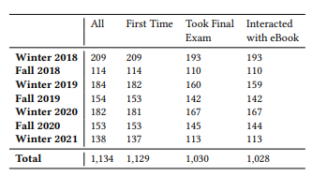
Methods: Semester Breakdown

Slide 8
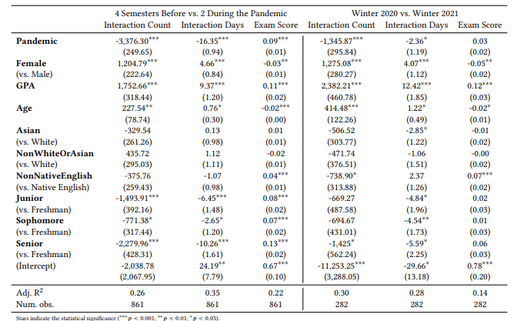
RESULTS: Regression data for both models

Slide 9
Results: Model Conclusions
Regression results indicate that, during the pandemic, on average, students had 3,376.30 fewer interactions with the eBook
Students also distributed their studying on 16.35 fewer days of the semester
As for the winter semesters, These results show that, on average, students had 1, 345.87 fewer eBook interactions and distributed their studying on 2.36 fewer days
We can clearly observe a significant decrease in the quantity (amount) and quality (spacing) of studying during the pandemic.

Slide 10
Summary:
The study collected data from 1, 028 students over seven semesters in a large introductory computer science course in the US
The results show a significant negative impact on student’s study habits resulting in lower quality studying
The results also show that students studied less frequently
These regression results indicate that the pandemic negatively affected the quantity (studying amount) and the quality of studying (spacing) in this course, which may have a lasting impact on the students’ education.
Additional studies will have to be conducted to determine why this occurred and if it as prevalent in advanced level CSE courses

Slide 11
Limitations:
Just a study of raw data, no causes could be determined, or participants interviewed
Limited Regression Models: Only two models were used, additional models could have been useful to theorize about the potential causes
Low diversity: Vast majority (over 75 percent) of data is from White and Asian students

Slide 12
Thank you ☺

