Slide 1
Reading Time Go over paper and review Discussion starts at 2:45

Slide 2

Engagement and Anonymity in Online Computer Science Course Forums
Sharma & McTavish et al. (2023) https://dl.acm.org/doi/10.1145/3568813.3600121
All information from paper listed above unless otherwise cited

Slide 3
Background
Course Discussion Forums
Piazza
Ed Discussion
Intersectionality
Gender
Race/Ethnicity

Slide 4
Research Questions
RQ1- Anonymity based on demographics
RQ2- Anonymity based on intersections and contexts
RQ3 – Lurking based on intersections
RQ4 – Accuracy of gender prediction models

Slide 5
Research Questions
RQ1- Anonymity based on demographics
RQ2- Anonymity based on intersections and contexts
RQ3 – Lurking based on intersections
RQ4 – Accuracy of gender prediction models

Slide 6
Learning is Social
Jean Piaget – Social Learning
Learning Communities
Knowledge Forum (1983)
StackOverflow & GitHub
Very Gender Imbalanced

Slide 7
Social Computing
“The world is a stage”
We develop and maintain a public image
Imposter Syndrome
Fear of looking dumb when asking questions – negative social effects
Anonymity online may drive more authenticity vs. curated images

Slide 8
Related Work
Online tools prolific in CS
Anonymity increases engagement
Clickers, Peer Instruction
Online Discussions
Women and men provide answers at similar rate
Inconclusive in prior work

Slide 9
Data
7847 Posts, 8 courses. Single School
14 courses asked, 6 said yes. 2 more taken from other semester
2216 students, 1578 posted
Demographics from registrar (term 1) and students (term 2)
Instructor and private posts removed

Slide 10
Gender Data
Registrar: Male, Female, Trans Male / Trans Man, Trans Female / Trans Woman, Genderqueer / Gender Non-Conforming, Decline to State, Self Describe
Survey: he/him/his, she/her/hers, they/them/theirs, prefer not to stay, or text input
Similar issues with Race/Ethnicity

Slide 11
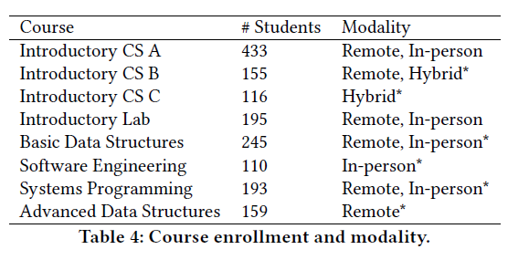
Modality
Highly selective enrollment – 24%

Slide 12
Calculating Anonymity
Mean anonymity rate per student
Avoid over-representation by students who post frequently
Is this a good measure?

Slide 13
Analysis
RQ2 – Pairwise z-tests
Intersections – Beta regression compared to baseline
Asian males largest group
RQ3 – chi square test (Piazza only)
RQ4 – direct comparison

Slide 14
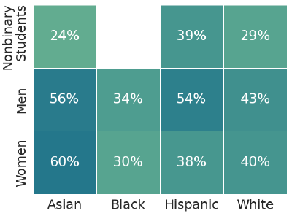
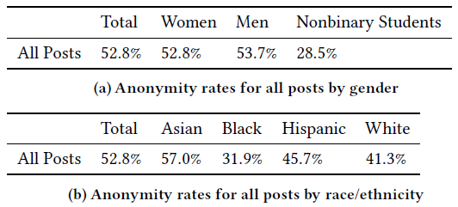
RQ1 Anonymity
Sig. Differences for nonbinary

Slide 15
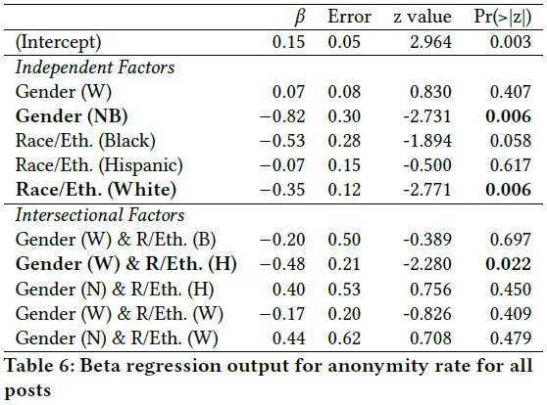
RQ1 Anonymity

Slide 16
RQ1 Key Finding
Women and men use anonymity at similar rate
Nonbinary much less likely
Asian more likely
Hispanic women much lower rate than Hispanic men

Slide 17
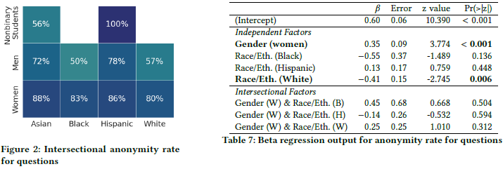
RQ2 Anonymity by Type

Slide 18
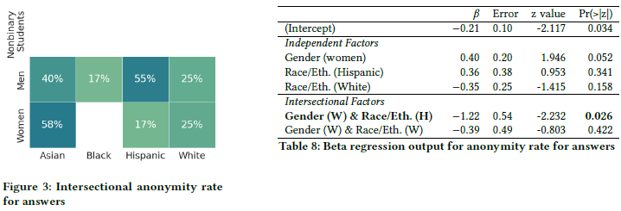
RQ2 Anonymity by Type

Slide 19
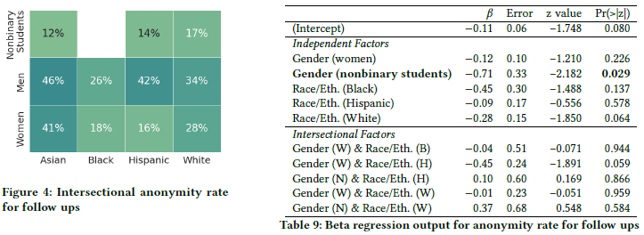
RQ2 Anonymity by Type

Slide 20
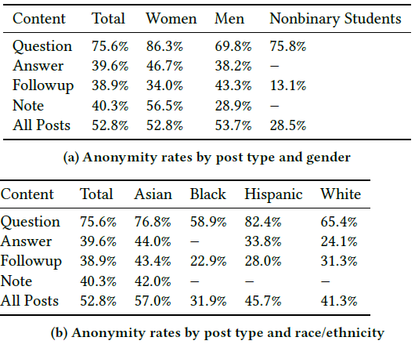
RQ2 Anonymity by Type

Slide 21
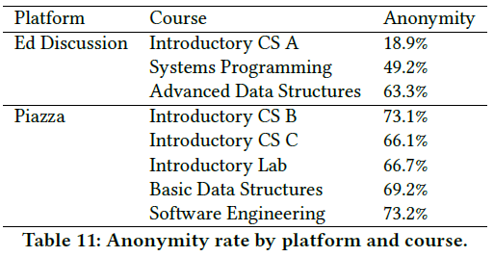
RQ2 Anonymity by Course

Slide 22
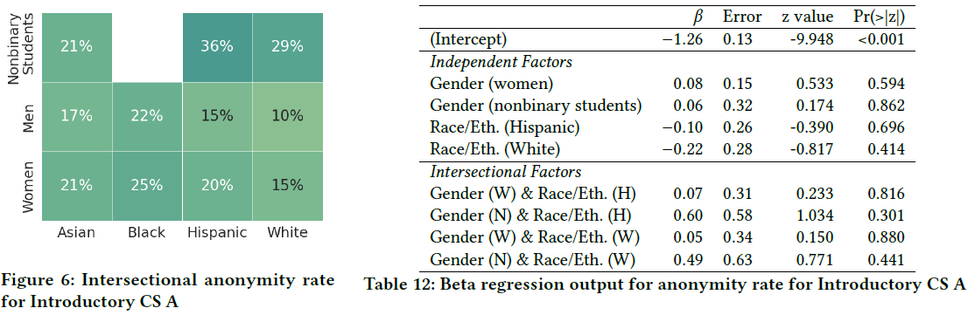
RQ2 Anonymity in CS A

Slide 23
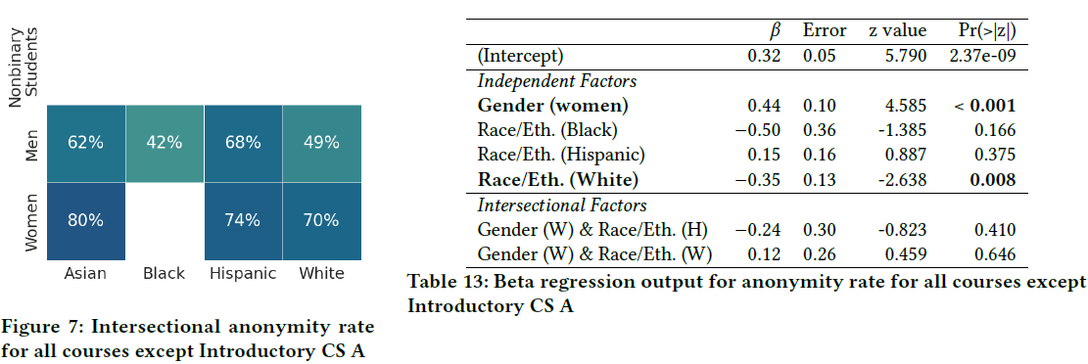
RQ2 Anonymity in Others

Slide 24
RQ2 Key Finding
Some differences based on post type
Dominant effect based on course
CS A lower anonymity, explained by demographics

Slide 25
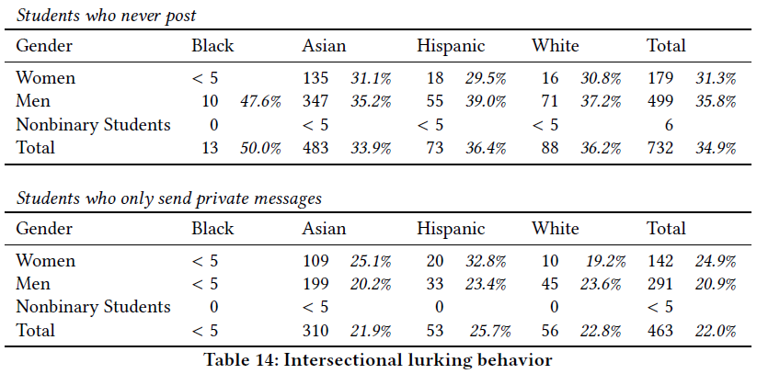
RQ3 Lurking

Slide 26
RQ3 Key Finding
No significant differences in lurking based on gender or race/ethnicity

Slide 27
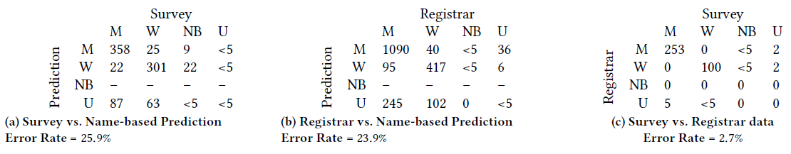
RQ4 Gender Data Source

Slide 28
RQ4 Key Finding
Name-based gender prediction introduces large number of inaccuracies
Worse for Black, Asian, nonbinary students
Is this relevant?

Slide 29
Impacts
Anonymity affected by course norms & design
Many intersectional impacts
CS A very diverse, other courses less diverse
Asian men – majority/minority
Lurking not impacted, but anonymity hides diversity
Gender prediction models are bad

Slide 30
Limitations
8 of 14 courses
Variability of gender, race/ethnicity data
Lack of multiracial identities
Single institution, competitive admission
Large class sizes
COVID-19 Semesters
Others?

