Slide 1
Reading Time Go over paper and review Discussion starts at 1:15
https://teach2impact.com/2020/07/19/the-story-of-normal-distribution-of-grades/

Slide 2

Geek Genes, Prior Knowledge, Stumbling Points and Learning Edge Momentum: Parts of the One Elephant?
Ahadi & Lister (2013) https://dl.acm.org/doi/10.1145/2493394.2493416
All information from paper listed above unless otherwise cited

Slide 3
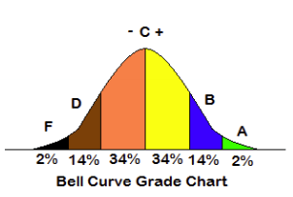
Normal Grade Distribution
https://teach2impact.com/2020/07/19/the-story-of-normal-distribution-of-grades/

Slide 4
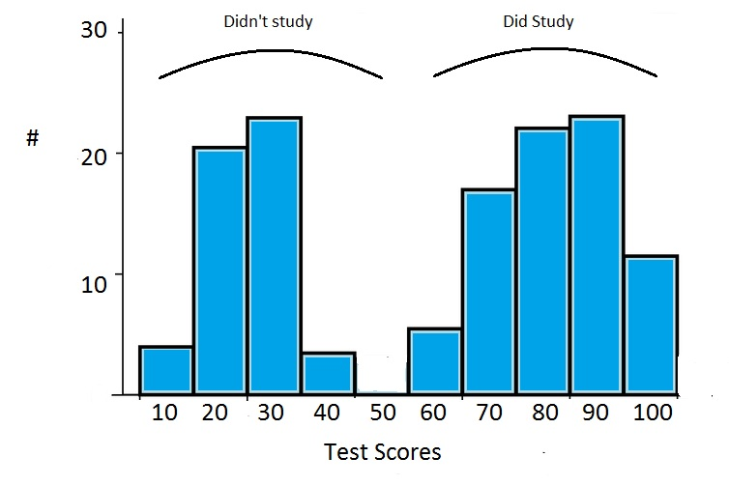
Bimodal Grade Distribution
https://www.statisticshowto.com/what-is-a-bimodal-distribution/

Slide 5
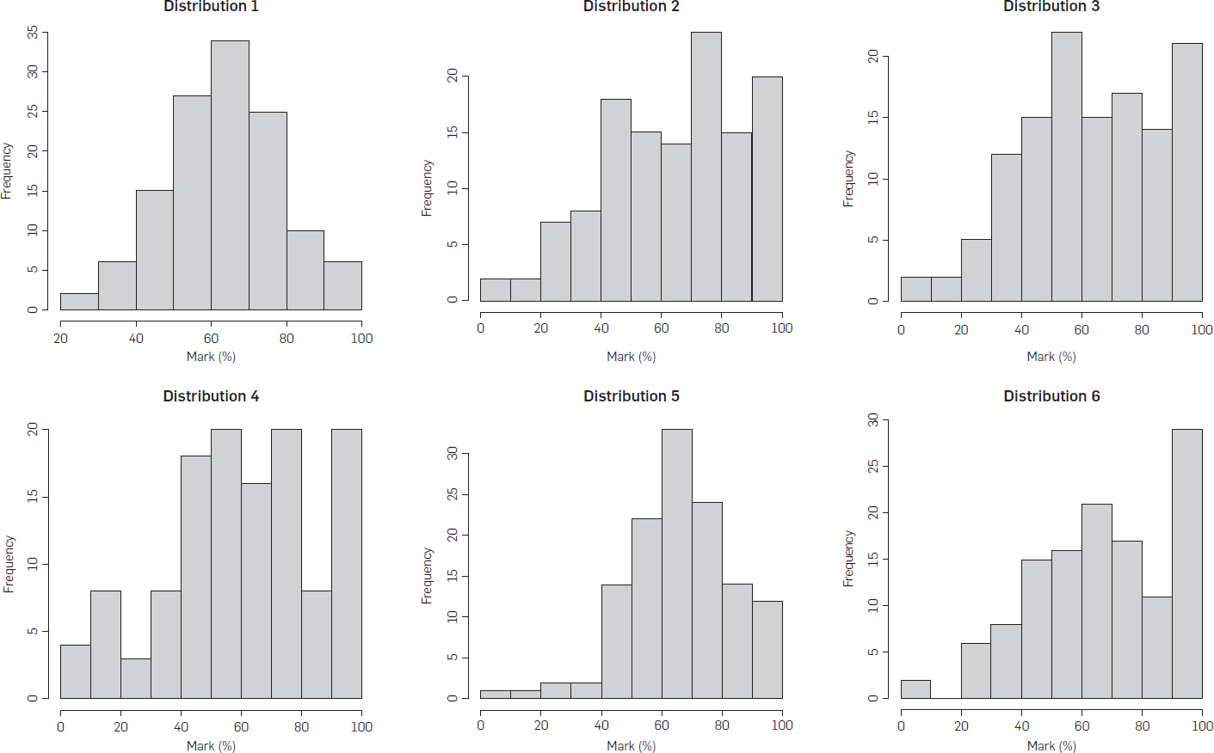
Is it Bimodal?
https://cacm.acm.org/magazines/2020/1/241705-evidence-that-computer-science-grades-are-not-bimodal/fulltext

Slide 6
Learning Edge Momentum
Equal probability of learning topic n
Success = better probability topic n+1
Failure = worse probability topic n+1
Robins (2010): https://depts.washington.edu/techdocs/papers/robinsLearningEdgeMomentum2010.pdf

Slide 7
Learning Edge Momentum
Equal probability of learning topic n
Success = better probability topic n+1
Failure = worse probability topic n+1
Example:
Student A does well in variables in CC 110.
Student B does poorly in variables in CC 110.
Which one will most likely do well with conditionals?
Robins (2010): https://depts.washington.edu/techdocs/papers/robinsLearningEdgeMomentum2010.pdf

Slide 8
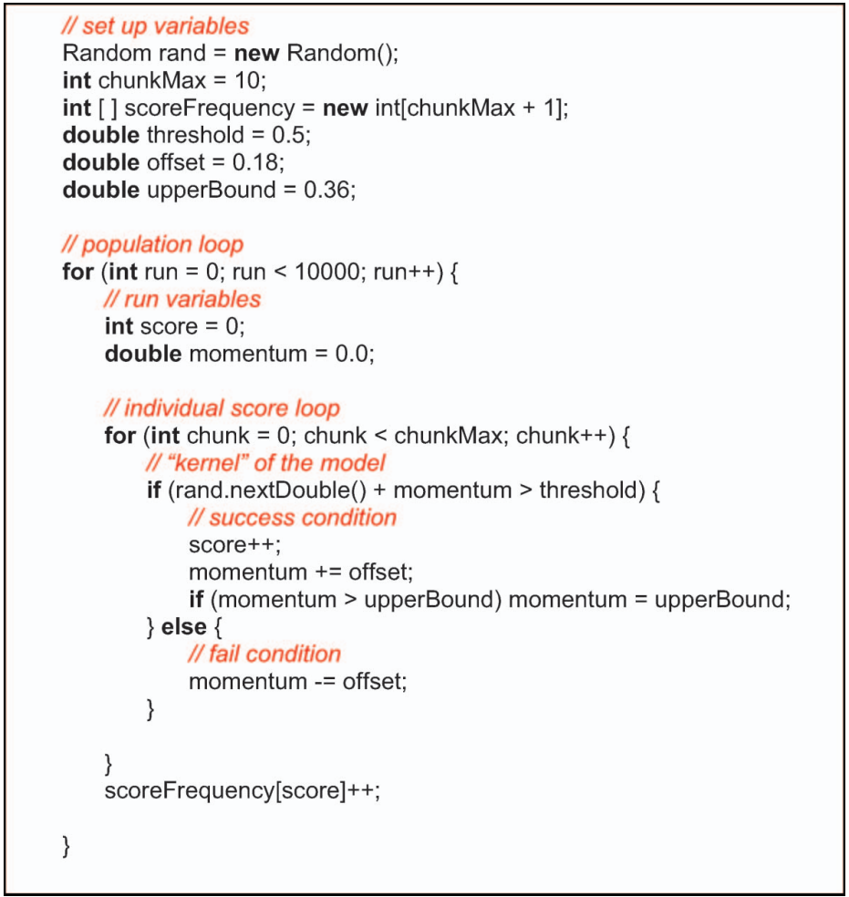
Robins (2010): https://depts.washington.edu/techdocs/papers/robinsLearningEdgeMomentum2010.pdf

Slide 9
Other Factors
Geek Genes
Prior Knowledge & Study Skills
Stumbling Points

Slide 10
Other Factors
Geek Genes
Prior Knowledge & Study Skills
Stumbling Points
Could all of these be involved?

Slide 11
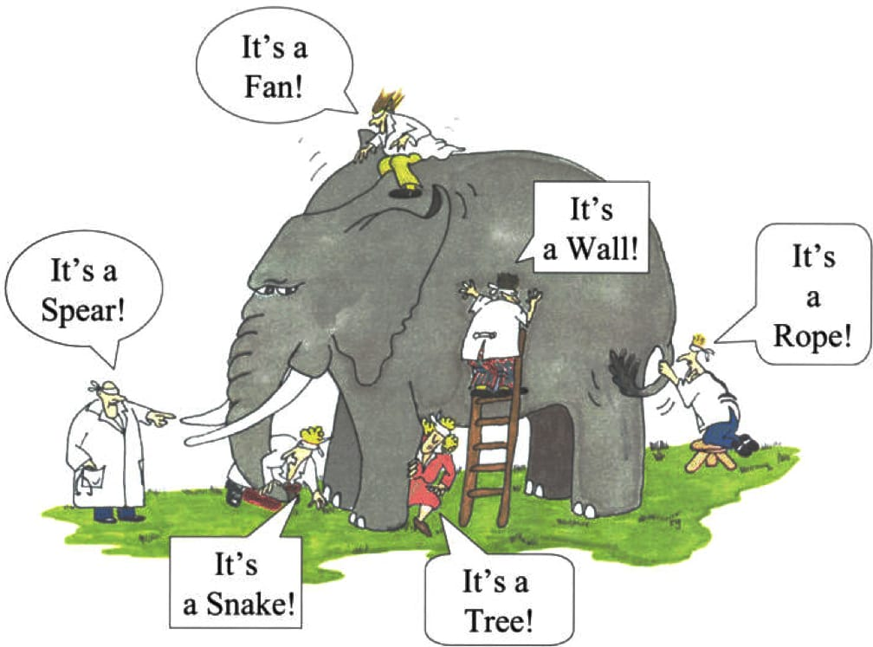
“Parts of the Same Elephant”
https://thereshopeintruth.blogspot.com/2017/03/jesus-and-john-hicks-elephant.html

Slide 12
Research Question
What types of empirical data, collected from real students, might distinguish between the competing hypotheses for the purported bimodal grade distribution?

Slide 13
Research Question
What types of empirical data, collected from real students, might distinguish between the competing hypotheses for the purported bimodal grade distribution?
Will use data collected to highlight difficulty in answering this question

Slide 14
Data
Introductory Programming Course
2 hr lecture + 2 hr lab + 1 hr recitation weekly
4 tests (Weeks 3, 4, 6, 7) start of lecture
Graded correct/incorrect (no partial points)
Voluntary participation (most did)
Little time pressure?

Slide 15
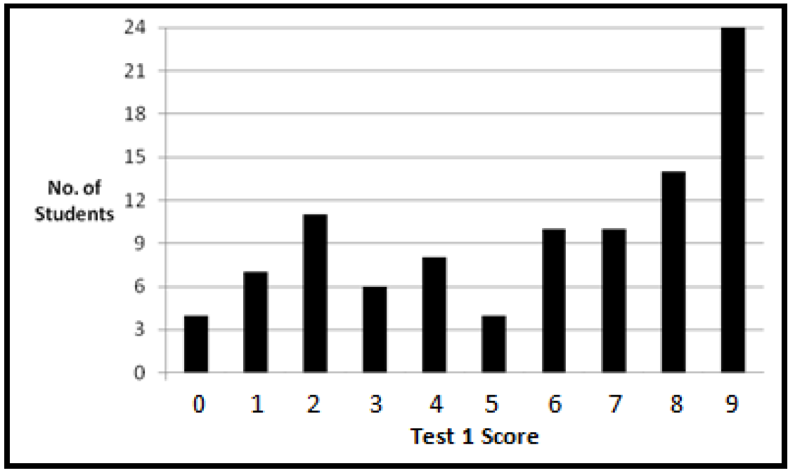
Test 1 - Assignments

Slide 16
Test 1
Bimodal? → Geek genes, prior knowledge
Not bimodal? → if this isn’t, are final grades bimodal? How can we tell?
Wide distribution of grades
Students quickly learn/don’t learn
Students varied in prior learning

Slide 17
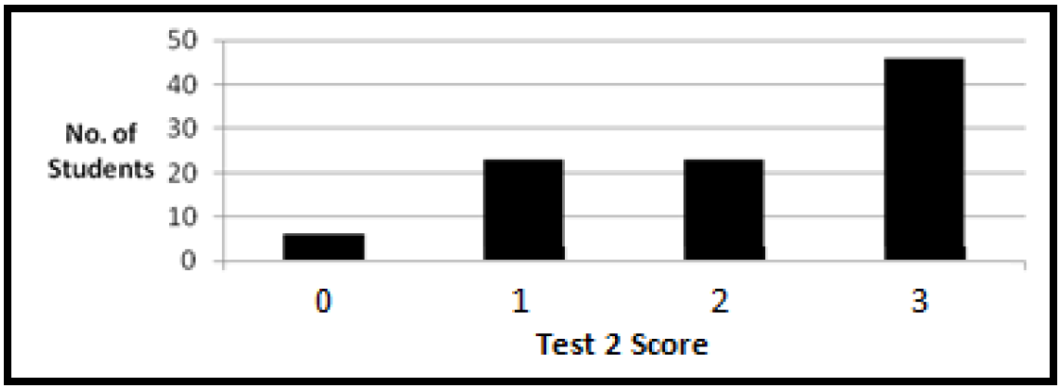
Test 2 - Assignments

Slide 18
Test 2
First 2 questions were review from Test 1
Question 3 was new (writing code)
What can we learn from this data?

Slide 19
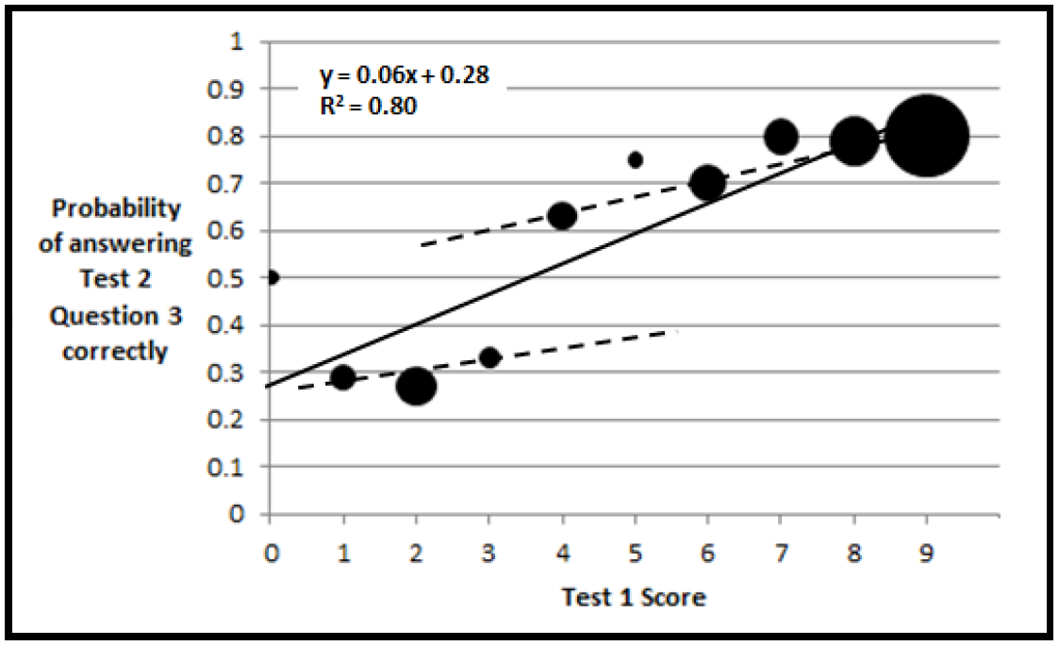
Test 1 vs Test 2

Slide 20
Test 1 vs Test 2

Slide 21
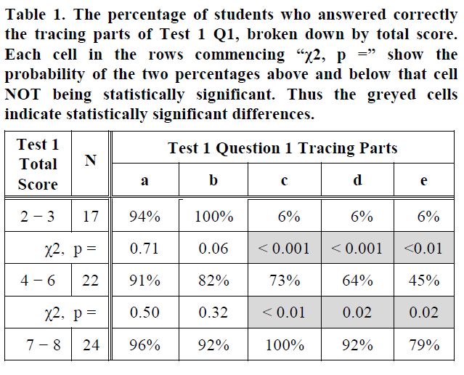
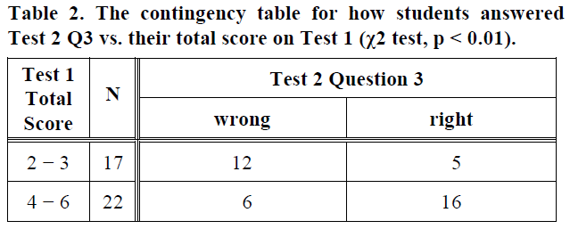
Test 1 vs Test 2

Slide 22
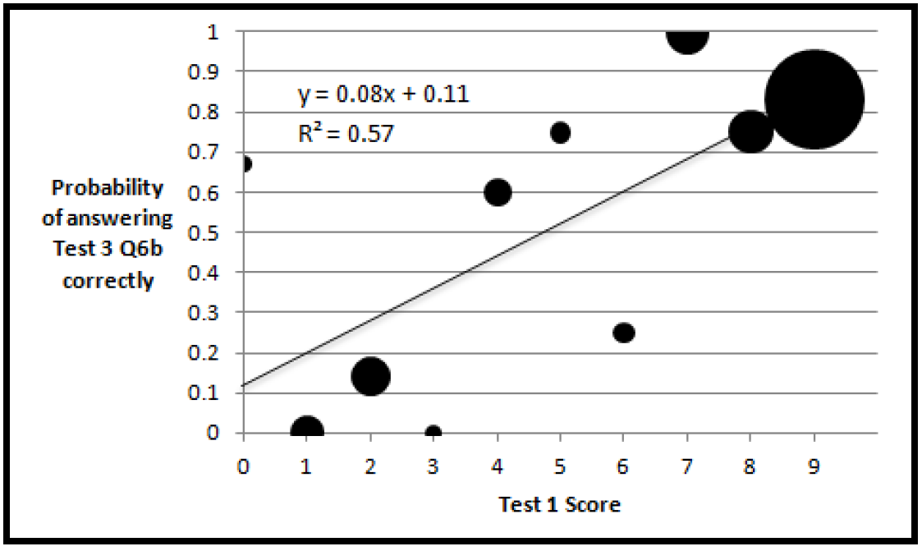
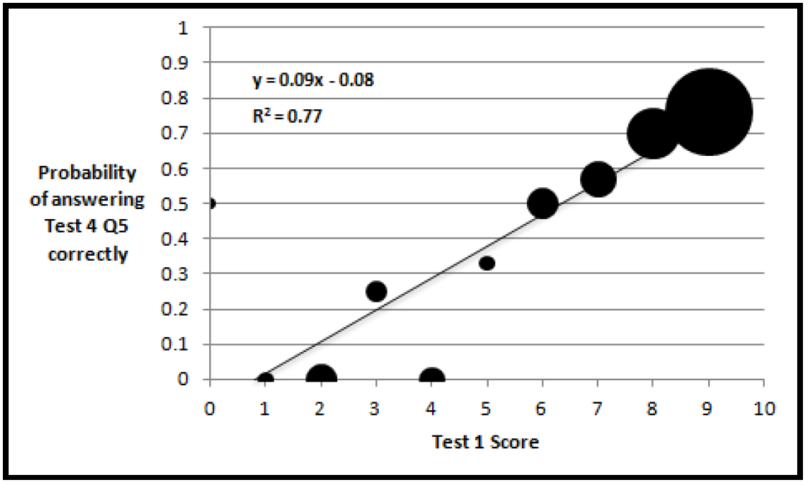
Test 1 v 3 and Test 1 v 4

Slide 23
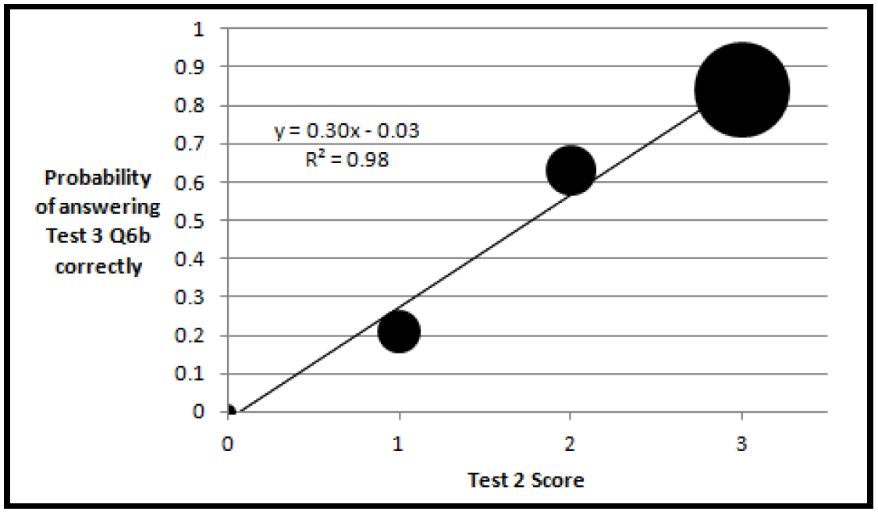
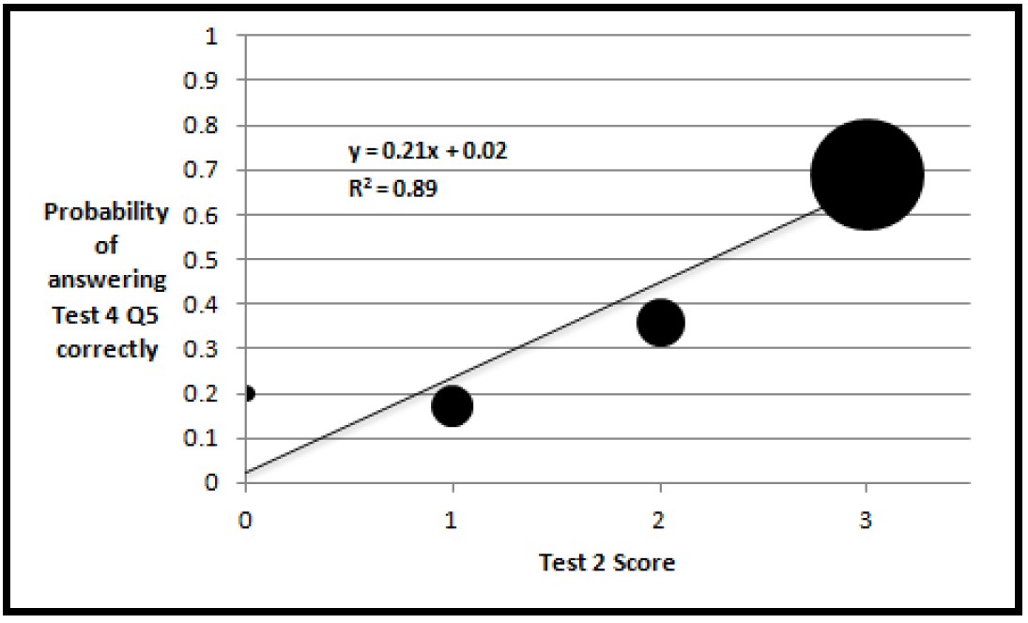
Test 2 v 3 and Test 2 v 4

Slide 24
Summary
All 3 hypotheses are supported in some way by this data
If there is no way to choose empirically, how can we know which one to believe?

Slide 25
Summary
All 3 hypotheses are supported in some way by this data
If there is no way to choose empirically, how can we know which one to believe?
Is there a way we can measure the whole elephant instead of just individual parts?

Slide 26
ACM SIGCSE Events
Technical Symposium (SIGCSE TS) – North America
Computing Education Research Conference (ICER) – Research Focus
Innovation & Technology in CS Ed (ITiCSE) – Europe
Global Computing Ed Conference (CompEd) – Outside North America & Europe

Slide 27
Paper Reviews
Short Summary (1-2 paragraphs)
Familiarity
Strengths & Weaknesses
Motivation/RQs
Prior & Related Work
Scientific Approach
Evidence
Impact/Contribution to Field
Presentation/Grammar
Audience
Overall

