Slide 1
Reading Time Go over paper and review Discussion starts at 1:15

Slide 2


Students' Initial Course Motivation and Their Achievement and Retention in College CS1 Courses
Shell, Soh & Flanigan (2016)
https://dl.acm.org/doi/10.1145/2839509.2844606
All information from paper listed above unless otherwise cited

Slide 3
Outline:
Definitions- Important aspects of motivation
Literature review
Research Questions for Current Study
Reasons for looking at students’ initial motivation
Methods
Results
Summary
Limitations

Slide 4
Important aspects of motivation:
Goal Orientations: Goal orientations refer to students' specific goals and motivations in an academic setting.
Learning-approach GO- seeking to develop long-term, deep understanding of information and skills from the course.
Learning-avoid GO- deliberately avoid learning of course material.
Example: Getting a grade whether you remember anything beyond that or not
Performance-approach GO- seeking to outperform others/ desire to obtain favorable judgments for ego protection.
Performance-avoid GO- avoiding negative performance evaluations/ avoid unfavorable judgments.
Example: Keeping others from thinking I am dumb
Task-approach GO- wanting to perform well on course assignments and tests.
Task/work-avoid GO- intention is to get through this course with the least
amount of time and effort

Slide 5
Important aspects of motivation:
2. Future Time Perspective(FTP): pertains to how students perceive the connection between their present actions and their future career goals.
Career Connectedness: refers to the ability to make connections between present activities and some future goal.
Example: One should be taking steps today to help realize future career goals
Perceived Instrumentality: is how students see the connection between what they are learning now and its usefulness in their future career success.
Endogenous instrumentality: reflects usefulness of the course content for achieving personally meaningful future goals and outcomes.
Exogenous instrumentality: reflects usefulness of students’ course grades in achieving
their future goals.
Example: The only aspect of this class that will matter after graduation is my grade

Slide 6
Important aspects of motivation:
3. Implicit intelligence theories/ Mindsets: refer to students' beliefs about the nature of intelligence and abilities.
Growth mindset: The belief that intelligence and abilities can be developed through effort and learning over time.
Example: No matter how much intelligence you have, you can always change it quite a bit
Fixed mindset : The belief that intelligence and abilities are innate and unchangeable.
Example: You can learn new things, but you can’t really change your basic intelligence
4. Self-Efficacy: Self-efficacy refers to students' confidence in their ability to perform specific tasks.

Slide 7
Literature review:
Need to attract and retain students in STEM majors.
Studies in CS have found that learning approach goals, endogenous instrumentality and growth mindset were associated with higher achievement and retention. And are associated with higher metacognitive strategy use and deep learning
Performance goals, learning avoid goals ,exogenous instrumentality and fixed mindset lead to lower achievement
Other studies in CS1 classes have shown that these goals change across the semester
Self-efficacy was identified as the strongest predictor of educational achievement and it is the key contributor to student choice of major and retention.

Slide 8
Research Questions for Current Study:
How are students' motivations at the beginning of an introductory CS1 course associated with their subsequent course achievement?
How are students' motivations at the beginning of an introductory CS1 course associated with their retention in the course? Goal: to investigate how students’ initial motivation was associated with their performance in the course, indicated by their grades, as well as their likelihood of staying enrolled in the course (retention). The previous work has looked primarily at during-class motivation; it has not examined the goal orientations and motivation of students at the start of the class in-depth.

Slide 9
Reasons for looking at students’ initial motivation:
Initial motivation tells us something about why they chose to take the class.
This can be important for attracting more students to CS and other STEM courses and majors.
If poor performance and withdraw can be linked to students’ initial motivation, it may be possible to identify students who are at risk by looking at their motivation at the beginning of class.
That could allow instructors to potentially intervene earlier and to tailor interventions based on students’ motivational characteristics.

Slide 10
Methods: Participants
Total Participants: 274 students participated out of 305 total enrollees who consented to participation from four courses in a suite of required introductory computer science courses (CS1) at a large Midwestern state university.
Gender Distribution: 229 men; 45 women
Academic Level: 153 freshmen, 62 sophomores, 30 juniors, 19 seniors, 10 other/unknown.
Courses:
CS majors (CSCE155A, 67 men, 9 women)
Combined business-CS honors program (RAIK183H, 20 men, 12 women)
Course for Engineers (CSCE155N, 60 men, 18 women)
A mix of computer engineering, other engineering, and general science majors (CSCE155E, 82 men, 6 women).
Course Content: Core content was the same for all courses, but courses were tailored for the different majors with different programming languages, lab exercises, and programming assignments

Slide 11
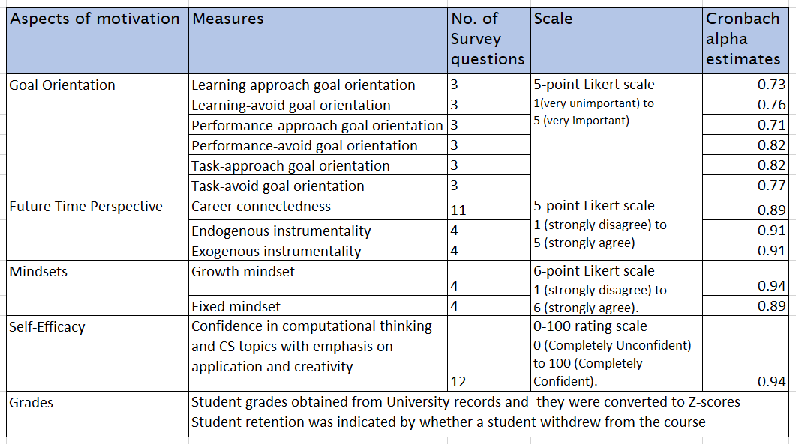
Methods: Measures

Slide 12
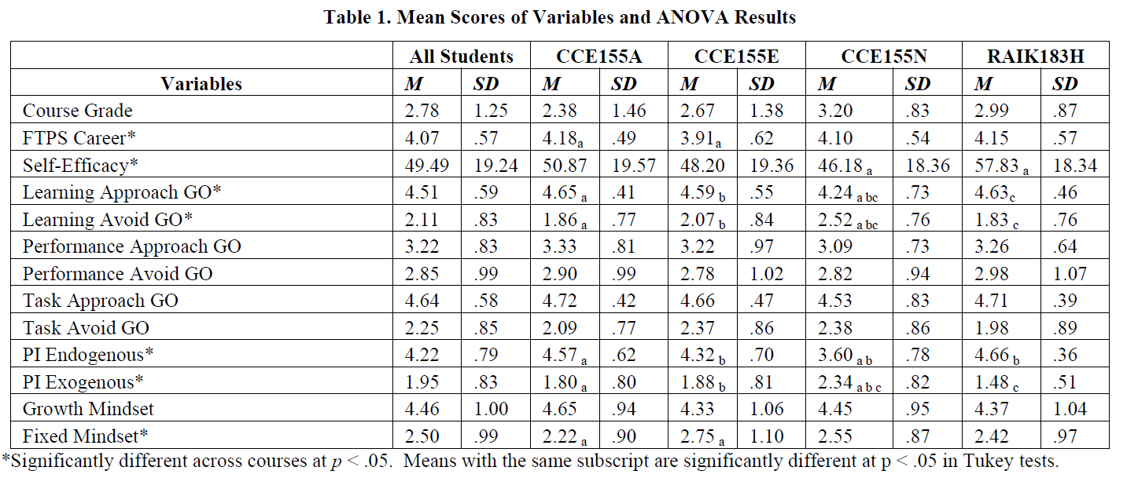
RESULTS: Mean scores for motivational variables

Slide 13
Results
1. Students’ Entering Motivation
the mean scores of motivational variables show that all students have a highly positive motivation towards their course.
High levels of learning approach and task approach goal orientations
High endogenous perceived instrumentality and high FTP career connectedness
High incremental theory of intelligence (Growth mindset)
Moderate levels of performance approach and performance avoid goal orientations.
Low levels of learning avoid, and task avoid goal orientations.
Low exogenous perceived instrumentality
Low entity theory (Fixed mindset)
Low self-efficacy – less computational thinking skills – first CS course
Significant differences in beliefs across the four courses was observed as a result of One-way ANOVA test for each of the motivational variables.
CSCE155N course for engineers and the other three courses – significantly different.
Students in course for engineers express significantly lower learning approach GO, endogenous instrumentality and self-efficacy.
Also, higher learning avoid goal orientation and exogenous instrumentality.
Reason: CSCE155N is an optional course and the other three courses are generally part of the students’ major field.

Slide 14
Results (cont.)
2. Prediction of Students’ Course Grades:
Multiple regression analysis – for all students combined:
For the prediction of course grades, the researchers used backward selection in multiple regression, which involves starting with all potential predictor variables and removing them one by one if they are not significantly contributing to the prediction.
The significant predictors that remained in the final model were:
Performance avoid GO(β = 0.113)
Learning approach GO(β = 0.198)
Endogenous instrumentality(β = -0.238) and
Exogenous instrumentality(β = -0.188).

Slide 15
Results (cont.)
Multiple regression analysis - Across four courses:
CSCE155A – the course for CS majors.
Final regression model was significant (R = .396, R² = .156)
Significant predictors:
fixed mindset (β = .270),
performance avoid GO (β= .217)
endogenous PI (β= -.263)
exogenous PI (β = -.343) and
self-efficacy (β= -.258)
CSCE155E – the course for a mix of computer engineering, other engineering, and science majors.
Final regression model was significant (R = .282, R2 = .080)
Significant predictors:
learning approach GO (β= .340)
endogenous PI (β= -.232)

Slide 16
Results (cont.)
CSCE155N – the course for engineers
no model achieved significant prediction
RAIK183H – the course for business-CS honors majors
Final regression model was significant (R = .888, R2 = .788)
Prediction was very high.
Significant predictors:
learning approach GO(β= .579)
performance avoid GO (β= .288)
endogenous PI (β= .877)
growth mindset (β= .769)
performance approach goal orientation (β= -.256)
task approach goal orientation (β= -.872)
Differences in the entering motivation of these students predicted almost all of the difference
in their final grade.

Slide 17
Results (cont.)
3. Prediction of Students’ Course withdrawal:
Logistic regression was used to predict students’ withdrawal from the course.
Twenty-two students withdrew from the four courses combined so the only analysis that could be done was for the entire sample.
Withdrawal was significantly predicted (χ2 (4) = 9.68, p = .021)
Likelihood of withdrawing was decreased by –
future time career connectedness (β = -.845, OR = .429)
learning approach goal orientation (β = -.635, OR = .530)
increased by having a growth mindset (β = .506, OR = 1.66).

Slide 18
Summary:
Students are primarily choosing CS1 course because they see it as personally relevant to their future goals.
Grades were significantly predicted from entering motivation; but prediction was highly variable across courses, ranging from not predicted for the engineering courses to highly predictable for the business-CS honors program.
Course withdrawal was significantly predicted.
CS1 students who set learning approach goals for their classes have better academic outcomes and higher retention. Other motivational beliefs were inconsistent in their impacts and varied by course and student population.
Except for students in an honors program, entering motivational beliefs weakly predicted achievement and retention.
Impacts of the course itself on motivation and how motivation changes during the course are perhaps more important than student’s initial motivation.

Slide 19
Limitations:
Potential Self-Selection Bias
Limited Course Retention Data: The number of students who withdrew from the course was relatively low, which might affect the reliability of the predictions related to course withdrawal.
Small Sample Size: Even though the study involved a total of 274 participants, the overall sample size is relatively small, especially when considering the multiple subgroups based on majors and academic levels
Absence of Intervention: The study focused on students' initial motivation without implementing any interventions or examining how instructional strategies might interact with motivation to influence outcomes.

Slide 20
Thank you ☺

