Slide 1
Reading Time Go over paper and review Discussion starts at 1:15
https://teach2impact.com/2020/07/19/the-story-of-normal-distribution-of-grades/

Slide 2

CS0 vs. CS1: Understanding Fears and Confidence amongst Non-majors in Introductory CS Courses
Hogan, Li, Soosai Raj (2023)
https://dl.acm.org/doi/10.1145/3545945.3569865
All information from paper listed above unless otherwise cited

Slide 3
Definitions
CS0 – Introductory CS Course
Less Programming
Both majors & non-majors
Equiv. CIS 115 / CC 110
CS 1 – First Programming Course
Programming focus
Equiv. CIS 200 / CC 210

Slide 4
Definitions
Self-efficacy – the belief that one can accomplish a task or succeed in a given situation
Often used as an alternative for measuring knowledge (highly correlated)

Slide 5
Definitions
Likert Scale – A symmetric rating scale of agreement/disagreement
Pronounced LIK-ərt not LY-kərt
Strongly disagree
Disagree
Neither agree nor disagree
Agree
Strongly agree

Slide 6
Majors vs. Non Majors
How do they differ?
Notes:
CS in other fields
Separate courses?
Important knowledge for everyone?

Slide 7
Research Questions
What are the fears of non-majors taking an introductory CS course?
How do confidence levels of non-majors differ in CS0 vs. CS1 courses?
Is there a connection between fears expressed and change in confidence of non-majors in CS0 vs CS1?

Slide 8
Non-Majors in Engineering
Failure
Workload
Time Management
Preparedness
Skill Level
Interest/Satisfaction

Slide 9
Population
CS0 – 124 students
CS1 – 502 students
Concerns with the population?
Notes:
Didn’t explicitly state that they are all non-majors (no info given there)
Doesn’t state which semester they are looking at
No measure of prior knowledge/experience

Slide 10
Survey Questions
What do you fear most about taking this class?
On a scale of 1 to 5, how confident are you about your ability to do well in this course?
Notes:
Didn’t explicitly state that they are all non-majors (no info given there)
Doesn’t state which semester they are looking at
No measure of prior knowledge/experience

Slide 11
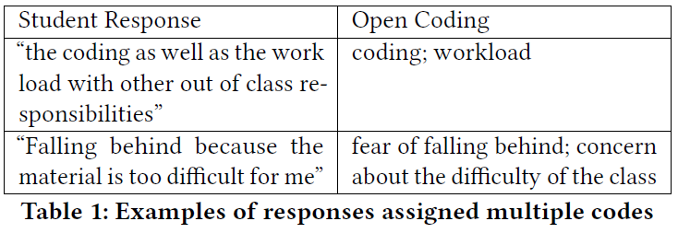
Coding
Open Coding – determining short descriptors for open-ended responses
Notes:
Didn’t explicitly state that they are all non-majors (no info given there)
Doesn’t state which semester they are looking at
No measure of prior knowledge/experience

Slide 12
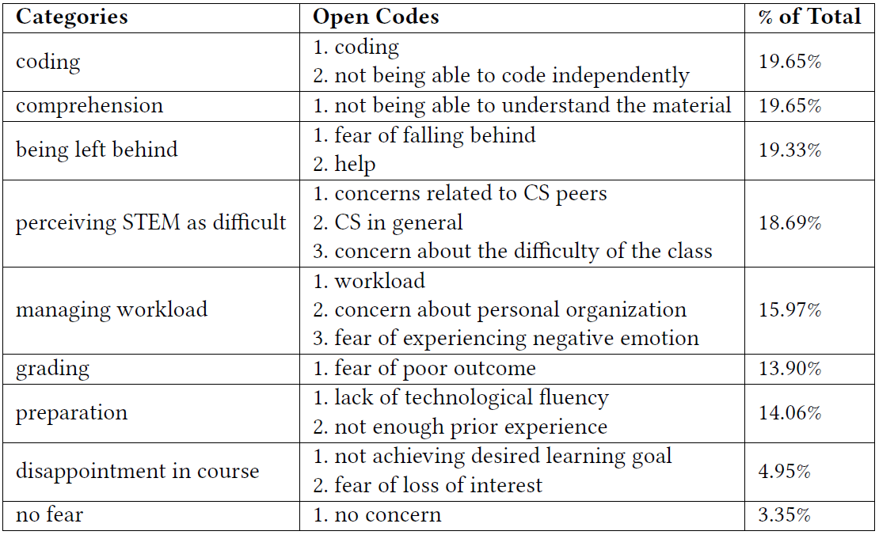
Notes:
Didn’t explicitly state that they are all non-majors (no info given there)
Doesn’t state which semester they are looking at
No measure of prior knowledge/experience

Slide 13
RQ1 Results
Some consistency between CS0 and CS1
Aligns with prior research
Many rooted in lack of confidence/self-efficacy
Impacts?
Notes:
Didn’t explicitly state that they are all non-majors (no info given there)
Doesn’t state which semester they are looking at
No measure of prior knowledge/experience

Slide 14
Mann-Whitney U Test
Tests for change in a population without assuming that values are normally distributed.
U – sum of “wins” - compare to (n^2) / 2
p – Significance (lower is better)
r – Effect size (<.3 is low effect)
Notes:
Didn’t explicitly state that they are all non-majors (no info given there)
Doesn’t state which semester they are looking at
No measure of prior knowledge/experience

Slide 15
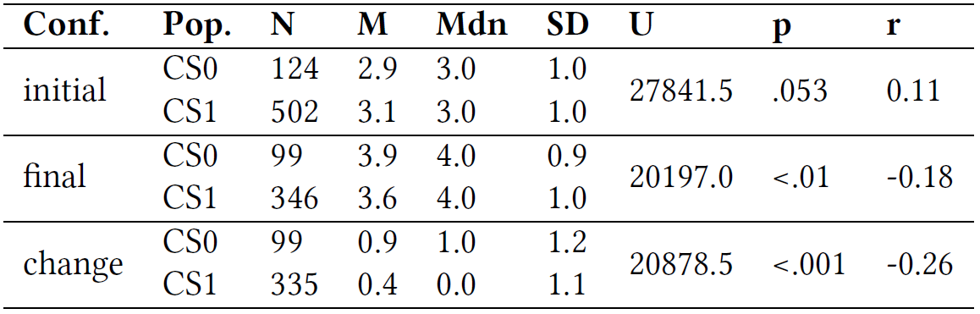
RQ2 Results
Notes:
Didn’t explicitly state that they are all non-majors (no info given there)
Doesn’t state which semester they are looking at
No measure of prior knowledge/experience

Slide 16
RQ2 Results
Students in CS0 had significantly higher increase in confidence than CS1 students
Impacts?
Notes:
Didn’t explicitly state that they are all non-majors (no info given there)
Doesn’t state which semester they are looking at
No measure of prior knowledge/experience

Slide 17
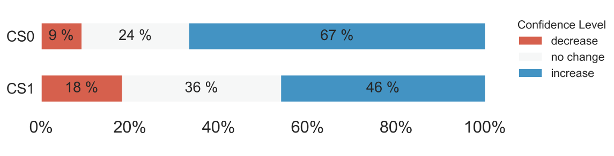
RQ3 Results
Notes:
Didn’t explicitly state that they are all non-majors (no info given there)
Doesn’t state which semester they are looking at
No measure of prior knowledge/experience

Slide 18
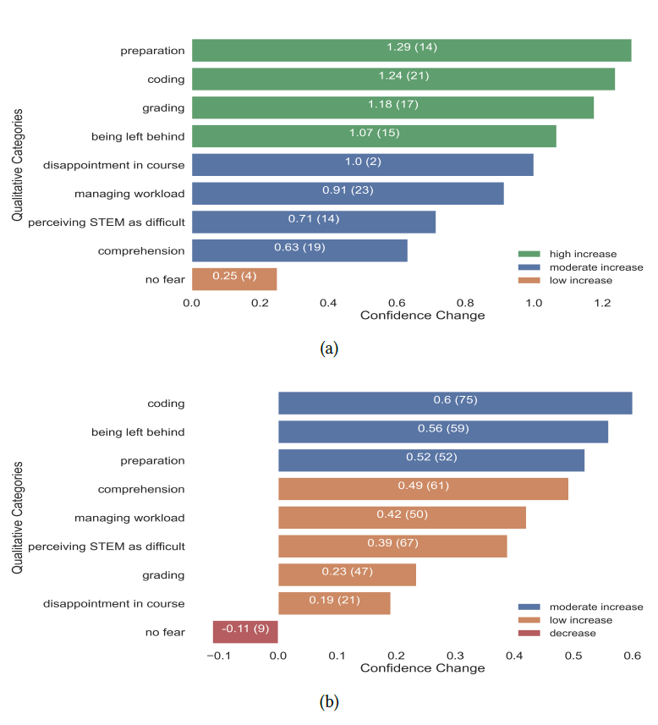
RQ3 Results
Notes:
Didn’t explicitly state that they are all non-majors (no info given there)
Doesn’t state which semester they are looking at
No measure of prior knowledge/experience

Slide 19
RQ3 Results
Students in CS0 and CS1 saw increases in confidence in similar areas
CS0 students saw much greater increases in confidence than CS1 overall
Impacts?
Notes:
Didn’t explicitly state that they are all non-majors (no info given there)
Doesn’t state which semester they are looking at
No measure of prior knowledge/experience

Slide 20
Limitations
Open Coding lacks specificity
Confidence is more than fears
Students who dropped are excluded from data (no last week survey)
Notes:
Didn’t explicitly state that they are all non-majors (no info given there)
Doesn’t state which semester they are looking at
No measure of prior knowledge/experience

Slide 21
Summary
Non-majors in CS0 and CS1 share a variety of fears
Non-majors in CS0 see much larger increases in confidence compared to CS1 students
CS0 and CS1 students see increases in similar areas
Notes:
Didn’t explicitly state that they are all non-majors (no info given there)
Doesn’t state which semester they are looking at
No measure of prior knowledge/experience

