Slide 1
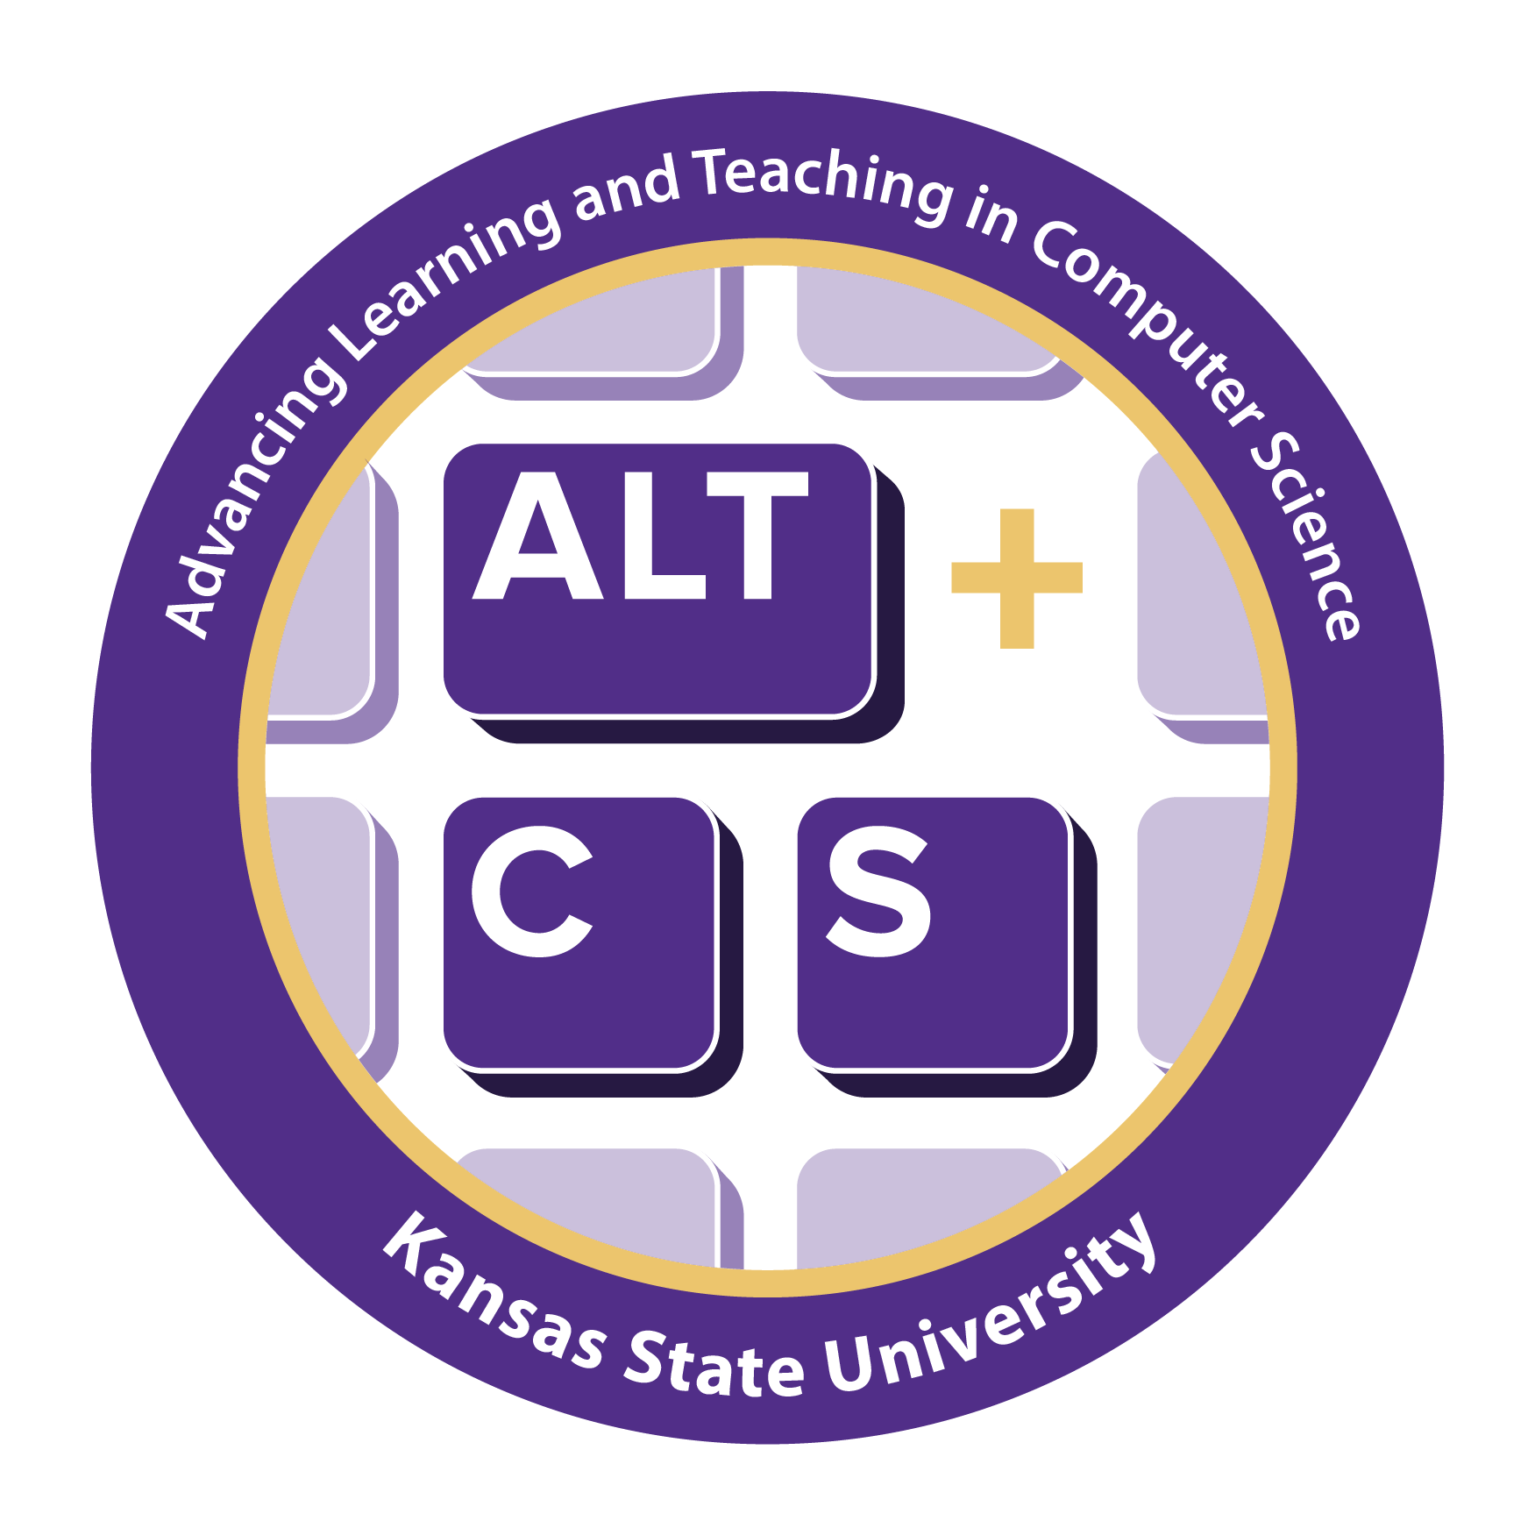
Recruitment
How do we fill the classroom?

Slide 2

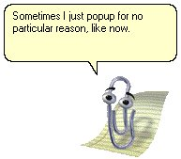
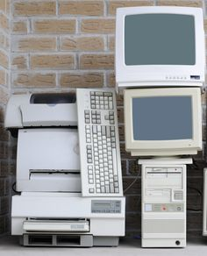
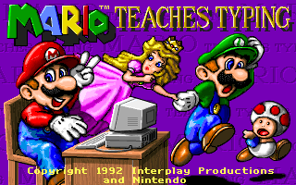
How “Computer Science” Education Started…

Slide 3
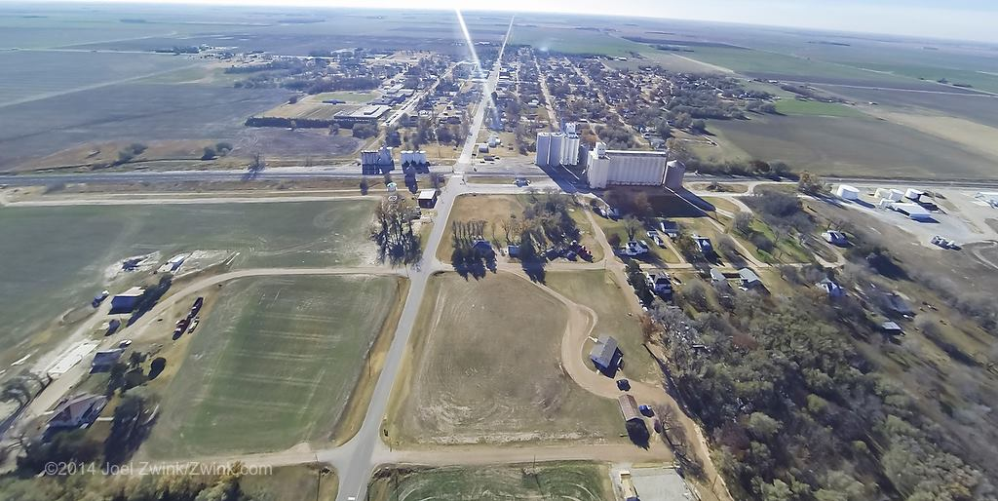
Photo Credit: Joel Zwink
Notes:
Talk about BreAnn’s story
-Parents matter

Slide 4


Computational thinking provides an equitable, inclusive environment for computer science that enables all to be critical consumers of technology and creators of much more.

Slide 5
Stereotypes
“Gender-interest stereotypes that STEM is for boys begins in grade school, and by the time they reach high school, many girls have made their decision not to pursue degrees in computer science and engineering because they feel they don't belong”
Source

Slide 6
Gender Stereotypes
51% of children believe girls are less interested in CS than boys
63% for engineering
What happens when children are told girls are less interested?
35% of girls chose activity when told boys were interested
65% of girls chose the activity in the reverse
P
Source

Slide 7
Recap
Kansas is a surprisingly diverse place
Clubs, groups, sports, afterschool groups, etc.
Reach out personally
Safe places
Positive role models, “people like me”
Managing bias
Make it fun
Culturally Responsive Computing
Notes:
Ice breaker events, show fun
Make CS required to prevent opt-out
Decorations
Making computing culturally relevant means that learners with a range of cultural identities will be able to identify with the examples chosen to illustrate computing concepts, to engage effectively with the teaching methods, and to feel empowered to use computing to address problems that are meaningful to them

Slide 8
Resources
csteachingtips.org
NCWIT
Girls Who Code
CS for All
Code.org
CSTA

Slide 9
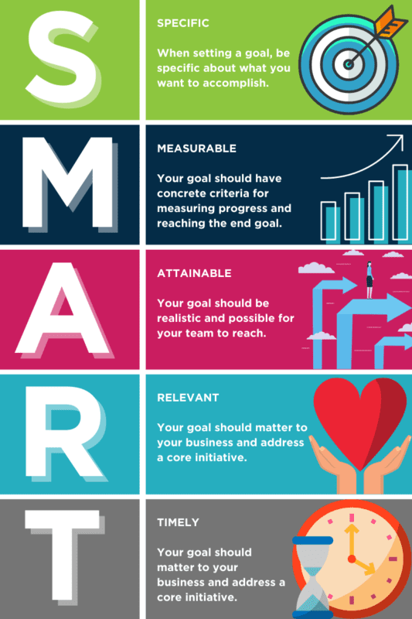
SMART Goal
Specific
What steps need done to reach goal?
Measurable
How do you know you are done?
Achievable
Is the goal realistic?
Relevant
Why?
Time-bound
Source

