Slide 1
Reading Time Go over paper and review Discussion starts at 1:15
https://teach2impact.com/2020/07/19/the-story-of-normal-distribution-of-grades/

Slide 2

CS1 Students’ Perspectives on the Computer Science Gender Gap: Achieving Equity Requires Awareness
Kimberly Michelle Ying, Alexia Charis Martin, Fernando J. Rodr´ıguez and Kristy Elizabeth Boyer (2021)
https://doi.org/10.1109/RESPECT51740.2021.9620659
All information from paper listed above unless otherwise cited

Slide 3
Appendix
Definitions
Introduction
Related Work
Data Collection
Results
Limitations
Summary

Slide 4
Definitions
CS1 – First Programming Course
Programming Focus
Equiv. CIS 200 / CC 210
Diversity, Equity and Inclusion (DEI) training
It refers to educational programs and initiatives designed to promote understanding, awareness, and action towards creating diverse, equitable, and inclusive environments.

Slide 5
Introduction
Facts
According to the U.S. Department of Labor, in 2018, only 25% of people in computing occupations were women.
This gap is also present earlier in the pipeline; in 2019, women comprised just 21% of the CS bachelor’s degree graduates at doctoral-granting institutions in the U.S. and Canada.
Any idea on what the current male to female ratio is ?

Slide 6
Related Work
Tsan et al. Findings
Gender disparities in computer science have been identified in population as young as fifth grade students.
Falkner et al. Findings
Interviewed female academics and postgraduate students in computer science to identify their gendered perceptions on their development as computer scientists.

Slide 7
Research Questions
RQ1: To what extent are CS1 students aware of the gender gap in CS?
RQ2: What are their perspectives on interventions to support gender diversity in CS?
RQ3: How are women’s and men’s awareness and perspectives on the gender gap different?

Slide 8
Data Collection - Survey
Survey Participants
There were 331 participants: 229 men, 96 women, and six individuals who indicated they preferred not to disclose their gender (with an average age of 19)
Survey Questions
There were six total questions on the gender gap: Q1 (yes/no question) & Q2, Q3, Q4, Q5, Q6 (Likert Scale)

Slide 9
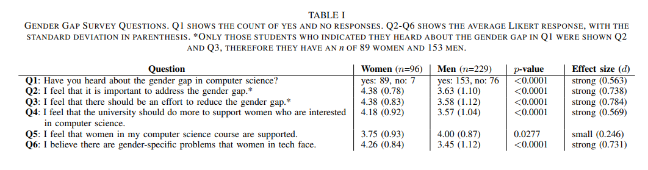
Survey Analysis - I

Slide 10
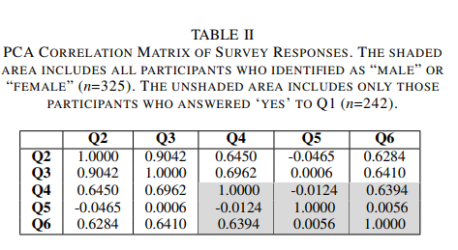
Survey Analysis - II

Slide 11
Data Collection - Interview
Interview Participants
30-minute follow-up interview with 10 slots reserved for women and 10 slots reserved for men (compensated with a $20 Visa gift card)
Interview Questions
Questions were about their chosen major, their confidence in completing a degree in CS, course satisfaction, classroom climate, and their views on the gender gap (Open Ended Discussion)

Slide 12
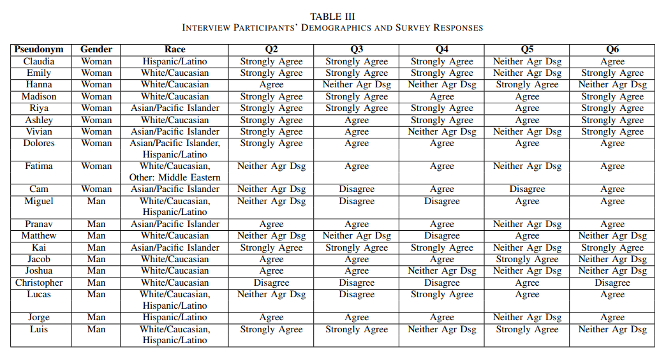
Interview Analysis

Slide 13
Students’ Perspective
While all participants in this study were enrolled in a co-ed CS1 class, the university newly offered an all-women CS1 class during the same semester, and some participants discussed their thoughts about it during the interview.
Now let's see different students' perspective and their common misconceptions on the gender gap.

Slide 14
Students Perspective
Let’s do everything we can to fix it.(5 W, 3 M)
They believed in proactive efforts to reduce the gender gap and suggested initiatives for collegiate women-women mentorship, K-12 exposure, and women centered clubs/organizations.
Misconception:
They mentioned that classrooms might be more welcoming if there was a more balanced gender composition and if there were more female teaching staff.
Any thoughts and myths on this?

Slide 15
Students Perspective
That’s just how things are. (4 W, 3 M)
They believed that the gender inequities in computing are largely the result of natural interest. Many of them mentioned that women tend to pursue medical or soft science careers.
Misconception:
STEM is a high stress major” and that it might be a factor in the widening of the gender gap because “some people just aren’t up to it.
Any thoughts and myths on this?

Slide 16
Students Perspective
It’s just not realistic. (7 W, 1 M)
They believed that offering an all-women’s class is an unrealistic and possibly counterproductive effort. The class could be a comforting experience for women who feel intimidated, but that it is an unrealistic safety net.
Misconception:
All-women’s class would be “babying them through the major” and “when they get in the workforce it’s going to be mostly men they are working with.
Any thoughts and myths on this?

Slide 17
Students Perspective
I’m just not too sure about it. (1 W, 2 M)
Their interview responses revealed they do not have strong opinions on the gender inequities in CS because they are not well-informed about it.
Let’s not get carried away. (4 M)
They agreed that there are gender imbalances within the field, but they expressed some objections to initiatives that might improve the issue.
Students with this perspective think people should be free to pursue what they are passionate about

Slide 18
Discussion
The survey and interview responses revealed a major concern with CS1 students’ understanding of the issue.
33% of men indicated they had not heard about it.
66% of men that had heard about the gender gap, only about half of them felt there should be efforts to reduce the gap.
80% of the women believed there were gender-specific problems.

Slide 19
Limitations
Survey and interview data were collected from participants at a large public research university in the southeastern United States.
Further research is needed to determine the generalizability of these findings to other contexts, such as smaller institutions or liberal arts schools.
This study only reports on the perspectives of students who identified as ‘female’ or ‘male’ because no other gender identity was specified.
The racial demographics of this population was majority White/Caucasian and Asian/Pacific Islander.

Slide 20
Summary
Conclusion
We found that compared to men, women were significantly more aware of the gender gap and felt significantly stronger that efforts should be made to reduce the gender gap.
Suggested Solution
This paper is a call-to-action for educators and curriculum developers to include DEI training in undergraduate computer science programs.

