Slide 1
Reading Time Go over paper and review Discussion starts at 1:15
https://teach2impact.com/2020/07/19/the-story-of-normal-distribution-of-grades/

Slide 2

Neo-Piagetian Theory as a Guide to Curriculum Analysis
Claudia Szabo and Katrina Falkner (2014)
https://doi.org/10.1145/2538862.2538910
All information from paper listed above unless otherwise cited

Slide 3
Piagetian Theory
Learning occurs in stages:
Sensorimotor
Pre-operational
Concrete Operational
Formal Operational

Slide 4
Neo-Piagetian Theory
Learning always follows the stage progression
This continues throughout our lives
It is specific to concepts and contexts
Learners typically operate in multiple stages at once, depending on mastery of subjects within a problem

Slide 5
Lister et. al
Developmental Stage | Characteristics
Sensorimotor (pre-tracing) | Student cannot trace code with >= 50% accuracy Looks for recognizable words in the code Dominant strategy is trial and error
Preoperational (tracing) | Student can trace code Often writes down the effect of each line or draws a diagram of program state Can describe what the code does, but the purpose of the code is not inferred, and may be guessed at based on input/output
Concrete Operational (abstract tracing) | Student can reason about code deductively and recognizes patterns in the code Dominant programming strategy is hasty design and futile patching First stage where student displays purposeful approach to writing code
Formal Operational (post-tracing) | Student can reason logically, consistently, and systematically about code, and can reflect on their own thinking Displays hypothetico-deductive reasoning (formulating and testing hypothesis)

Slide 6
Curriculum Development
A process of developing course materials that includes:
Identifying instructional goals
Developing/selecting:
Course content and materials
Learning activities
Assessment strategies

Slide 7
Curriculum Challenges
Courses continue to evolve
Can “drift” away from original goals
Prior courses may stop teaching prerequisites
New teachers may not understand prior structure/goals

Slide 8
Curriculum Maps
A graphical representation of the curriculum identifying content to be taught and prerequisite/postrequisite relationships
Ideally a Directed Acyclic Graph

Slide 9
Proposed Framework
Integrate Neo-Piagetian Levels into Curriculum mapping to:
Ensure students are not assessed at a higher level than taught (assessment leaps)
Ensure prerequisite knowledge and level is reached earlier in the curriculum (prerequisite concepts)

Slide 10
Classification Taxonomy
Concrete Operational
Representational Systems
Single Abstractions – Familiar
Formal Operational
Single Abstractions – Global
Abstraction Mapping
Abstraction Systems
Principles

Slide 11
Single Abstractions
Familiar
Abstraction used concretely within a single programming language
Global
Abstraction within a new context (programming language, library, etc)

Slide 12
Abstraction Mapping
Reasoning about relationships between closely related concepts, i.e.:
While and Do While loops
Interfaces and Abstract classes in C#
Virtual and Abstract methods in C#

Slide 13
Abstraction Systems
Interactions between distantly related concepts, for example:
Program stack and memory allocation through the ‘new’ keyword
Stack overflow exception and infinite recursion

Slide 14
Principles
Unifying principles from the entire domain, i.e.
Structured Programming
Type Systems

Slide 15
Audience Participation
Where do the following fit in?
In-memory binary representation of numeric types
Strings as lists of characters
Recursive methods and looping structures

Slide 16
Mapping Process
Define Concepts
Classify Teaching Activities
Classify Assessment Activities
Revise and Compare
Identify prerequisites and assessment leaps

Slide 17
Define Concepts
Analyze sources for concepts used in the class
Syllabi Accreditation (ABET)
Textbooks ACM/IEEE Curriculum
Lectures
Be aware of LATENT (assumed or hidden) concepts

Slide 18
Classify Teaching Activities
For each activity integrate into the concept table integrating:
Concepts taught
Levels taught at
When taught
Context & Examples

Slide 19
Classifying Assessment Activities
Review summative assessments and record:
Perceived level of assessment
Integrate into the concept table

Slide 20
Revision and Comparison
Review the concept table as a group, revising levels based on consensus
Address issues raised by the mapping:
Missing prerequisites
Assessment leaps

Slide 21
Case Study
Used for first year (3 course) programming sequence
Introduction to Programming
Object-Oriented Programming
Data Structures and Algorithm Design

Slide 22
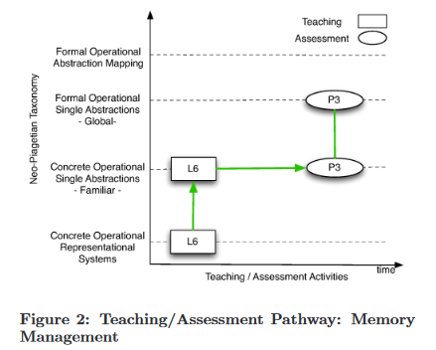
Case Study Diagrams

Slide 23
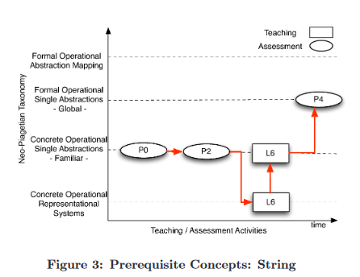
Case Study Diagrams

Slide 24
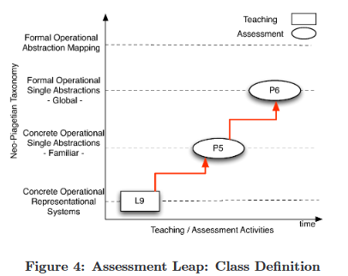
Case Study Diagrams

Slide 25
Conclusion
Reiterates the usefulness for this style of curriculum mapping
Underscores the importance of finding and addressing
Prerequisites
Assessment leaps

