Slide 1
Reading Time Go over paper and review Discussion starts at 2:45 PM
https://dl.acm.org/doi/10.1145/3545945.3569805

Slide 2

Plagiarism Deterrence in CS1 Through Keystroke Data
Kaden Hart, Chad Mano and John Edwards (2023)
https://dl.acm.org/doi/10.1145/3545945.3569805

Slide 3
Introduction
Overview
Computer science programs are the worst offenders of academic integrity code violations
Students are able to defeat existing anti-plagiarism tools
Logging keystroke data with code submissions reduces temptation to cheat

Slide 4
Objective
To investigate the effect of keystroke data submission on plagiarism deterrence
Survey conducted on the effectiveness of the approach
Explore privacy issues surrounding the implementation

Slide 5
Existing Plagiarism Detection
Code similarity detection software
MOSS
SIM
Jplag
Comparing the abstract syntax trees or binary compilations

Slide 6
Audience Participation
What are the ways students smartly circumvent plagiarism software?
What are some of the drawbacks of existing plagiarism detection software?

Slide 7
Programming Process Analysis
Error Quotient (EQ)
WATWIN Score
RED Score
NPSM
Number of attempts
Code submissions
Typing speed

Slide 8
Research Data
Keystroke data
Provides a detailed view of how students complete their programming assignments.
Step-By-Step Playback
Builds code snapshots

Slide 9
Study Design
Conducted over two terms of a CS1 course
Three groups of students were involved
One with no keystroke logging
One with keystroke logging but not shared with the instructor
One with keystroke logging shared with the instructor

Slide 10
Detecting Plagiarism with Keystroke Data
Copying then renaming variables and shuffling lines of code within the editor
Copying, renaming, and shuffling outside of the editor
Retyping plagiarized code

Slide 11
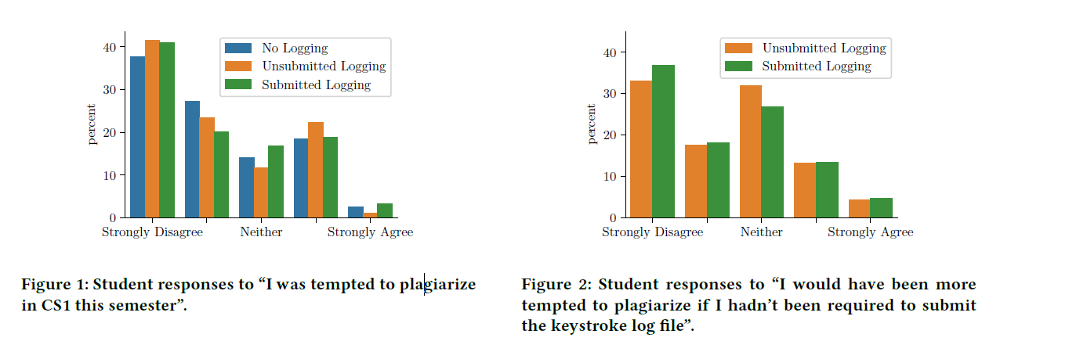
Results: Temptation

Slide 12
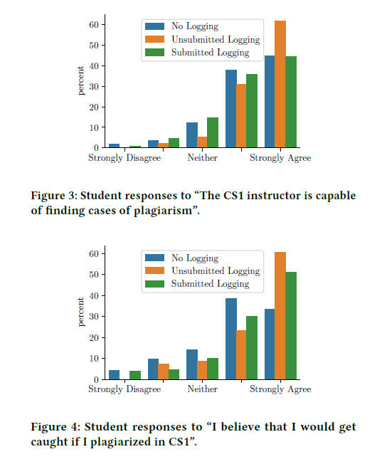
Results: Deterrence

Slide 13
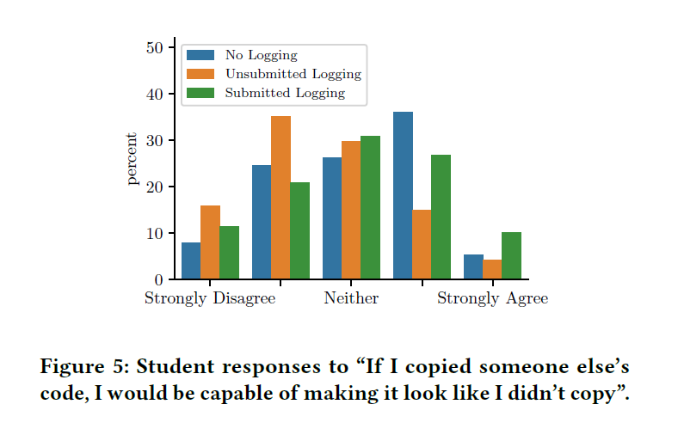
Results: Deterrence (Cont’d)

Slide 14
Results: Anxiety
False positives
9.5% of students expressed anxiety
Sample Response:
“Even though I didn’t cheat, I was constantly stressed
out that my assignments were being marked for plagiarism.
This caused A LOT of anxiety throughout
the semester, so much so that I wish I didn’t take this
class because of the emphasis on cheating....It would
be really helpful if my professor was more clear about
what the plugin is, especially for students who are
prone to feelings of anxiety”.

Slide 15
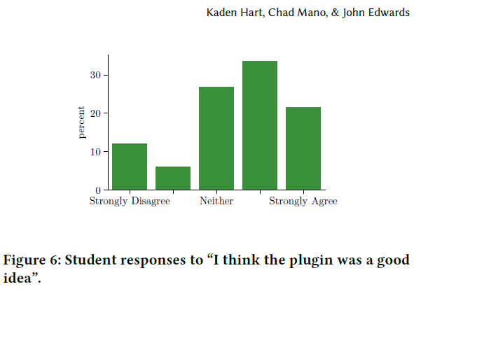
Results: General Attitude

Slide 16
Strengths
Innovative approach to the use of keystroke data as a means to deter plagiarism
Privacy concerns related to keystroke data collection.
The survey conducted among students

Slide 17
Weaknesses
The article focuses on data from a single university and a single instructor
Lack of in-depth-analysis
Anxiety issues not dealt with in detail

