Slide 1
Reading Time Go over paper and review Discussion starts at 1:15

Slide 2

Examining the Digital Divide between Rural and Urban Schools: Technology Availability, Teachers’ Integration Level and Students’ Perception
Pei-Yu Wang (2013)
https://www.sciedu.ca/journal/index.php/jct/article/view/3512/2152
All information from paper listed above unless otherwise cited

Slide 3
Definitions
Digital Divide – unequal access to information and communications technology (ICT)
Internet
Laptops/Tablets/Smart Phones

Slide 4
Facts
Among U.S. public schools,
58% of public schools have laptops
73% have interactive whiteboards
4% provide handheld computing devices
Actual distribution differed by districts
Any thoughts?

Slide 5
Will Skill Tool Model
Integration of ICT is a function of
internal factors (i.e., will and skill) and
external factor (i.e., tool)

Slide 6
Research Questions
Is there any significant difference in terms of
technology availability
teachers’ attitudes, competence, levels and experiences in technology integration
students’ attitudes, competence and experiences in technology integration
between rural and urban elementary schools?

Slide 7
Data Collection
A paper-based survey was sent to 322 teachers and 322 students from 46 public schools (half urban and half rural schools)
Received responses from
275 teachers (47.6% urban, 52.4% rural)
293 students (46.4% urban, 53.6% rural)

Slide 8
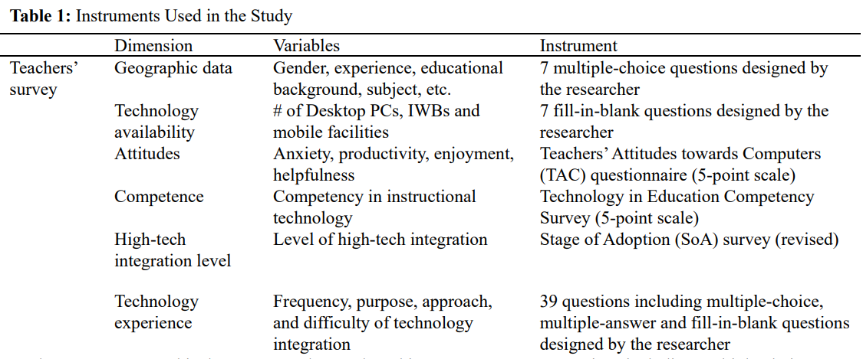
Teachers’ Survey

Slide 9
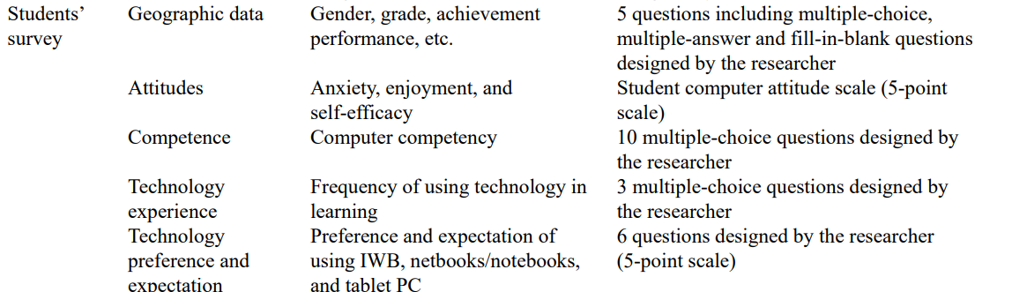
Students’ Survey

Slide 10
Qualitative Data
Qualitative data collection was conducted through interviews with four participants
(selected randomly; two from rural schools and two from urban schools)
Concerns with the data?

Slide 11
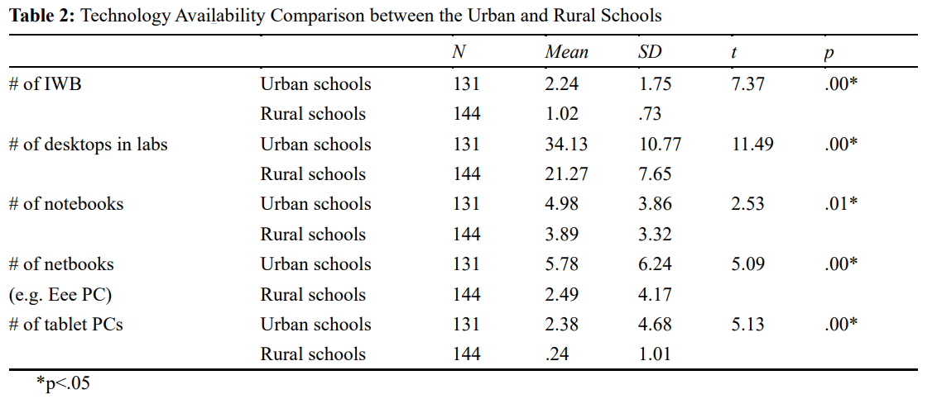
Results
Analysis of Technology Availability

Slide 12
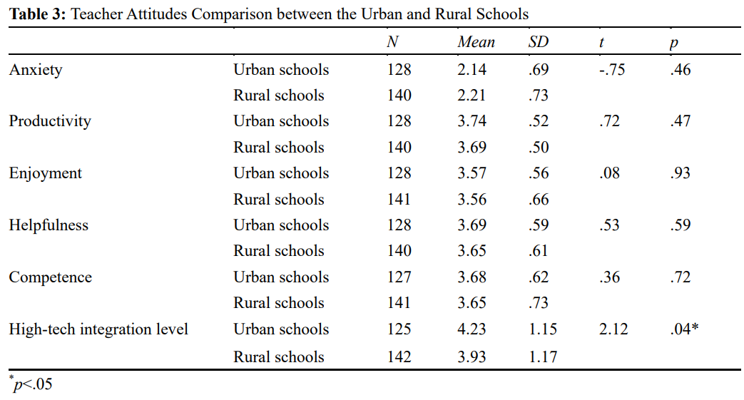
Analysis Teachers’ Attitudes, Competence, and Levels in Terms of Technology Integration

Slide 13
Analysis of Teachers’ Experience of Technology Use
More than 40% of teachers did not have experience teaching with the IWBs, notebooks and netbooks.
Only 8% - 12% of teachers had experience teaching with tablet computers.
Interestingly, the percentage of rural teachers who had experience with netbook/notebook integration in class was higher than that of urban teachers.

Slide 14
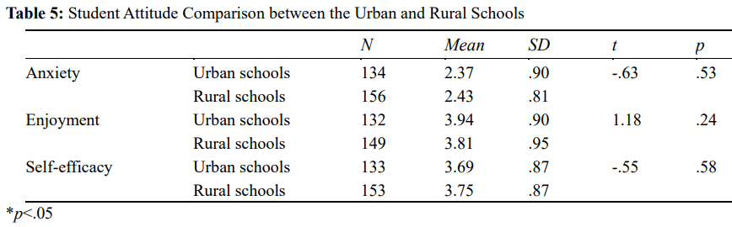
Analysis of Students’ Attitudes in Terms of Technology Integration

Slide 15
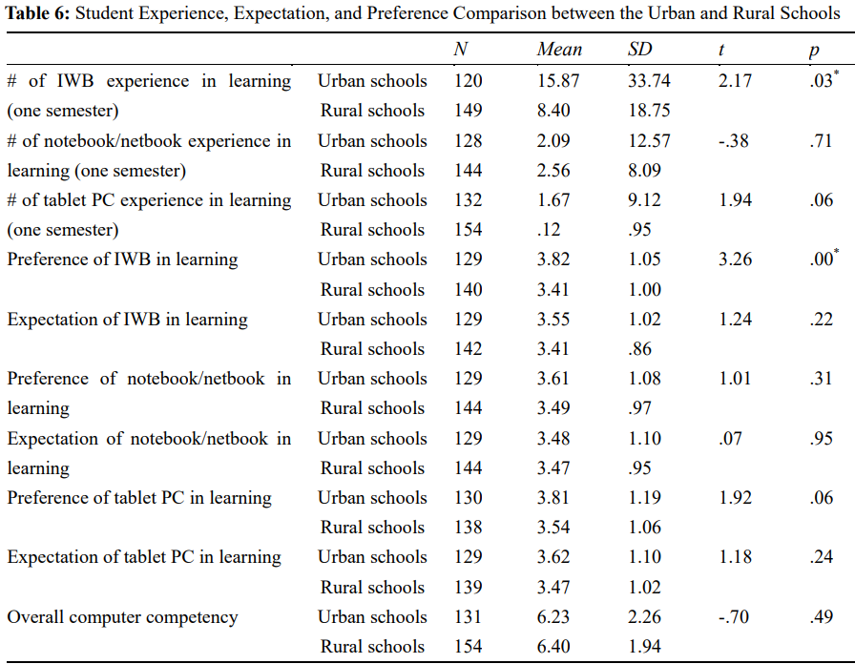
Analysis of Students’ Experience, Expectation in Terms of Technology Integration

Slide 16
Limitations
Self-reported data which can be biased
Restricted sample size

Slide 17
Summary
1. Technology Availability
Significant gap exists between urban and rural schools
Unequal resources
Under qualified computer teachers

Slide 18
Summary
2. Teachers’ Attitudes and Competence
Positive attitude towards tech integration
Did not differ between both schools
Teachers’ Experience and Levels
Urban – Level 4 (Familiarity & Confidence)
Rural – Level 3 (Understanding and application of the process)

Slide 19
Summary
3. Students’ Attitudes and Competence
Positive attitude towards tech integration
Did not differ between both schools
Students’ Experience and Levels
Difference in IWB experience in learning

Slide 20
Suggested Solutions
Improve the quantity of advanced facility (IWBs and mobile tools)
Increase the number of qualified computer teachers
Provide training sessions based on the needs of teachers
Increase student experience and expectation for rural students

