Slide 1
DellQA: developing a closed-domain QA model for IT support.
Cian Prendergast

Slide 2
Overview:
QA
SQuAD
TechQA
DellQA
Data Collection
Domain Adaptation
Results
Discussion
Conclusion

Slide 3
Question and Answering (QA)
IT support is a key element of a successful technology company, but it can be timeconsuming and expensive to provide timely and helpful responses to so many customers and products (Yu et al., 2020).
Dell Technologies has a vast community, answering questions posted on the community IT support forum. But it can be difficult to search and retrieve known solutions.
Question and Answering (QA) systems are a form of machine learning comprehension which extract relevant information (answers) from documents based on a prompt (question).
Notes:
IT support is a key element of a successful technology company, but it can be timeconsuming and expensive to provide timely and helpful responses to so many customers and products (Yu et al., 2020).
Dell Technologies has a vast community, answering questions posted on the community IT support forum. But it can be difficult to search and retrieve known solutions.
Question and Answering (QA) systems are a form of machine learning comprehension which extract relevant information (answers) from documents based on a prompt (question).

Slide 4
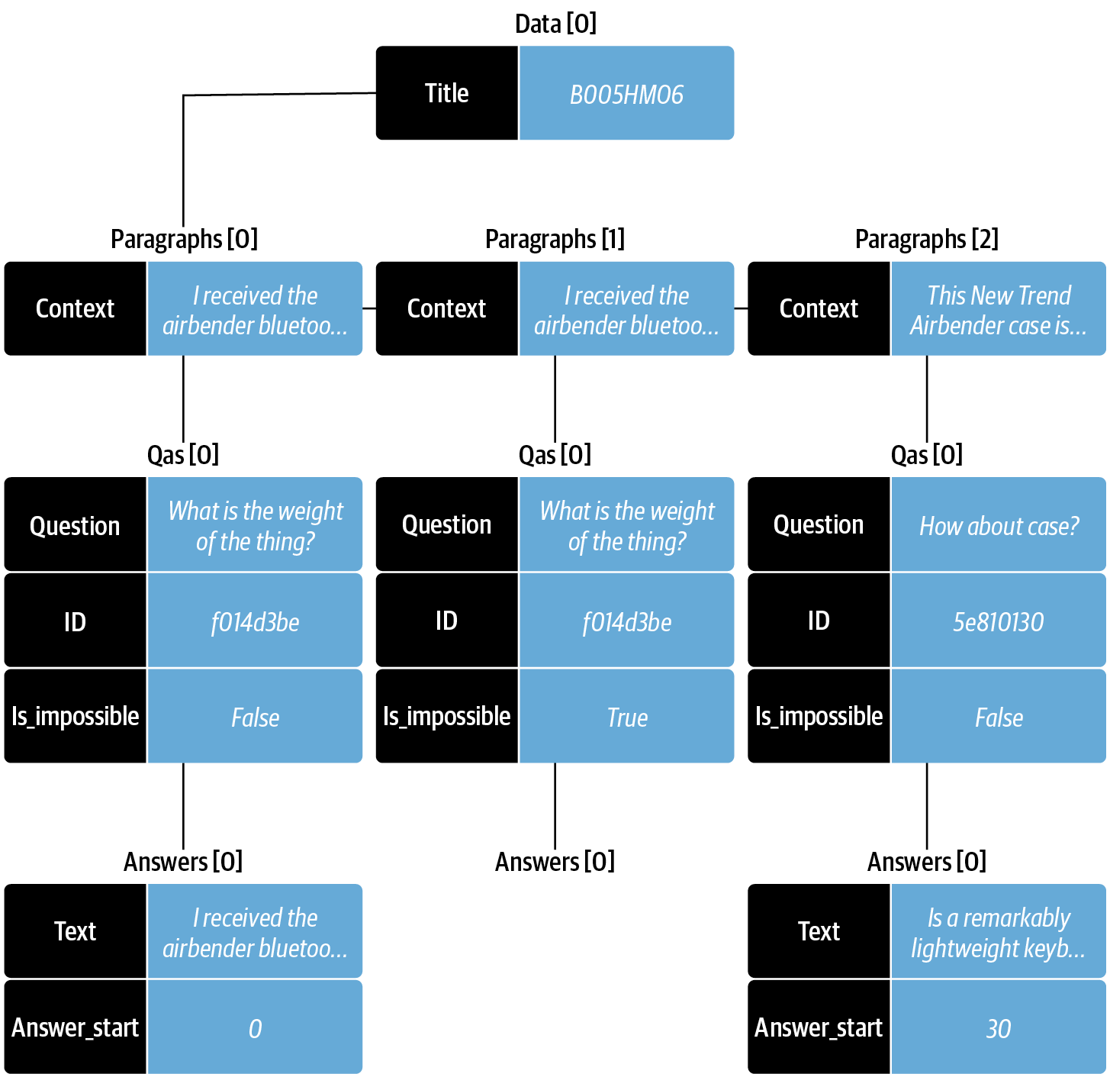
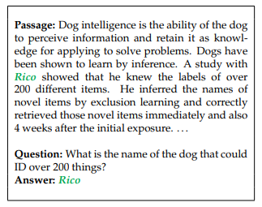
SQuAD (open-domain)
Fig 1, SQuAD format (Tunstall et al., 2023)
Notes:
To extract answers from the retrieved document we frame the problem as a span classification problem.
QA requires Q, DOC, ANS SPAN, this dataset structure is derived from SQuAD (Rajpurkar et al, 2016)
SQuAD open-domain QA for factoid style questions (Rajpurkar et al, 2016).
Large dataset, crowd-sourced annotation, see example
SQuAD experience performance deterioration upon user-generated questions (Yu et al., 2020).
This is because models trained on domain general corpus (Wikipedia) perform poorly with domain specific documents (Maufe, 2022).

Slide 5
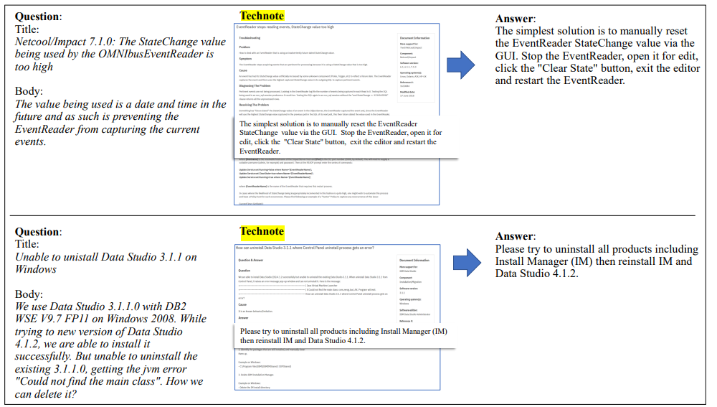
TechQA (closed-domain)
BERT language model already trained on larger open-domain SQuAD dataset.
Fine-tune on closed-domain custom dataset TechQA (Kia, 2022).
Fig 2, IBM Technotes used to train TechQA (Castelli et al 2019)
Notes:
A model trained on a large-scale SQuAD learns the capability to answer questions in diverse domains and can quickly adapt to and perform efficiently in a new domain (Maufe, 2022).
Specialised closed-domain datasets remain scarce (Hazen et al., 2019; Kia et al., 2022). Need expert annotation.
This lack of domain specific datasets has contributed to closed-domain QA performing poorly compared to open-domain QA (Maufe, 2022).
The best QA model performance is obtained when the datasets are the same for both finetuning and prediction (Soni & Roberts, 2020).
TechQA the only IT support QA dataset
Data was collected from online IT support forums (Castelli et al 2019), IBM Technote—a technical document that addresses a specific technical issue (Castelli et al 2019).
Size of the released data (600 training questions) is in line with real-world scenarios.
Limited Question to align with SQuAD
TechQA model development followed the two-step transfer learning process

Slide 6
DellQA Aims:
The study aims to:
Create a high-quality custom QA dataset called DellQA for IT support.
Fine-tune a model on this custom dataset
Demonstrate the feasibility of domain adaptation for IT support.

Slide 7
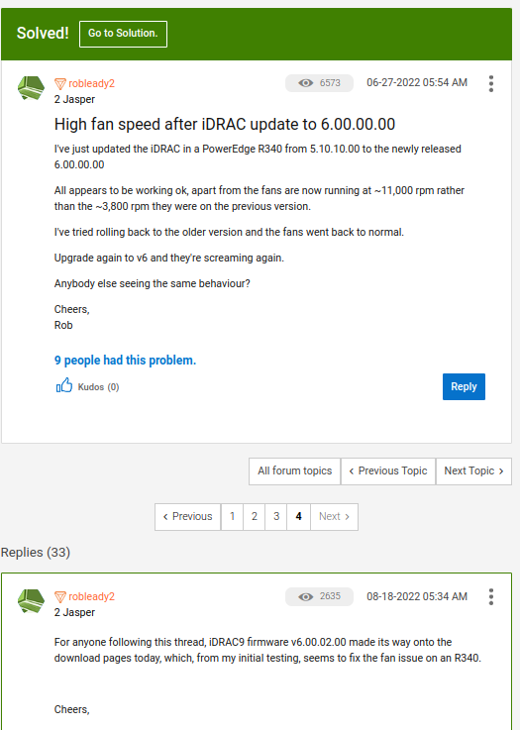
Dell Data Collection
“Many answers cannot be obtained by extracting portions of a documents based on language alone: in many cases, domain knowledge is needed and often a question cannot be answered from the data collection without a reasoning step.”
Castelli et al 2019
Fig 3, screenshot of the Dell support forum (Prendergast, 2023)
Notes:
Originally we wanted to follow TechQA approach (using kb articles referenced in answers)
[aside] * talk about attempts of using kb articles, lacks structure and does not necessarily address the question (example next slide)
‘Hardware’ category of posts and where an answer given has been marked ‘solved’ by the community. A total of 1,901 question and answer pairs were collected from the website.
Data was exported as two csv files (questions and answers)

Slide 8
“Hello,i bought a dell poweredge r610 server. The bios firmware is very old and I get an error when I try to upgrade it. The current version is version 2.1.15. The version I want to upgrade is 6.6.0 version. I tried this on Windows, I ran the 6.6.0 bios update file. After waiting for a while, the warning came that instead of 2.1.15, the 6.6.0 upgrade would be processed and the server would be restarted. I pressed yes and waited for a while, and after waiting a few minutes on the black screen, the update failed. The server continues to boot with 2.1.15 firmware again. I tried this update on linux operating systems but I get the same error. I have been dealing with this problem for 10 days. Please help me to solve this problem. Thank you.”
“Hello @mcym, The server is really out of date, trying to update it from its current version directly to the latest one can cause issues. When starting firmware version is too old is much better to update step by step. Instead of updating from a very old to the latest firmware version. Check the downloads site and look for the oldest bios version available. For a R610 is the 6.1.0: https://dell.to/3dVsINv “
Notes:
“please type in your service tag and check the warranty: URL”

Slide 9
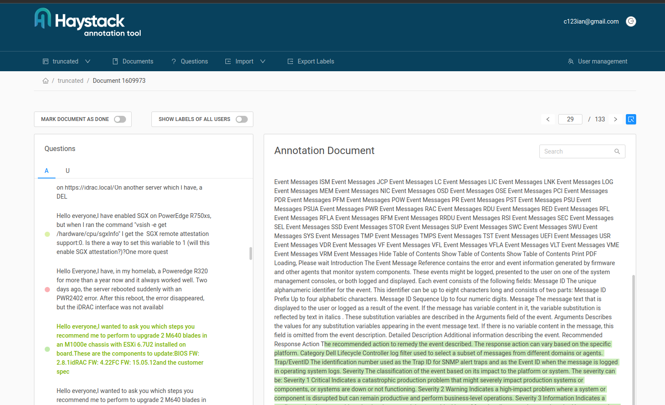
Domain Adaptation: Preparation
1,901 question and answer pairs.
Pre-trained models anticipate the input data to be in this specific structure (SQuAD v2).
Haystack Annotation tool for highlighting answer spans.
Exports as SQUAD v2 format
Fig 4, screenshot taken while annotating answer spans using Haystack (Prendergast, 2023)
Notes:
Prepare it for SQuAD, answer span classification using Haystack GUI

Slide 10
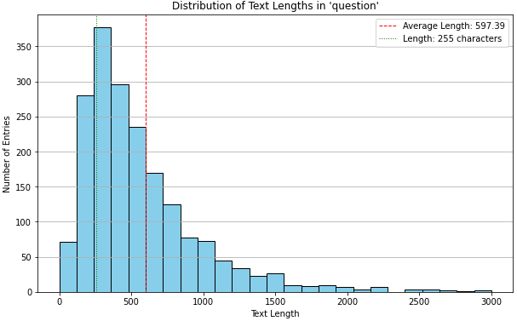
Haystack 255 character limit for Questions
Average Length | Maximum Length | Minimum Length | % of questions >255 chars
597 | 27039 | 0 | 79.01%
Fig 5, distribution of text length from raw dataset (Prendergast, 2023)
Notes:
Castelli et al. (2019) opted to limit question-answer length to better align with SQuAD.
However, even with variation in answer lengths between datasets transfer learning is effective (Hazen et al., 2019 https://arxiv.org/pdf/1911.02655.pdf ).
But, Haystack tool has a 255 question limit, thus we had to truncate and losing info from questions

Slide 11
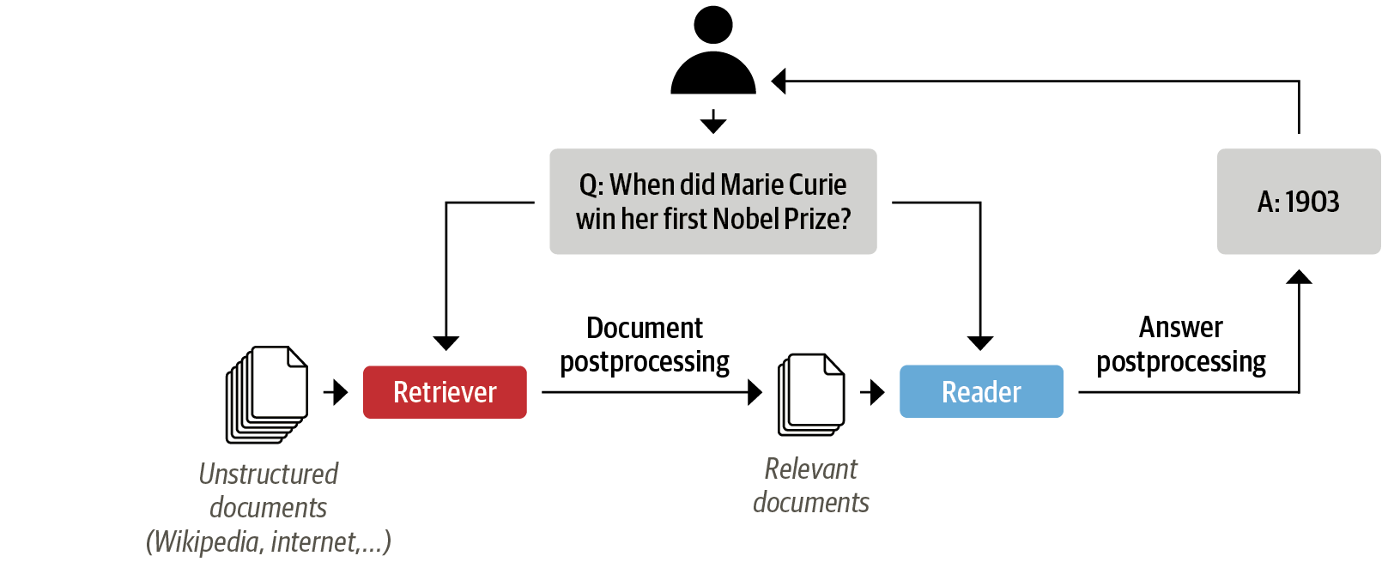
Domain Adaptation: Training DellQA
Fig 6, Haystack QA Pipeline (Tunstall et al., 2023)
Notes:
Using the two-step transfer learning process.
Train/test 80:20 ratio split (random).
Using the two-step transfer learning process.
For tokenization a distilled version of BERTbase (MiniLM) was used for its speed and the has been pre-trained on the larger SQUAD 2.0 dataset (downloaded from Hugging Face Hub)
Haystack was used to build the QA pipeline, which requires a document store for storing documents or passages for fast retrieval (Tunstall, 2022).
The DocumentStore used was Elasticsearch, chosen for its compatibility with dense retrievers.
A Dense Passage Retrieval (DPR) retriever was used to find information (passages) relevant to a query, leveraging its ability to handle variations in query phrasing.
FARMReader was selected as the reader due to the ease of incorporating pre-trained models.

Slide 12
Results
200 entries for DellQA, truncated questions, 197 Answerable and 1 Epoch Training results
EM (Exact Match): The model answered 27.5% of the 197 answerable questions with the exact correct answer.
F1 Score: The F1 score measures a balance between precision (how many of the model's answers were correct) and recall (how many of the correct answers were captured by the model). The F1 score for the model is approximately 44.76%. This suggests that even when the model's answers weren't an exact match, they were often close or partially correct.
The model's predictions are often close but not exact, as indicated by the F1 scores being higher than the EM scores.
TechQA F1 score: 54.05%
Notes:
of 197 answerable question-answer pairs, interrpret the following results: {'EM': 27.500000000000004, 'f1': 44.7551173010347, 'top_n_accuracy': 67.5, 'top_n': 4, 'EM_text_answer': 24.324324324324326, 'f1_text_answer': 42.97850519030778, 'top_n_accuracy_text_answer': 64.86486486486487, 'top_n_EM_text_answer': 32.432432432432435, 'top_n_f1_text_answer': 52.48132351665551, 'Total_text_answer': 37, 'EM_no_answer': 66.66666666666666, 'f1_no_answer': 66.66666666666666, 'top_n_accuracy_no_answer': 100.0, 'Total_no_answer': 3}
EM is binary—either the prediction is right or it's not. F1 Score, on the other hand, can provide a more nuanced evaluation, giving partial credit to answers that are close but not exact.
Overall Performance:
EM (Exact Match): The model answered 27.5% of the 197 answerable questions with the exact correct answer.
F1 Score: The F1 score measures a balance between precision (how many of the model's answers were correct) and recall (how many of the correct answers were captured by the model). The F1 score for the model is approximately 44.76%. This suggests that even when the model's answers weren't an exact match, they were often close or partially correct.
Text Answer Performance (For questions that have a text answer):
Total Text Answers: Out of the 197 answerable questions, 37 have text answers.
EM Text Answer: The model gave the exact correct text answer for about 24.32% of these 37 questions.
F1 Text Answer: The F1 score for text answers is approximately 42.98%.
Top-n Accuracy Text Answer: The correct text answer was within the model's top 4 predictions 64.86% of the time.
Top-n EM Text Answer: The exact correct answer was within the model's top 4 predictions for 32.43% of these questions.
Top-n F1 Text Answer: The F1 score considering only the top 4 predictions for text answers is approximately 52.48%.

Slide 13
Discussion
There are few publicly available closed-domain datasets– and was only one currently for IT support (Yu et al., 2020). We want to contribute to the field by creating a second IT support QA dataset, DellQA.
This study used open-source tools to create a custom closed-domain dataset to train a QA model.
Originally attempted to use kb articles, but by scraping data from Dell’s community forum got real-world questions and answers that may contain “reasoning”.
Haystack annotation tool limitations could be better addressed (not truncate long questions).
While DellQA is small, it is in-line with real-world creation of closed-domain QA.
The exact match rates for textual answers could be improved by training on more epochs or on larger set of question-answer pairs.
Notes:
There are few publicly available closed-domain datasets– and was only one currently for IT support (Yu et al., 2020). We want to contribute to the field by creating a second IT support QA dataset, DellQA.
This study used open-source tools to create a custom closed-domain dataset to train a QA model.
Originally attempted to use kb articles, but by scraping data from Dell’s community forum got real-world questions and answers that may contain “reasoning”.
Haystack annotation tool limitations could be better addressed (not truncate long questions).
While DellQA is small, it is in-line with real-world creation of closed-domain QA.
The exact match rates for textual answers could be improved by training on more epochs or on larger set of question-answer pairs.

Slide 14
Conclusion
Deploying QA System in the world can be tricky
The best QA model performance is obtained when the datasets are the same for both finetuning and prediction.
Addressing the scarcity of closed-domain QA datasets for IT support by creating DellQA.
Fine-tuned DellQA model using a two-step transfer learning process demonstrates the feasibility of domain adaptation for IT support using open-source tools.
GitHub page: https://github.com/c123ian/Dell_QA
Future Work:
Address question limit (pending PR with Haystack or create another work-around)
Create a larger DellQA dataset using raw dataset.
Generative QA: RAG
Notes:
The best QA model performance is obtained when the datasets are the same for both finetuning and prediction (Soni & Roberts, 2020).
RAG: Swap the reader with a generator and use DPR to retrieve

Slide 15
Thank you!
cian.prendergast23@mail.dcu.ie

