Slide 1
5G Edge Cloud
Week 5

Slide 2


Meet the Team
Rahul Rajkumar
Andrew Michael
5G Edge Cloud Applications
June
2025

Slide 3
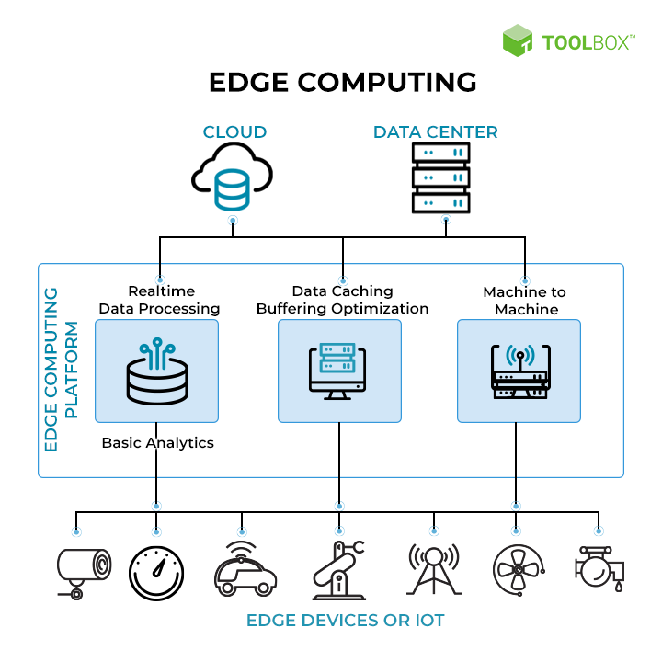
REVIEW
EDGE
What are we working on: Edge
What are we doing: Creating BenchmarkS
“

Slide 4
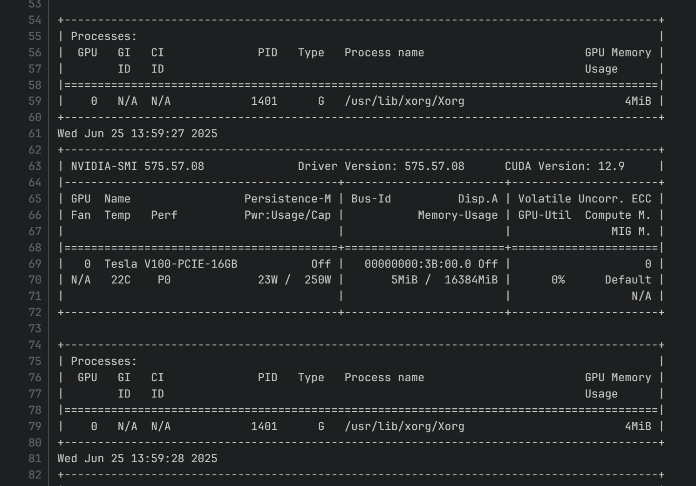
This Week
Point 1
Assess the compute using existing benchmarks (PTS)
Point 2
Measure system utilization of exporter using script
Point 3
Conduct stress tests on the GPU and CPU on different load %s
Company Name

Slide 5
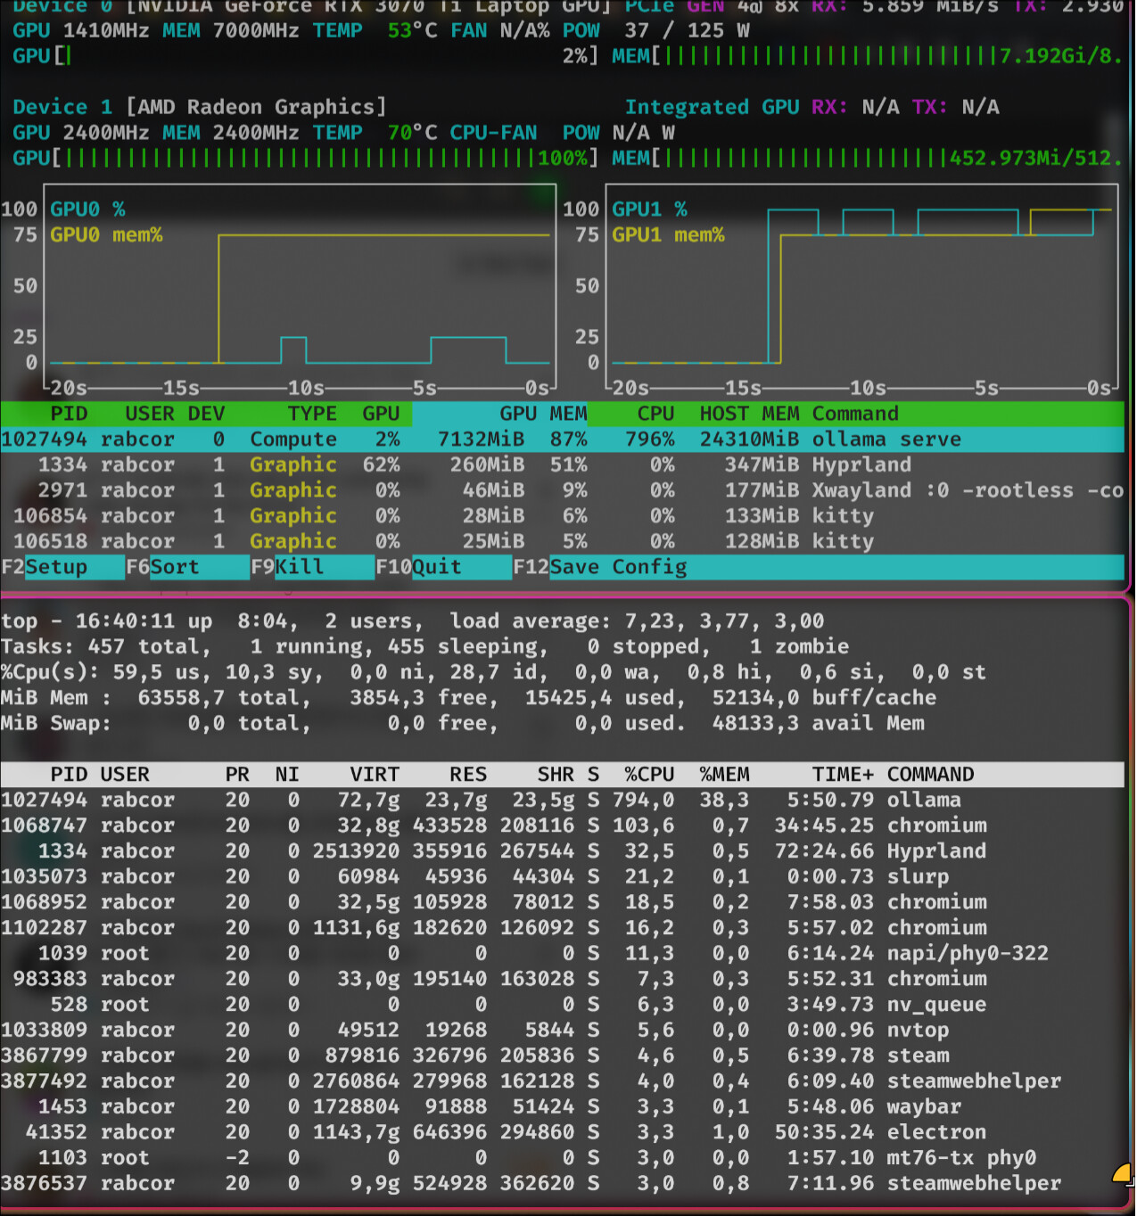

Key capabilities
1
2
3
Observe progressive GPU overload using Ollama and requests
Deviate actual benchmark # based on performance
Develop and train an ML model

Slide 6




Questions?
Grade 5

