Slide 1
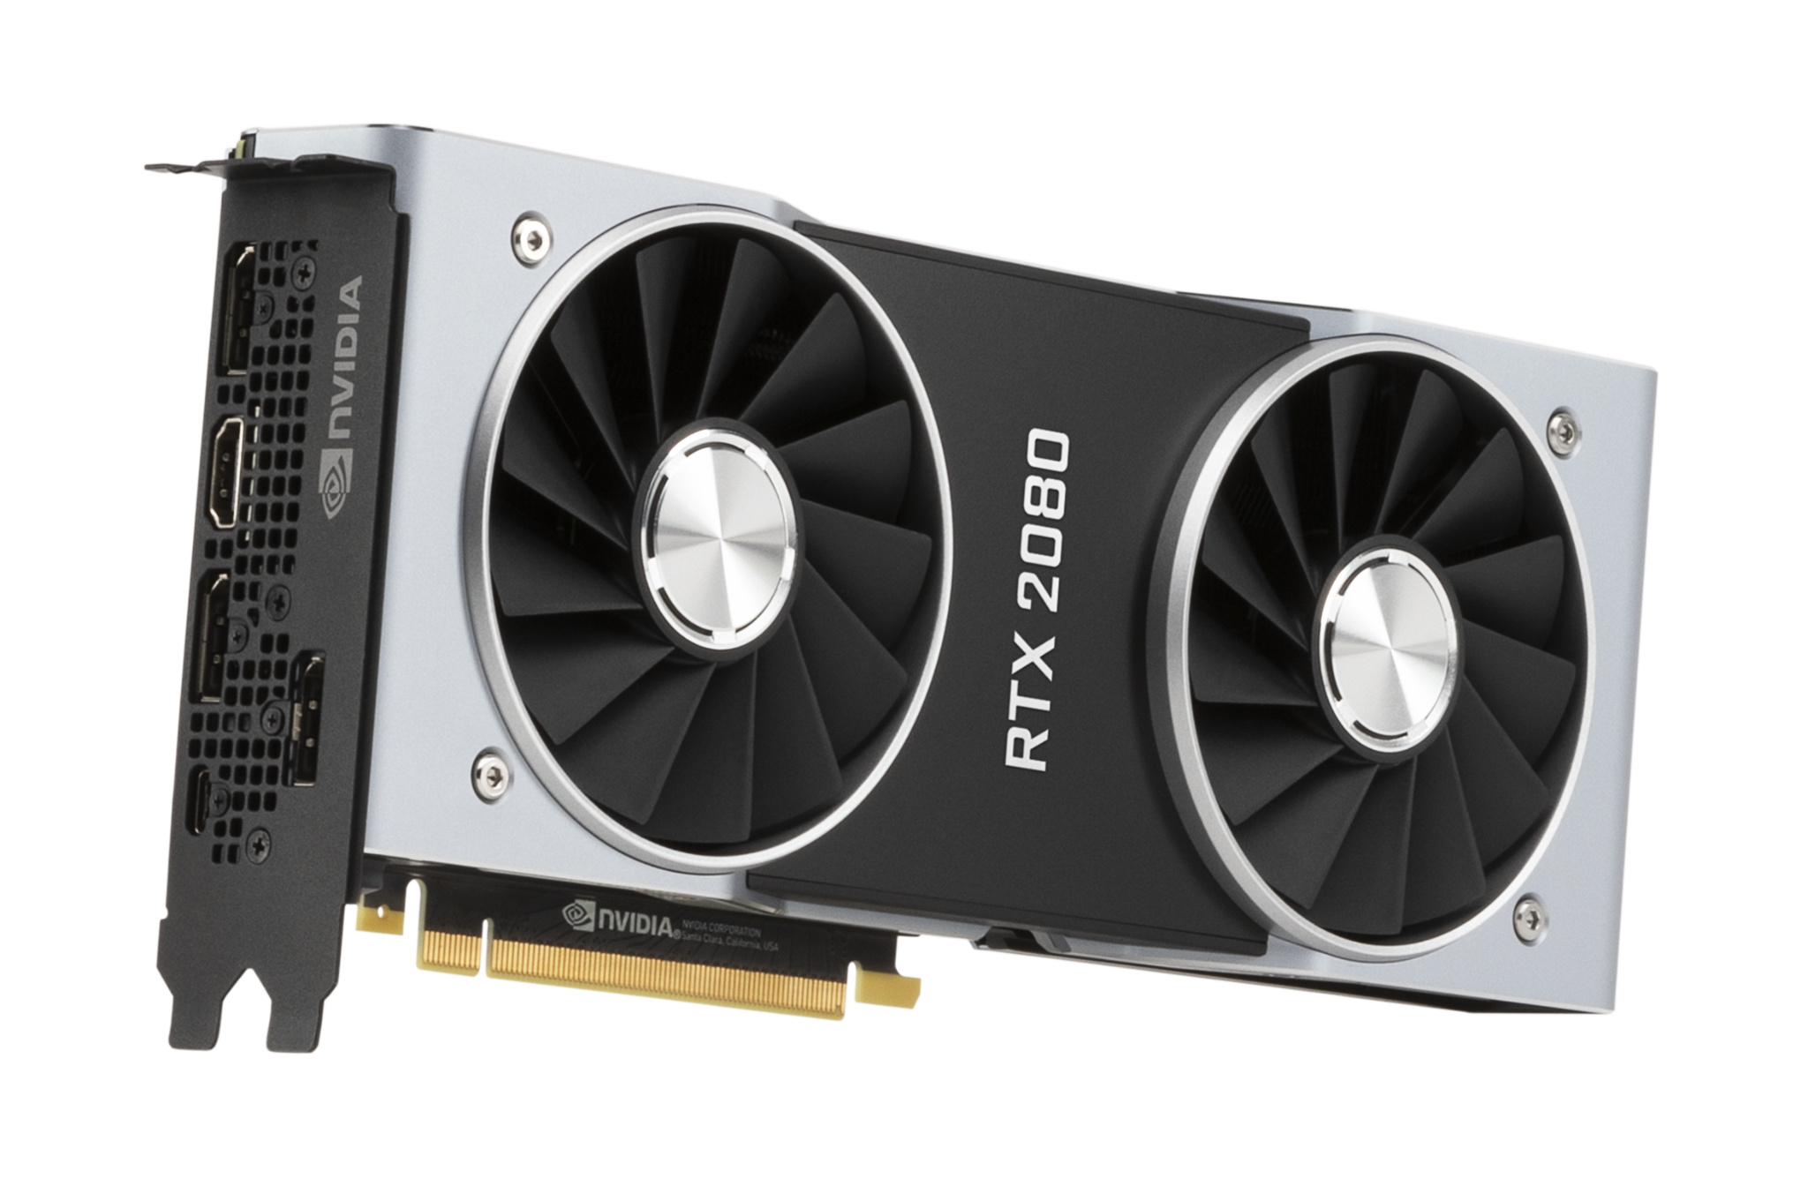
5G EDGE CLOUD APPLICATIONS
By: Rahul Rajkumar and Andrew Michael

Slide 2


THE TEAM
Rahul Rajkumar
Andrew Michael
Special thanks to our advisors: Ivan Seskar & Xiaotian (Jack) Zhou

Slide 3
Edge Computing
Distributed computing model that brings compute closer to the sources of data.
Lower latency, higher bandwidth, and addresses privacy and security concerns with cloud computing
Needs improvement in running AI applications
Notes:
Edge computing is a distributed computing model that brings computation and data storage closer to the physical location where it’s needed, instead of sending all data to centralized cloud servers, edge computing processes data locally or near the data source, which reduces latency and improves real-time responsiveness.
Low latency: Faster response times by avoiding delays from cloud roundtrips.
Bandwidth efficiency: Reduces the need to transmit large volumes of data to the cloud.
Enhanced privacy: Sensitive data can be processed locally without being transmitted.
Reliability: Can continue to function even when the cloud connection is slow or lost.

Slide 4
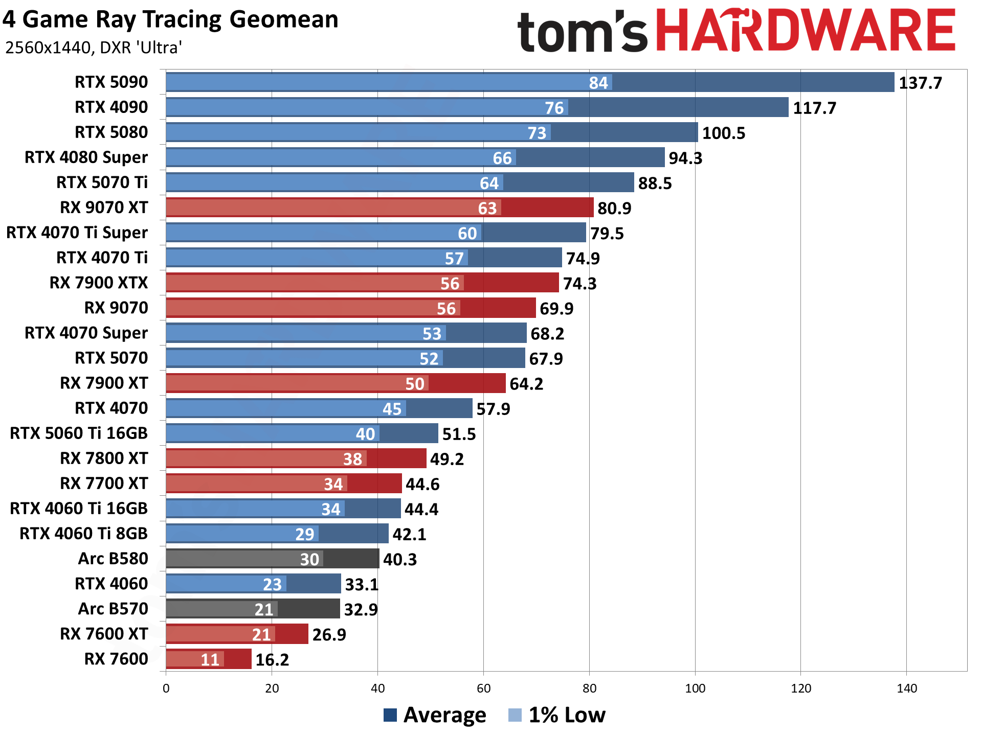
Project Overview
Improve scheduling issue by creating benchmarks
Focusing on AI applications, specifically running LLMs on Nvidia GPUs
Prioritizing latency of LLM response

Slide 5

CONDUCTING THE EXPERIMENT
Send prompts to LLM (llama 3.1:8b) being run on Nvidia GPUs (Tesla V100 & A100) via a Python script
Collect GPU metrics & LLM performance metrics
Store and understand the collected data

Slide 6
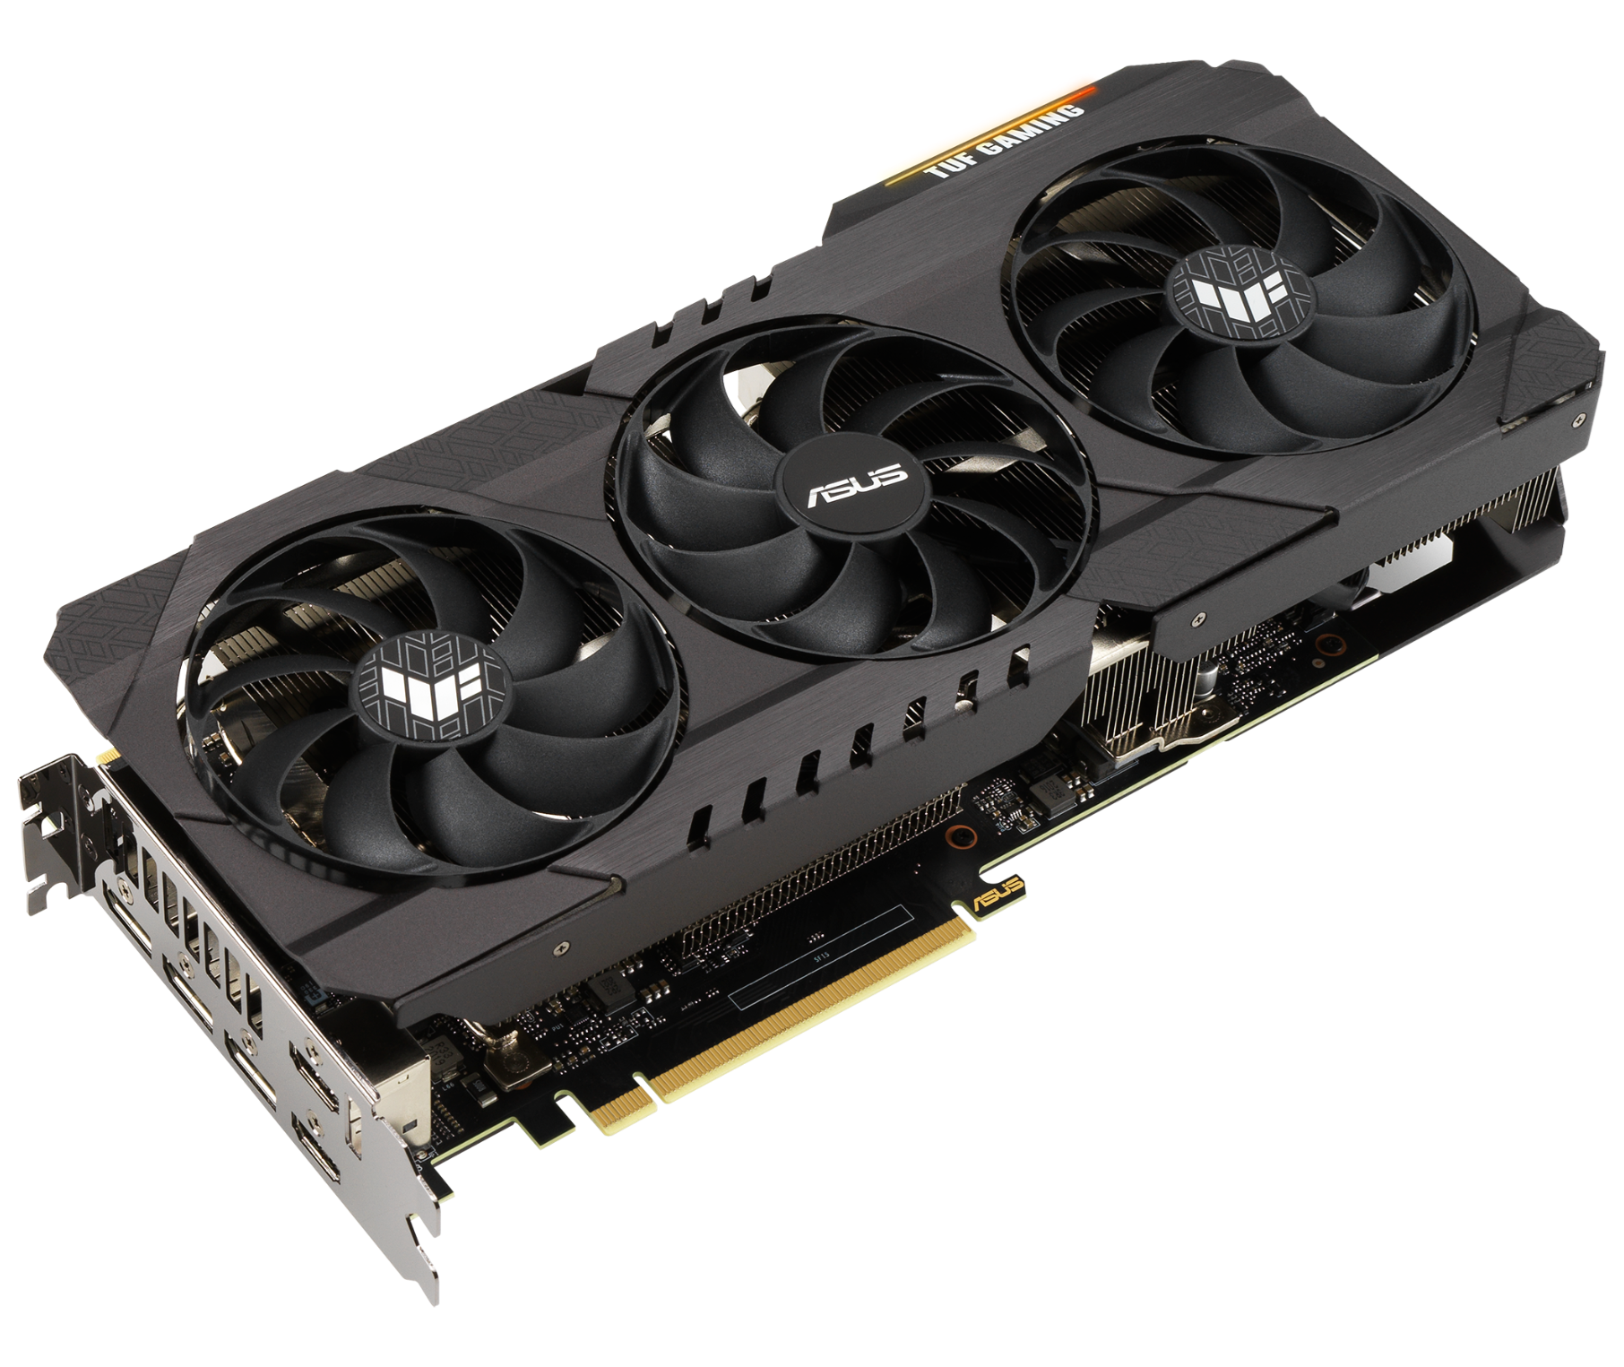




TOOLS USED
EXPORTERS
PROMETHEUS
GRAFANA
OLLAMA
Exports GPU live metric information to port
Listens to the exporters and collects that data
Takes GPU metrics & displays it on dashboard
Receives prompts and sends them to local LLM
MONGODB
Collects the metrics sent from Prometheus & stored in database

Slide 7
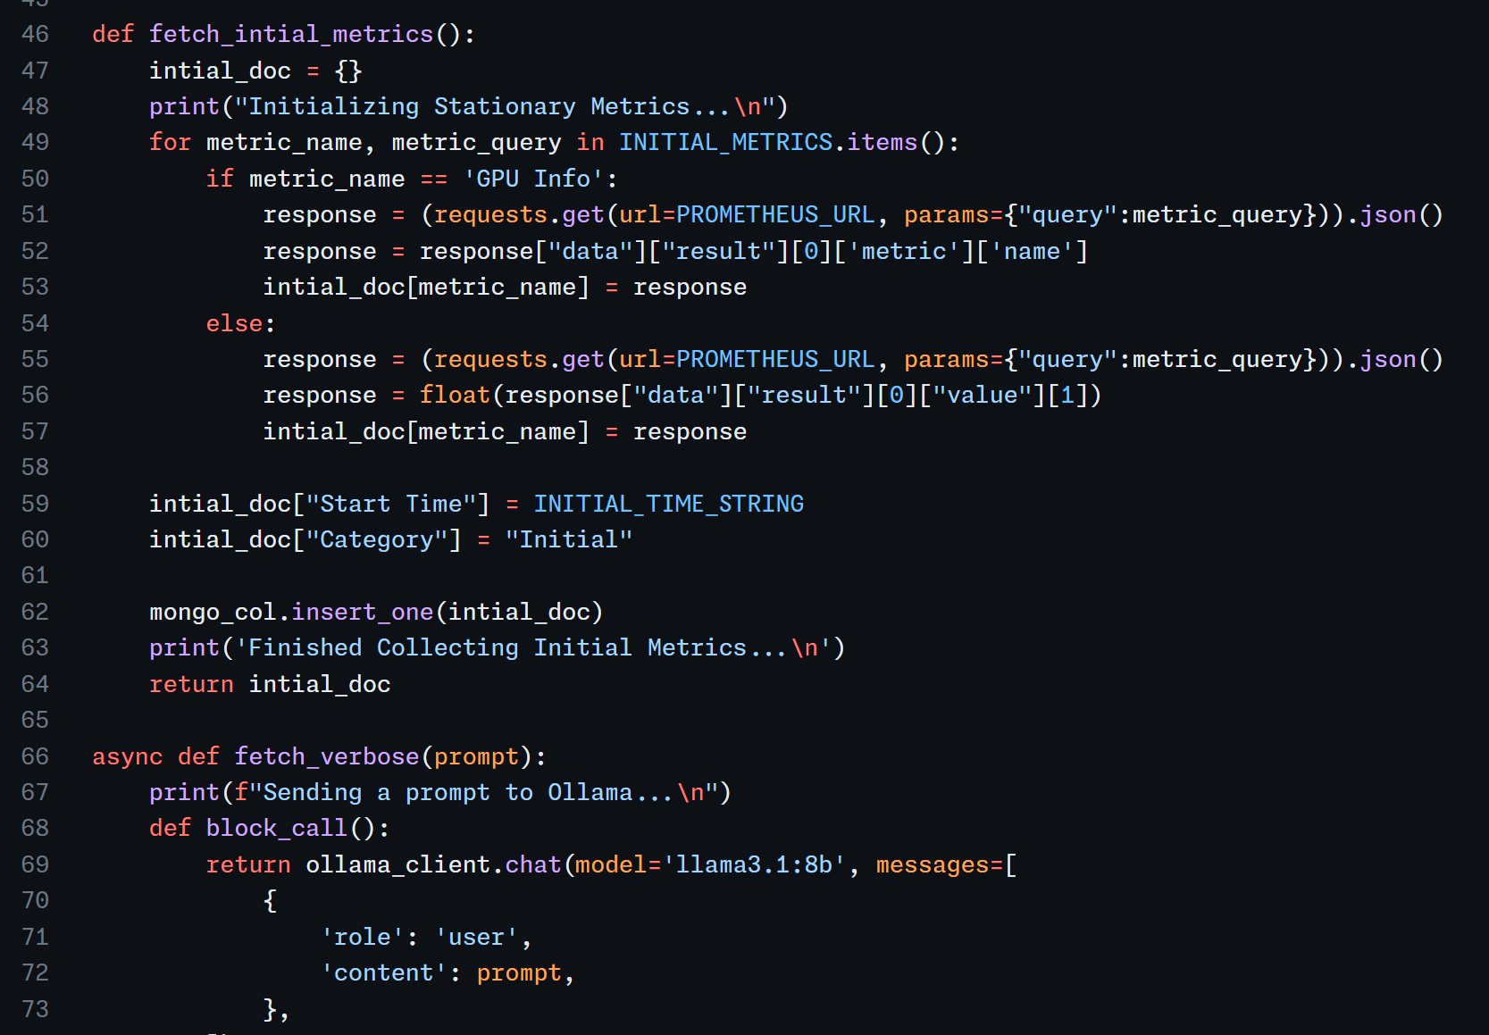
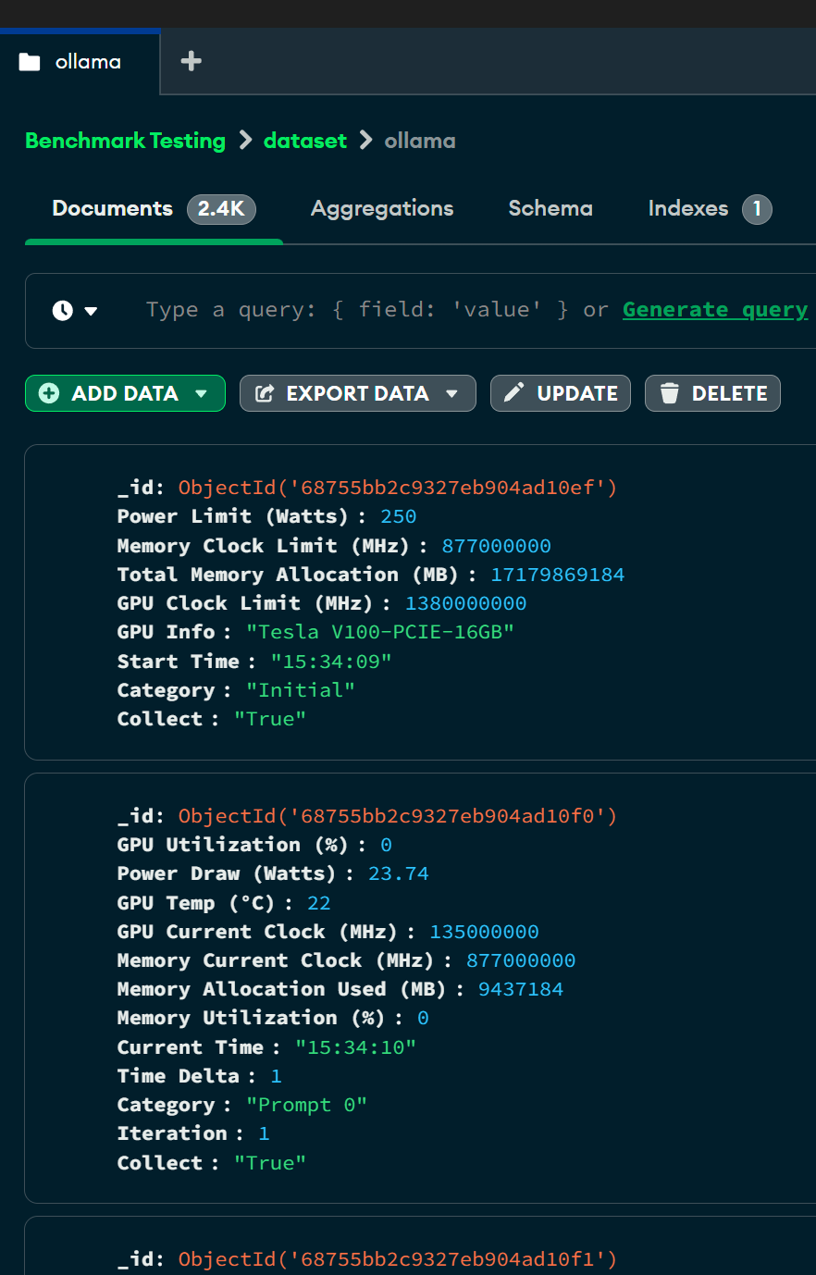
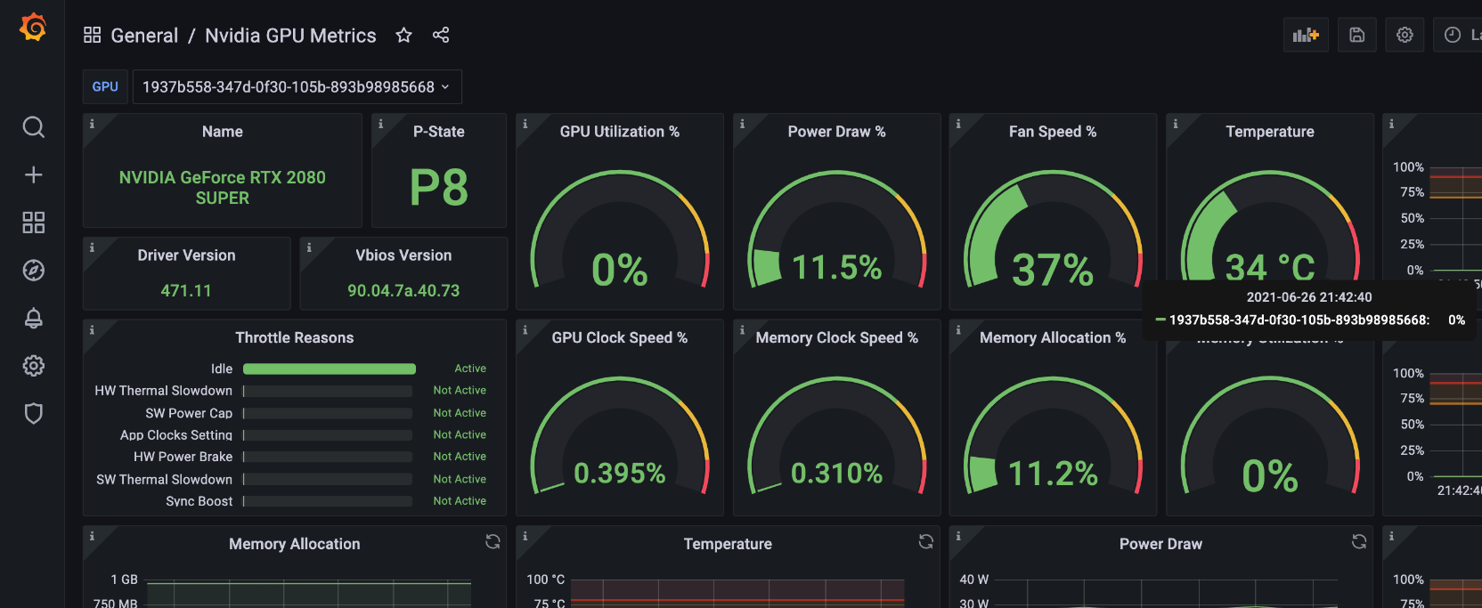
SET UP VISUALS

Slide 8
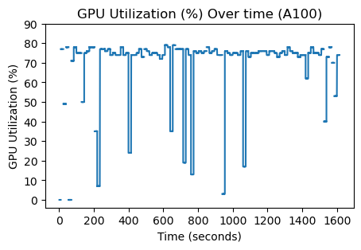
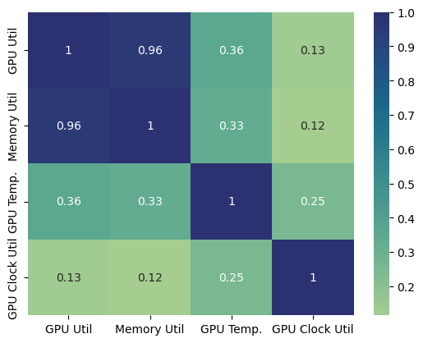
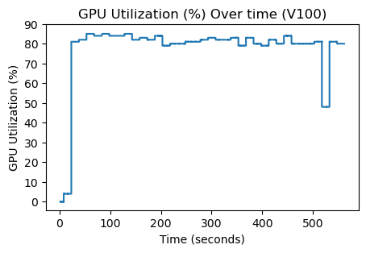
DATA VISUALIZED
A100
Heatmap
V100
*Test run on V100 only consisted of 70 request vs A100 was 700 requests.
GPU Util

Slide 9
CREATING BENCHMARKS
Created a relative weighted-sum score (compare between 2 different GPUs)
Use the three most important metrics which are, GPU utilization, memory utilization, and response time
Created 3 weights based on these metrics and multiply them against their average
Our tests result in the scores:
Tesla A100: 0.103
Tesla V100: -0.233

Slide 10
CONCLUSIONS
We concluded a scoring method to compare performance of GPUs in running LLMs
Restricted to only this application & Nvidia GPUs
However, there are many other factors to consider…

Slide 11
FUTURE WORK
Expanding other GPUs, networking, other hardware
GPU is not always idle, impacts to benchmark score if other processes are running
Creating a more rigorous scoring method

Slide 12
Thank you!
By: Rahul Rajkumar and Andrew Michael

Slide 13
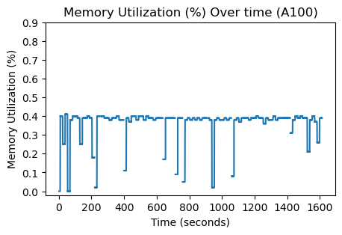
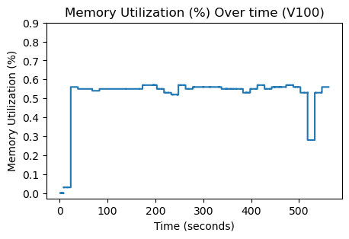
DATA VISUALIZED
Memory utilization for A100 and V100 over time
Memory utilization for V100 remains stable but A100 fluctuates
A100
V100
Memory Util

Slide 14
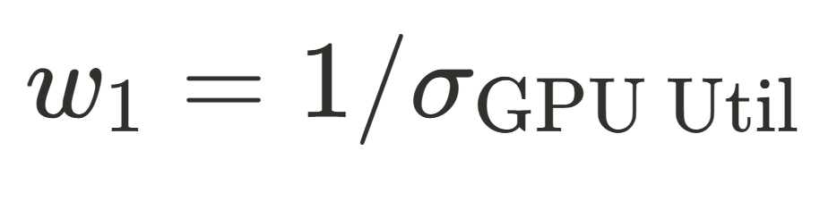
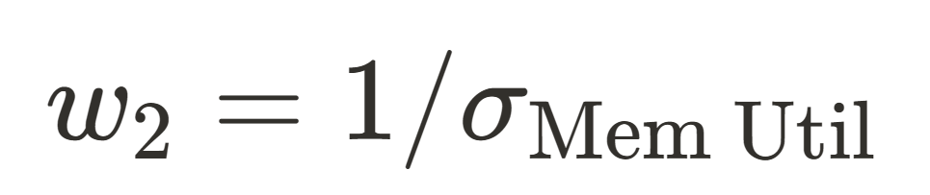
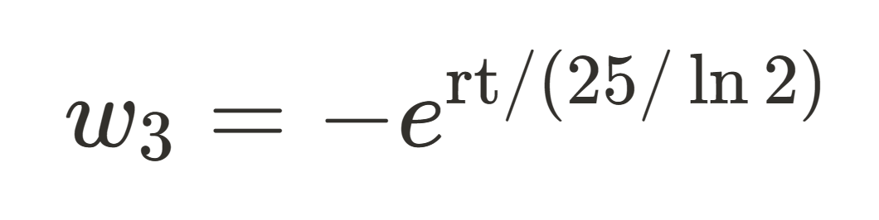
WEIGHTS
Reciprocal of the standard deviation of the gpu utilization over the entire test
Reciprocal of the standard deviation of the memory utilization over the entire test
Negative of the exponential of the average response time divided by 25 over the natural log of 2

