Slide 1
5G Edge Cloud
Week 7

Slide 2


Meet the Team
Rahul Rajkumar
Andrew Michael
5G Edge Cloud Applications
June
2025

Slide 3
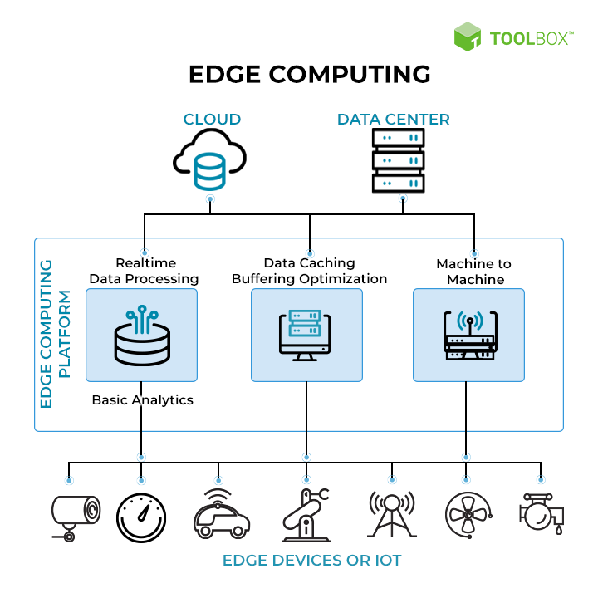
REVIEW
EDGE
What are we working on: Edge
What are we doing: Creating Benchmarks
“

Slide 4
This Week
Point 1
Finished automating our data collection pipeline
Point 2
Created a pool of prompts to send to the LLM & collected data
Point 3
Did some basic EDA on data and tried to figure out important factors

Slide 5




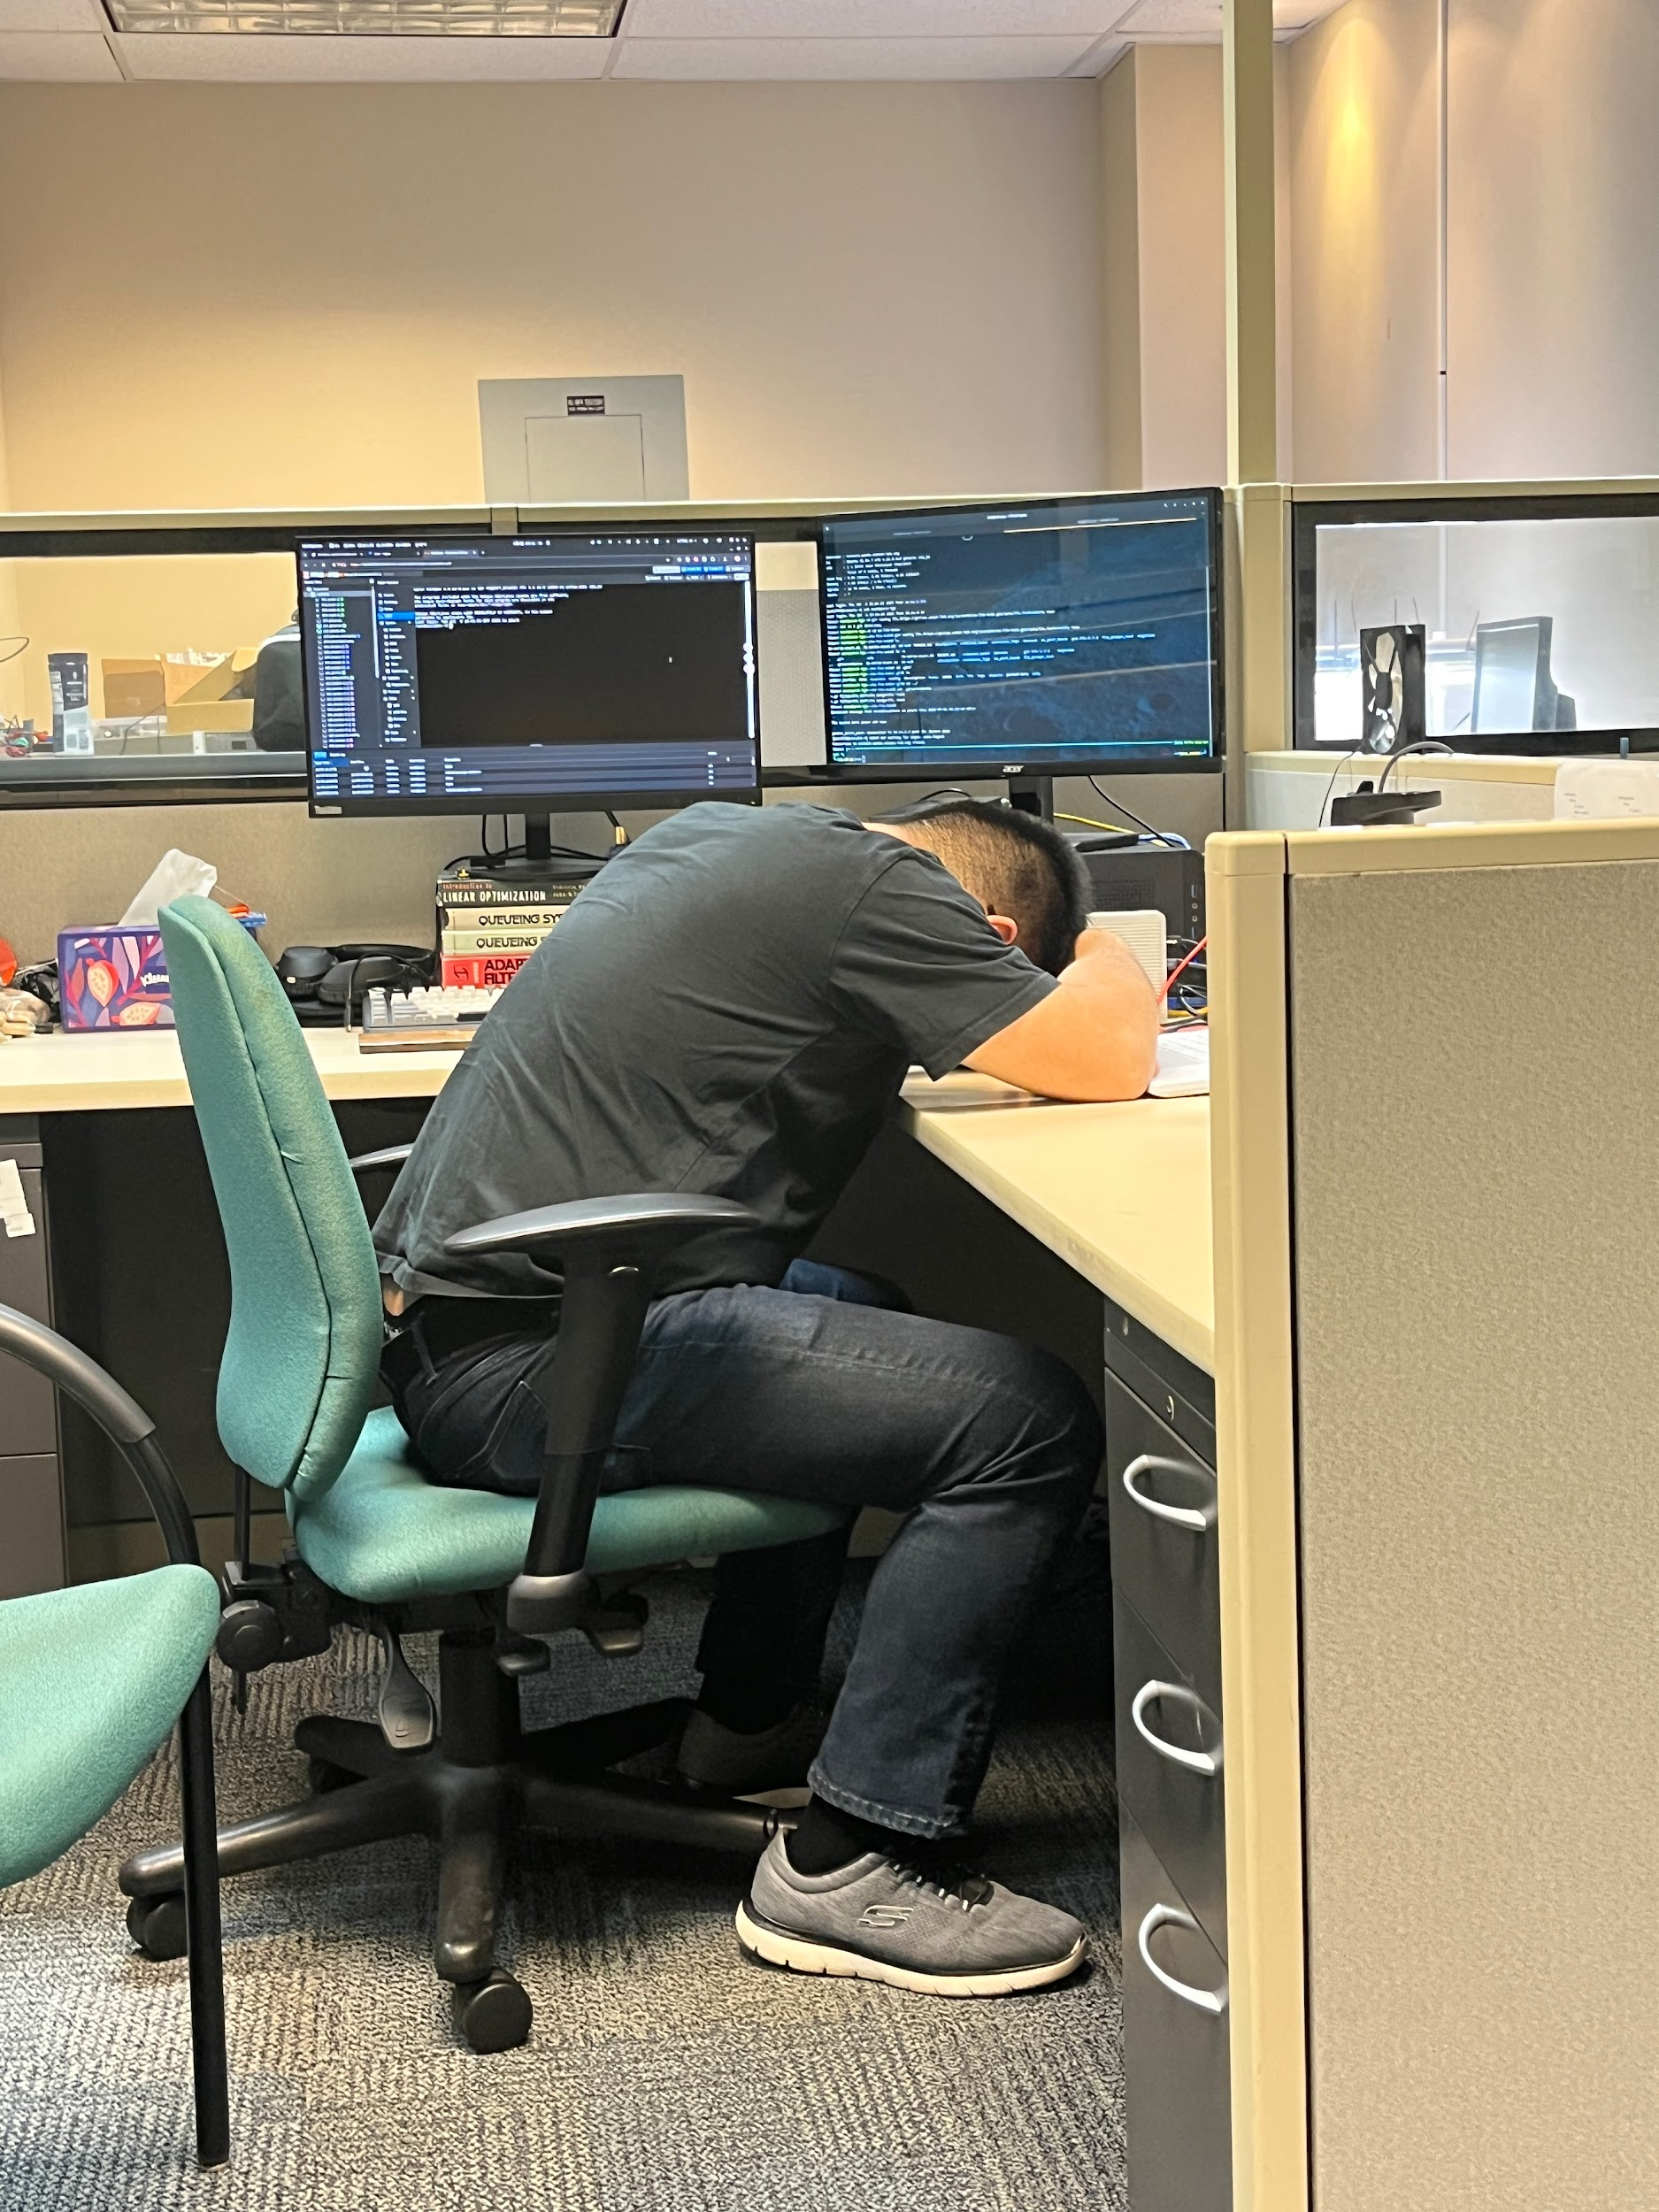
Future Plans…
WEEK 1
1
2
WEEK 7
Derive an actual benchmark number based on data
Rerun the experiment on a smaller scale to test reproducibility

Slide 6


Questions?
Grade 5
In case if you can’t tell, we are in

