Slide 1
5G Edge Cloud
Week 6

Slide 2


Meet the Team
Rahul Rajkumar
Andrew Michael
5G Edge Cloud Applications
June
2025

Slide 3
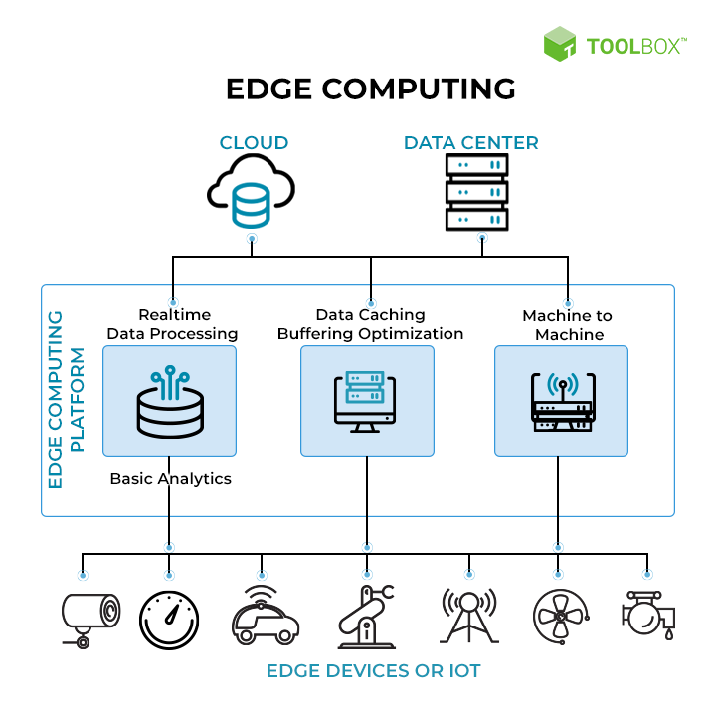

REVIEW
EDGE
What are we working on: Edge
What are we doing: Creating BenchMarkS
“

Slide 4

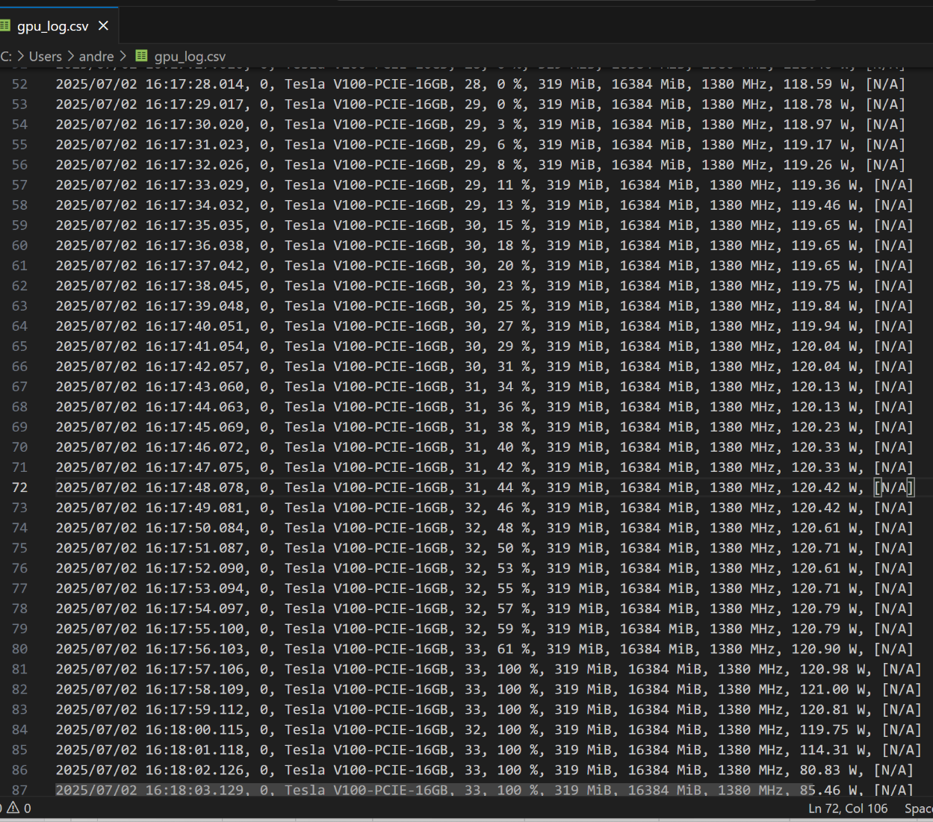

This Week
Point 1
Progressively measured GPU stress metrics (artificially)
Point 2
Integrated metrics for LLM performance and GPU
Point 3
Stress the GPU using Ollama requests

Slide 5


Future Plans
1
2
3
Conduct exploratory data analysis on data collected
Derive an actual benchmark number based on data
Develop an ML model to predict benchmarks

Slide 6
Questions?
Grade 5

