Slide 1
5G Edge Cloud
Applications

Slide 2


Meet the team
Rahul Rajkumar
Andrew Michael

Slide 3
Our Objective
Creating benchmarks for Edge Platforms
Aiding the scheduler in assigning tasks

Slide 4
Progress
1
Created visualizations on the metrics collected versus time
2
Checked if there is strong statistical correlation between specific metrics and our target
3
Rethought about the scheduling problem our benchmarks with help solve

Slide 5
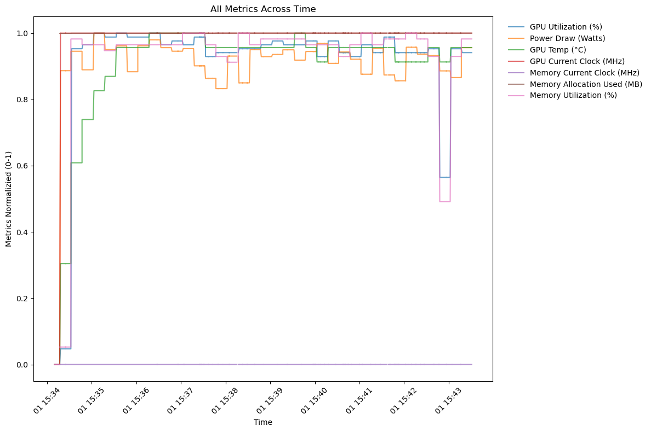
Visualizations
(Part 1)

Slide 6
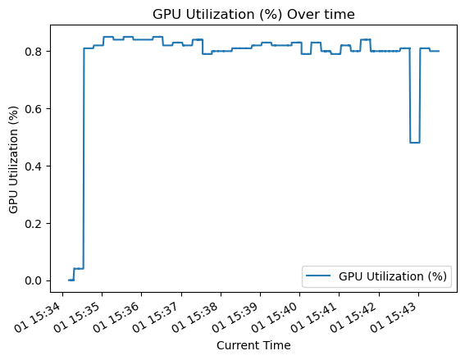
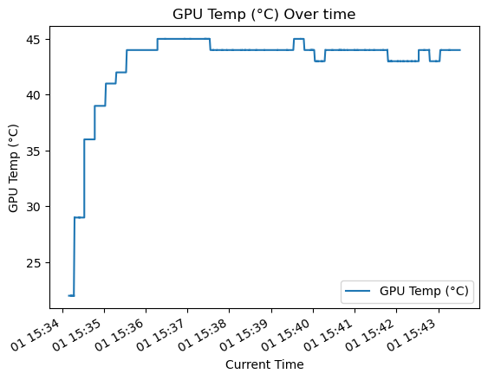
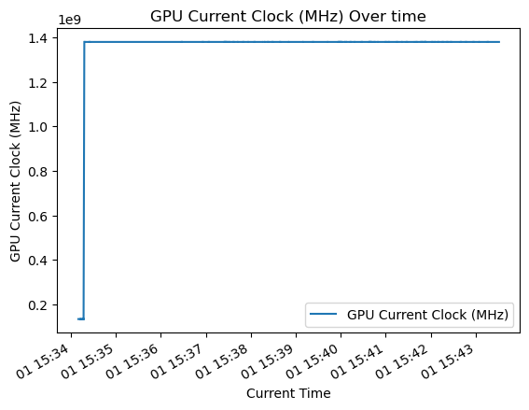
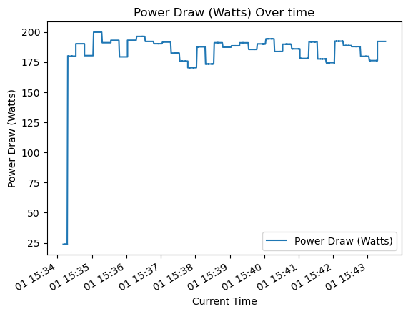

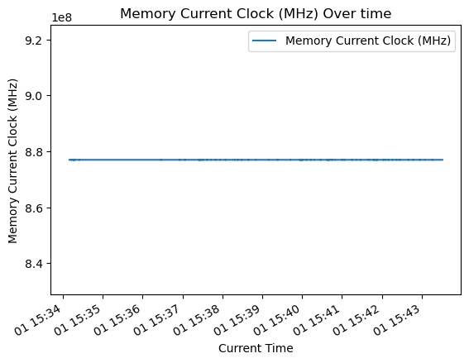
Visualizations (Part 2)

Slide 7
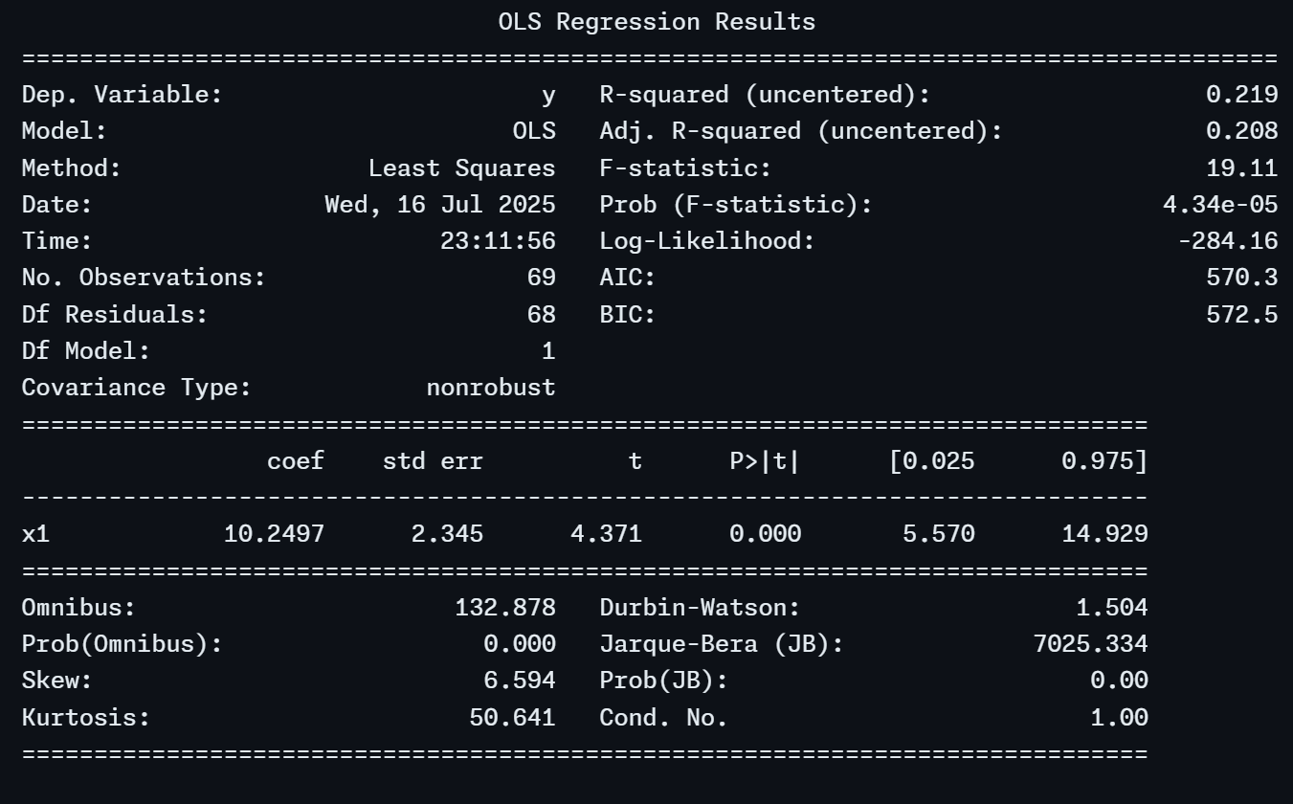
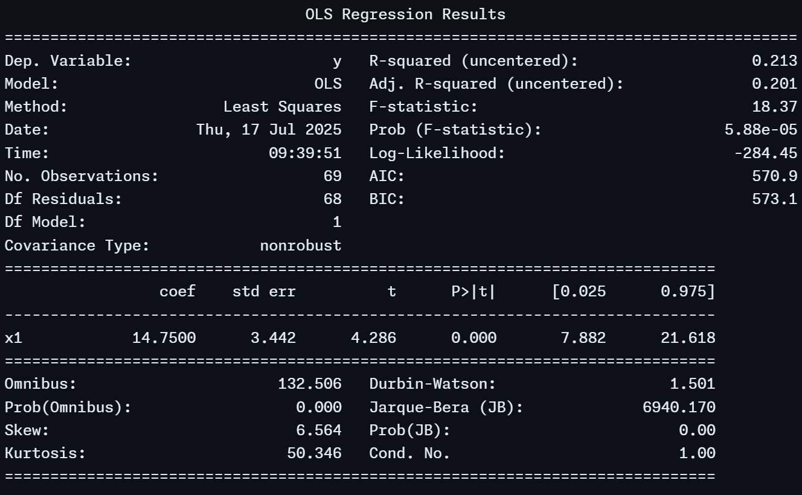
OLS Regression
Average GPU utilization vs Response Time
Average Memory utilization vs Response Time

Slide 8
The problem
Create a trade-off between average response time and (GPU temperature and Power Consumption)
Our weighted-sum benchmark with 2-3 parameters should reflect this trade-off
Company Name
Month Year

Slide 9
Upcoming
Using an ML model to optimize weight of the metrics
Finding the weights of the metrics

Slide 10
Thank you

