Slide 1
5G Edge Cloud
Applications

Slide 2


Meet the team
Rahul Rajkumar
Andrew Michael

Slide 3
Our Objective
Creating benchmarks for Edge Platforms
Aiding the scheduler in assigning tasks

Slide 4
Progress
1
Ran more extensive tests for more data
2
Began concluding observations and training DL model
3
Scrapped our DL model and went to simpler ML algorithm to find optimized weights

Slide 5
Why use Lasso?
Lasso helps find the optimum weights associated with each metric
Lasso is good because it reduces coefficients to zero
Weights represent trade-off for low response time

Slide 6
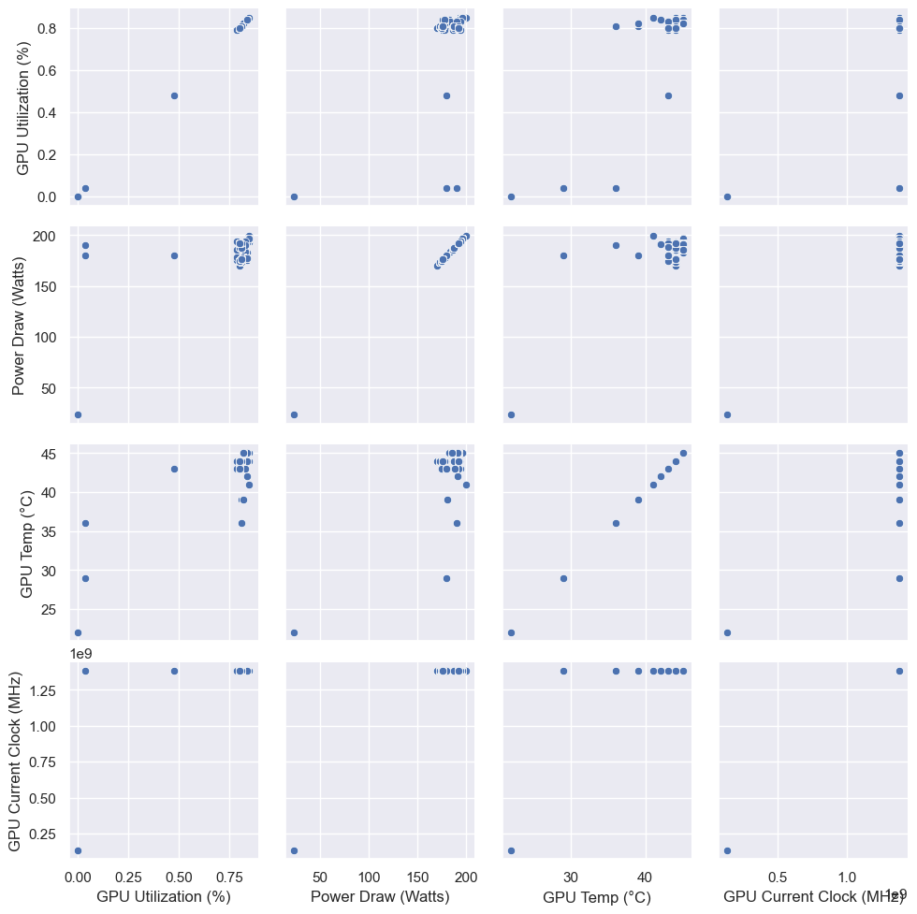
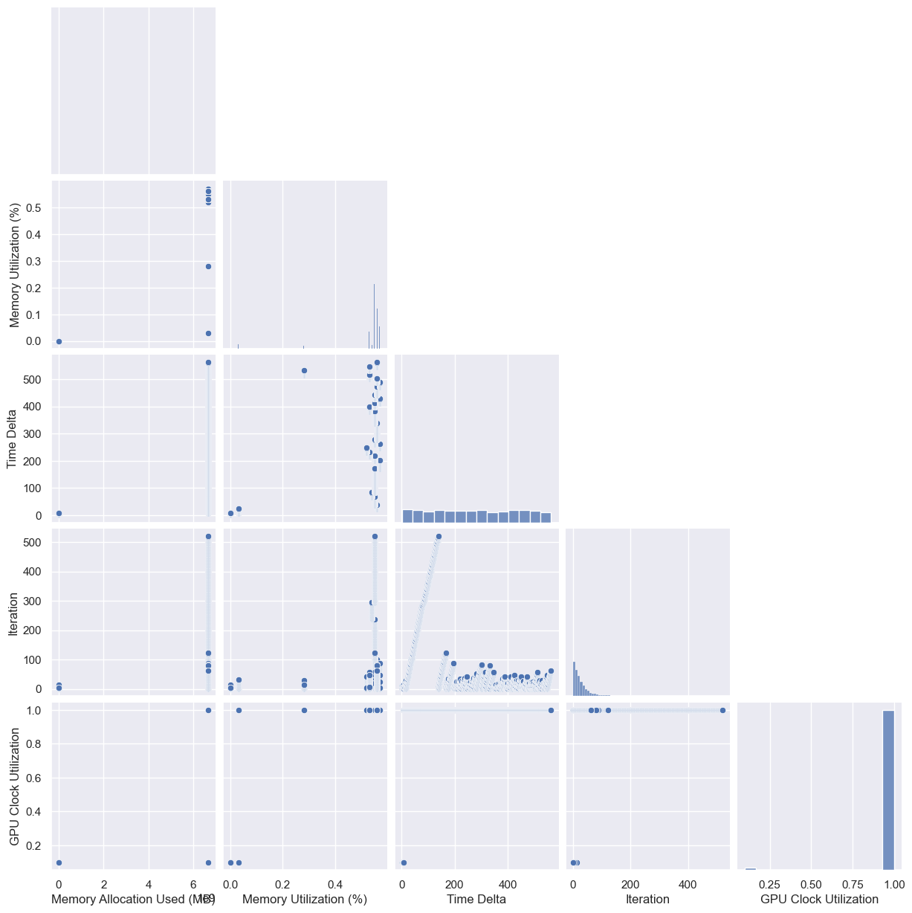
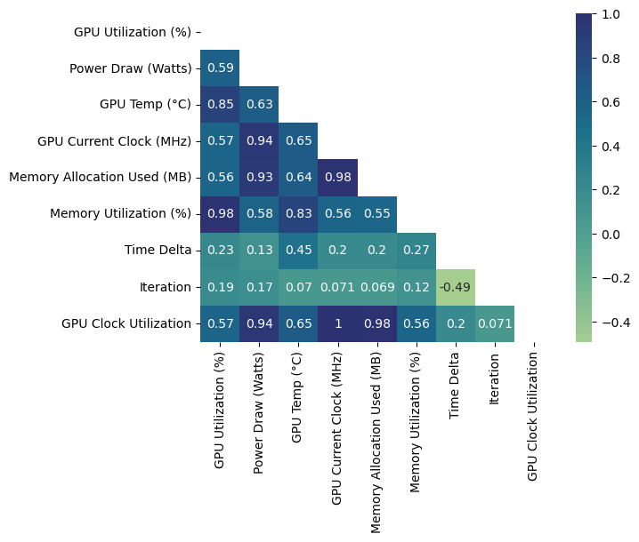
Feature Extraction & Selection

Slide 7
Upcoming
Concluding numeric benchmarks
Clean up our codebase to for reproducibility

Slide 8
THANK YOU

