Slide 1
ENGI 301 Human Motion Tracking Project Proposal
10/05/2021
Angelica Torres

Slide 2



Background Information
What is your story?
With the pandemic, people have become more sedentary. It is recommended that people stand for at least 4 hours a day
Previous solutions using motion tracking have been focused on virtual reality or the tracking of animals
https://www.hackster.io/max-coutte-gabriel-combe/relativty-open-source-vr-headset-with-steamvr-support-89186c
https://www.hackster.io/318942/anitrack-d29086
With this project, we can make a mini wearable device that can let people when they should stand.

Slide 3
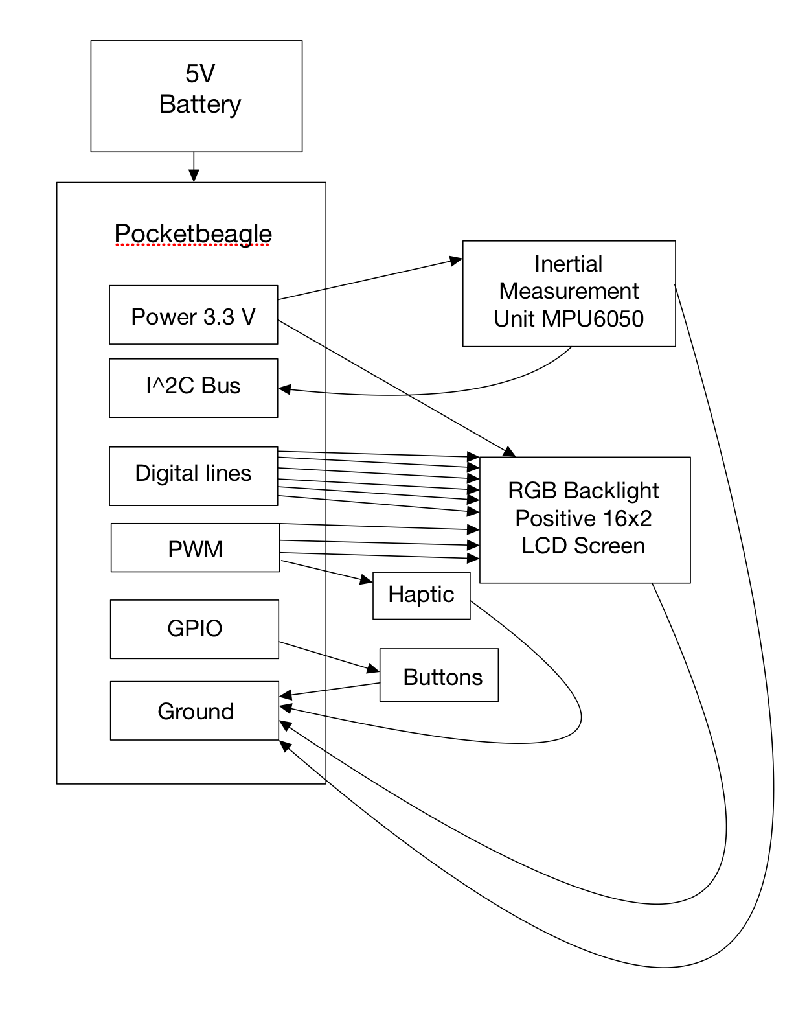
System Block Diagram

Slide 4
Power Block Diagram
5V power source that powers pocketbeagle
Mini Vibration Motor
3V input
<80 mA input
MPU 6050 (IMU)
2.375-3.46V input
Normal operating current with accelerometer, gyroscope, and MPU: 3.9 mA
0.9*VDD output high voltage
RGB backlight positive LCD
2.7-5.5V input
Max 300 uA in voltage range of interest (2.7-4.5V) because I am planning on powering at 3.3V
0.8 * VCC output high voltage in same range of interest

Slide 5
Components / Budget
Component | Need to Buy | Cost
HiLetgo GY-521 MPU-6050 MPU6050 3 Axis Accelerometer Gyroscope Module 6 DOF 6-axis Accelerometer Gyroscope Sensor Module 16 Bit AD Converter Data Output IIC I2C for Arduino | Yes | $5.99 on Amazon
Adafruit RGB backlight positive LCD 16x2 + extras [ADA398] | Yes | $12.99 on Amazon
Miady 2-Pack Portable Charger 5000mAh, 3.45oz Lightweight Power Bank, 5V/2.4A Output & 5V/2A Input Battery Pack Charger, Mini Portable Phone Charger for iPhone, Samsung Galaxy and etc | Yes | $15.99 on Amazon*
tatoko 20PCS 10mmx2mm Mini Vibration Motor 12000rpm Flat Coin Button-Type Micro DC Vibrating Motor for Mobile Phone Cell Phone Pager Tablet | Yes | $15.59 on Amazon
VELCRO Brand Bulk Pack 12 Reusable Fastening Cable Straps with Buckle Variety Sizes 8"-12"-18" Multi-Purpose Cinch Strap VEL-30100-AMS | Yes | $12.65 on Amazon
Long Wires | Checking OEDK
Need all components to be purchased by instructor listed; additional components may be purchased by student

