Slide 1
ENGI 301 Body Position Sensing PCB Proposal
November 16, 2021
Angelica Torres

Slide 2
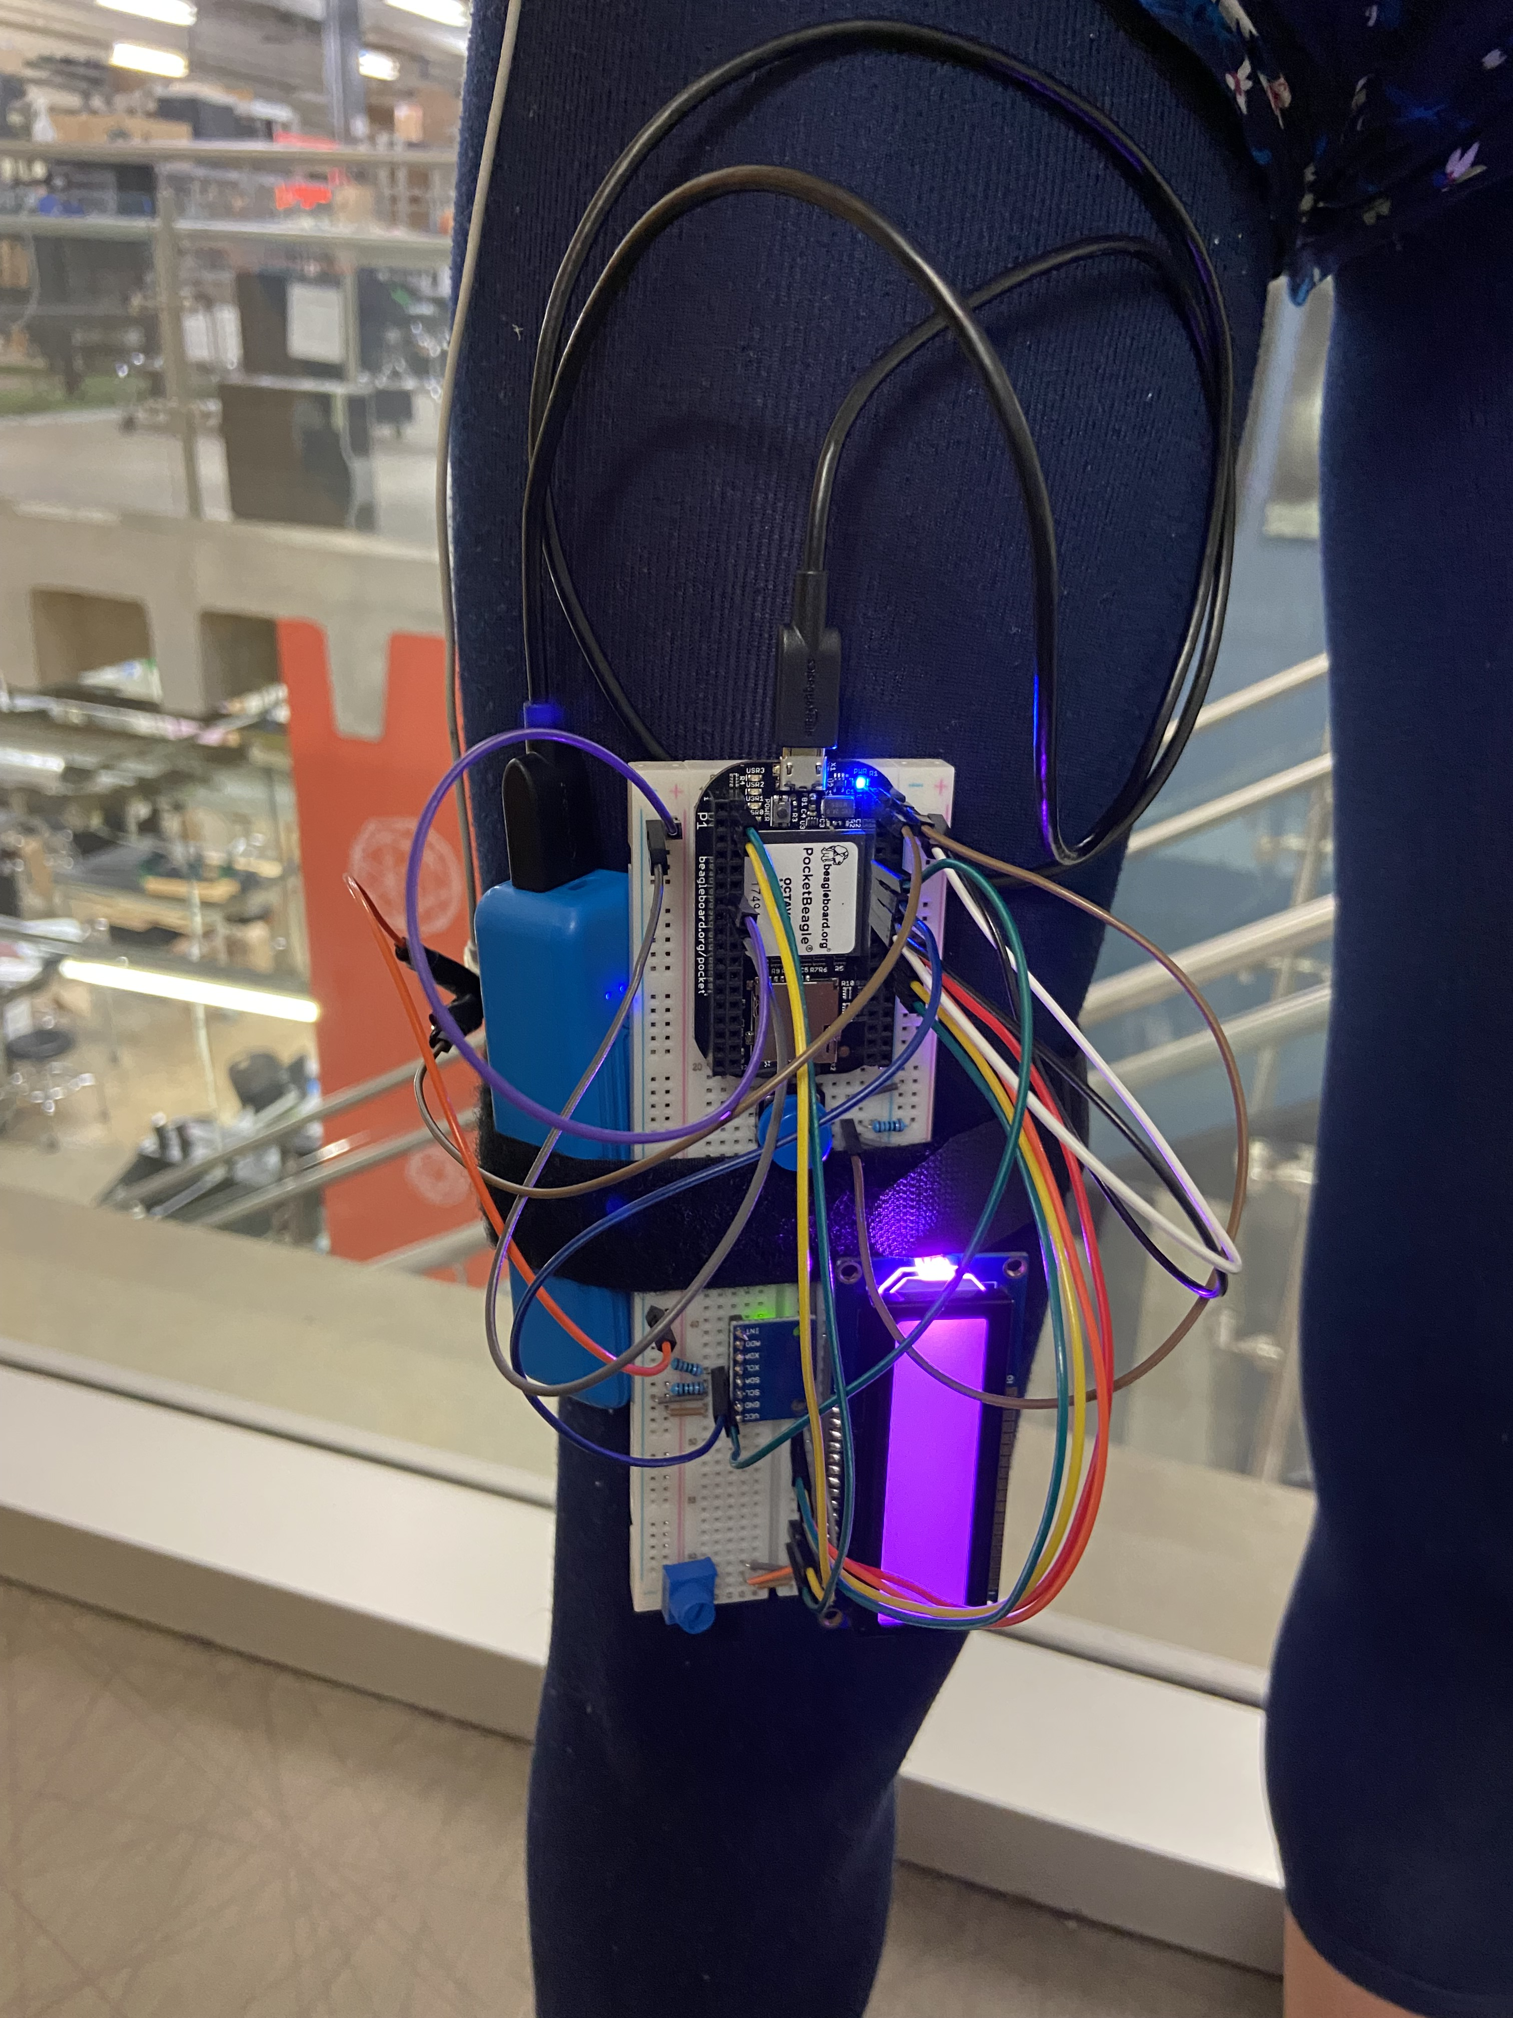
Background Information
This project is looking to design a printed circuit board for a Body position sensor that lets the user know when they need to stand.
https://www.hackster.io/431666/body-position-sensing-with-an-accelerometer-gyroscope-5139e5Links to your Hackster page / GitHub
https://github.com/alt7rice/ENGI301/tree/main/project_01
This prototype was functional but the haptic can be improved my adding more so that the vibration is more intense against the user’s leg.
Additionally, since the Pocket Beagle will be on the bottom the device will need a power LED to let the user know the device is on.

Slide 3
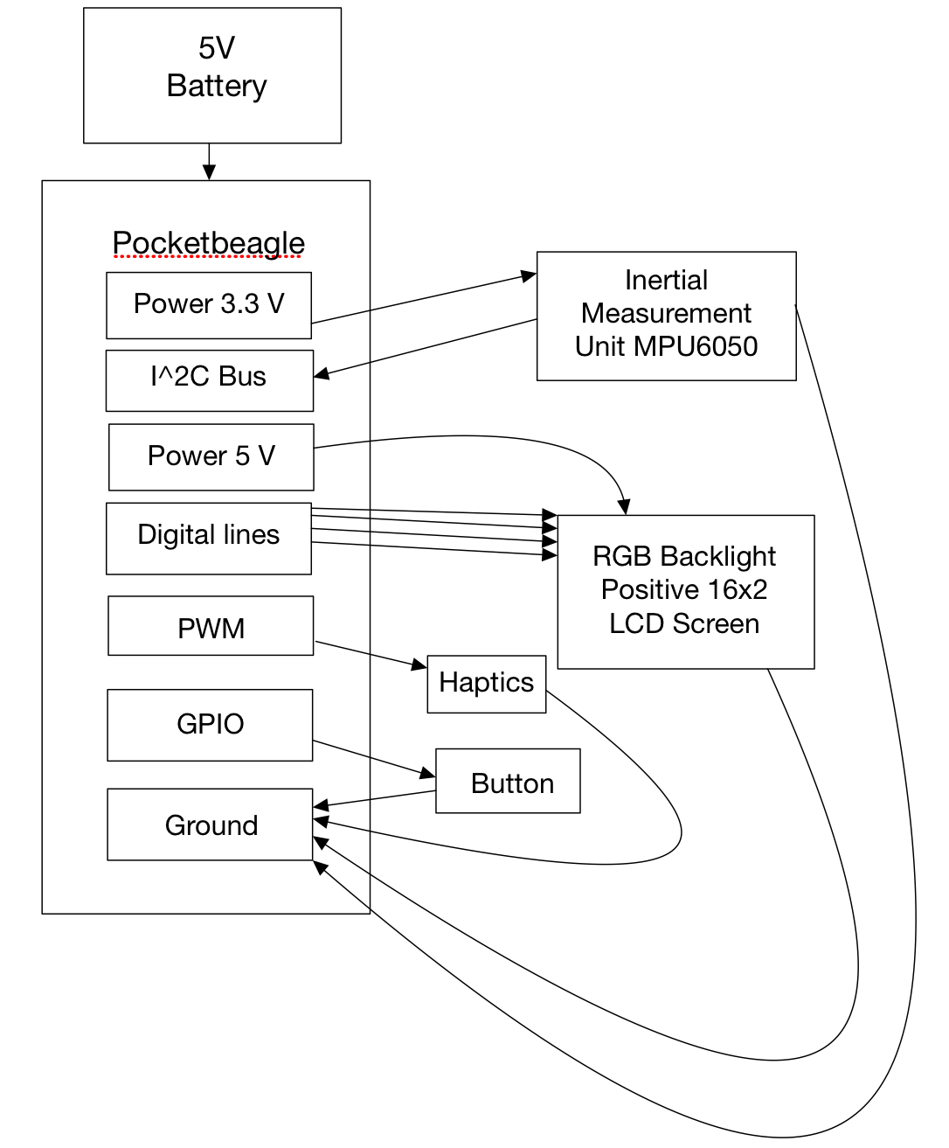
System Block Diagram
MPU-6050
Power → P1.14
Ground → P1.16
I2C:
SCL → P2.9
SDA→ P2.11
RGB LCD Screen
Pins 11-14 → P2.18,20,22,24 (GPIO)
Power
Pin 2,15 → P2.13
Button
P2.2
Two Mini Vibration Motors
PWM P2.1 and P1.36

Slide 4
Front Mechanical Block Diagram
7”
2.17”
Pot.
Pocket Beagle
LCD Screen
1.38”
2”
1.41”
IMU
USB
Button
3.15”
Power LED
Notes:
What should I do about the potentiometer for the LCD screen?
What way are the words facing
Where are the pins for the LCD screen
IMU in the center of the board

Slide 5
Back Mechanical Block Diagram
5”
Mini Motors
2”
Notes:
What battery can I get? You suggested it but then I did not know how to implement it.
Where are the two wires that connect to motor going? 2-pin 100mil female header (take from servo)

Slide 6
Components Required
Pocket Beagle
2 Mini Vibration Motors
External 5V Battery
LEDs
Buttons
MPU 6050
RGB LCD Screen

