Slide 1
ENGI 301 Body Position Sensing PCB Proposal
November 16, 2021
Angelica Torres

Slide 2
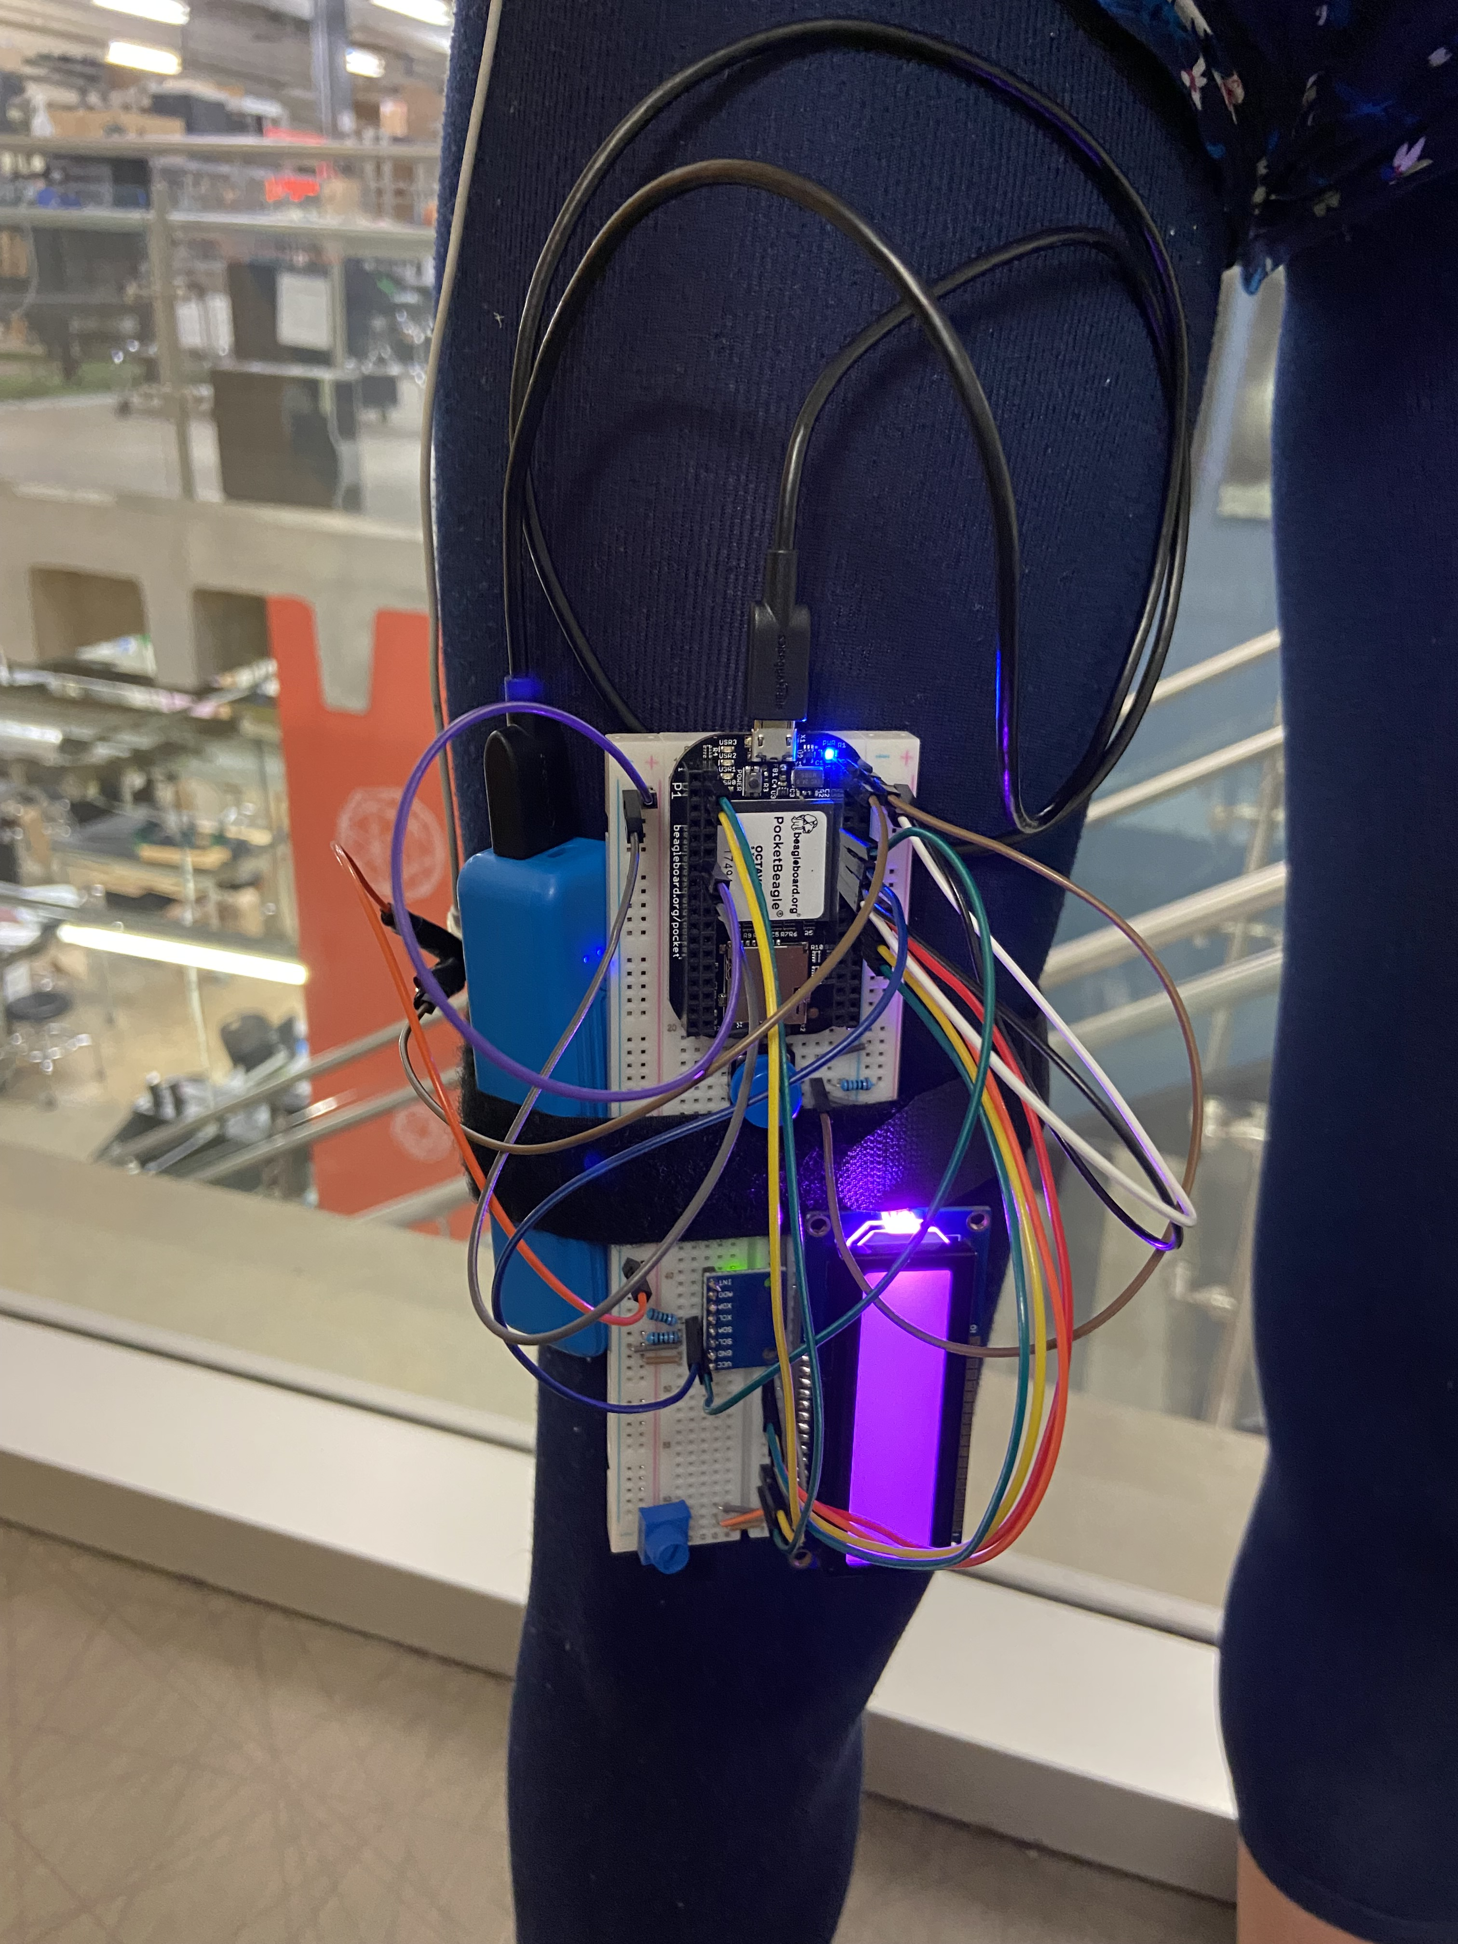
Background Information
This project is looking to design a printed circuit board for a Body position sensor that lets the user know when they need to stand.
https://www.hackster.io/431666/body-position-sensing-with-an-accelerometer-gyroscope-5139e5Links to your Hackster page / GitHub
https://github.com/alt7rice/ENGI301/tree/main/project_01
This prototype was functional but the haptic can be improved my adding more so that the vibration is more intense against the user’s leg.
Additionally, since the Pocket Beagle will be on the bottom the device will need a power LED to let the user know the device is on.

Slide 3
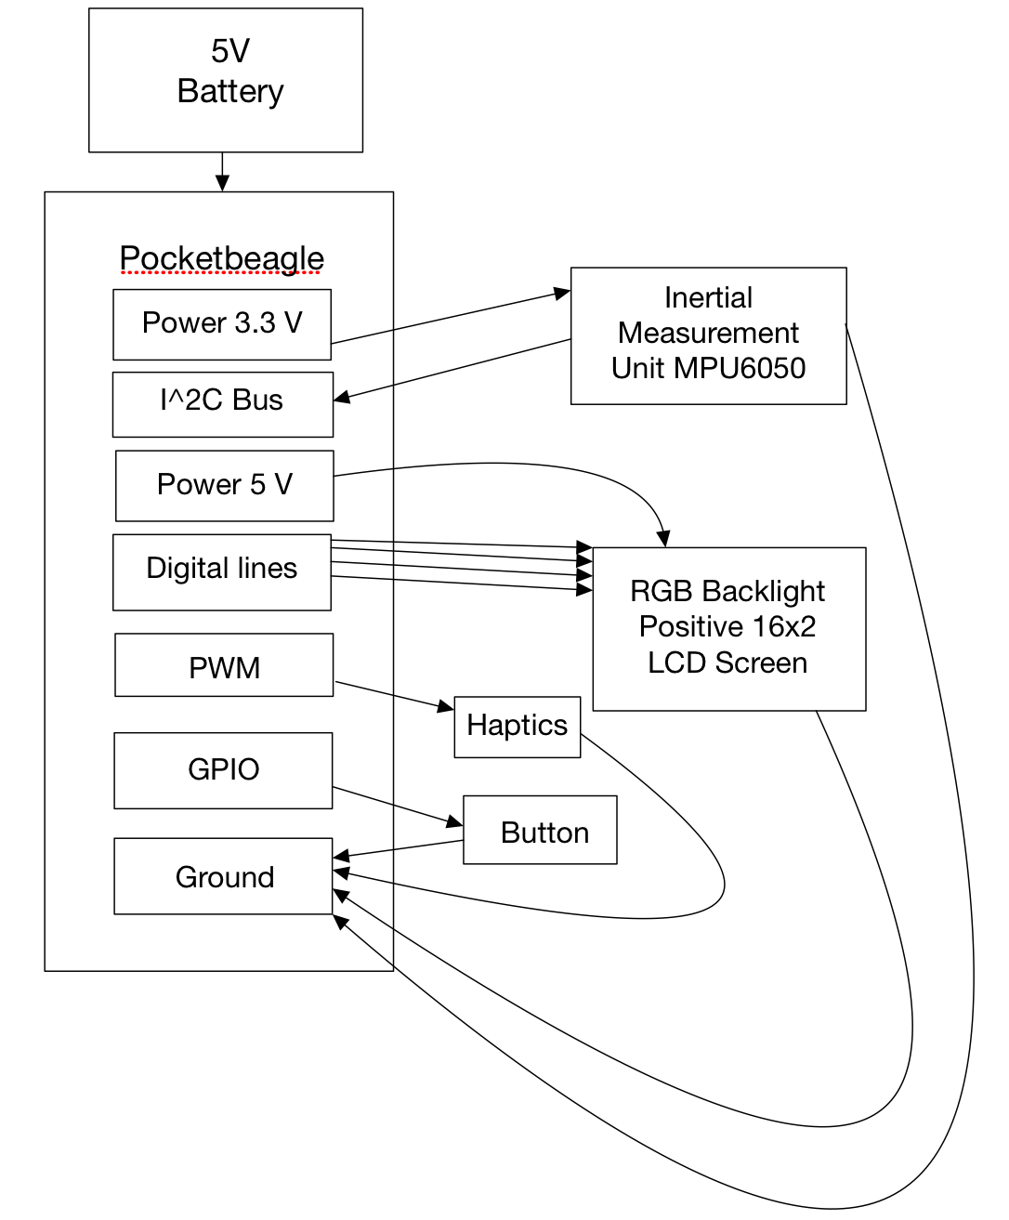
System Block Diagram
MPU-6050
Power → P1.14
Ground → P1.16
I2C:
SCL → P2.9
SDA→ P2.11
RGB LCD Screen
Pins 11-14 → P2.18,20,22,24 (GPIO)
Power
Pin 2,15 → P2.13
Button
P2.2
Two Mini Vibration Motors
PWM P2.1 and P1.36

Slide 4
Front Mechanical Block Diagram
5”
LCD Screen
1.41”
Button
2”
3.15”
IMU
Power
LED
Notes:
What should I do about the potentiometer for the LCD screen?

Slide 5
Back Mechanical Block Diagram
5”
Battery
2.17”
Pocket Beagle
1.38”
USB
2”
Mini Motors
Notes:
What battery can I get? You suggested it but then I did not know how to implement it.

Slide 6
Components Required
Create a list of all the components that you require for the PCB
Pocket Beagle
2 Mini Vibration Motors
Battery
LEDs
Buttons
MPU 6050
RGB LCD Screen

