Slide 1


Free And Open Source System
Free and open-source software (FOSS) is software that can be classified as both free software and open-source software. That is, anyone is freely licensed to use, copy, study, and change the software in any way.

Slide 2

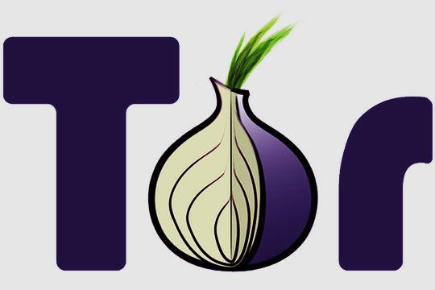
Torbrowser
Torbrowser is one of the software includes in open source system ,
Tor Browser protects your privacy while you are surfing the Internet ,
Tor Browser is based on Firefox.

Slide 3


Paul Syverson is the founder of tor browser The first public release occurred On 13 August 2004

Slide 4


Tor is illegal to use The deep web is a dangerous place to browse and get hackers and viruses attacked Darknet websites are accessible only through networks such as Tor

Slide 5

Impacts of Torbrowser ~ Encrypts your connection ~ Keeps you anonymous ~ Protects you from malicious Javascript and cross site scripting ~Too slow ~Disabled javascript so some scripts won’t work. You can enable it but you will be more vulnerable to attacks / getting tracked down

Slide 6

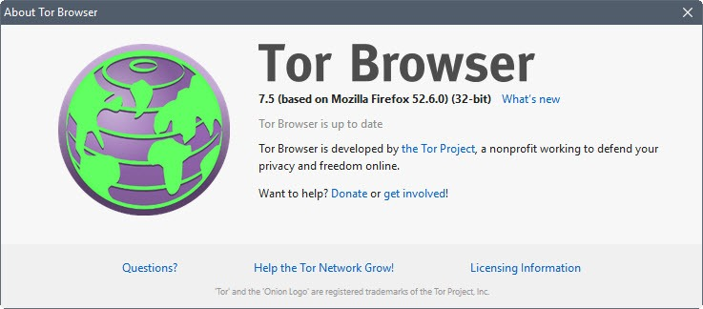
Tor includes anonymity software as well as a special browser, but it's the network that stands to benefit most from this spike in interest. In the past few weeks, there's been a 100 percent rise in the number of Tor clients
Tor's popularity is attracting more and more attention from spy agencies who are working hard to figure out how to track users. It's not just Tor, either. The use of encrypted email services and other proxy services also attract the attention of the NSA and friends, according to a secret document published last month by The Guardian

Slide 7

Thanking you

