Slide 1

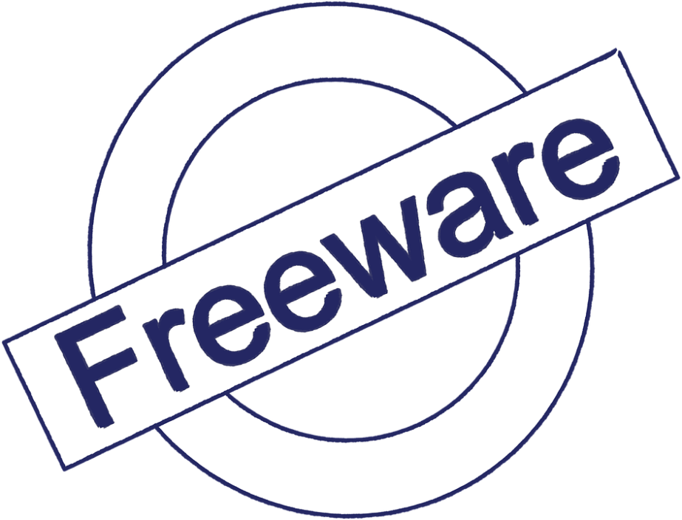
INTRODUCTION
TO
FREEWARE
SOFTWARE LICENSE
ALTAB ANSARI

Slide 2

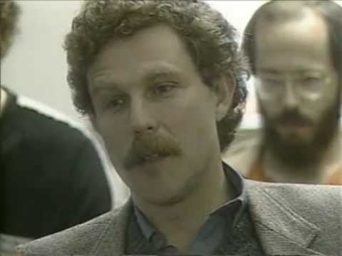
HISTORY
In late 1982 Fluegelman developed PC-Talk, a very popular and successful communications software.^{[4]} He marketed it under a system he called "Freeware",
Andrew Cardozo Fluegelman
Notes:
In 1981 Fluegelman was the owner and sole employee of The Headlands Press, a small book publisher in Tiburon, California. He had attended an early computer expo in San Francisco in the late 1970s, and after agreeing to publish and coauthor Writing in the Computer Age decided to purchase his first computer. In October Fluegelman received one of the first IBM PCs sold in San Francisco, and in two weeks began to write his own accounting program in IBM BASIC.^{[3]}
In late 1982 Fluegelman developed PC-Talk, a very popular and successful communications software.^{[4]} He marketed it under a system he called "Freeware", which he characterized as "an experiment in economics more than altruism".^{[5]} Freeware was licensed under terms that encouraged users to make voluntary payments for the software, and it allowed users to copy and redistribute the software freely as long as the license terms and text were not altered. He collaborated with PC-File (database software) developer Jim Knopf to adopt similar names (PC-File was originally "Easy-File"), and prices, for their initial shareware offerings; they also agreed to mention each other's products in their program's documentation.

Slide 3

Ideology
Andrew Cardozo
Fluegelman
Proposed a software call PC-Talk that is available for use at
no monetary cost.
Hence freeware software
were introduced
Notes:
Freeware is software that is available for use at no monetary cost. In other words, while freeware may be used without payment it is most often proprietary software, and usually modification, re-distribution or reverse-engineering without the author's permission is prohibited.^{[1][2][3]} Two historic examples of freeware include Skype and Adobe Acrobat Reader. There is no agreed set of rights or a license or an EULA which would define "freeware" unambiguously; every Freeware publisher defines their own rules for their Freeware. For instance, redistribution of Freeware by third-parties is often permitted but there is a significant portion of Freeware which prohibits redistribution.

Slide 4

The Light is GREEN for Freeware.
Save money and provide stability.
To forced upgrades.
Reach a skilled community of developer.

Slide 5

I AM NOT A
OPEN SOURCE
OR
FREE SOFTWARE EXPERT.
Notes:
Software classified as freeware may be used without payment and is typically either fully functional for an unlimited time, or has limited functionality, with a more capable version available commercially or as shareware.^{[10]} In contrast to what the FSF calls free software, the author usually restricts the rights of the user to use, copy, distribute, modify, make derivative works, or reverse-engineer the software.^{[1][2][11][12]} The software license may impose various additional restrictions on the type of use, e.g. only for personal use, private use, individual use, non-profit use, non-commercial use, academic use, educational use, use in charity or humanitarian organizations, non-military use, use by public authorities or various other combinations of these type of restrictions.^{[13]} For instance, the license may be "free for private, non-commercial use". The software license may also impose various other restrictions, such as restricted use over a network, restricted use on a server, restricted use in a combination with some types of other software or with some hardware devices, prohibited distribution over the Internet other than linking to author's website, restricted distribution without author's consent, restricted number of copies, etc.^{[11][12]} Restrictions may be required by the licence, or enforced by the software (e.g., not usable over a network).

Slide 6

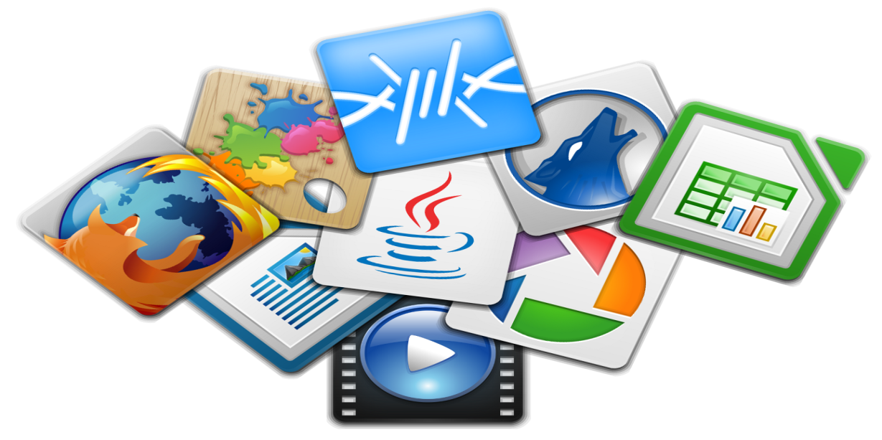


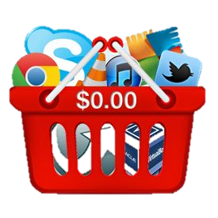
Two historic examples of freeware
include Skype and Adobe Acrobat Reader.
Popular
software
Under Freeware
Licence

Slide 7


LIBREOFFICE is powerful free office program can replace MICROSOFT OFFICE
LibreOffice is a free and open-source office suite that's compatible with Microsoft Office files. Since it's an open-source software, the program is continually updated and at no charge to you.
Notes:
If you're typing up a document, filling out a spreadsheet or creating a presentation, there's a good chance you're using Microsoft Office. It's still the gold standard of productivity software.
Unfortunately, it's also on the expensive side. If you have an older version that's no longer supported, or you have a computer that doesn't have it, you might be reluctant to spend a bundle to get the latest version. Fortunately, you can get the same power and performance without the hefty price tag.
Allow us to introduce LibreOffice. If you haven't heard of it before, LibreOffice is a free and open-source office suite that's compatible with Microsoft Office files. Since it's an open-source software, the program is continually updated and at no charge to you.
LibreOffice offers six programs that will feel instantly familiar to you if you've used Office before. Writer, Calc, and Impress are equivalent to Microsoft Word, Excel, and PowerPoint. They have most of the same features, you just might need to poke around to find some of them.

Slide 8
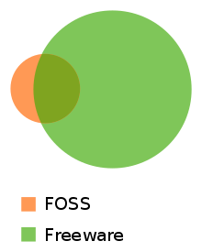
This Venn diagram describes the typical relationship between freeware and open source software: According to David Rosen from Wolfire Games in 2018, open source software (orange) is most often gratis but not always. Freeware (green) seldom expose their source codes.^{[5]}

Slide 9
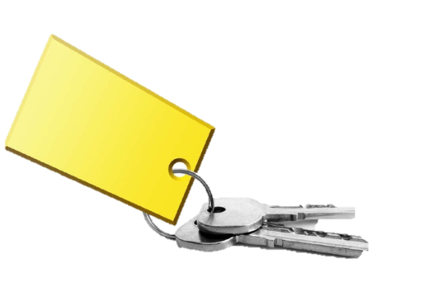
Freeware has been criticized as "unsustainable" because it requires a single entity to be responsible for updating and enhancing the product, which is then given away without charge. Other freeware projects are simply released as one-off programs with no promise or expectation of further development.
These may include source code, as does free software, so that users can make any required or desired changes themselves, but this code remains subject to the license of the compiled executable and does not constitute free software.
Impact

Slide 10


