Slide 1

A Heuristic Approach to Portfolio
Optimization
Name: Altaf Ahmad Roll: 18MA20005
Supervisor: Dr Geetanjali Panda Department of Mathematics Indian Institute of Technology Kharagpur

Slide 2

INtroduction and background
Portfolio optimization is the process of selecting the best mix of investments to achieve a desired return with minimum risk.
The objective of the problem is to maximize the expected return of the portfolio while considering the overall risk, measured by the variance of returns.
This project aims to extend the classic Markowitz mean-variance optimization framework by incorporating transaction costs and the need for periodic portfolio rebalancing using genetic algorithms.

Slide 3

What is portfolio optimization
Portfolio optimization is selecting the best mix of assets to maximize returns while minimizing risk. It involves calculating expected returns and risks, using mathematical models to achieve investment objectives. The goal is to maximize returns for a given level of risk or minimize risk for a given level of return.

Slide 4

Markowitz Model - A Cornerstone of Modern Portfolio Theory
Developed by Harry Markowitz in 1952, the Markowitz Model is one of the most important contributions to modern portfolio theory.
The model involves selecting a set of assets from a larger set of available assets and determining the optimal allocation of funds to each asset in the selected set.
The objective is to maximize the expected return of the portfolio, subject to a constraint on the overall risk of the portfolio.
By diversifying investments across multiple assets, investors can reduce the overall risk of their portfolio without sacrificing expected return.

Slide 5

Genetic algorithm
Optimization algorithm inspired by natural selection and evolution in biology.
Solves complex optimization problems by maintaining a population of candidate solutions evaluated based on their fitness.
Fitter solutions are selected as parents and combined through crossover and mutation to produce new offspring.

Slide 6

Problem Formulation for Genetic Algorithm in Portfolio Optimization
Define parameters: assets and weights
Establish fitness function
Create initial population of portfolios
Use random number generator to assign weights
Successive generations evolve portfolios towards optimal solution(s)
Factors influencing convergence: population size, generations, selection pressure

Slide 7

Experiment and data
Develop dynamic portfolio optimization methods
Regularly rebalance portfolio to maintain optimal performance
Dataset: 30 stocks from National Stock Exchange (NSE) in India
Selected based on liquidity and popularity among investors
Time period: 100 days (April 1, 2022 - August 26, 2022)
Includes large-cap, mid-cap, and small-cap stocks from various industries

Slide 8
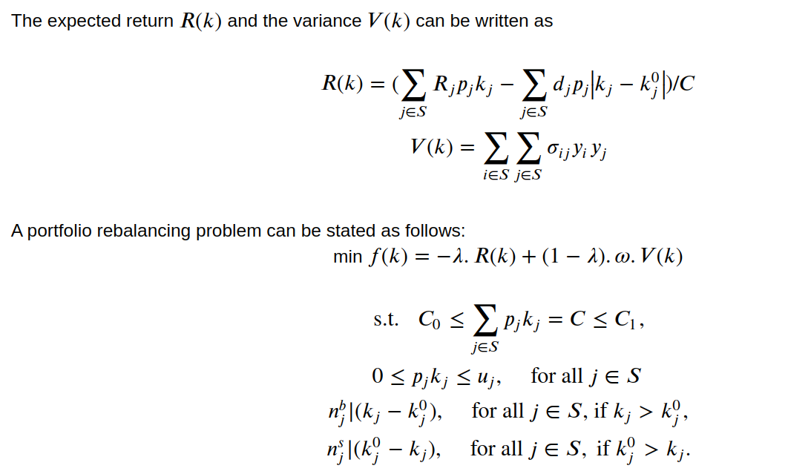
Modelling the problem

Slide 9
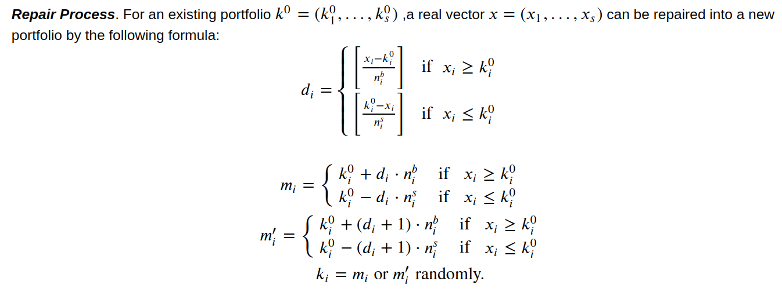
Repair process – helper function

Slide 10

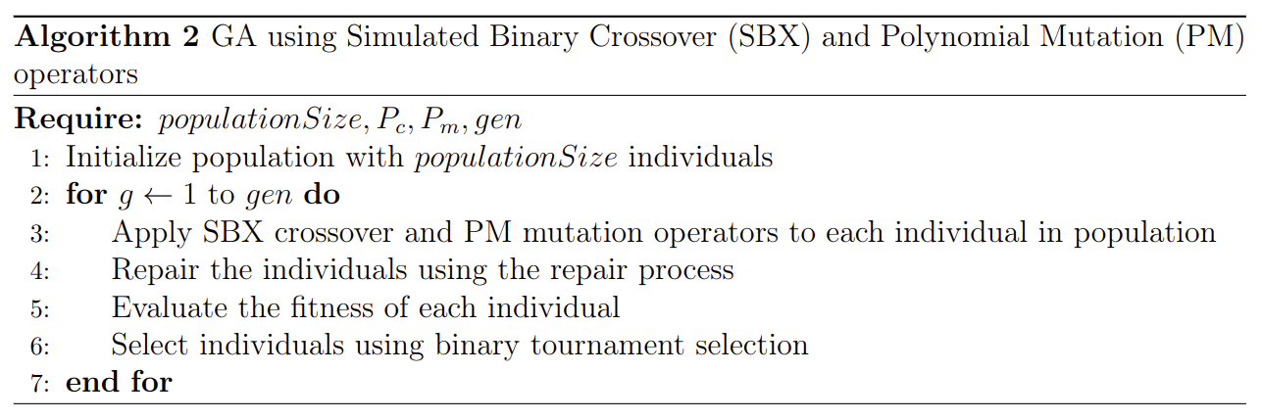
algorithm

Slide 11
REsults
Algorithm run on NSE dataset with various lambda values
Comprehensive set of risk and return values obtained
Insights into potential risks and expected returns for each lambda value
Analyze risk-return trade-off for each lambda to identify optimal value
Refine and test algorithm iteratively to identify most suitable lambda value
λ | 0 | 0.2 | 0.4 | 0.6 | 0.8 | 1
Return | 1.13E-01 | 1.14E-01 | 1.15E-01 | 1.19E-01 | 1.20E-01 | 1.20E-01
Risk | 4.19E-04 | 4.20E-04 | 4.28E-04 | 4.62E-04 | 4.99E-04 | 5.10E-04
Fitness | 4.19E-02 | 1.09E-02 | -2.04E-02 | -5.27E-02 | -8.60E-02 | -1.20E-01

Slide 12
conclusion
Multi-objective portfolio optimization model implemented which considers risk and returns as objectives while incorporating transaction lots as constraints and introduces transaction costs
Implemented and repair algorithm effectively handles all the constraints of the optimization model
Improvement and Future Work:
Estimation: Historical returns proven to be unreliable, aim to shrink covariance matrix towards a stable matrix
Genetic Algorithm: prioritize convergence over-diversification, define criteria for stopping the optimization process

