Slide 1

Image Classification Using Convolutional Neural Networks (CNN)
Anjani Kumar (210905262)
Sharad Kalavadia (210905300)
Yuvraj Singh Singhel (210905280)
Drishaan Prasad (210905282)

Slide 2
Methodology and Approach
Our Architecture: Custom CNN model with layers tailored to capture intricate image details:
Three convolutional layers (ReLU activation) for feature extraction, each followed by max-pooling layers.
Dense and softmax output layers for categorizing images into CIFAR-10 classes.
Why This Structure? This balanced structure lets us handle 32x32 images effectively without excessive complexity.
Training and Testing:
Optimizer: Adam optimizer.
Loss Function: Categorical cross-entropy for multi-class classification.
Data Split: 80% training, 20% validation, with metrics like accuracy and loss tracked.
Epochs: 10 epochs to capture the learning trend over time.

Slide 3
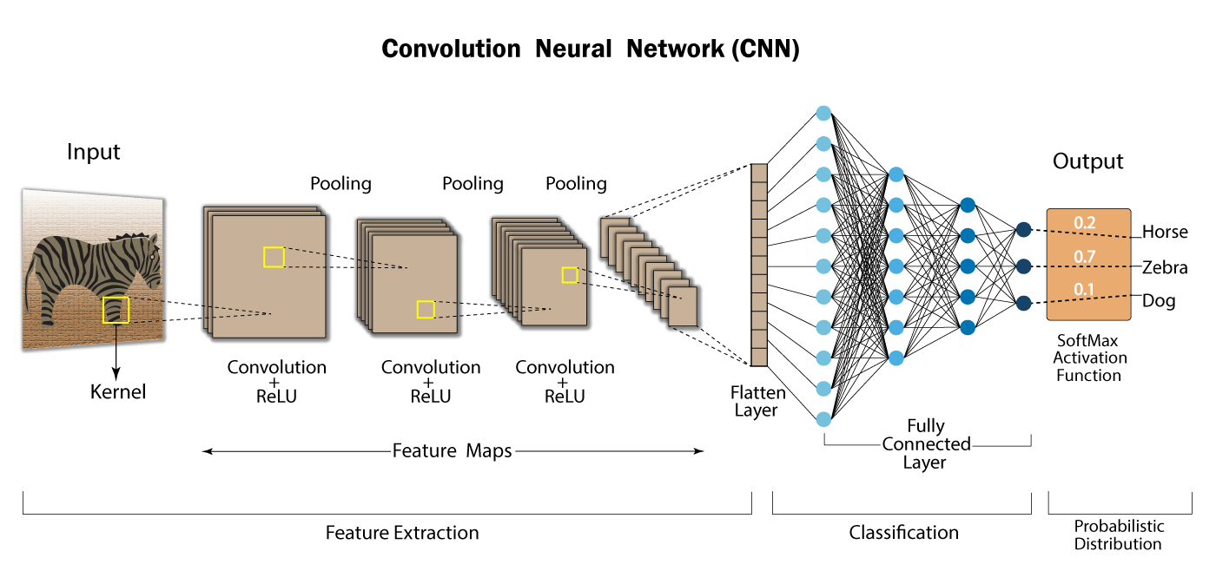

Slide 4
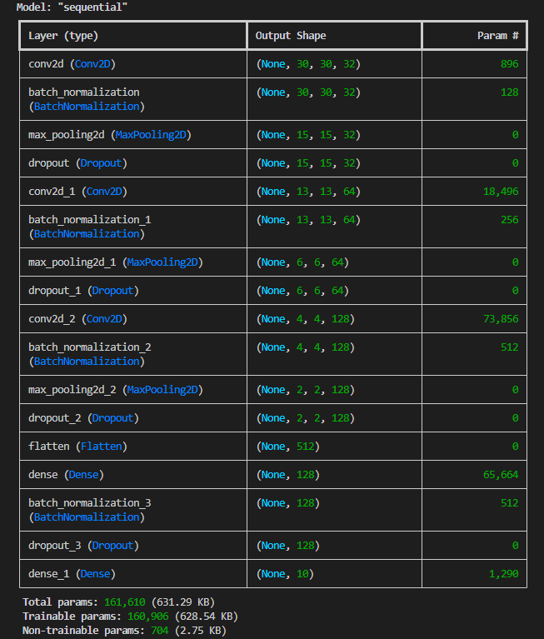
Architecture Model

Slide 5
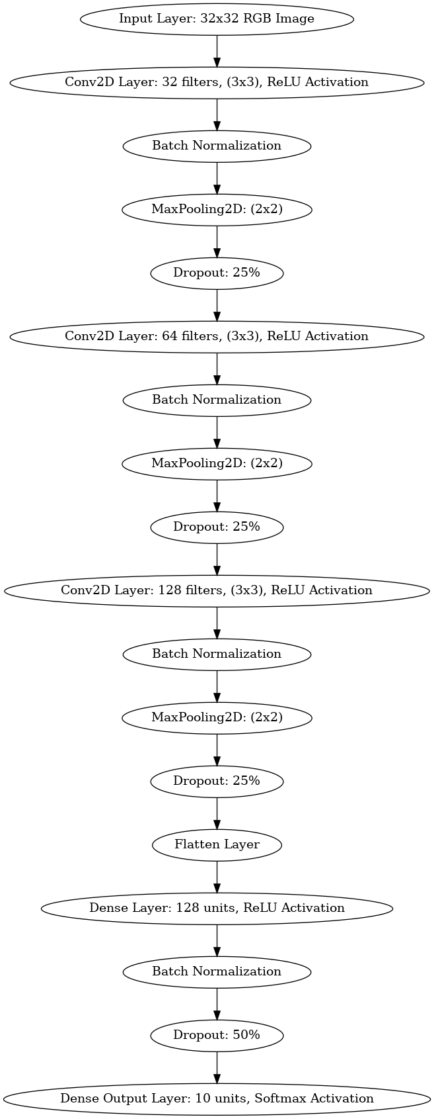
CNN Architecture

Slide 6

Data Preprocessing
1. Normalization: Pixel values are scaled from the range [0, 255] to [0, 1] by dividing by 255.0. Advantage: Helps speed up training and ensures more stable gradients, leading to faster convergence and better performance.
2. One-Hot Encoding: Converts class labels from integers (e.g., 0, 1, 2...) to one-hot vectors (e.g., [1, 0, 0, ..., 0]). Advantage: Prepares the labels for multi-class classification by the neural network, enabling it to predict across multiple categories
3. Data Augmentation: Artificially increases the training dataset by applying transformations like rotation, flipping, shifting, and zooming. Advantage: Enhances generalization, reduces overfitting, and makes the model more robust to variations in the data.
Notes:
The labels in the CIFAR-10 dataset are initially integers representing the class (e.g., 0 for airplane, 1 for automobile, etc.).
You convert these integer labels into one-hot encoded vectors. For example, if the label is 2 (say for "bird"), it will be converted into a vector [0, 0, 1, 0, 0, 0, 0, 0, 0, 0] with 1 at the third position (index 2).
Why One-Hot Encode?
Neural networks require the output layer to have the same dimensionality as the number of classes (in this case, 10 classes). One-hot encoding transforms the labels into a format suitable for multi-class classification.
Normalize - train_images, test_images = train_images / 255.0, test_images / 255.0
One Hot - train_labels = to_categorical(train_labels, 10)
test_labels = to_categorical(test_labels, 10)
Data Augment - datagen = ImageDataGenerator(
rotation_range=15,
width_shift_range=0.1,
height_shift_range=0.1,
horizontal_flip=True,
zoom_range=0.2
)
datagen.fit(train_images)

Slide 7
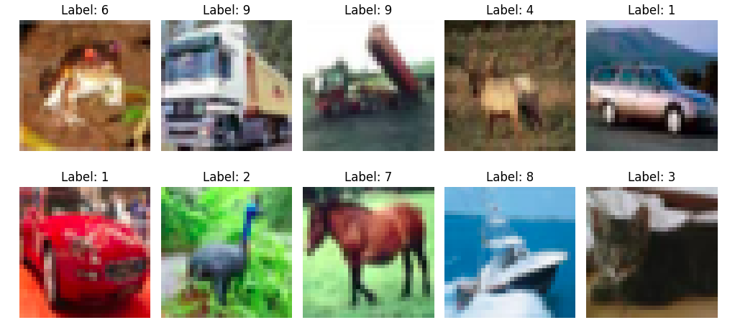

Slide 8
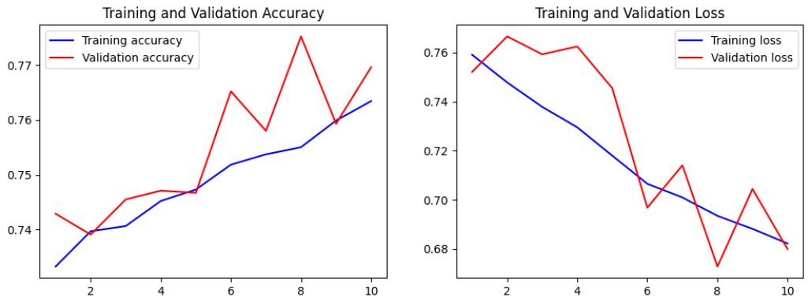
Training Performance & Visual Insights
Accuracy and Loss Curves: Plots of accuracy and loss over epochs to track learning patterns and overfitting.
Confusion Matrix: Visual representation of performance per class, showing high/low accuracy areas.

Slide 9
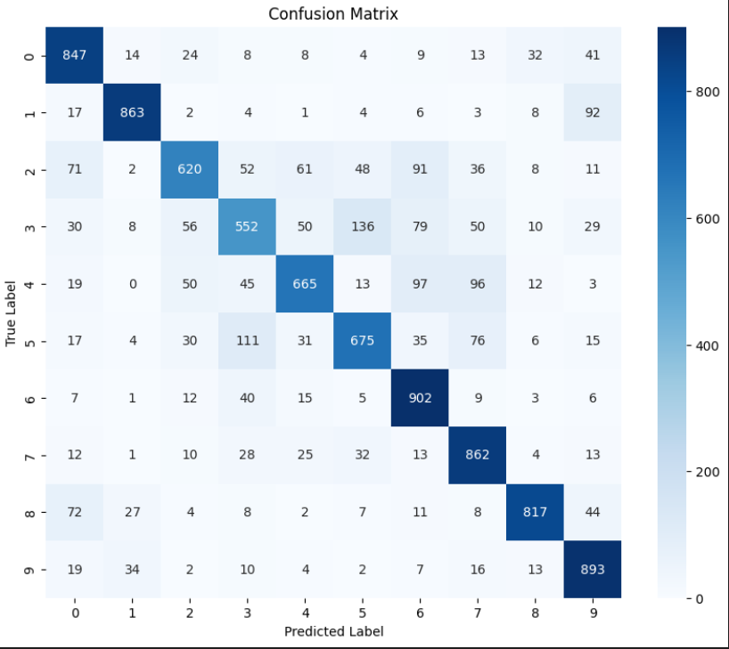
What We Achieved
Results:
Accuracy: 70% test accuracy; 85% training accuracy highlights the challenge of generalizing across categories.
Generalization: The slight overfitting suggests potential for improvements like regularization to help balance learning.
Visual Outcomes:
Confusion Matrix: Offers an in-depth look at classification success and errors, especially in similar classes.
Accuracy and Loss Curves: Reflect overfitting, showing areas for future improvement.

Slide 10
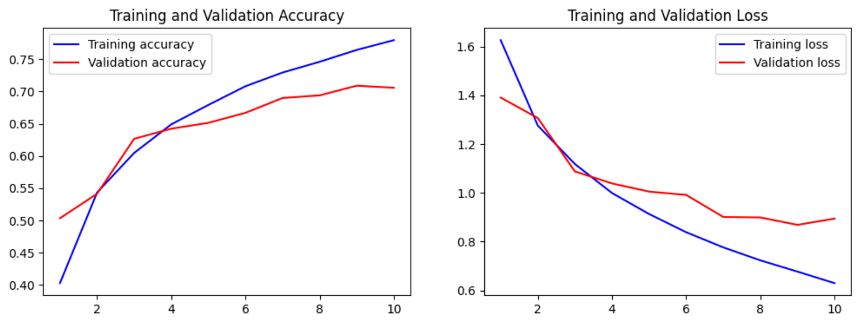
Fine-Tuning Performance
Model’s Performance by Category: Vehicles are easier to classify due to unique shapes, while animals, like cats and dogs, are more challenging.
Classification Challenges: Highlight specific insights from confusion matrix analysis, particularly challenging areas like animal classes.

Slide 11
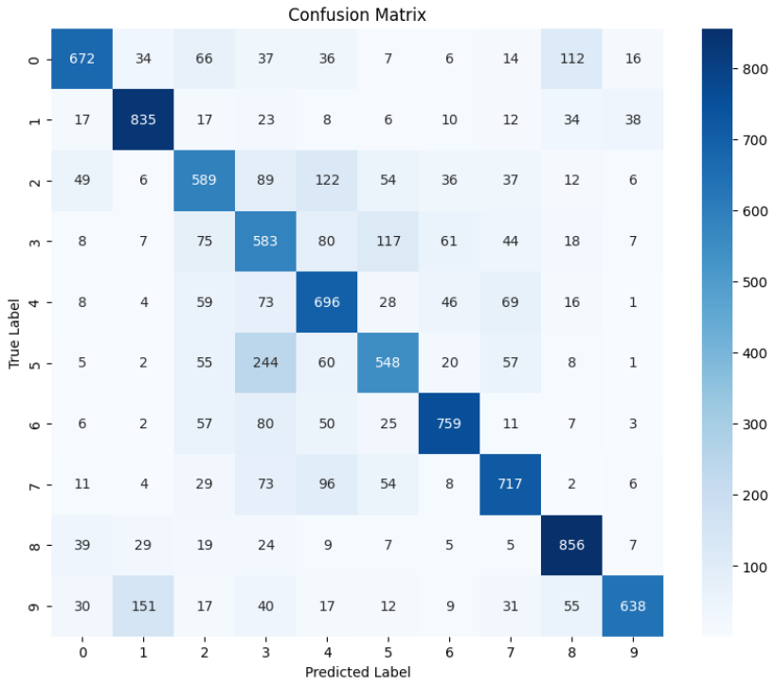
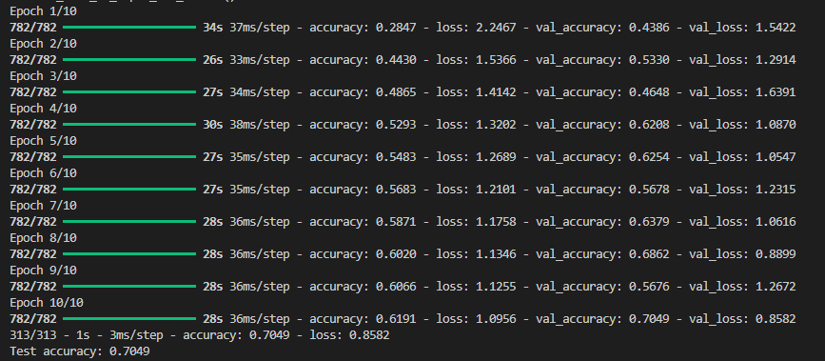

Slide 12
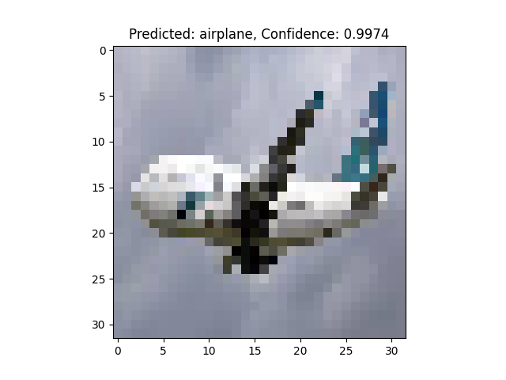

Postprocessing Result

Slide 13
Why Our Model Stands Out (Novelty)
Using CIFAR-10 Uniquely:
CIFAR-10 is a challenging benchmark dataset, with 60,000 images across 10 classes.
Instead of a standard CNN, we designed a model optimized specifically for these small images to capture the unique patterns in each class.
Model Choices:
Three-layer CNN provides a balance, avoiding excessive complexity without sacrificing detail.
Data Augmentation and Batch Normalization:
Data augmentation techniques like rotation, shifts, flipping, and zooming enhance model robustness by simulating additional data, improving generalization, and reducing overfitting beyond standard training approaches.
Batch normalization, applied after convolutional layers, stabilizes and accelerates training by normalizing activations, helping the model converge faster and enhancing overall performance.
Visual Tools: Confusion matrix to understand success and failure points, informing model adjustments.

Slide 14
Concluding Insights and Future Plans
Key Takeaways:
Our CNN model is effective on CIFAR-10, showing CNNs’ powerful ability to process and classify images, with room for better generalization.
Future Directions:
Data Augmentation: More complex data augmentation techniques such as random cropping, brightness shifts, and noise addition.
Regularization: Explore techniques like L2 regularization or more adaptive dropout strategies to further combat overfitting, especially on smaller datasets or during longer training.
Tuning Hyperparameters: Experimenting with learning rates, adding more layers, or using different optimizers.
Final Thought:
Our project highlights CNNs’ impact in image classification and provides a clear path for further enhancements in both accuracy and robustness.
By leveraging more sophisticated techniques such as transfer learning, advanced data augmentation, and fine-tuning, the model’s accuracy and generalization can be significantly improved, paving the way for applications in more complex image datasets and real-world scenarios.

Slide 15
Thank You

