Slide 1

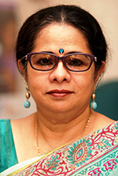
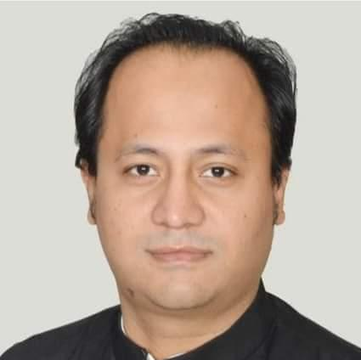
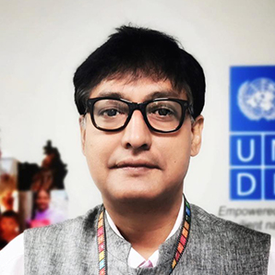
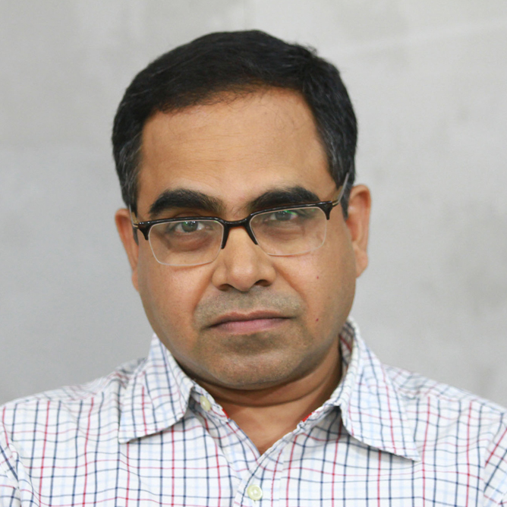



title
Education, empathy and tolerance in shaping Responsive citizenship
p1_name
p2_name
p1_details
p2_details
p3_name
p4_name
p3_details
p4_details
date
time

