Slide 1
Astrometric Positions for 18 Irregular Satellites of Giant Planets from 23 Years of Observations
Altair Ramos Gomes Júnior (Observatório do Valongo)
Marcelo Assafin (OV)
Roberto Vieira Martins (ON)
Júlio I. Bueno de Camargo (ON)
Felipe Braga Ribas (UTFPR)
Bruno Eduardo Morgado (ON)
Alex Dias Oliveira (ON)
Gustavo Benedetti Rossi (ON)
Jean-Eudes Arlot (IMCCE)
Yann Duchemin (IMCCE)
Josselin Desmars (IMCCE)
Valéry Lainey (IMCCE)
William Thuillot (IMCCE)
Alexandre Andrei (ON)
Dario N. da Silva Neto (UESO)

Slide 2
Irregular Satellites
Burns (1986): Satellites are irregular when their orbital planes precess primarily under the influence of torques from the Sun.
Their orbits are eccentric, usually highly inclined and distant from their planets. The direction of their movements can be prograde or retrograde.

Slide 3


Irregular Satellites
Satellites of Jupiter
Satellites of Saturn

Slide 4
Irregular Satellites
Capture:
  Gas Drag (Cuk & Burns, 2003);
  3-body interation (Nesvorný et al., 2007);
  Collision (Sheppard, 2006).
Orbital Evolution:
  Origin of the orbital family of satellites (Nesvorný et al., 2004);

Slide 5
Goal
Organize and reduce three database with images of the irregular satellites of the giant planets observed between 1992 e 2014 at OPD, OHP e ESO.
Obtain precise positions from these observations which can be used to:
  New numerical integrations of the orbits of these satellites.
  Predict and observe stellar occultations by these objects.

Slide 6
Observations

Slide 7
OPD (Itajubá) Telescopes
3 Telescopes: Perkin-Elmer (1.6m), Boller&Chivens (0.6m) and Zeiss (0.6m);
11 Detectors used;
FOV: 5'x5' – 13'x13';
Pixel Scale: 0.176'' – 0.702'';
Filters used: Clear, U, B, V, R, I;
5248 observations (1992-2014).

Slide 8
OHP Telescope
Aperture of 1.2m;
CCD 1024x1024 pixel;
Pixel scale of 0.69'';
FOV of 12'x12';
Filters used: V, R, I;
2408 observations (1998-2008).
Telescópio 1m20 (OHP)

Slide 9
ESO Telescope
2.2m Max-Planck Telescope;
Wide Field Imager Detector with 8 CCDs;
The size of each CCD is 2k x 4k pixel with a pixel scale of 0.238”;
Each CCD has a FOV of 7.5'x15';
The filter used was a broad-band R filter (ESO#844) with λc = 651.725 nm and ∆λ = 162.184 nm;
810 observations (2007-2009).

Slide 10
Reduction Process
Bias and flat-field calibration.
PRAIA (Assafin et al., 2011):
  Extract data of the header of the images;
  Detect objects in the image (x, y);
  Identify catalogue reference stars;
    UCAC4
  Obtain (α,δ) from gnomonic projection;
  Global Reduction (Assafin et al., 2012) for the mosaic CCDs;
  Identify targets in the images.
    JPL ephemeris.

Slide 11
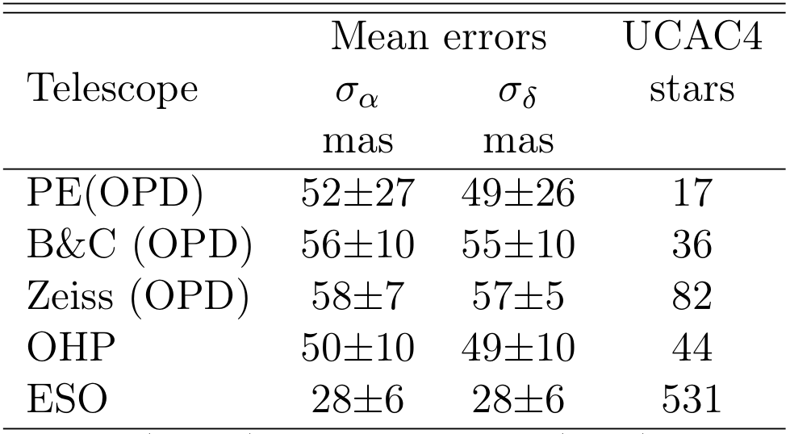
Astrometry
Mean errors are the standard deviations in the (O−C) residuals from (α, δ) reductions with the UCAC4 catalog.

Slide 12
RESULTS

Slide 13
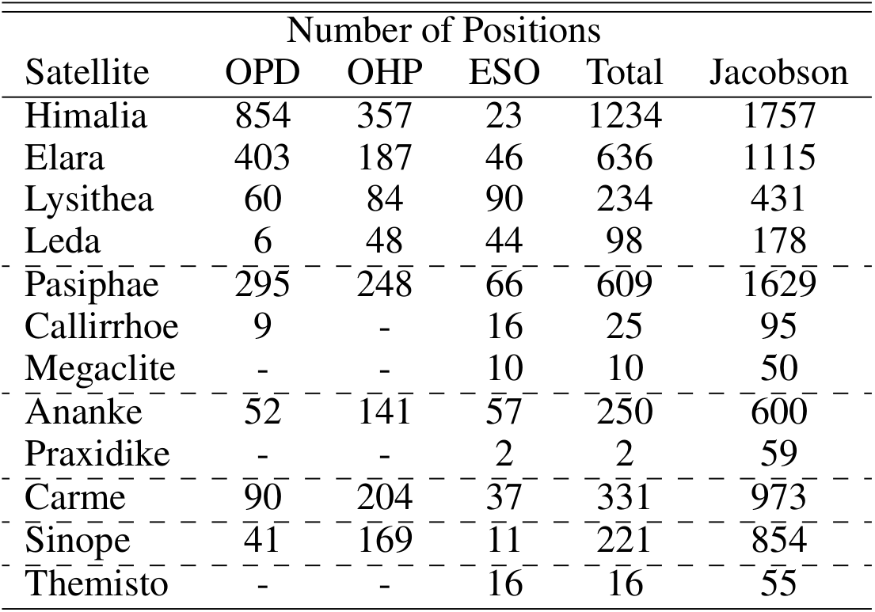
Results
*
* Jacobson, R. A. et al, 2012, The Astronomical Journal

Slide 14

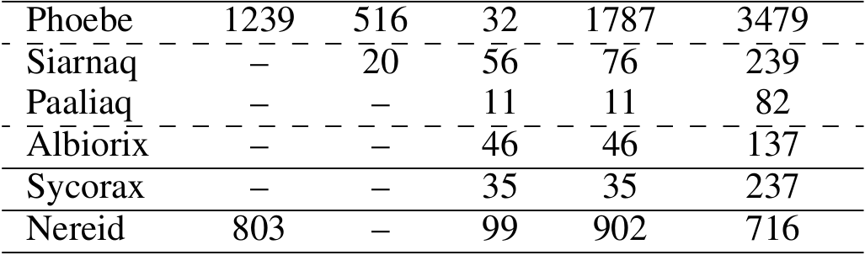
Results
*
* Jacobson, R. A. et al, 2012, The Astronomical Journal

Slide 15
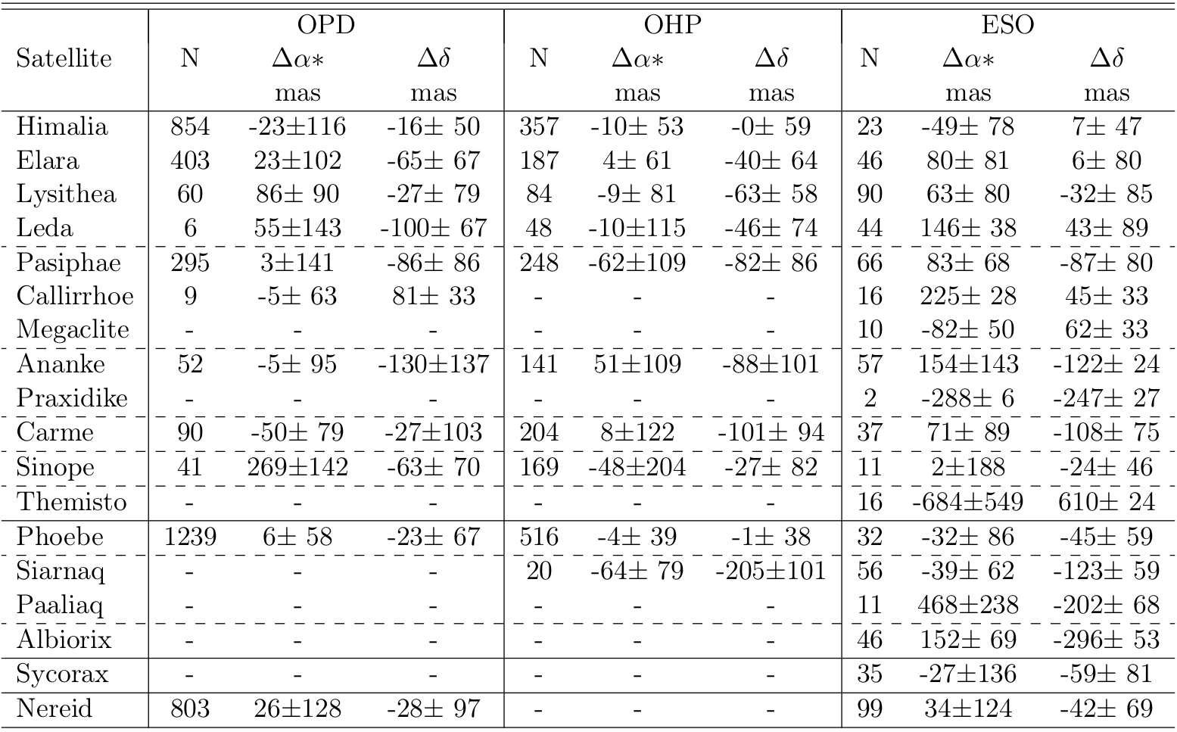
Results - Offsets
N: Number of positions
Δα* = Δα cosδ

Slide 16
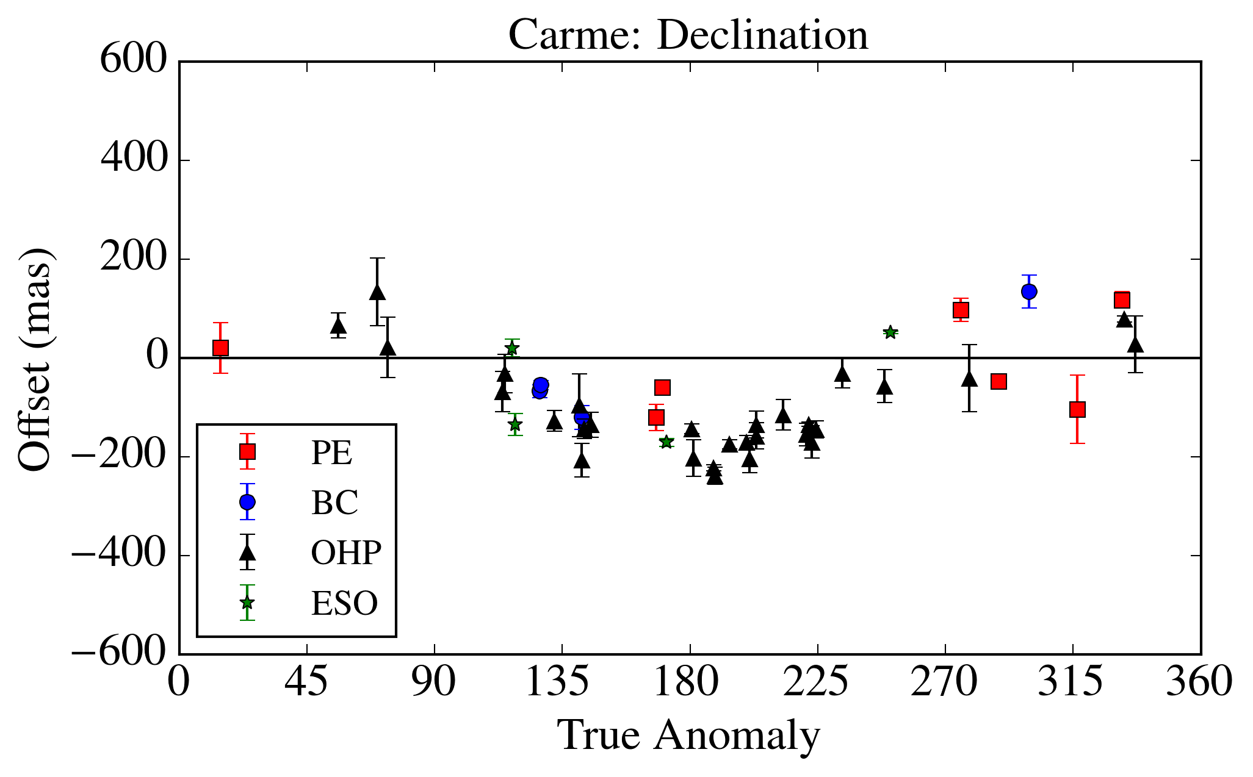
Results - Carme
*
* Relative to JPL jup300 ephemeris

Slide 17
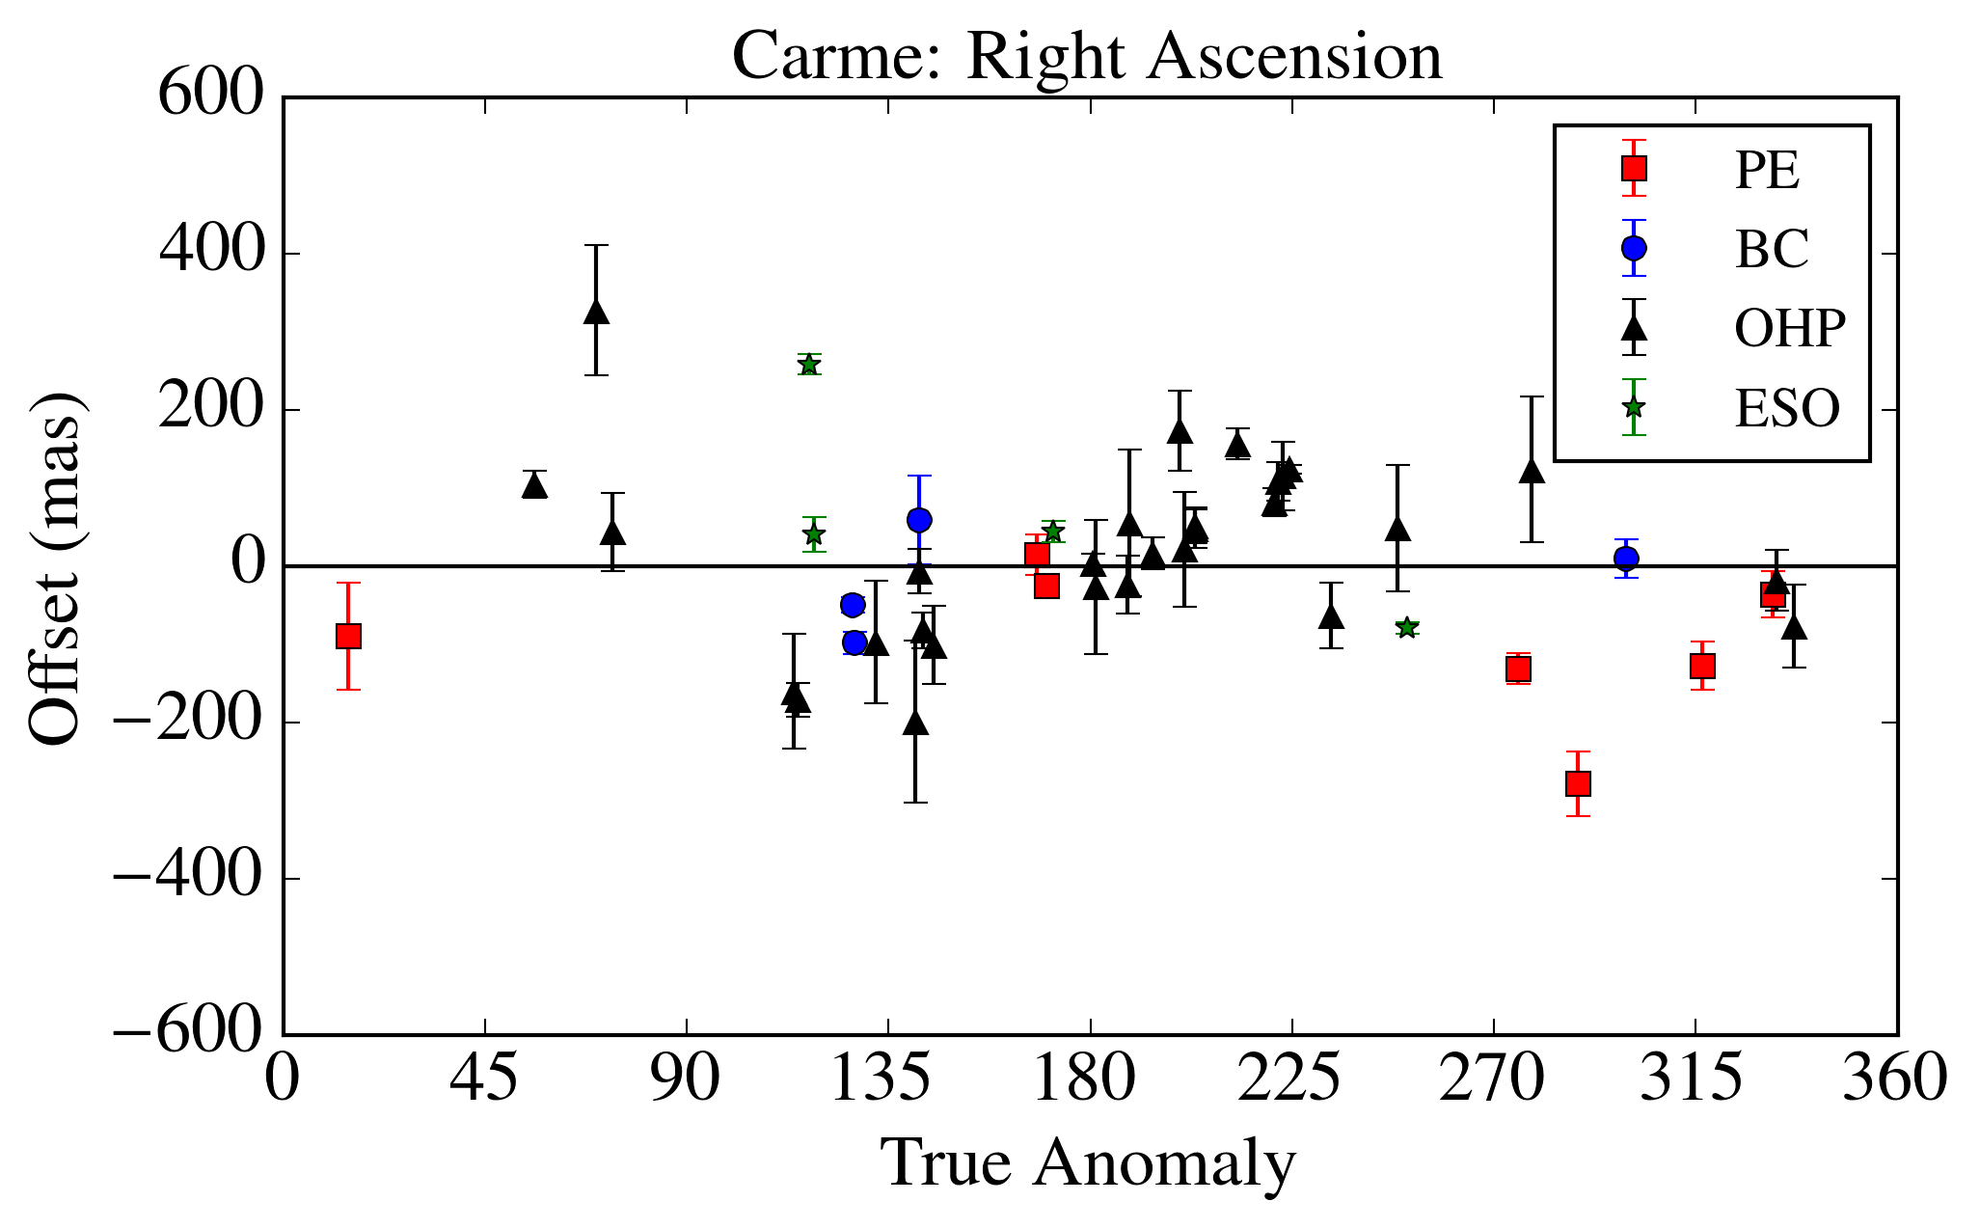
Results - Carme
*
* Relative to JPL jup300 ephemeris

Slide 18
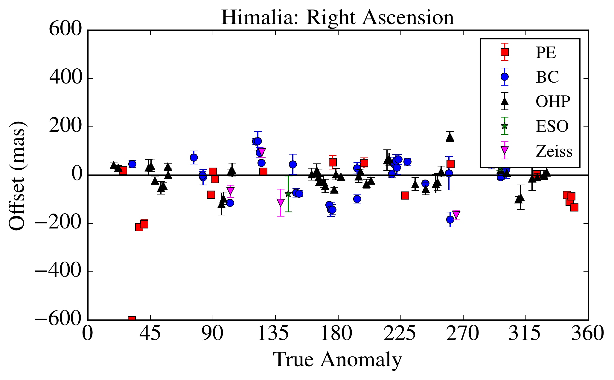
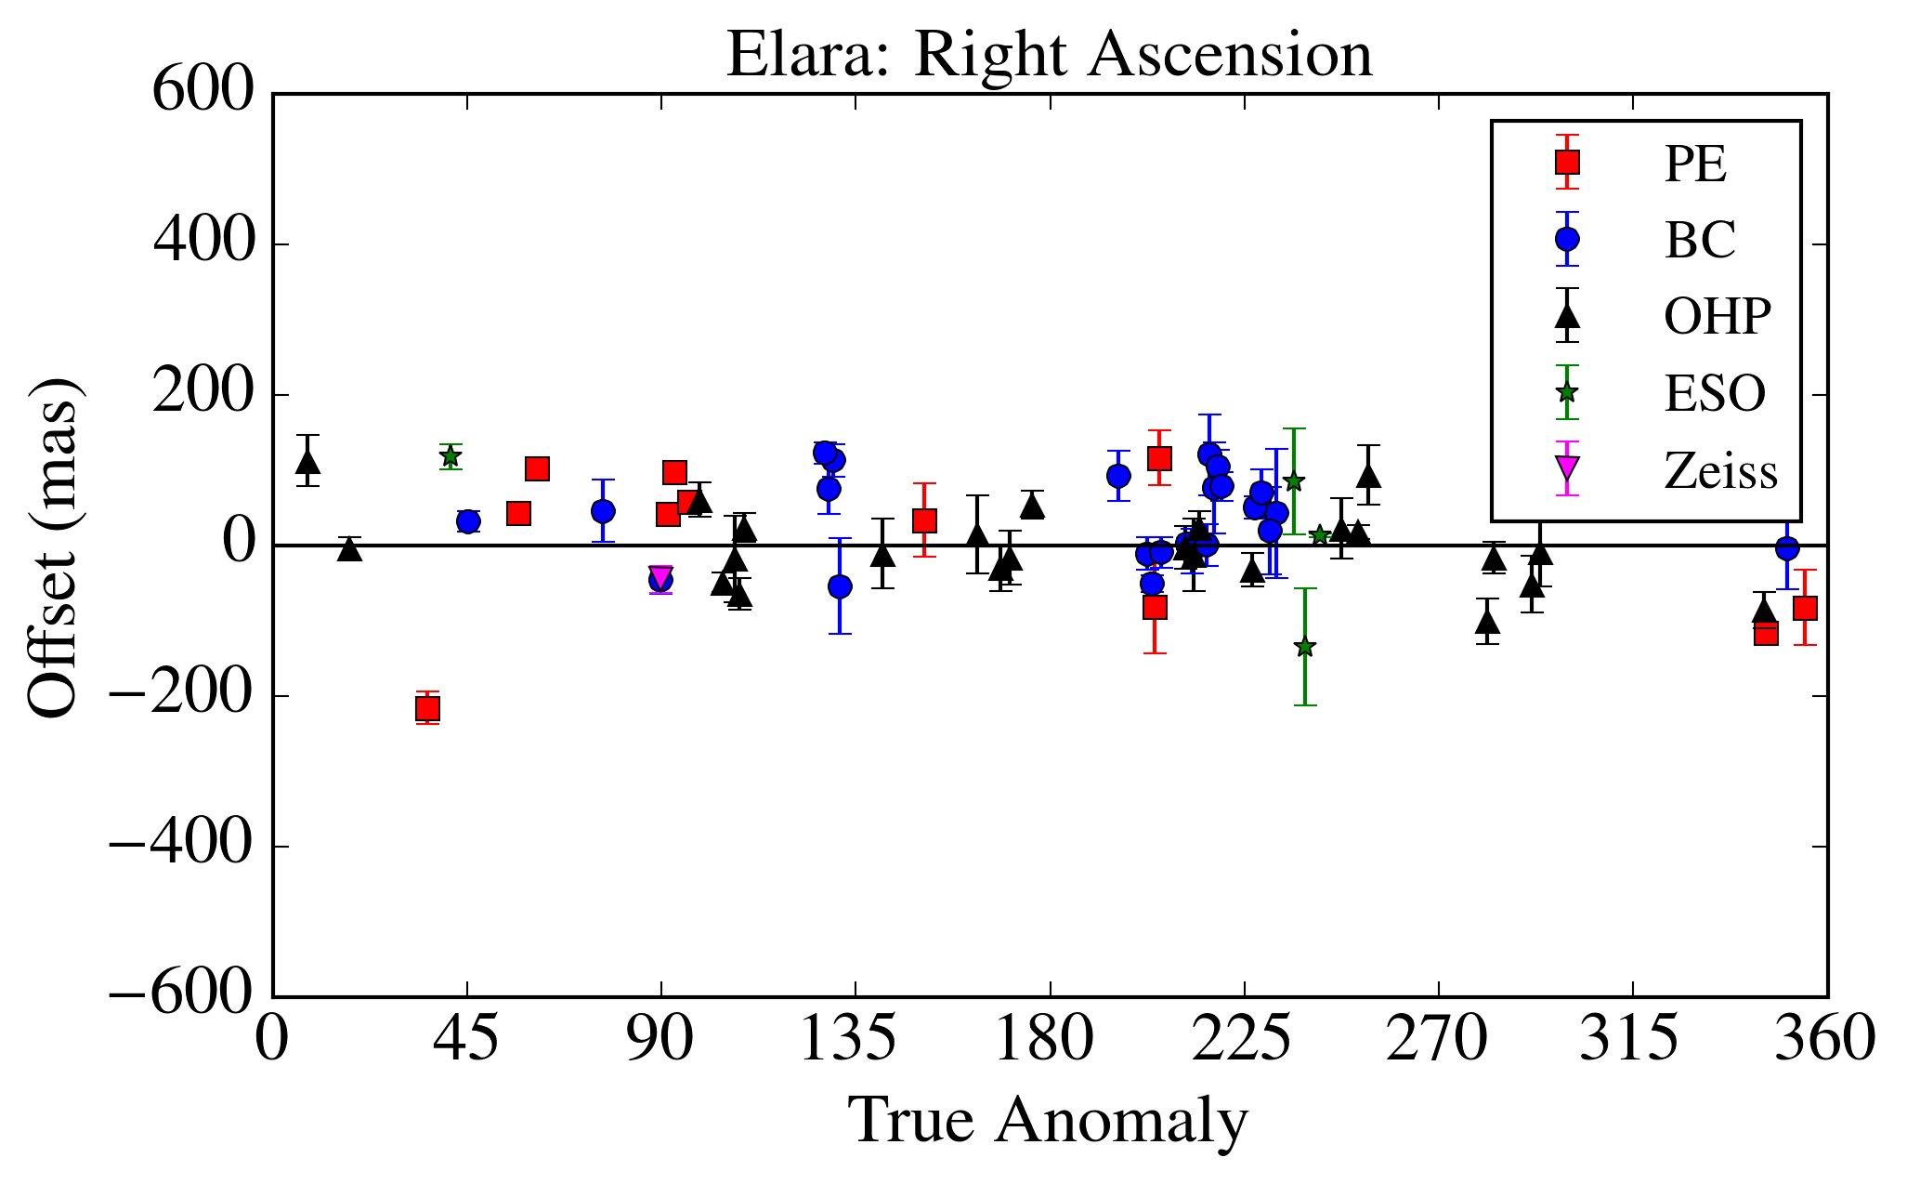
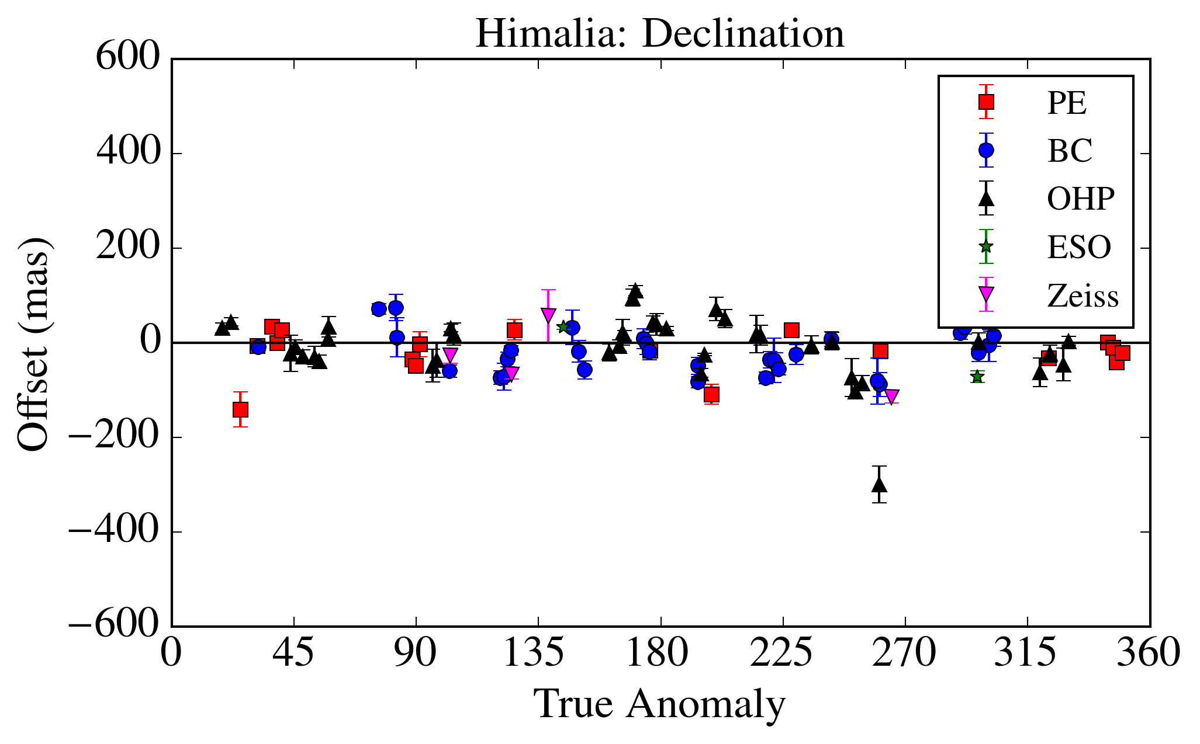
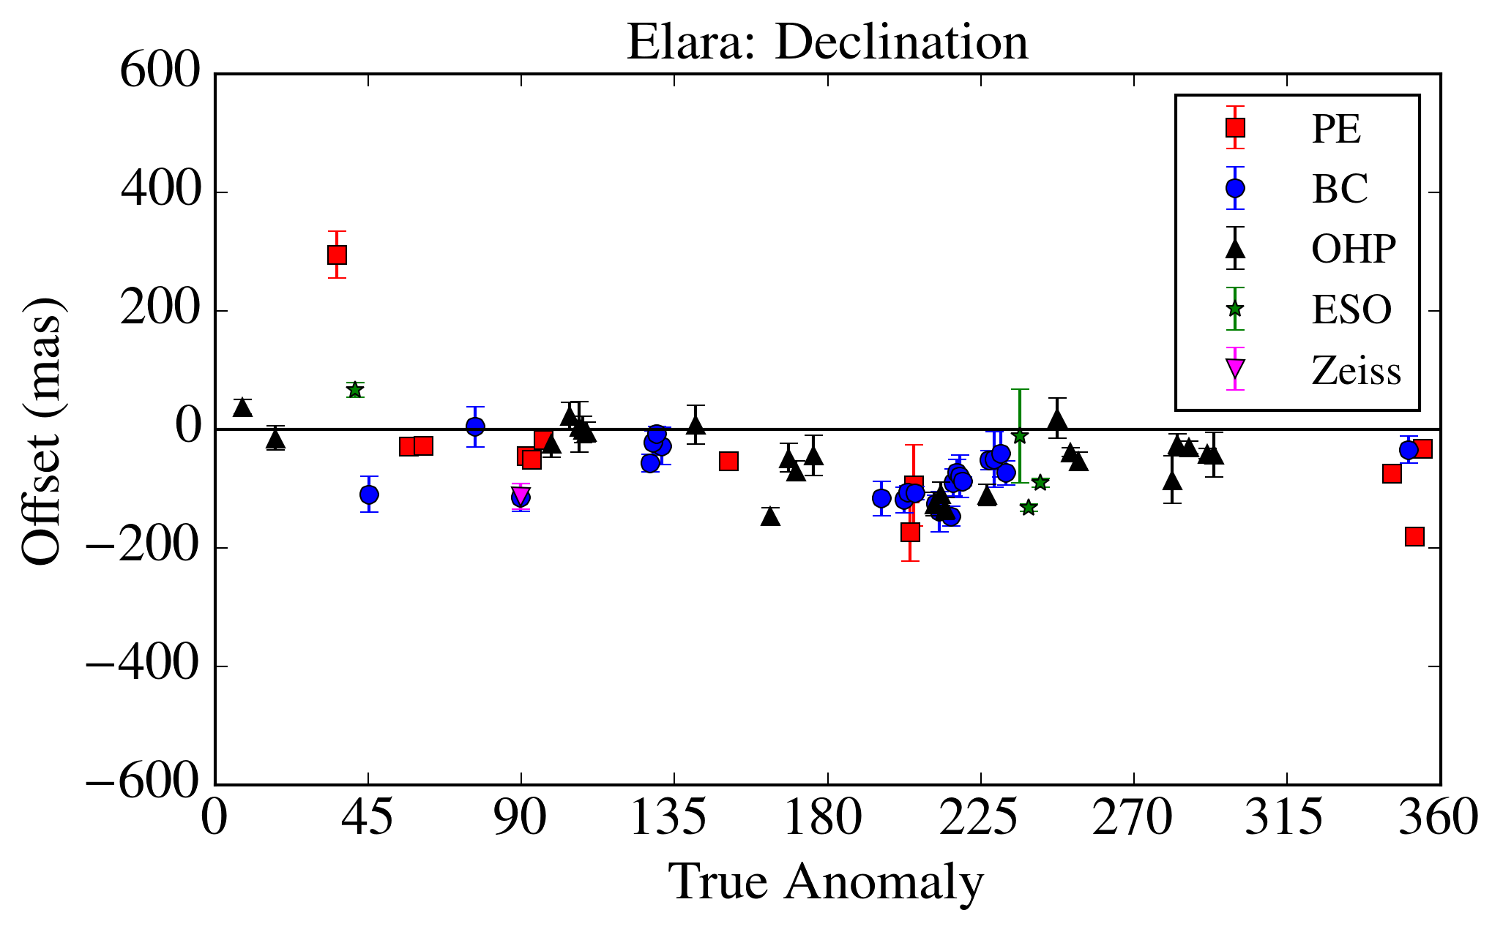
Results – Himalia and Elara

Slide 19
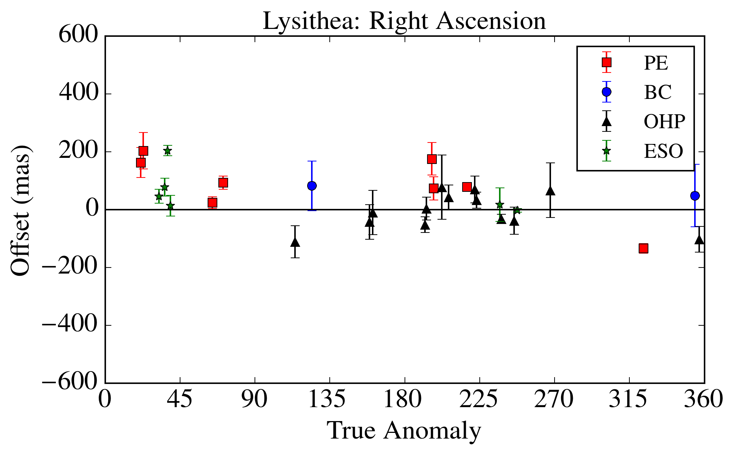
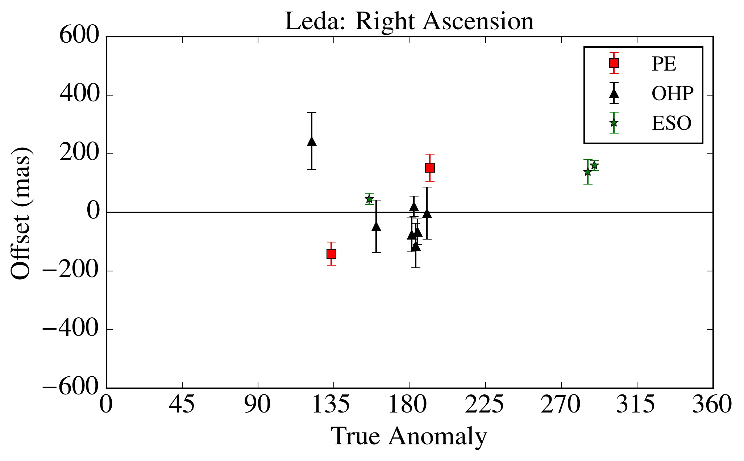
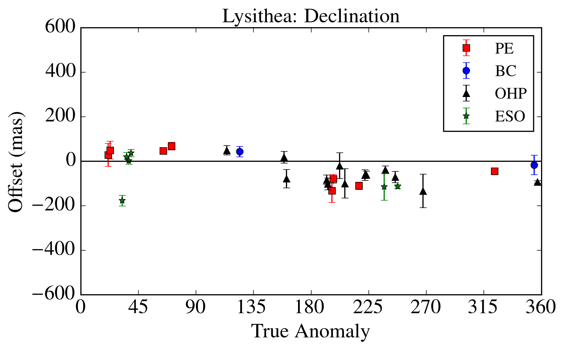
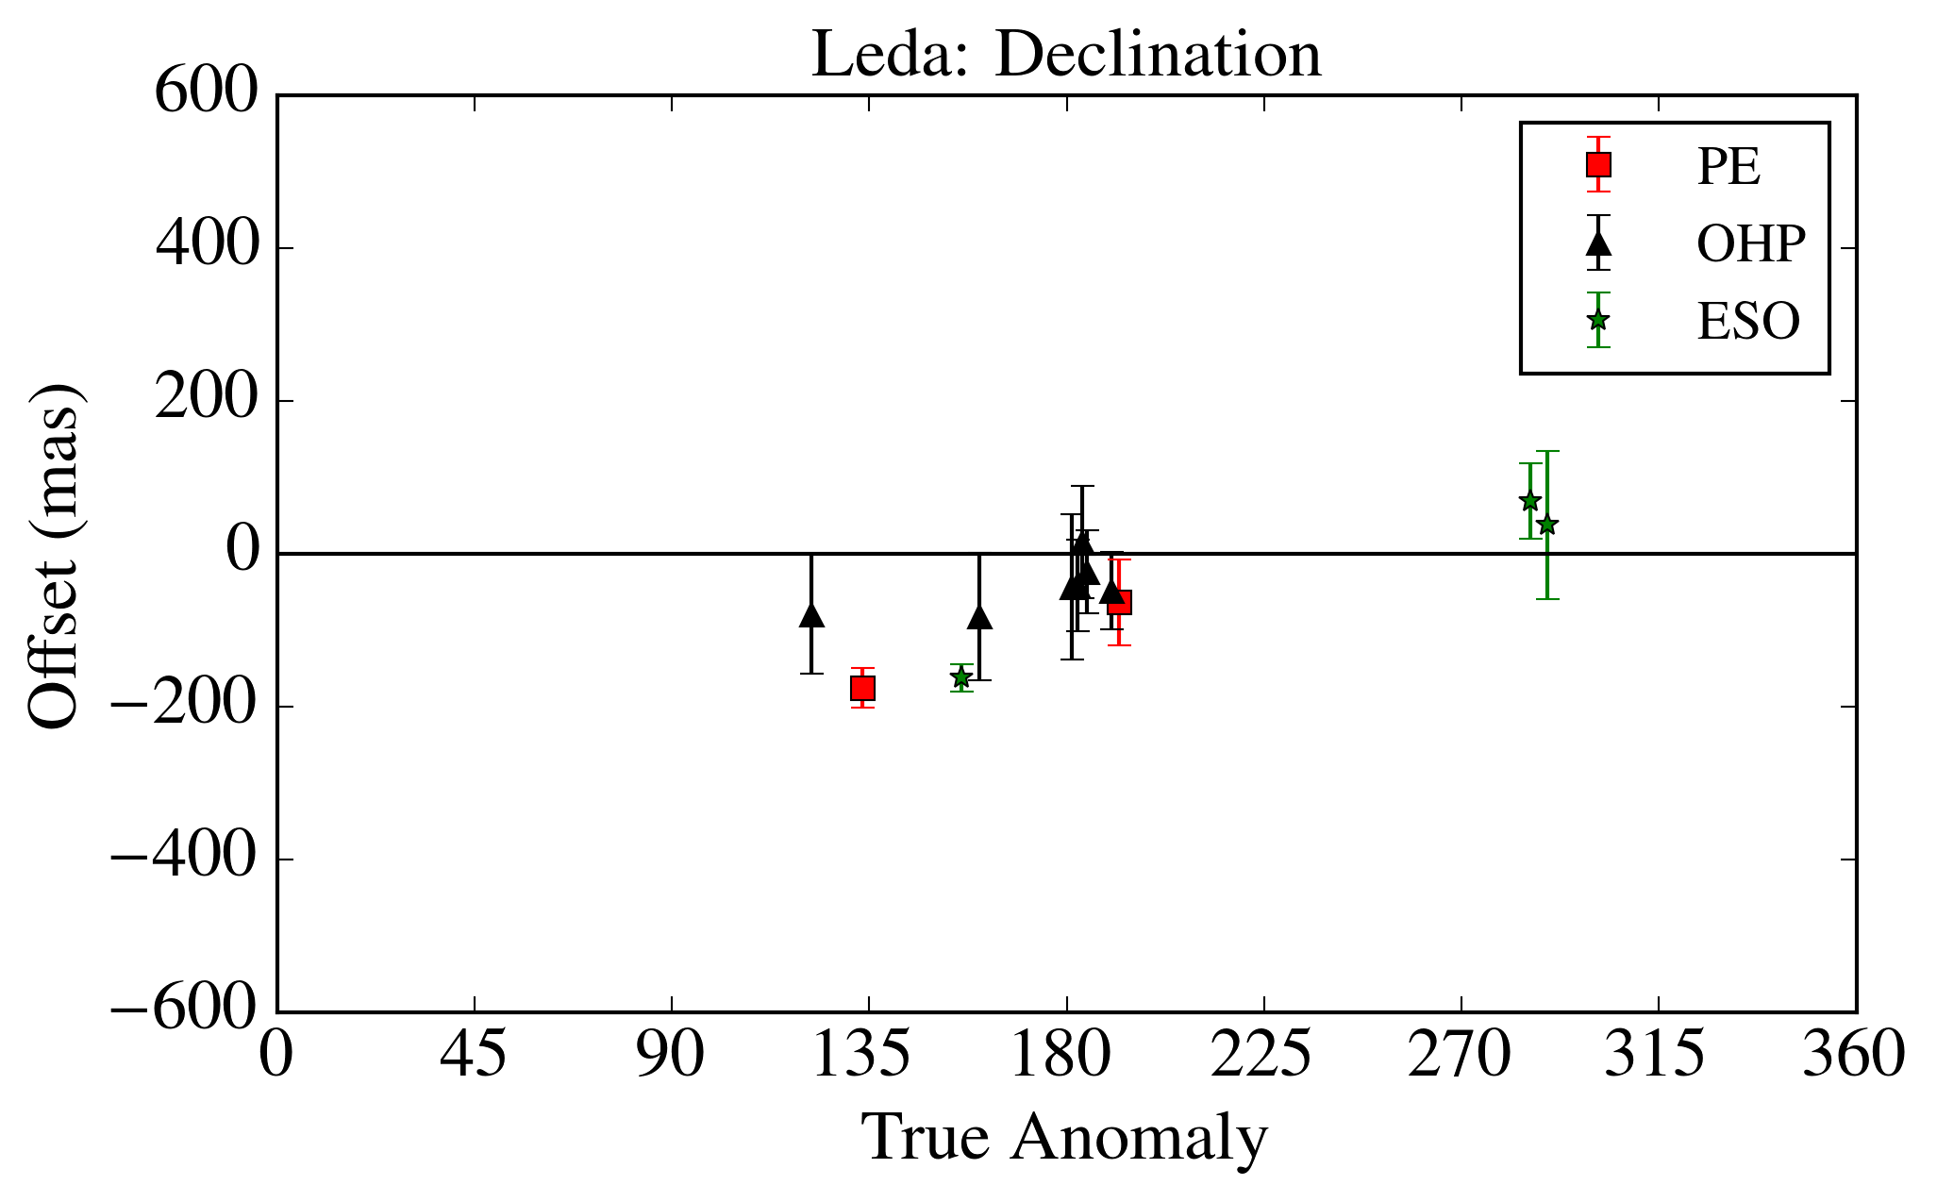
Results – Lysithea and Leda

Slide 20
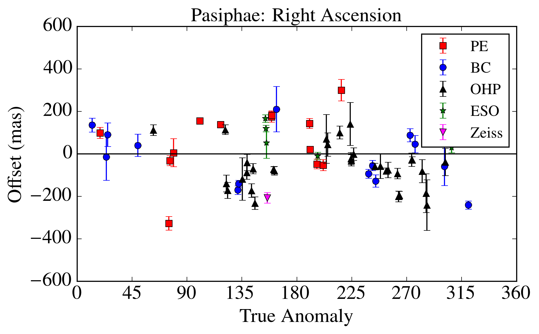
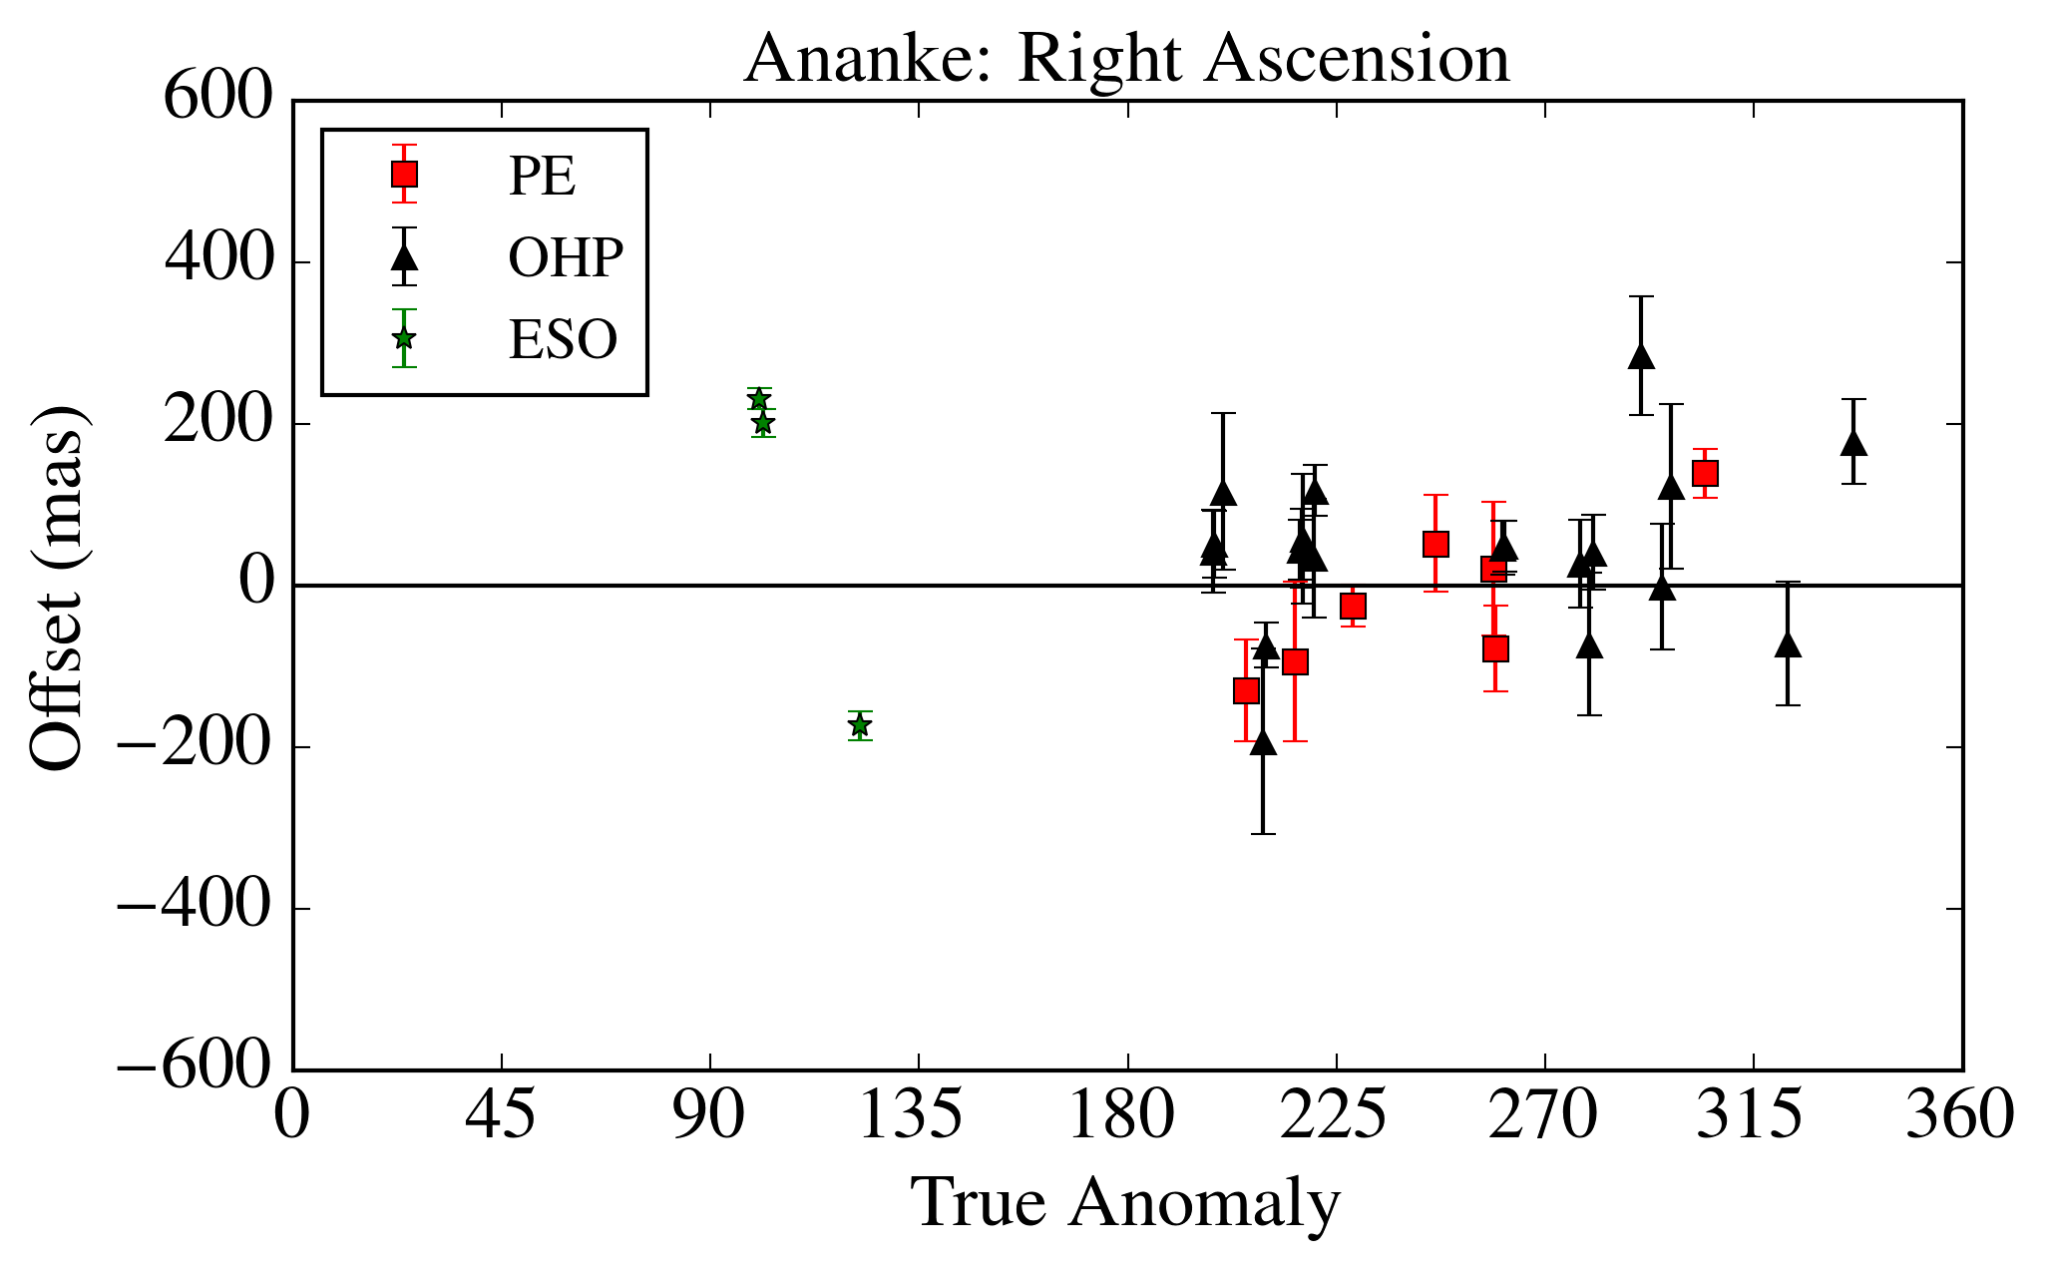
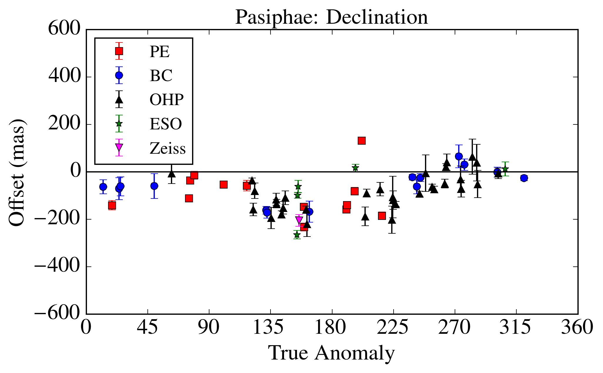
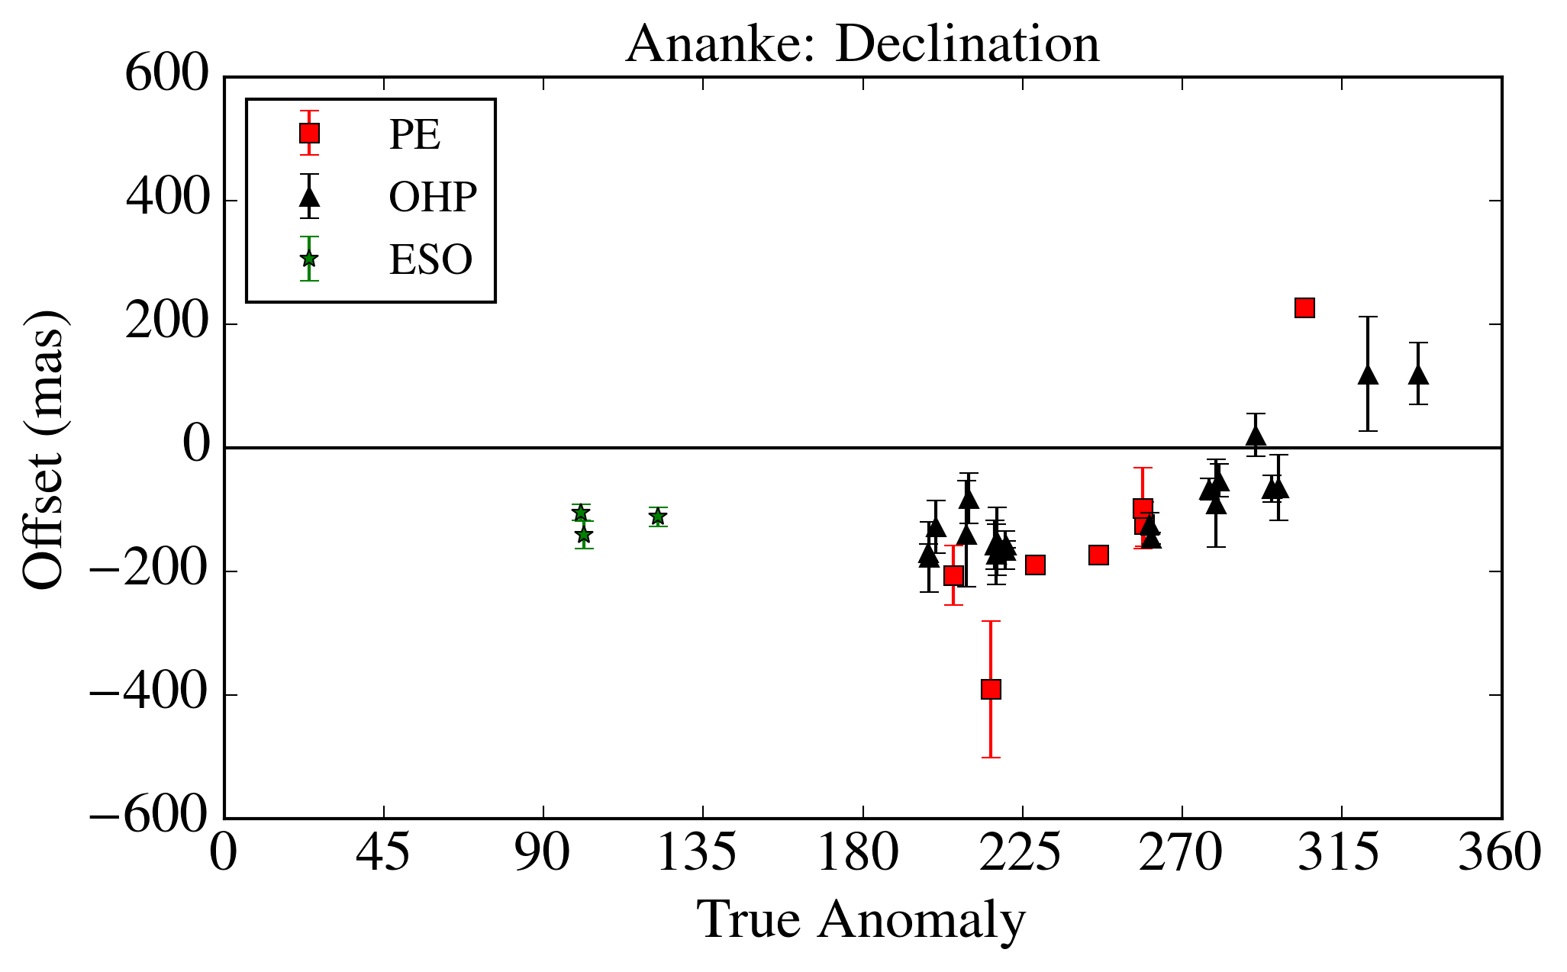
Results – Pasiphae and Ananke

Slide 21
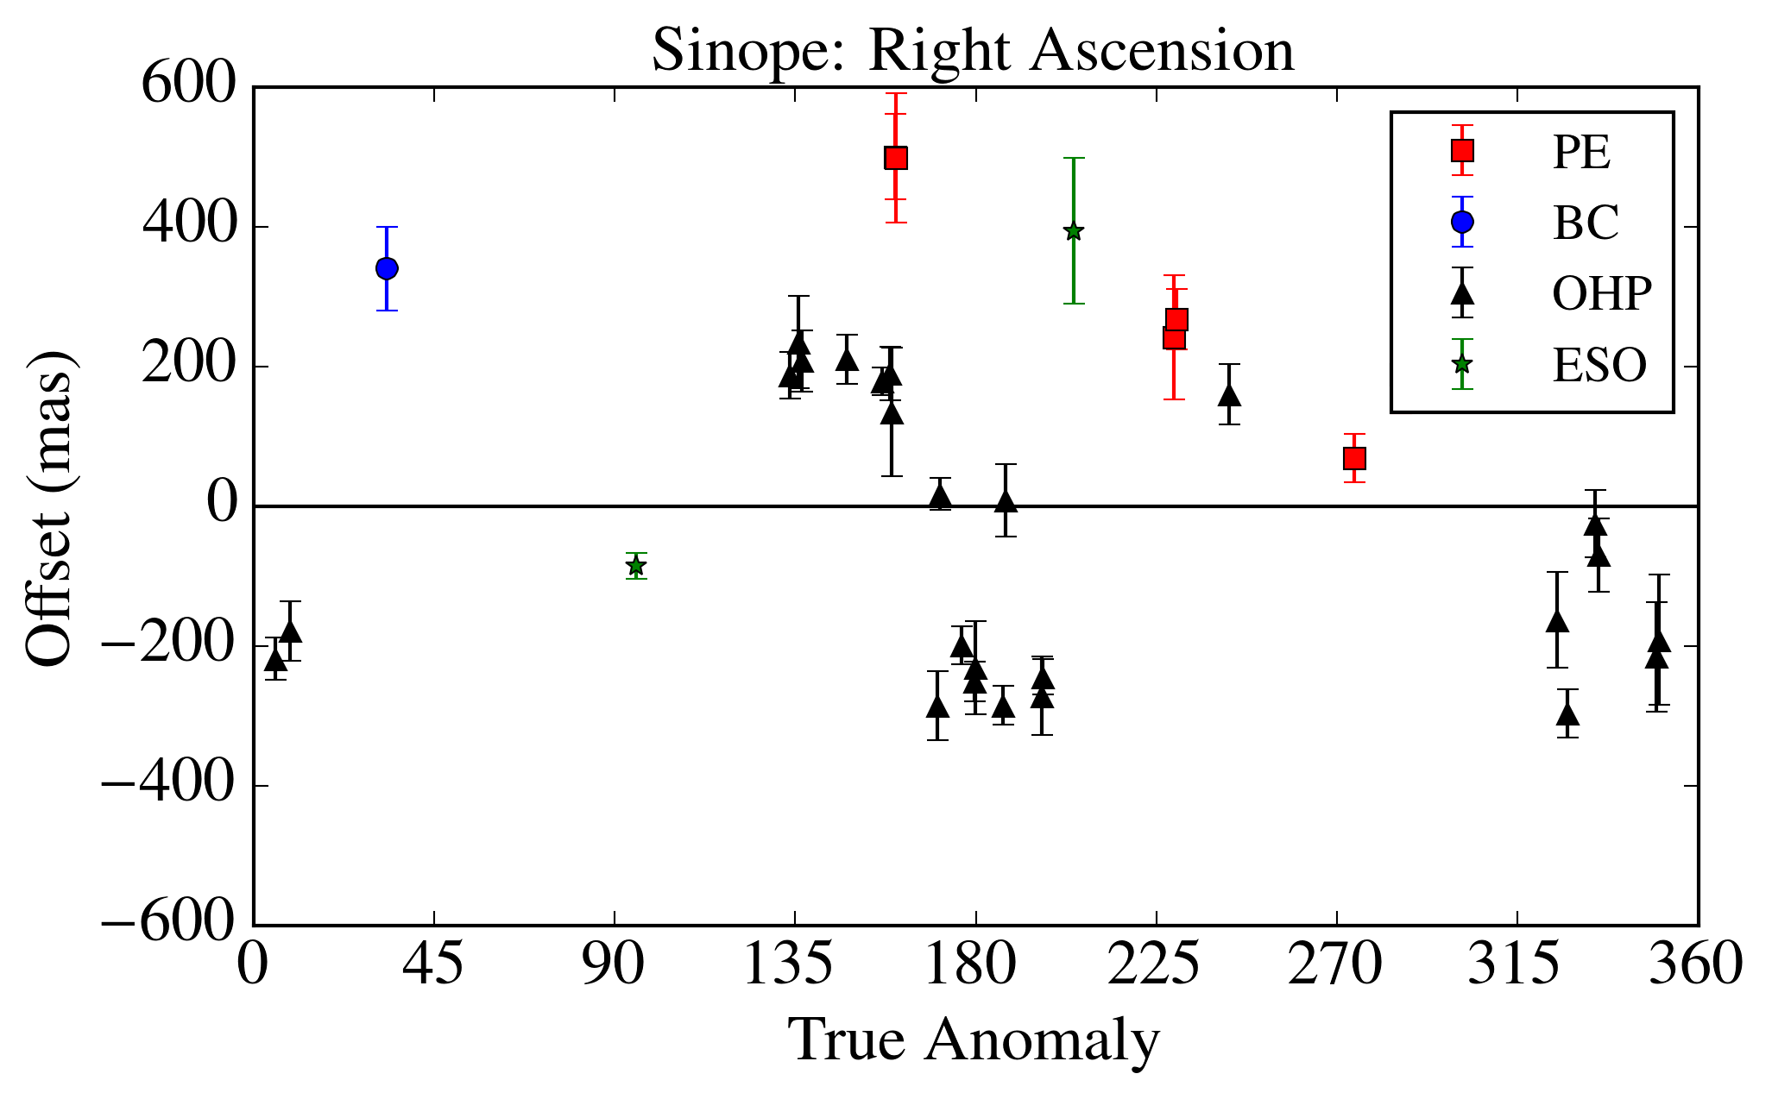
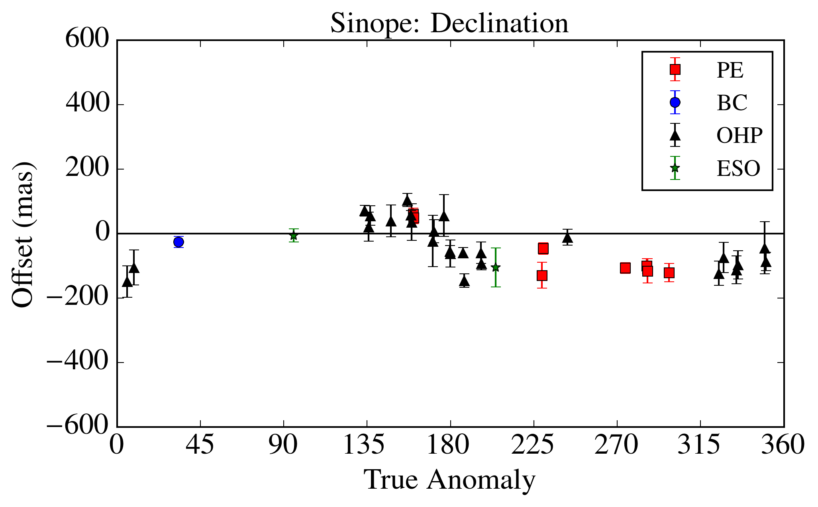
Results -Sinope

Slide 22
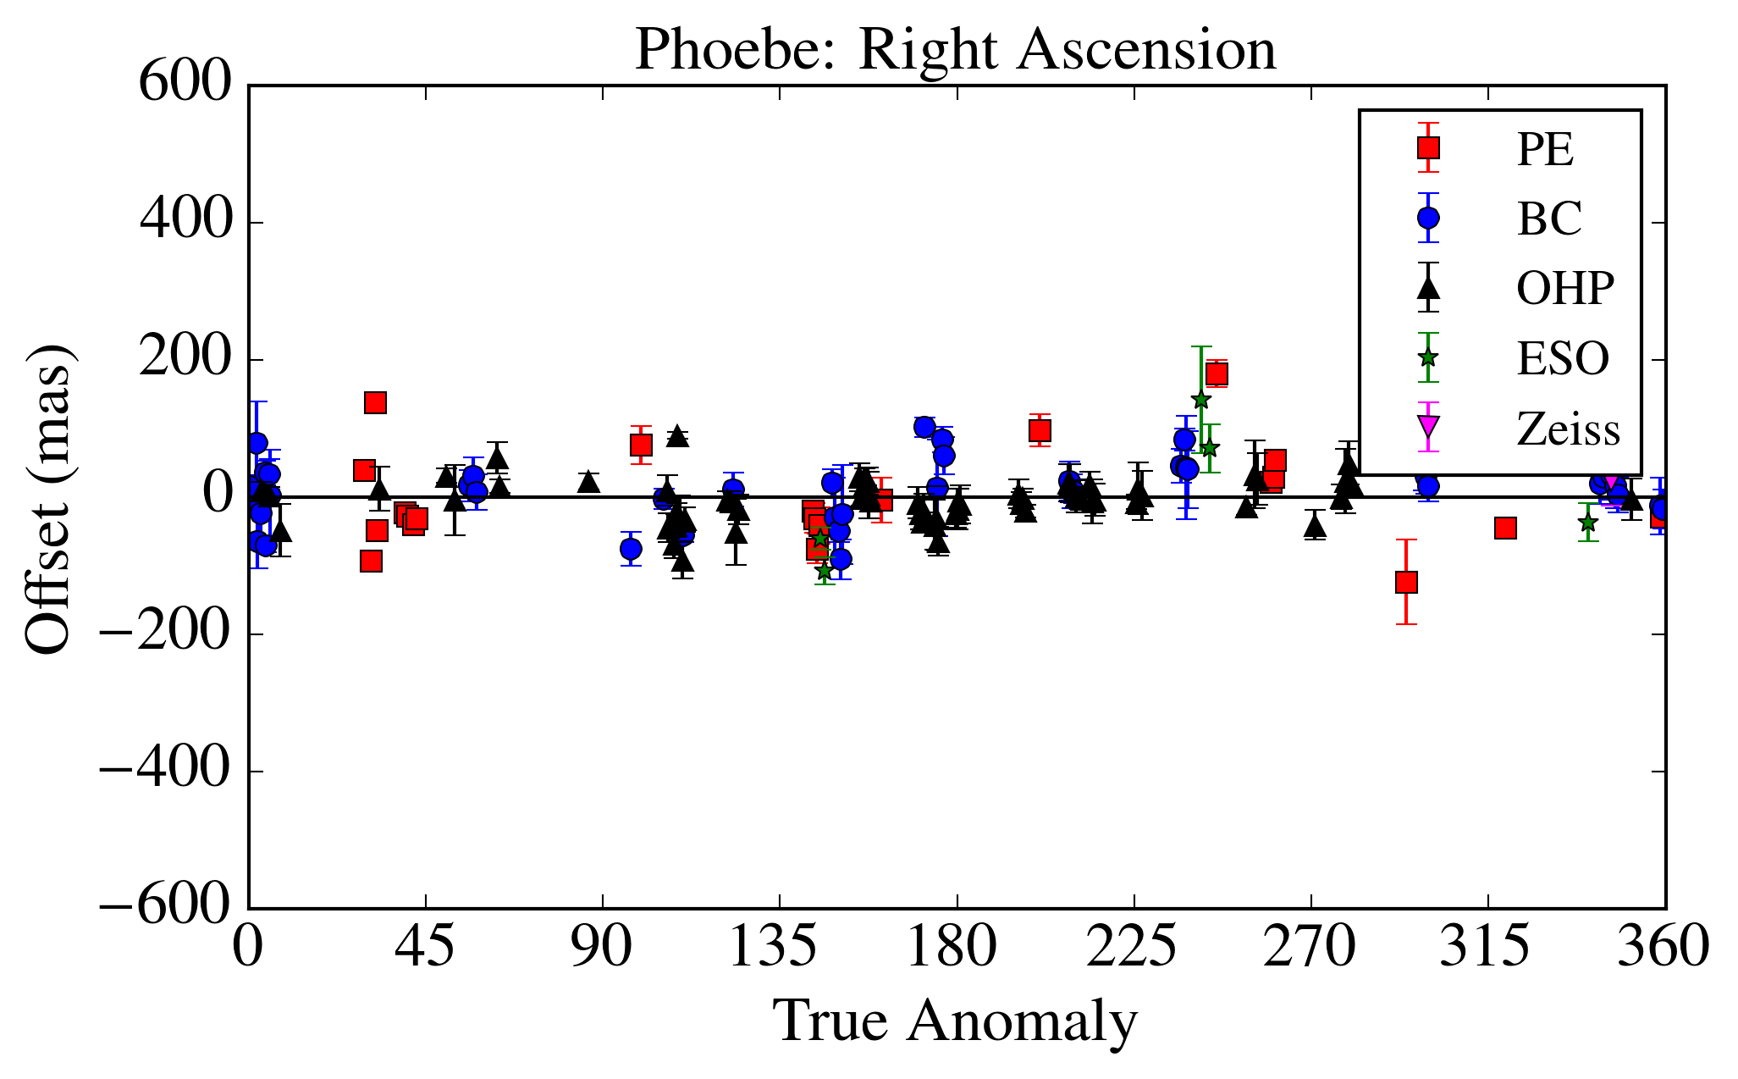
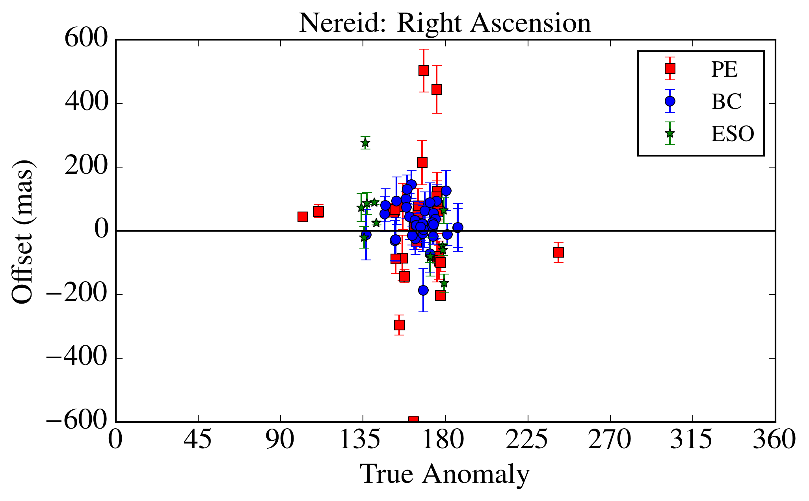
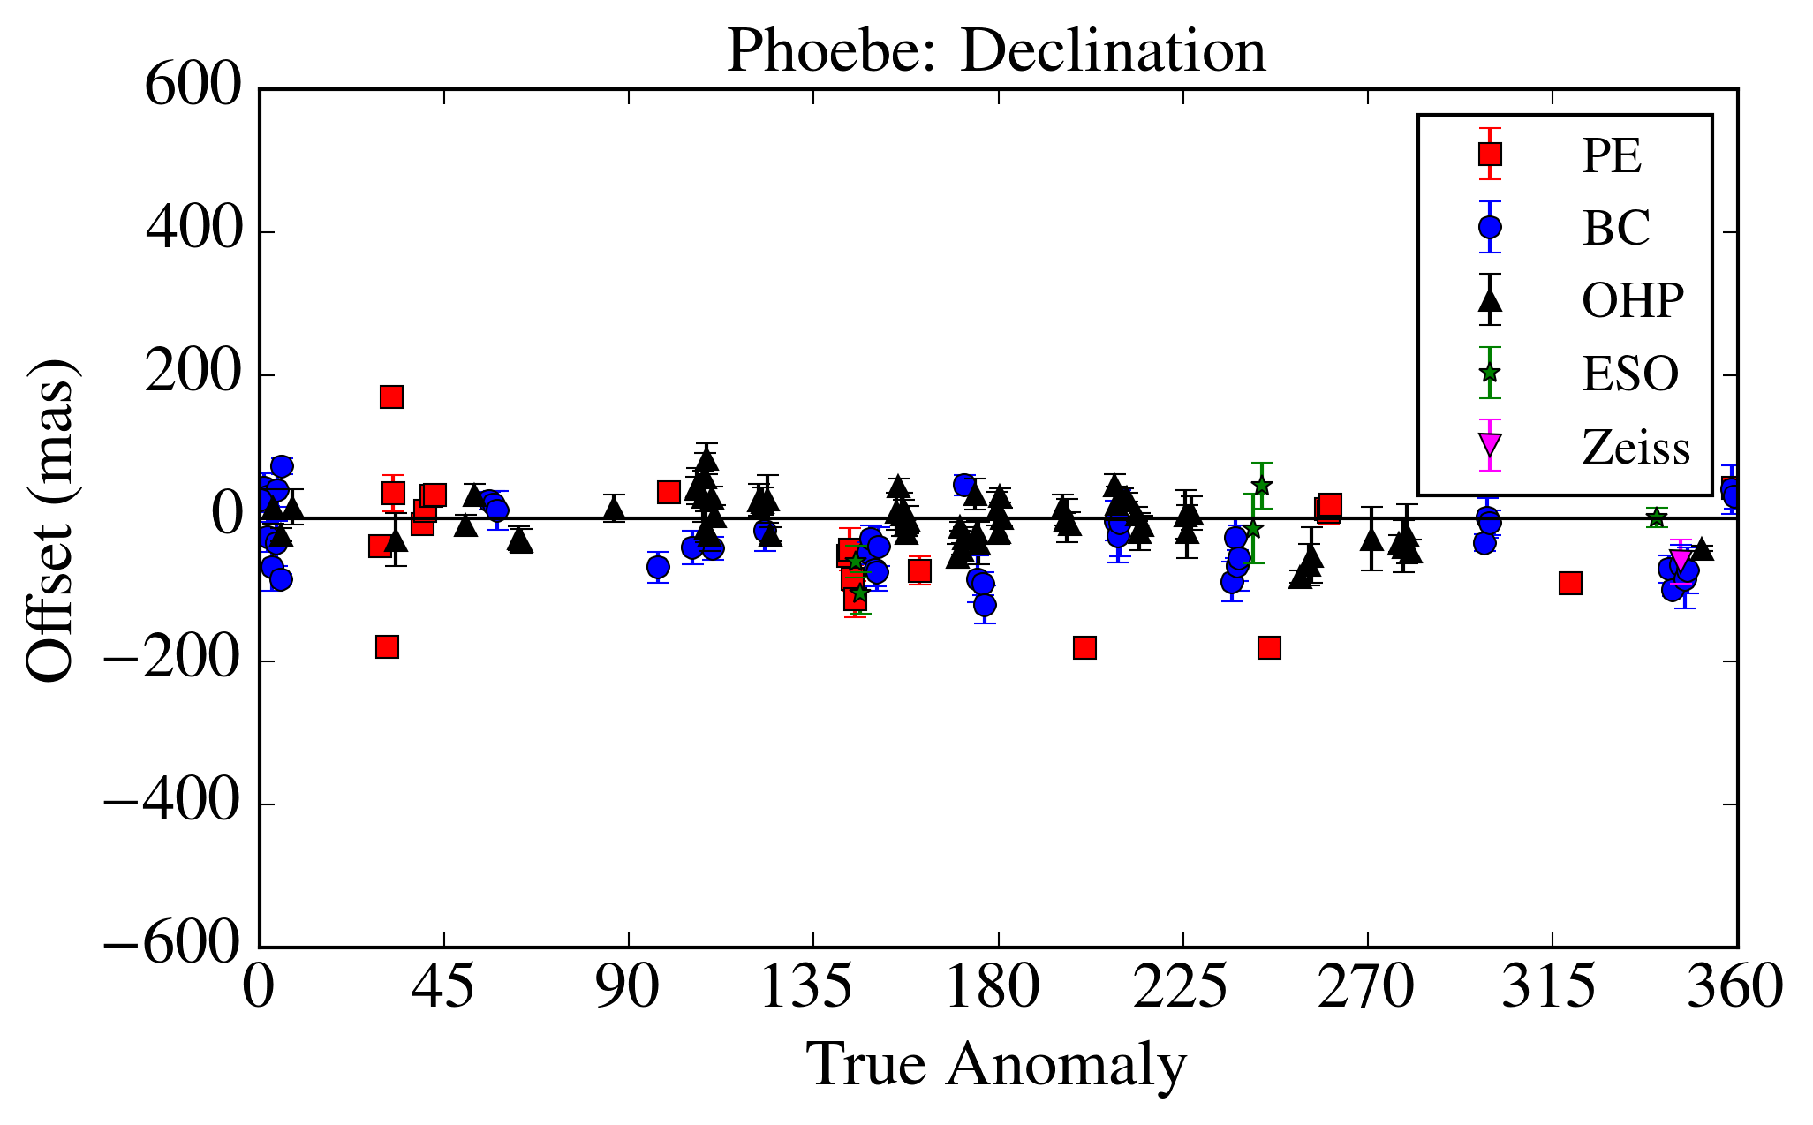
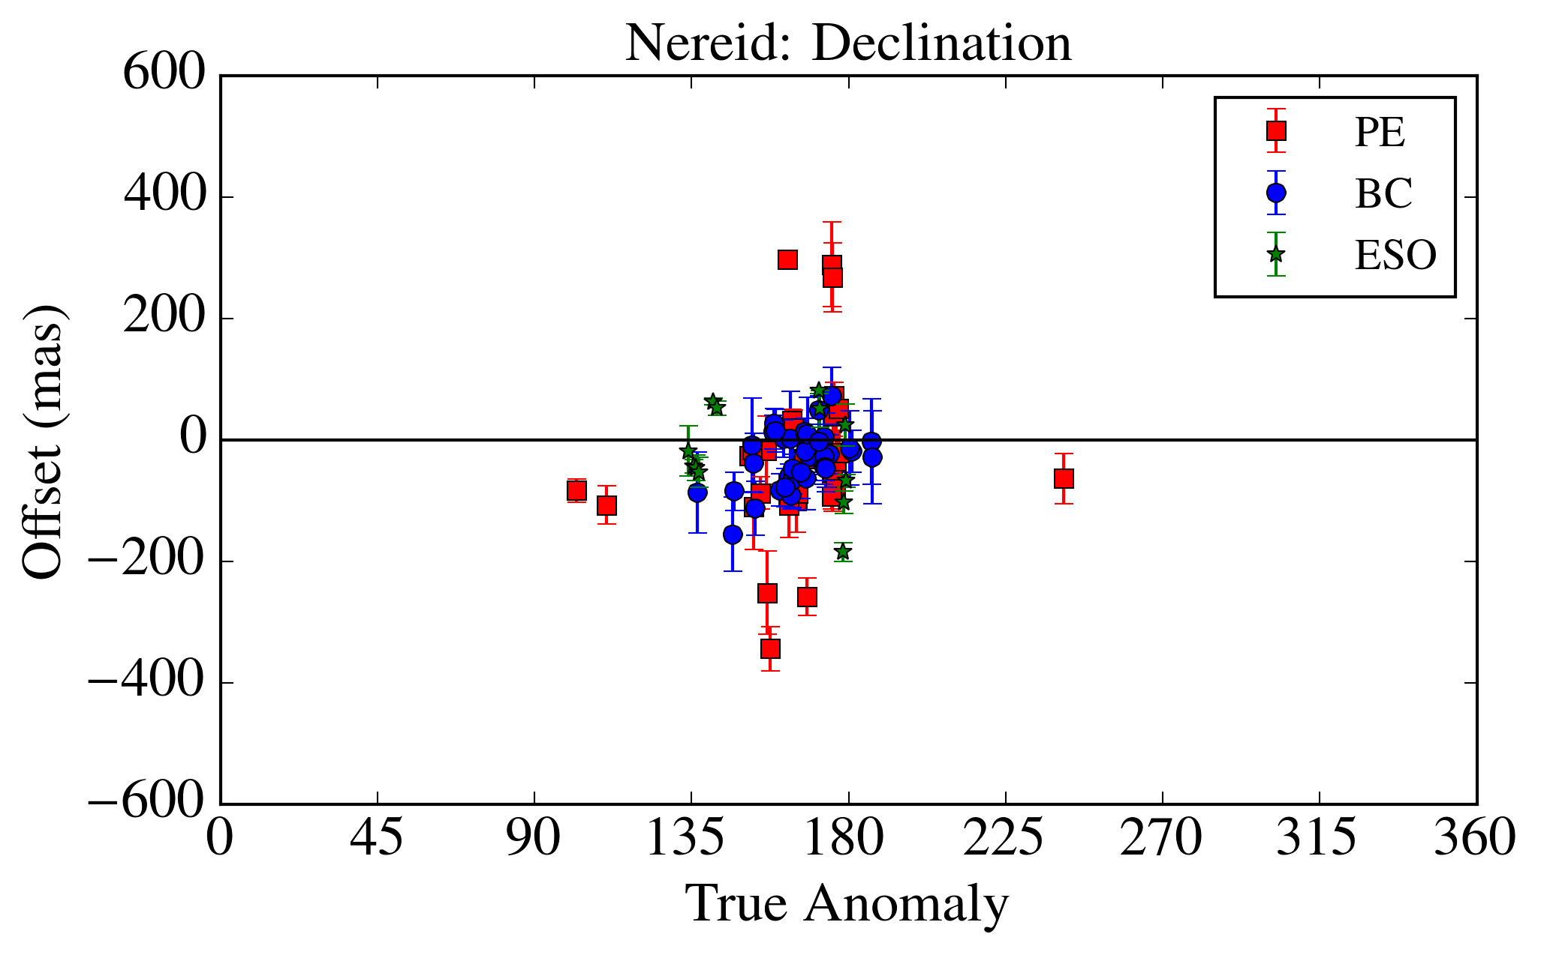
Results – Phoebe and Nereid

Slide 23
Conclusion
We identified 8466 observations of irregular satellites, from which we obtained 6523 suitable astrometric positions.
Position errors estimated of about 60-80 mas depending on brightness.
All positions are available at the CDS

Slide 24

Results

Slide 25
Next Steps
Numerical Integration of the orbits of the Irregular Satellites.
Predict and observe stellar occultations by these objects.
Re-reduce the observations with GAIA catalogue.

Slide 26
Thank You

